Slide 1
LINUX
Presented by Nagesh

Slide 2
What is Linux
Linux is Operating system(OS). It’s completely free
It is similar windows OS and Mac OS

Slide 3
What is Operating System
It’s an interface between user and hardware(System)
Without OS we can’t perform any actions/tasks
It can run any kind of hardware.

Slide 4
Who invented Linux Operating System
The Linux operating system was invented by Linus Torvalds in 1991
He initially created it as a personal project to create a free and open-source

Slide 5
Which Technology used for linux OS
C Programming Language
Assembly Language

Slide 6
Types Of Linux Flavors
Ubuntu
Redhat
Centos
Debian
Mandira
Slackware
Suse
Fedora

Slide 7
Advantages of Linux
Free of cost
Open Source
Secure
Easy to install
Easy to use
Lightweight
Supports almost all of the most used programming languages
It is a multitasking operating system as it can run multiple tasks simultaneously without affecting the system speed.

Slide 8
Comparison
windows
Linux
It is not free
Source code is not open
Supports GUI and CLI
Virus effect
secure
It is free of cost
Source code open
Supports GUI and CLI
It wont allow the virus
More secure than windows

Slide 9
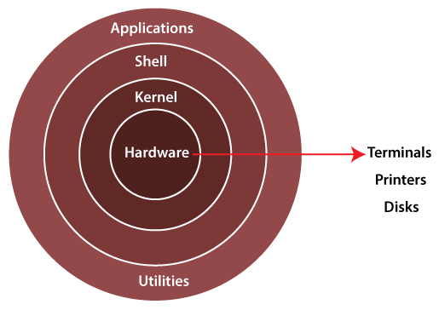
Linux Architecture

Slide 10
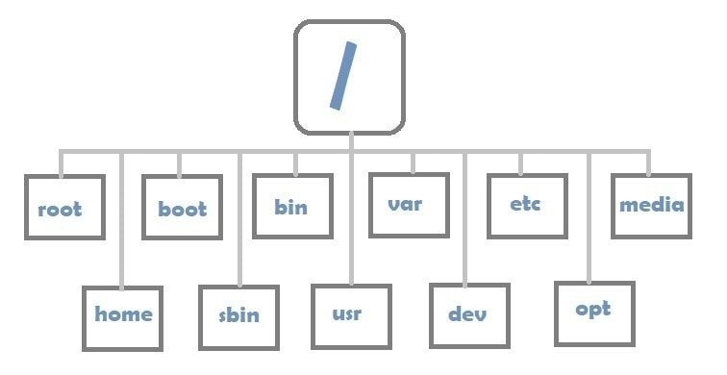
Linux (FHS)

Slide 11
User Accounts in Linux
Linux
Windows
Non-root user
Root user/super user
Administrator (Full Permission)
Default user Account (Limited Access)

Slide 12
Unix Linux
Before Linux we have Unix
It was Born in 1970 at AT&T Labs
American Telephone and Telegraph

Slide 13
Components
KERNEL: The Kernel is the core of the system and manages the cpu,memory, and peripheral devices. The kernel is the lowest level of the os
DAEMONS: These are background services (printing,sound,scheduling,etc.) that either start up during boot or after you log into the desktop
SHELL: Is an environment in which we can run our commands, programs,and shell scripts.A shell provides you with an interface to the Unix system. it gathers input from you and executes programs based on that input. When a program finishes executing, it displays that program’s output

