Slide 1




INTEROPERABLE TRANSACTIONS
BY:
SAI & KAMAL

Slide 2
INDEX
1.
2.
3.
4.
Interoperability
Business Case
Blockchain
Introduction
Interoperable
Payments
5.
6.
7.
8.
Tech Stack
Hyperledger
Fabric &
Ripple XRP
Transaction
Flow
Our
Solution &
Output Screens

Slide 3
The Incredible Technology: BLOCKCHAIN
1.
Ledger
A blockchain is an open, distributed ledger.
Network
The data is distributed across all the devices in the network
2
3
Decentralized
The whole blockchain is decentralized.
Secure
The data inside the blockchain is very secure
4
Logging
We get the whole history of activities.
5

Slide 4
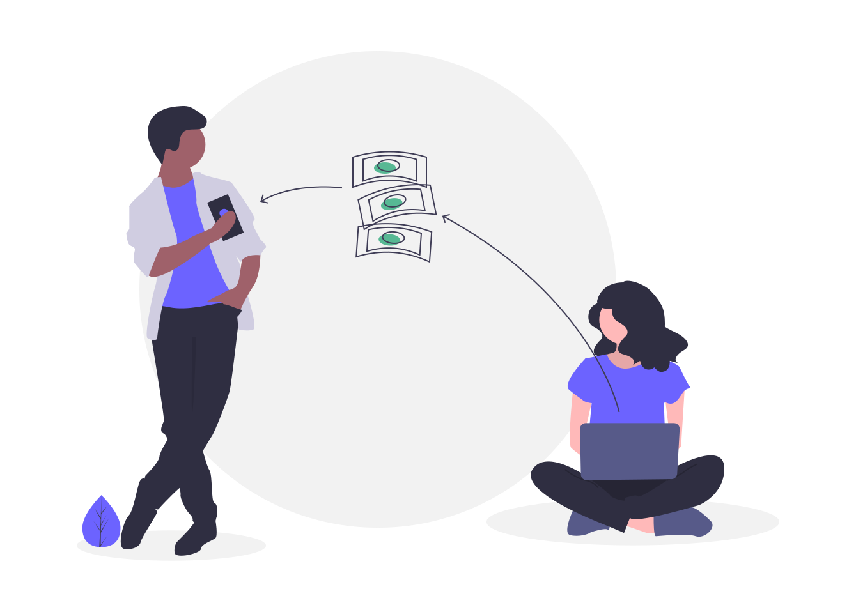
INTEROPERABILITY
Interoperability is seen as a means for people worldwide to make electronic payments in a convenient, affordable, fast, seamless and secure way through a transaction account.
INTEROPERABLE PAYMENTS
When payment systems are interoperable, they allow two or more proprietary platforms or even different products to interact seamlessly. Interoperability can promote competition, reduce fixed costs and enable economies of scale that help ensure the financial viability of the service and make payment services more convenient.
INTEROPERABILITY
AND
INTEROPERABLE PAYMENTS

Slide 5

BUSINESS CASE REQUIREMENT
To create a platform in which peers of different banks of different organizations can transfer asserts between each other without any external intermediate involvement.
The transfer of asserts between banks is performed by using cryptocurrency as a medium as exchange.
The whole system should be flexible, secure and trustworthy.

Slide 6
ERC20Token
For Tokenization of Asserts
Node SDK
Used to communicate with the Frontend
Hyperledger-Fabric
The blockchain technology for creating the private distributed ledger
Angular
Frontend Framework
TECH STACK

Slide 7
HYPERLEDGER FABRIC.
RIPPLE XRP
Ripple XRP is an open source, peer to peer, payment network – a simple way for anyone in the world to send money at practically no cost
The XRP Ledger is an online system for payments, powered by a community without a central leader. Anyone can connect their computer to the peer-to-peer network that manages the ledger. The XRP Ledger is the home of XRP, a digital asset designed to bridge the world's many currencies. The XRP Ledger is one part of the developing Internet of Value: a world in which money moves the way information does today.
Permissioned membership
Hyperledger Fabric is a framework for permissioned networks, where all participants have known identities. When considering a permissioned network, you should think about whether your blockchain use case needs to comply with data protection regulations.
Protection of digital keys
HSM (Hardware Security Module) support is vital for safeguarding and managing digital keys for strong authentication. Hyperledger Fabric provides modified and unmodified PKCS11 for key generation, which supports cases like identity management that need more protection
“ripple-lib” API’s are used to manage the transactions
It uses XRP as the currency
Key attributes of RIPPLE XRP:
The ripple API Server
The Ripple API ServerNet credentials
Address
Secret
The address is the unique address of the sender or receiver.
The secret is basically the password of the address.
The address acts as the sender address when we send XRP from that address.
The same address acts as the receiver when XRP is received.
The user needs to provide the secret when they act as the sender in the transaction.
The address can be shared but the secret should never be shared with others.
When the XRP is transferred the new owner of the asset is updated in the ledger.
Data on a need-to-know basis
Hyperledger Fabric is a framework for permissioned networks, Businesses, due to competitiveness, protection laws, and regulation on confidentiality of personal data dictate the need for privacy of certain data elements, which can be achieved through data partitioning on the blockchain. Channels, supported in Hyperledger Fabric, allow for data to go to only the parties that need to know all participants have known identities. When considering a permissioned network, you should think about whether your blockchain use case needs to comply with data protection regulations.

Slide 8
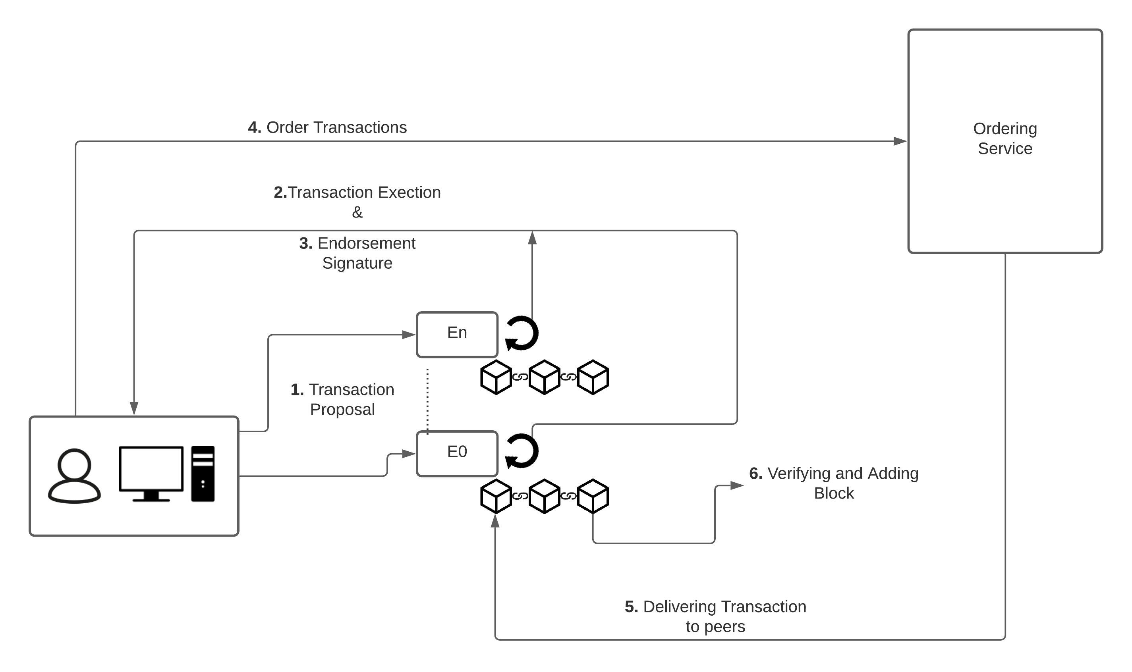
TRANSACTION FLOW
Step4: Order Transaction Application submits responses as a transaction to be ordered. Ordering happens across the fabric in parallel with transactions submitted by other applications
Step1: Propose Transaction Client application will propose a transaction by sending the transaction details to all the endorsing peers available on the network. All the endorsing peers on the network will receive .
Step5: Deliver Transaction Ordering service collects transactions into proposed blocks for distribution to committing peers. The ordering service forms a block of transactions by using ordering services like Kafka, solo (here we are using solo).
Step2: Executing Proposed Transaction All the endorsing peers in the network will execute the proposed transaction. Each execution will capture the set of Read and Write data, called RW Sets. Transactions can be signed and encrypted.
Step3: Proposal Response The Read Write sets are asynchronously returned to the application. The Read Write sets are signed by each endorser and this will be later checked in the consensus process.
Step6: Validate Transaction Every committing peer validates against the endorsement policy. Validated transactions are applied to the world state and retained on the ledger. Invalid transactions are also retained on the ledger, but it will not update the world state

Slide 9
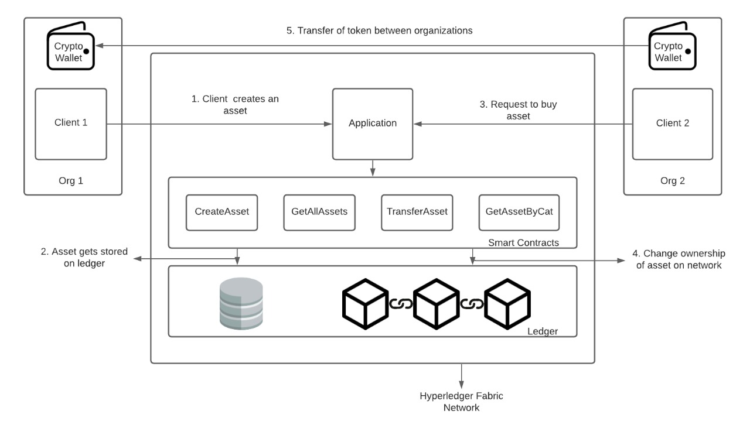
HIGH LEVEL ARCHITECTURAL FLOW

Slide 10
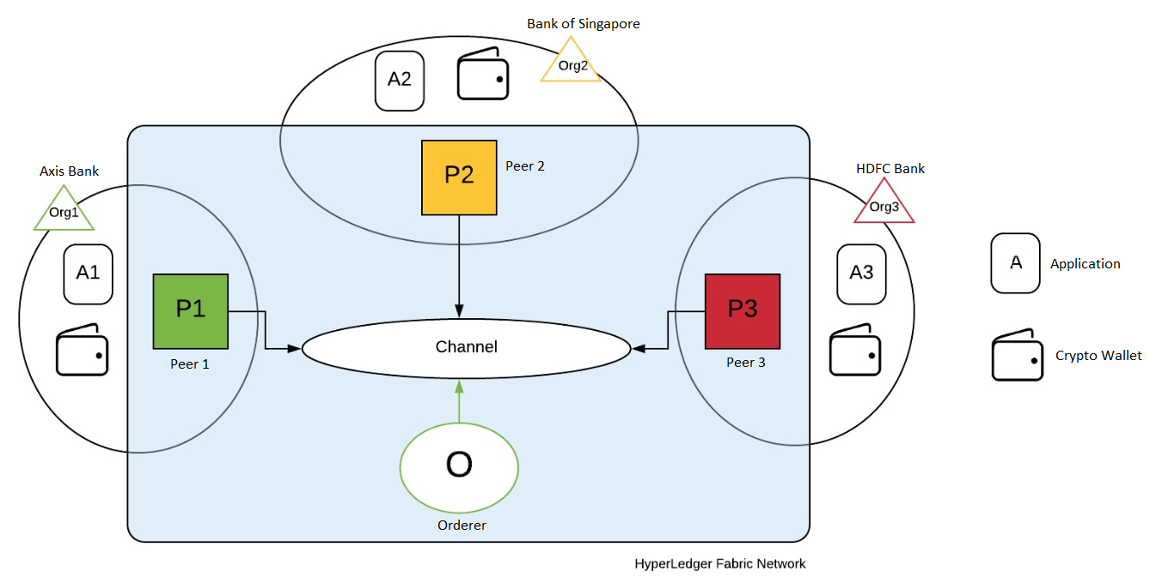
NETWORK OVERVIEW

Slide 11
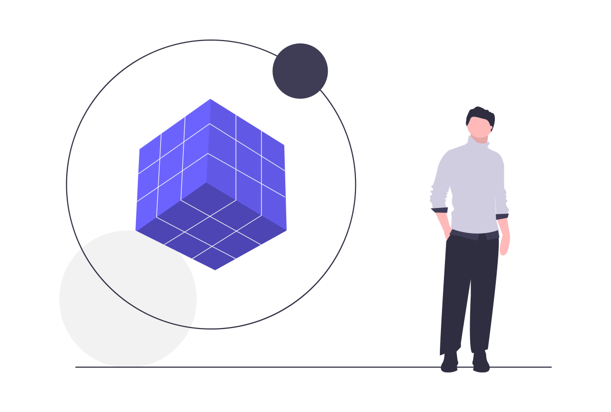
OUR SOLUTION!
Synopsis
Using Hyperledger Fabric to setup a permissioned blockchain network and adding all the banks (of different organizations)
We use chaincodes (smart contracts) to implement the business logic.
Every organization has its own ledger
We use membership providers to add peers into the network
Every member in the network is a trusted member by the organization
We can hide the internal details of a transaction.
Every transactions is recorded in the ledger.
We use ERC20Token to tokenize the asserts.
Data Structure
We defined a data structure which contains the details of the transaction
{
UNQID: VERSION: ISSUERID: ISSUERNAME: OWNER: PRODUCTNAME: ISSUEDATE: VALUE: STATE: CATEGORY: GASFEE: }
Working
We categorize every bank based on its organization.
We create a channel and add all the organizations in the channel.
The channel acts as a medium of exchange.
We tokenize every assert so that it can be used in the assert transfer
We can issue or assign or query an assert
Category
Every assert is categorized into one of the below category:
VEHICLES, MACHINERY, COMPUTERS, STOCKS AND BONDS

Slide 12
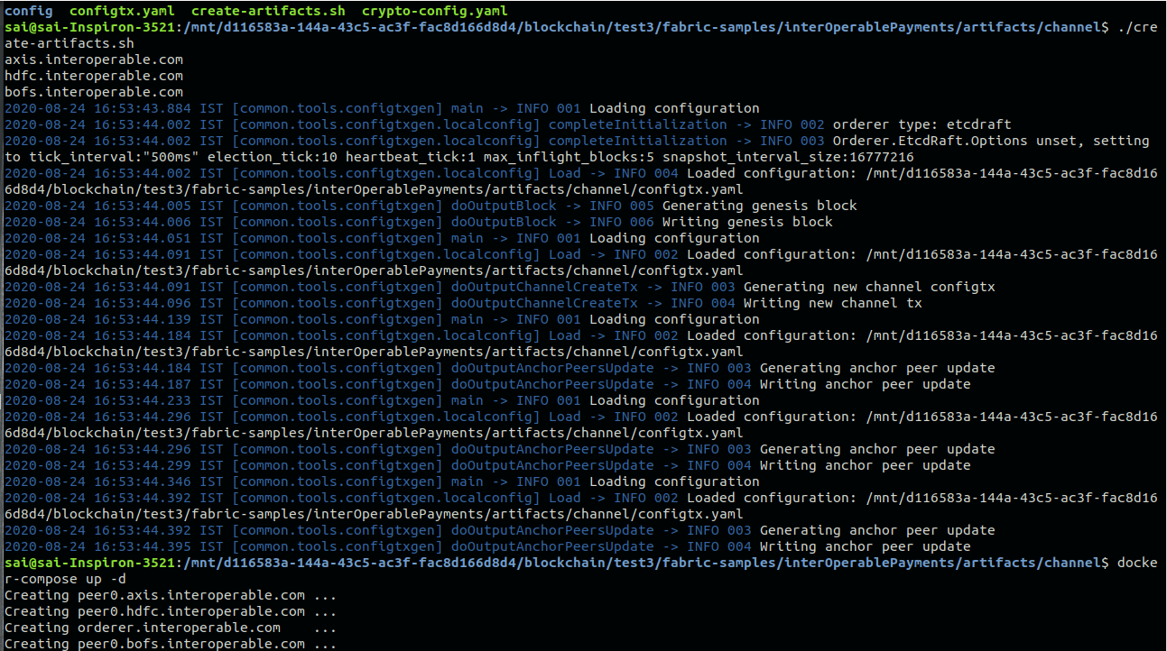
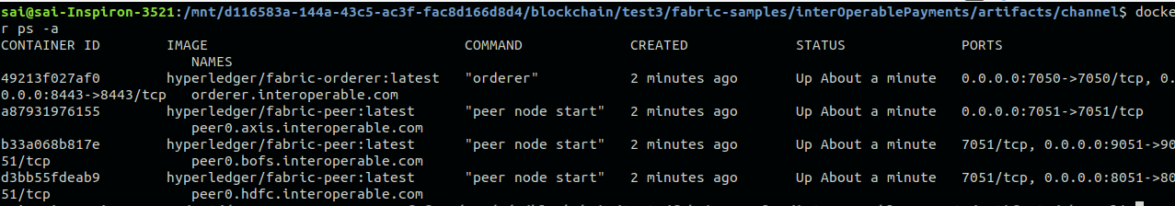
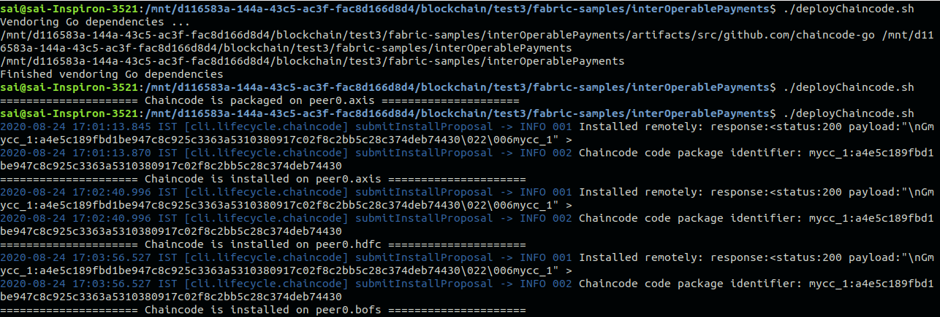
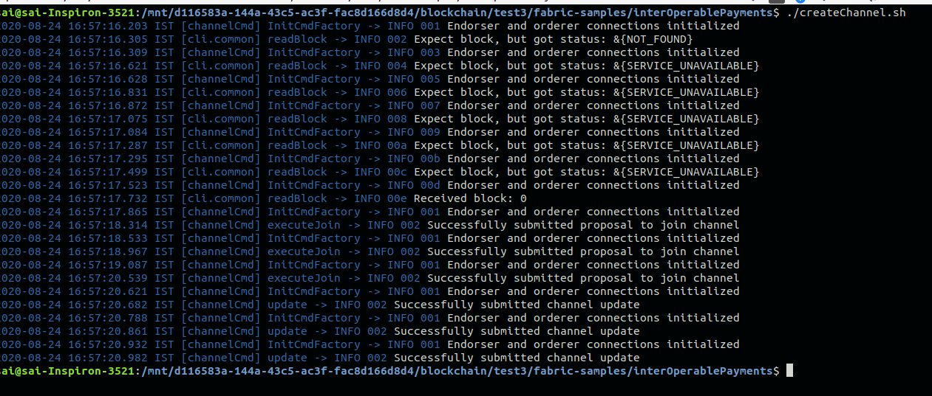
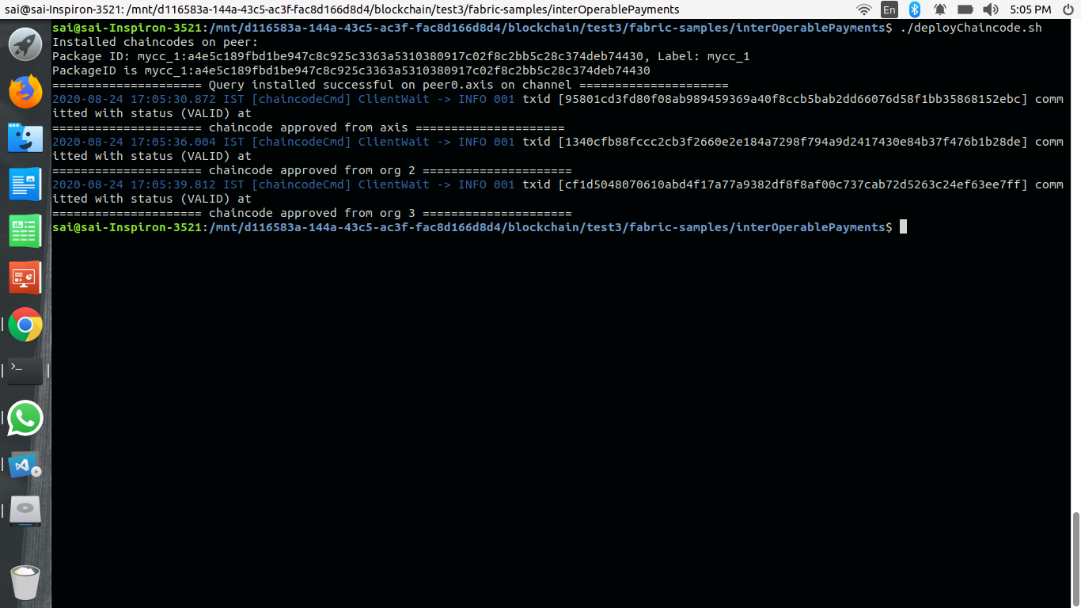
OUTPUT SCREENS
Containers Created
Creating Certificates and Starting the containers
Chaincode Installed
Creating Channel
Chaincode Approved

Slide 13
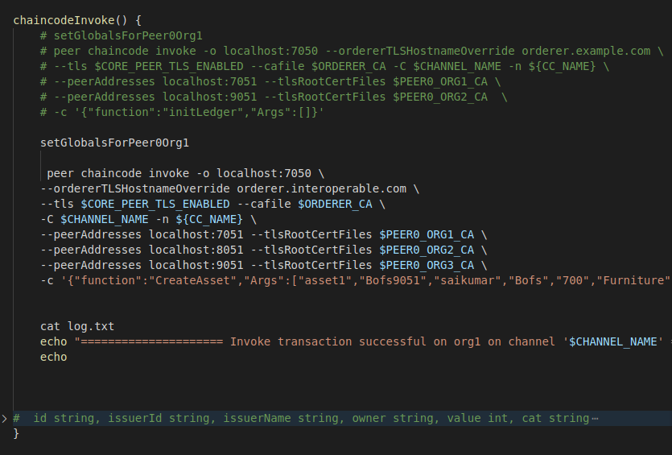
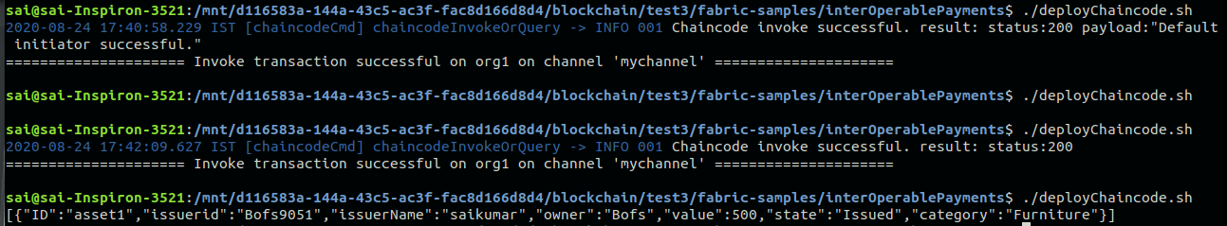
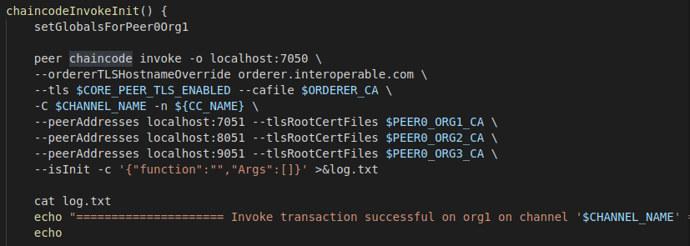
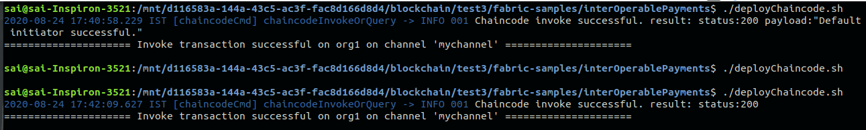
Query after creating assert
Create Assert Function
Chaincode Invoke Init Function
Invoke create assert

Slide 14
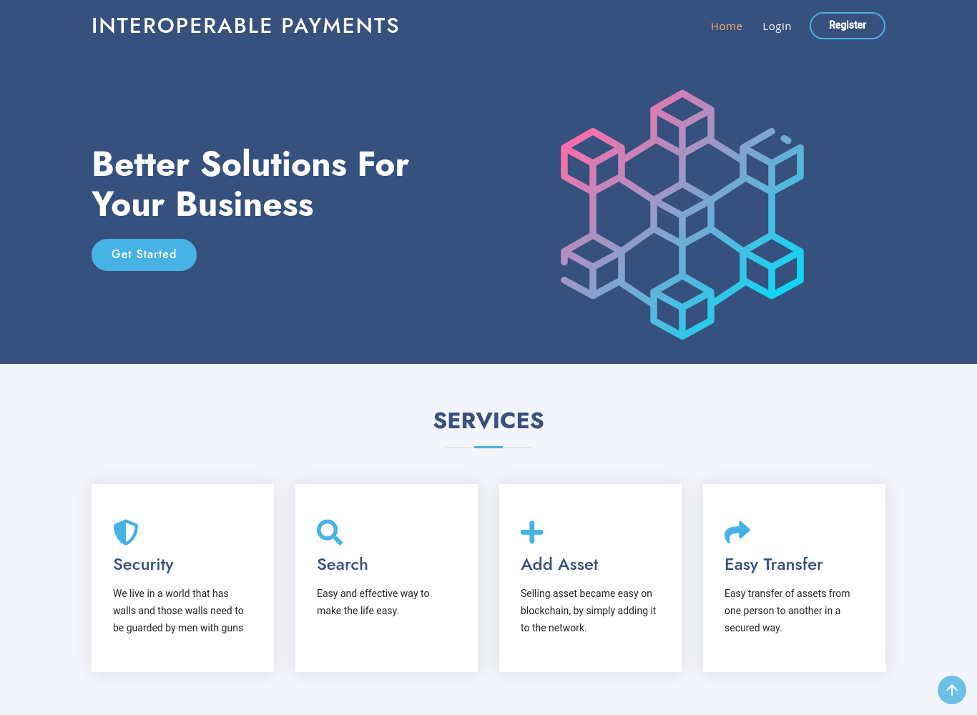
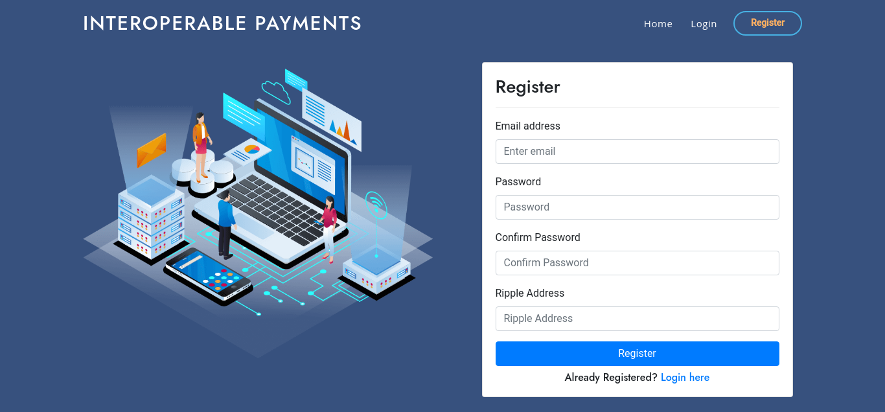
Home Page
Login and Register Page

Slide 15
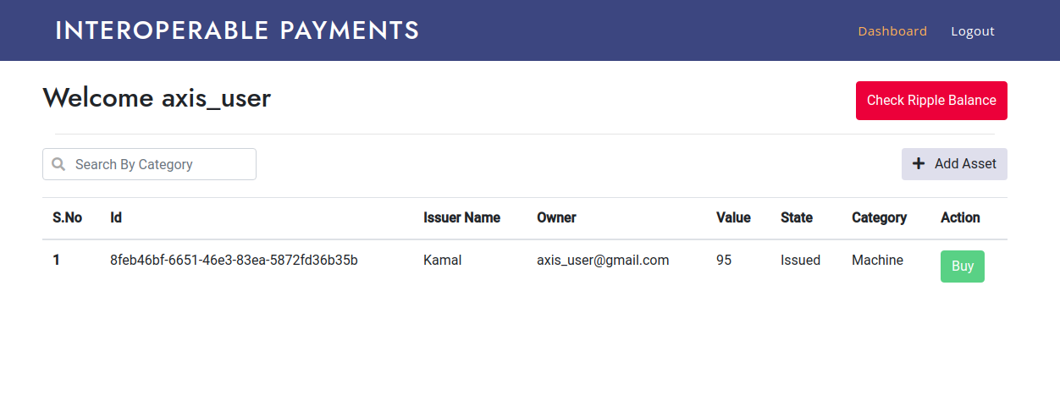
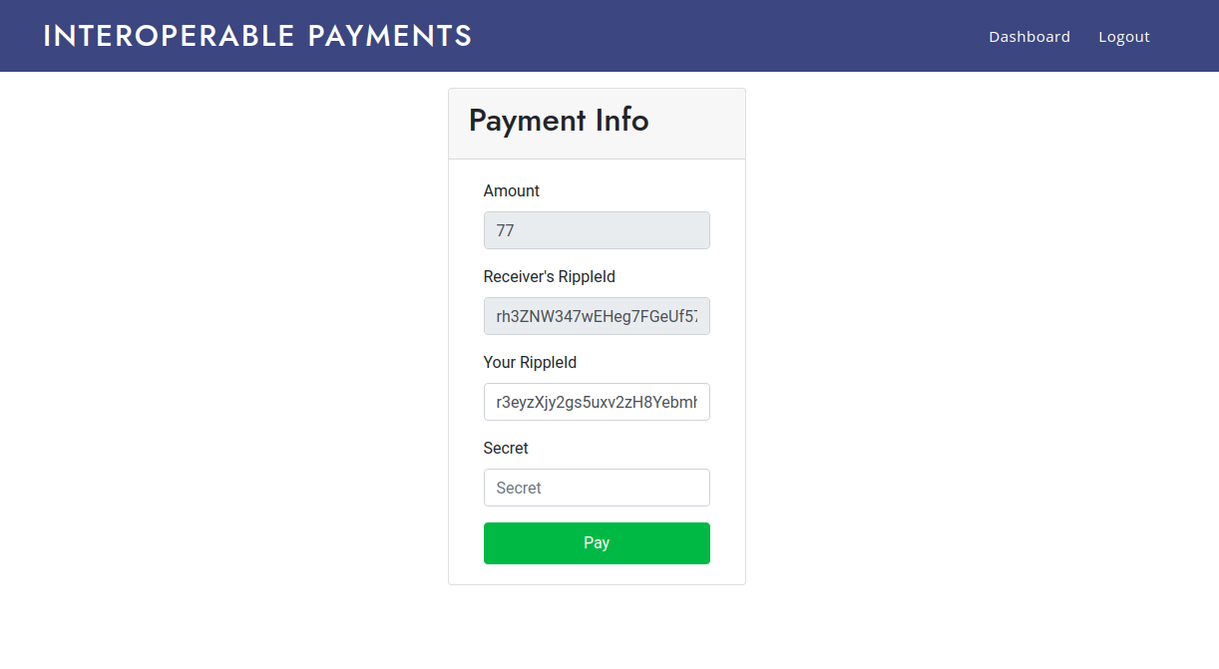
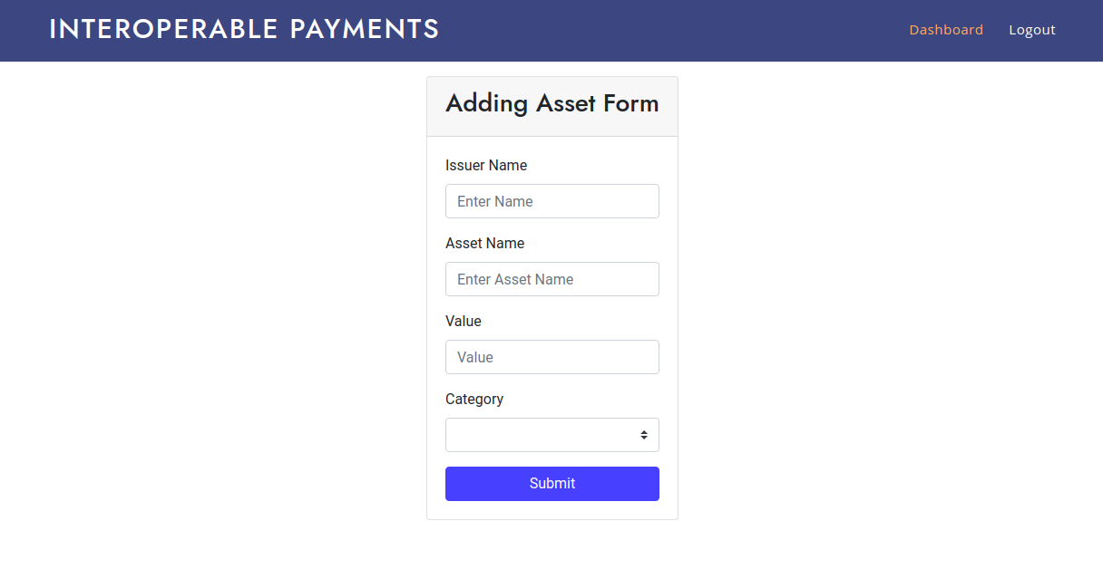
Dashboard
Adding an Asset
Buying an Asset

Slide 16
Thank You!

