Slide 1

ONLINE BUG TRACKING SYSTEM
Submitted by:
Nagesh V B (P18FY23S126011)
Bhoothraju Y M (P18FY23S126019)
Under the guidance of:
Prof. Sreelakshmy P P

Slide 2
INTRODUCTION
Bug tracking is a critical part of the software development lifecycle.
Manual tracking of bugs is often time-consuming and error-prone.
An online bug tracking system provides a centralized platform for managing bugs.
It helps developers, testers, and project managers log, assign, and monitor issues.
The system ensures real-time updates and status tracking of bugs.
It improves team collaboration, accountability, and project transparency.
Reduces communication gaps and speeds up bug resolution.
Leads to better software quality and faster delivery cycles.

Slide 3
OBJECTIVE
To develop a web-based platform for tracking and managing software bugs.
To enable efficient reporting, assigning, and resolution of bugs.
To provide real-time updates on bug status for all users.
To implement role-based access for developers, testers, and admins.
To reduce manual errors and communication delays in bug handling.
To improve collaboration among team members.
To ensure accountability and historical tracking of issues.
To enhance software quality and development productivity.

Slide 4
EXISTING SYSTEM
Bugs are often tracked using manual methods like spreadsheets or emails.
Limited systems like Bugzilla focus on bug linking and developer collaboration.
No automated triage — bugs must be manually reviewed and assigned.
High redundancy in bug reports, leading to wasted time.
Lack of scalability and data reduction techniques.
Difficult to maintain clear visibility of bug status and progress.

Slide 5
PROPOSED SYSTEM
A web-based system with centralized bug tracking and management.
Uses text classification for automatic bug triage.
Implements feature selection and instance selection to reduce data size.
Removes redundant and uninformative bug reports.
Ensures real-time updates, priority tagging, and status tracking.
Improves accuracy, collaboration, and bug resolution speed.
Delivers comparable information with fewer bug entries and fewer words.

Slide 6
SOFTWARE REQUIREMENTS
Operating System: Windows XP
Coding Language: J2EE
Database: MySQL

Slide 7
HARDWARE REQUIREMENTS
System: Pentium IV 2.4 GHz
Hard Disk: 40 GB
Floppy Drive: 1.44 Mb
Monitor: 15” VGA Colour
Mouse: Logitech
RAM: 512 MB

Slide 8
MODULES
User Authentication Module
Bug Reporting Module
Bug Assignment Module
Status Tracking Module
Notification Module
Admin Dashboard

Slide 9
METHODOLOGY USED
Requirement Gathering
System Design (ER Diagrams, Schema)
Development (Frontend & Backend)
Database Integration
Testing
Deployment

Slide 10
RESULTS
Successfully implemented a web-based bug tracking system.
Real-time bug reporting and status updates enabled.
Automatic bug assignment improved triage efficiency.
Redundant bug reports reduced through data filtering techniques.
Developers and testers experienced improved collaboration.
Historical tracking of bugs supported for accountability.
Reduced overall debugging time and manual workload.
Enhanced software quality and on-time delivery of products.

Slide 11
CONCLUSION
The system provides a centralized platform for efficient bug management.
It automates bug triage, reducing manual effort and human error.
Helps in assigning bugs accurately using classification methods.
Enhances transparency and collaboration among development teams.
Reduces debugging time and improves software quality.
Facilitates faster and more reliable software releases.

Slide 12
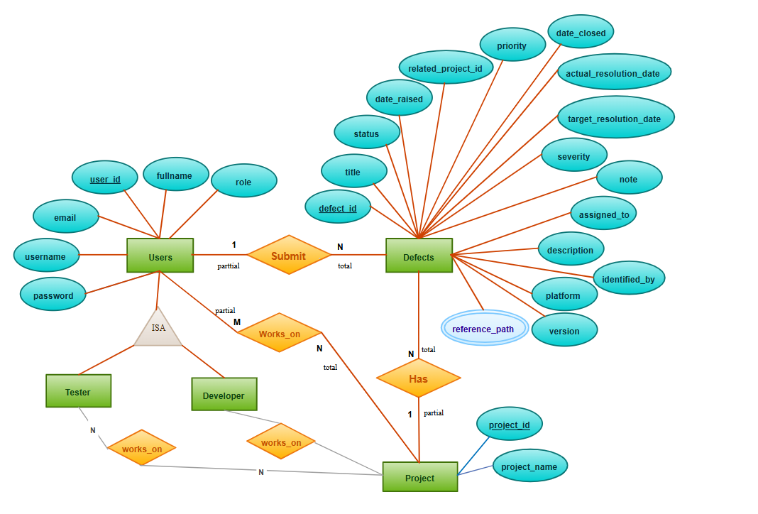
ER Diagram:

Slide 13
THANK YOU

