Slide 1

System Identification
Presentation by: VINAY NAGULA
Registration No. 1761724
Guide: Prof. Oliver Nelles
Date: 11/09/2024

Slide 2
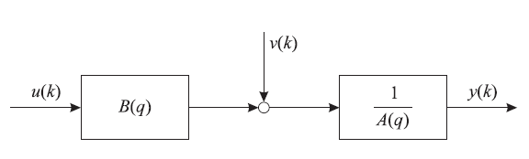
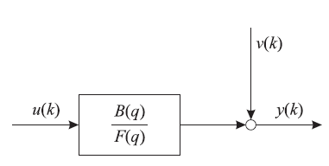
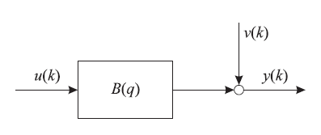
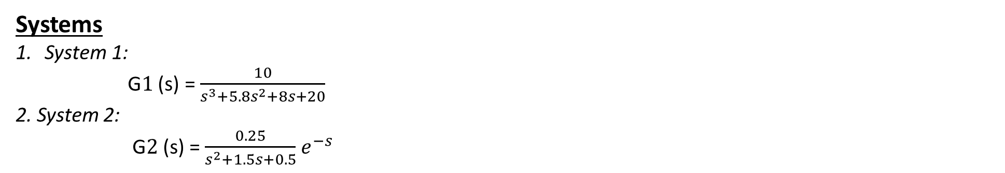
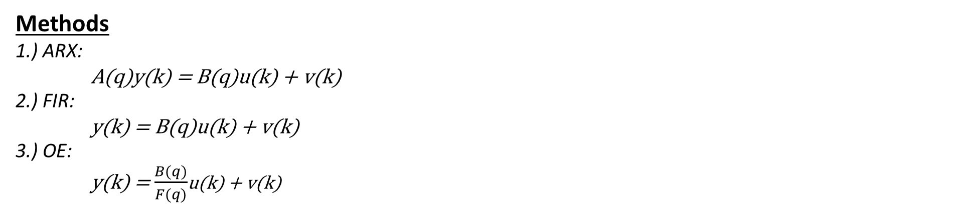
Objective
To evaluate the models of two systems in different methods and compare their result.
Systems
System 1:
G$1$ (s) = $\frac{10}{s^{3}+5.8s^{2}+8s+20}$
2. System 2:
G$2$ (s) = $\frac{0.25}{s^{2}+1.5s+0.5}$ $e^{−s}$
(System 3. order, PT3)
(System 2. order with dead time, PT2-Tt)
Methods
1.) ARX:
A(q)y(k) = B(q)u(k) + v(k)
2.) FIR:
y(k) = B(q)u(k) + v(k)
3.) OE:
y(k) = $\frac{B(q)}{F(q)}$u(k) + v(k)
Fig. 1. ARX model
Fig. 2. FIR model
Fig. 3. OE model

Slide 3
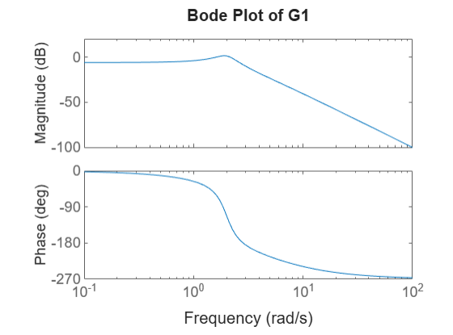
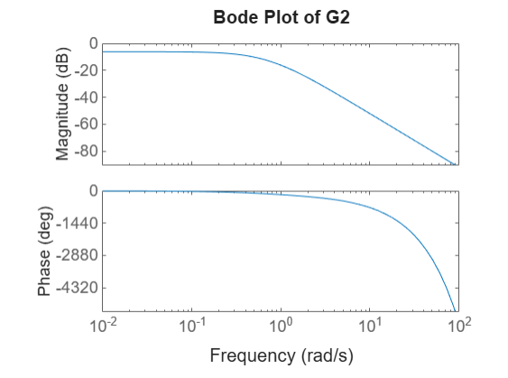
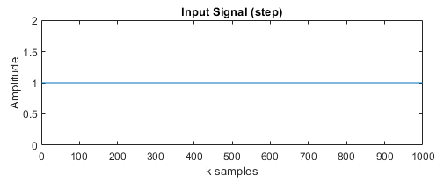
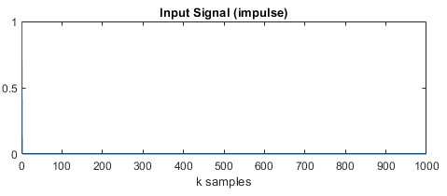
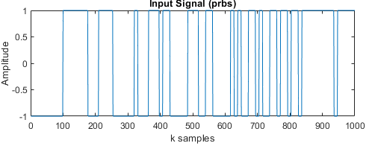
System Response
System 1:
System 2:
Input Signals
Step Input
Impulse Input
PRBS Input

Slide 4
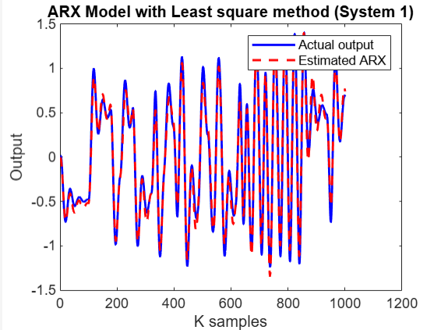
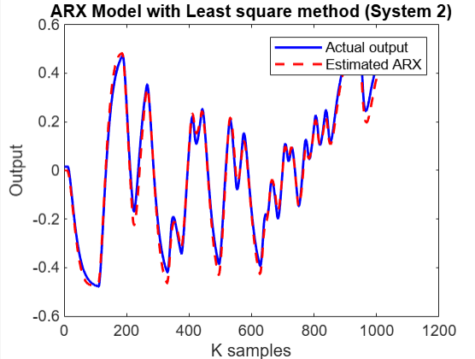
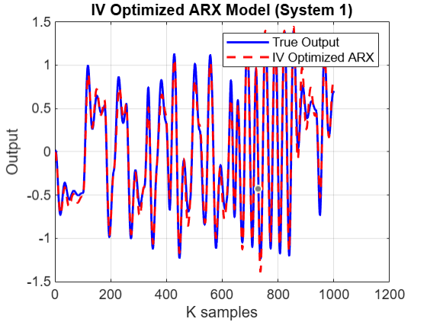
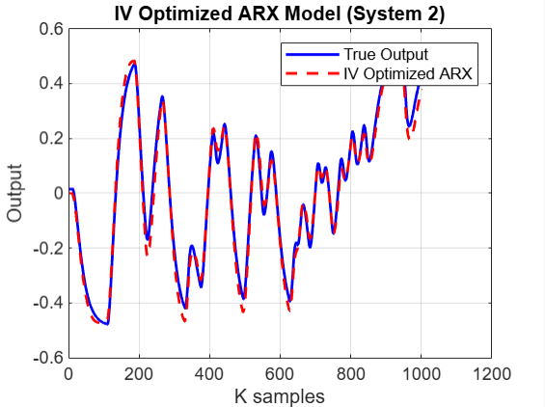
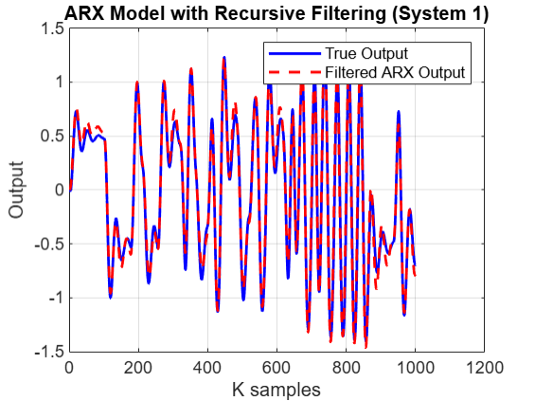
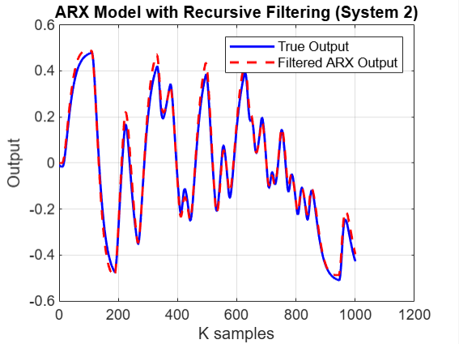

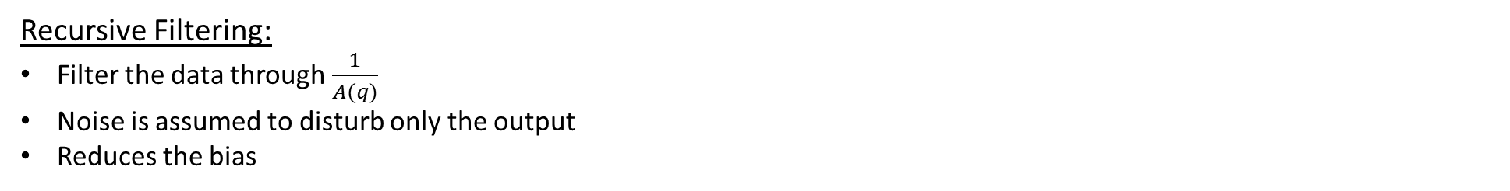
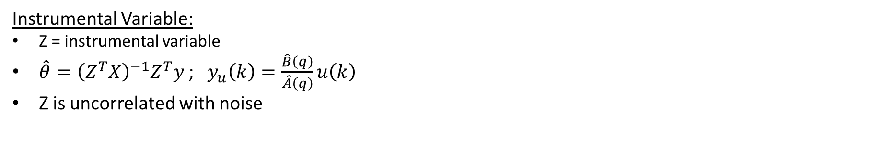
ARX Model
Least Square:
$\hat{θ}={\left(X^{T}X\right)}^{−1}X^{T}y$
$\hat{y}=Xθ$
It is linear model of optimization.
Instrumental Variable:
Z = instrumental variable
$\hat{θ}={\left(Z^{T}X\right)}^{−1}Z^{T}y$ ; ${ y}_{u}\left(k\right)=\frac{\hat{B}\left(q\right)}{\hat{A}\left(q\right)}u\left(k\right)$
Z is uncorrelated with noise
Recursive Filtering:
Filter the data through $\frac{1}{A(q)}$
Noise is assumed to disturb only the output
Reduces the bias

Slide 5
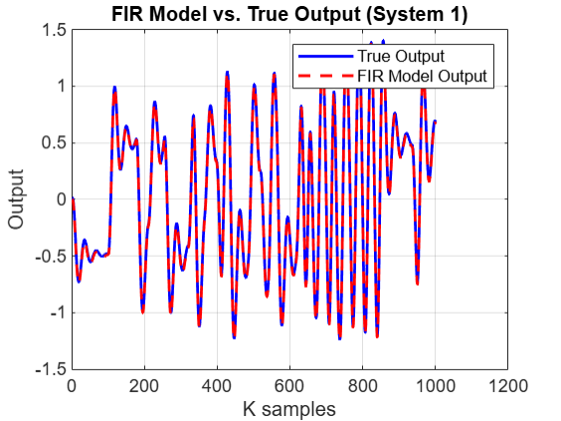
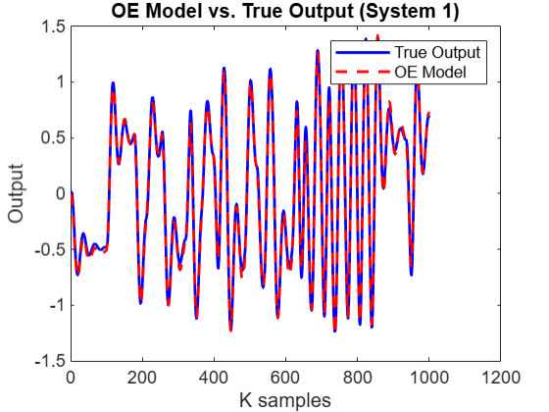
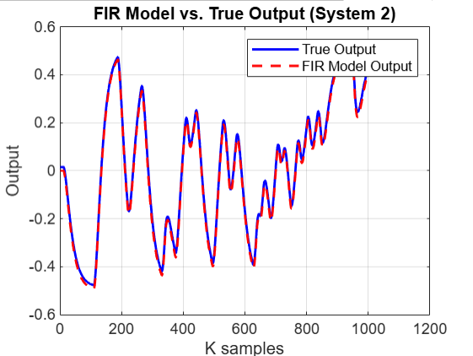
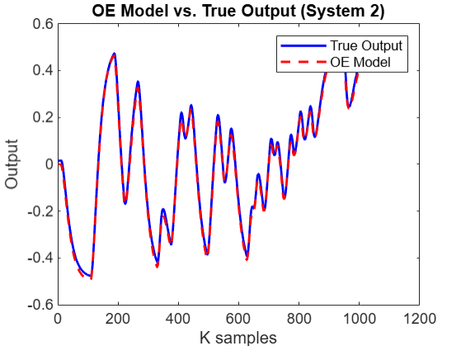
FIR Model
OE Model
Simple linear Moving Average filter model
Noise is correlated only in output
Approximation error depends on model order
Nonlinear Optimization method
Noise is correlated only in output
Can be used only for modelling of stable system

Slide 6
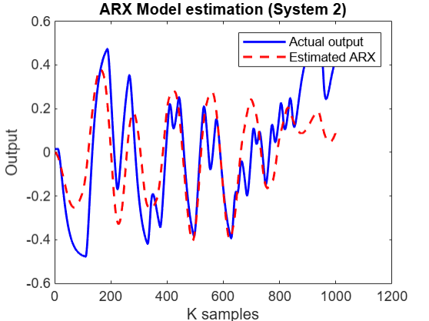
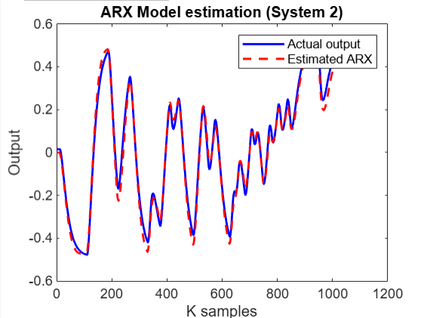
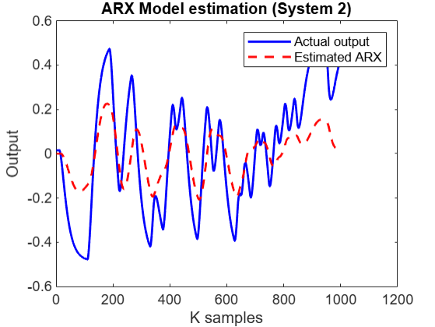
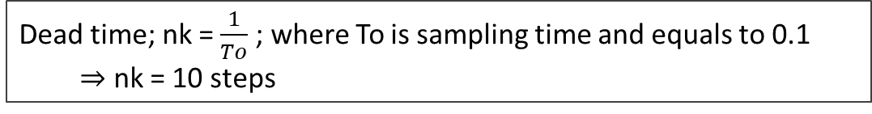
Investigations
1.) Effect on ARX estimation if the dead time is not considered accurately
Dead time; nk = $\frac{1}{To}$ ; where To is sampling time and equals to 0.1
$⇒$ nk = 10 steps
1.) nk = 0 (RMSE : 0.18716) [Early response]
2.) nk = 10 (RMSE : 0.02987) [Proper response]
1.) nk = 15 (RMSE : 0.19198) [Late response]
From the above comparisons of the graph, it implies that for a system with dead time, the delay time has to be properly considered to get an equivalent model response w.r.t the actual output.

Slide 7
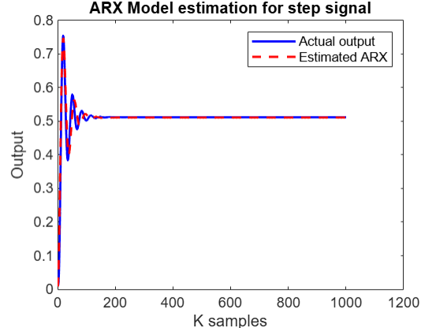
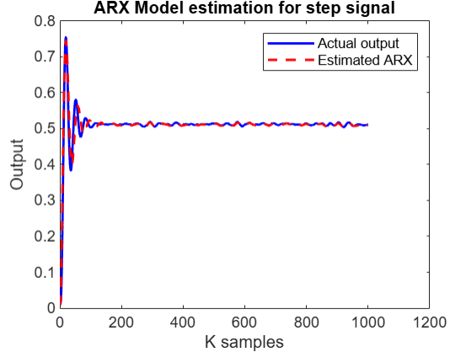
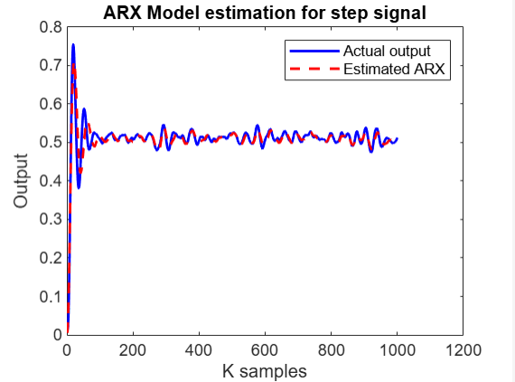



2.) Effect of different levels of measurement noise on ARX estimation for step signal
$1.) σ$ = 0 (RMSE = 0.01341)
$2.) σ$ = 0.01 (RMSE = 0.01352)
$3.) σ$ = 0.05(RMSE = 0.01846)
By introducing noise, the disturbance in the system increases which is resultant from the above graph and their corresponding RMSE value.

Slide 8
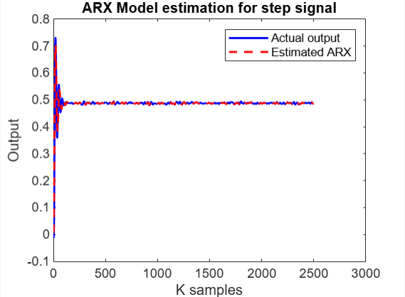
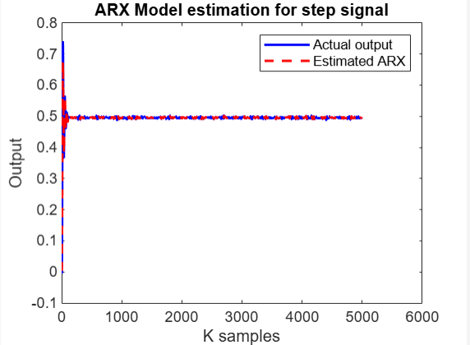




3.) Effect of noise level for different sample size
$σ$ = 0.01
$1.) N=1000$ (RMSE = 0.01353)
$2.) N=2500$(RMSE = 0.00811)
$3.) N=5000$ (RMSE = 0.00310)
By increasing the number of samples, the random noise will approach to Zero mean, and the effects of noise will become negligible in the system.

Slide 9
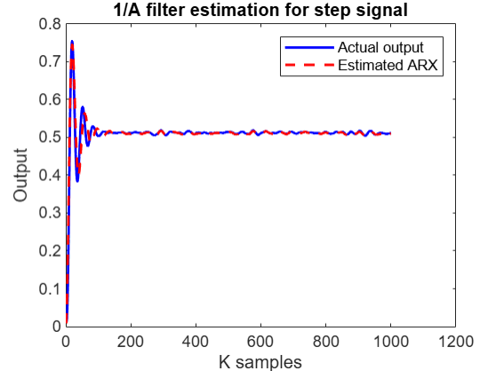
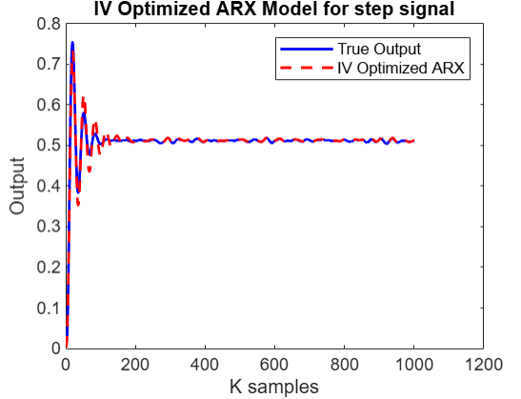
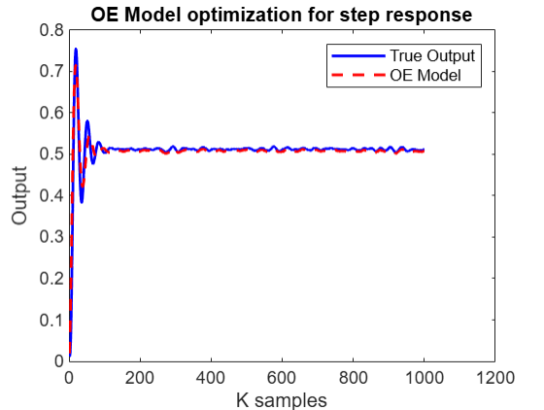
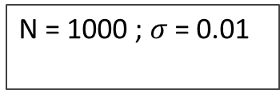
4.) Effect of different ARX models to noisy step response
N = 1000 ; $σ$ = 0.01
RMSE (L.S) = 0.01353
RMSE = 0.0035
RMSE = 0.00865
RMSE = 0.00461
All the above described, method has a better system response for same noise level compared with Least Square ARX model.
Note:
Z matrix of IV model may have high variance error than X matrix.
1/A filter should be stable to get a stable model response

Slide 10
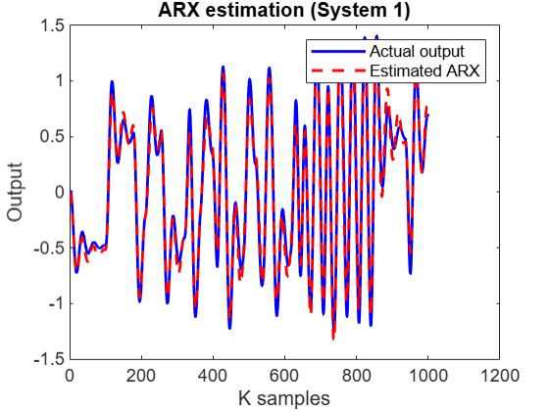
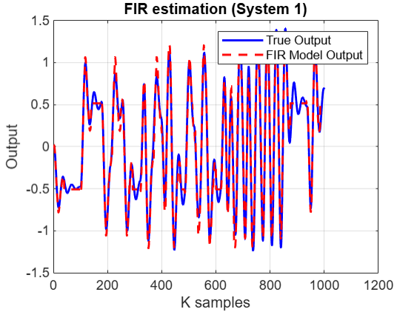
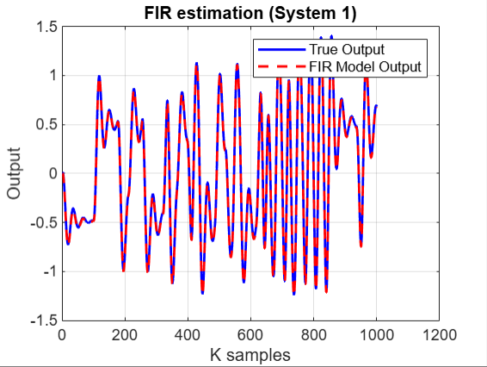

5.) Estimation of suitable model order for FIR model
N = 1000 ; $σ$ = 0.01
nb : Order of the system
System 1
RMSE = 0.09307
RMSE = 0.09793 (nb = 40)
RMSE = 0.01184 (nb = 150)
For a FIR model of system 1, to get an almost similar model response of ARX model, the order of the FIR model system should be nb = 40

Slide 11
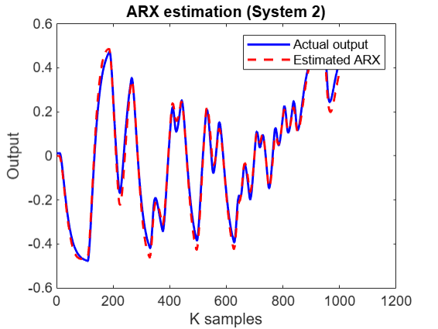
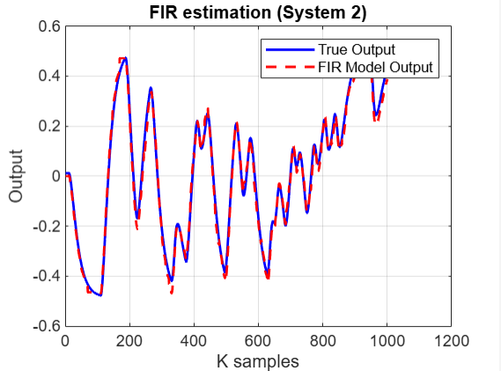
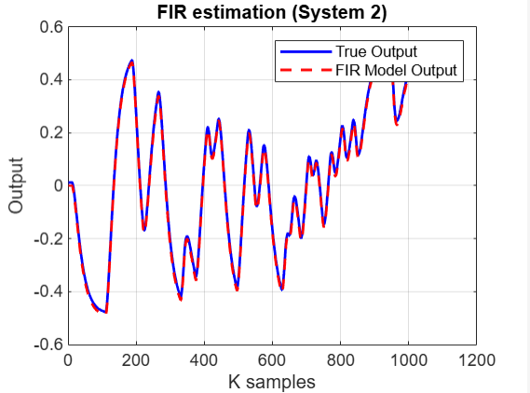
5.) Estimation of suitable model order for FIR model
N = 1000 ; $σ$ = 0.01
nb : Order of the system
System 2
RMSE = 0.02966
RMSE = 0.02524 (nb = 60)
RMSE = 0.01169 (nb = 150)
For a FIR model of system 2, get an almost similar model response of ARX model, the order of the FIR model system should be nb = 60

Slide 12
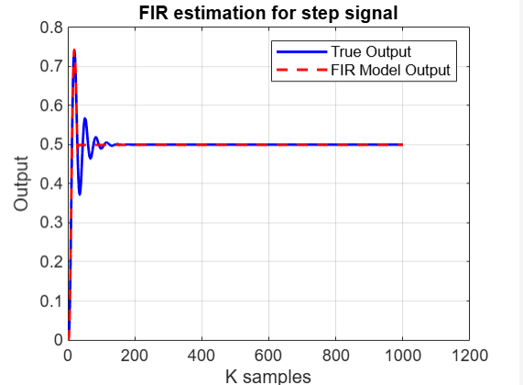
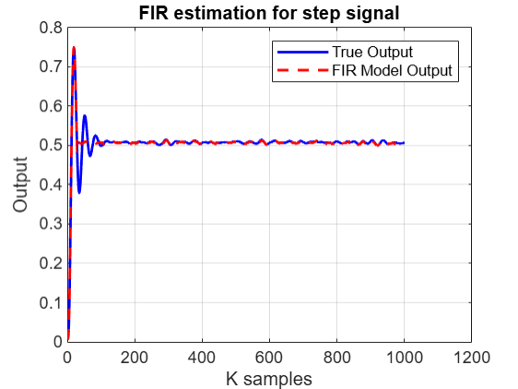
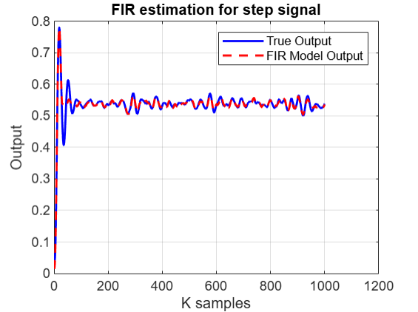



6.) Effect of noise on FIR model for step signal
N = 1000 ; nb = 30
$σ$ = 0 (RMSE = 0.01329)
$σ$ = 0.01 (RMSE = 0.01334)
$σ$ = 0.05 (RMSE = 0.01399)
Compared to ARX Least Square model, FIR model handles the noise effectively.

Slide 13
Conclusions
Each models have their inherent characteristics, selecting a suitable model highly depends on the requirements and expectation from the system.
In general, it is better to start with a simple model like an ARX model if there is a limited dataset or FIR model if there are plenty of data’s (parameters) which can be used.
By comparing the model error produced by this simpler models, advanced optimization techniques can be considered to improve it (if needed).
If accuracy of the model is of crucial importance and there is a source for high computation, it is a good choice to go with non linear optimization techniques like OE model.
Understanding and processing of the systems structure is of equal importance to that of model selection to get an proper response.

Slide 14
Thank you

