Slide 1
OOM Project
Under The guidance Of:
Dr. OP Vyas
Dr. Rahul Kala
Dr. Sonali Agarwal

Slide 2
Group Members
Group NO. 41
Name | Enrollment No.
Nagumalli Vinay | IIT2021247
Harshit Yadav | IIT2021249
Vishal Kashyap | IIT2021246

Slide 3
Nine Box Puzzle

Slide 4
Abstract of the project
We are given a task to create a 9-box puzzle game Software
A nine box puzzle game consists of nine boxes that are labeled from one to eight. Player needs to arrange the labeled boxes serially.
The game counts the number of attempts by the player. A player with the minimum number of attempts is the winner of the game
The puzzle game also accepts the name of the player and keeps track of the Players performance

Slide 5
Technologies used in project
Java swing, Java OOPS.
We used java swing because it is lightweight they are less resource intensive than AWT.
It contains Jbuttons, Jtables,ActionListnes ,Jframes,Jmenu, Joptions etc.
We used Abstraction,inheritance of Java OOPS.

Slide 6
Our Approach to the Project
Home Screen will redirect the Player to desired -> MainView extends JPanel.
Game board will have 8 buttons -> Box extends JButton.
Box will be clicked , so to listening that event -> EventHandler extends action Listener (with Sound / Other Animation ).
We needed a panel to hold boxes and display swaps -> PlayArea extends JPanel.
We needed a Brain for the Game, that will keep track of algorithm , it will initialise, it will validate moves (right or not) -> GameCPU.

Slide 7
6. We also had to track Player name and score, we stored it in an Arraylist ->
ScoreBoard extends JPanel.
7. But each player data is unique -> PlayerData.
8. What if someone does not know how to play game -> Rules extends JPanel.

Slide 8
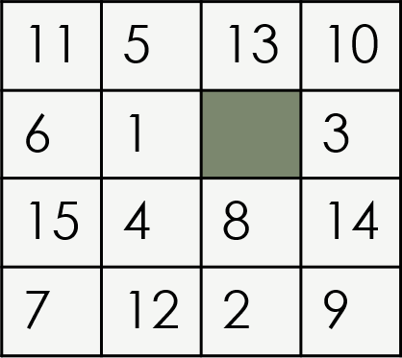
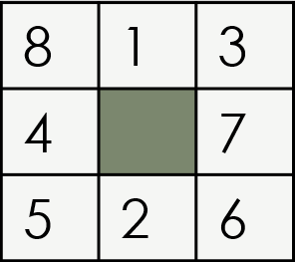
Future Scope of the project
We can increase the number of boxes to N^2 ( 16,25,36……..)

Slide 9
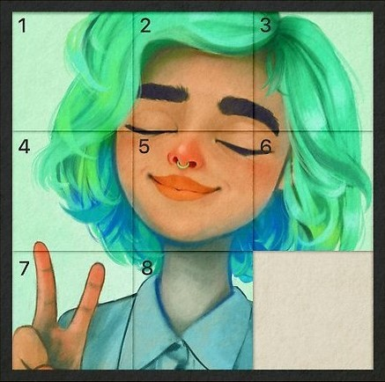
We can extend number puzzle to picture puzzle.

Slide 10

What is UML Diagram?
It is based on diagrammatic representations of software components.
UML diagrams can be used as a way to visualize a project before it takes place or as documentation for a project afterward. But the overall goal of UML diagrams is to allow teams to visualize how a project is or will be working, and they can be used in any field, not just software engineering.

Slide 11
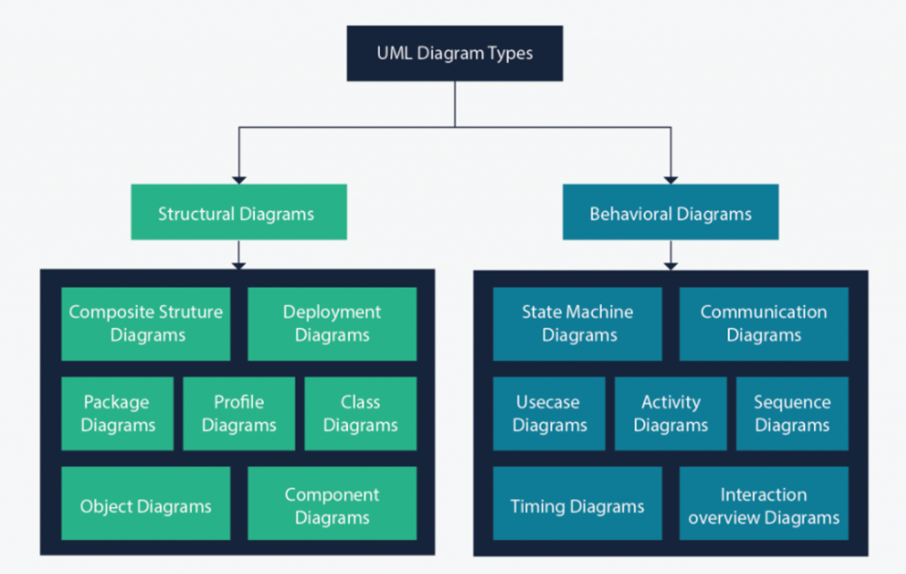

Slide 12
Structure diagrams show the static structure of the system and its parts on different abstraction and implementation levels and how they are related to each other.
Behavioral diagrams show what should happen in a system. They describe how the objects interact with each other to create a functioning system.

Slide 13
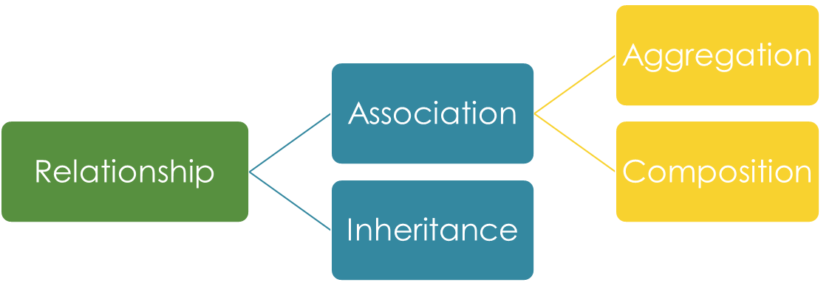
Class diagram
The class diagram is a central modeling technique that runs through nearly all object-oriented methods. This diagram describes the types of objects in the system and various kinds of static relationships which exist between them. Class diagram also shows the attributes and operations of a class
There are three principal kinds of relationships which are important :

Slide 14
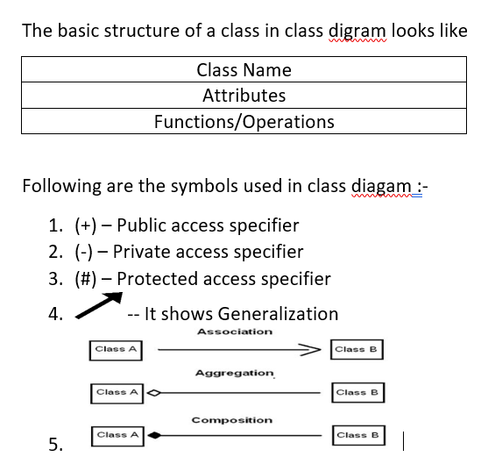
Basic Structure Of Class Diagram

Slide 15
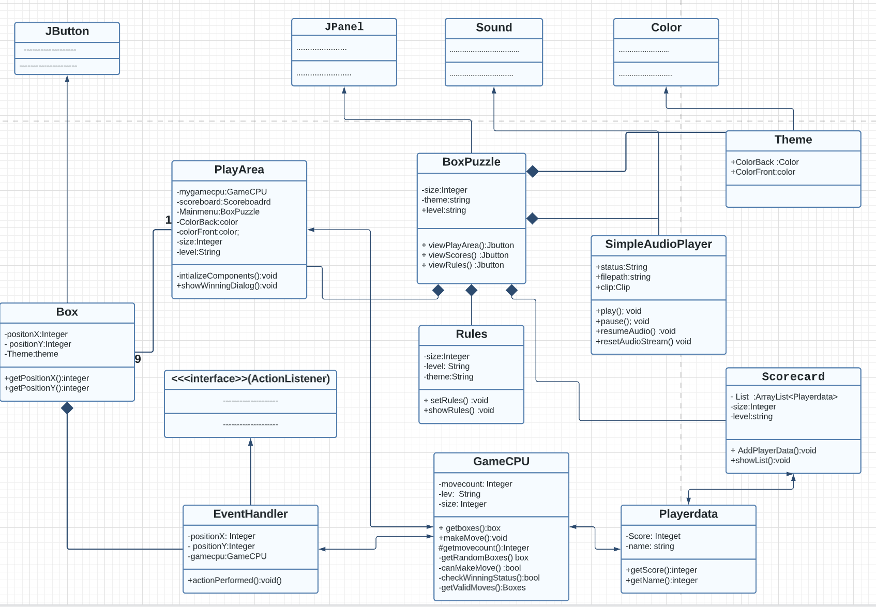
The Puzzle Box class diagram

Slide 16
USE CASE diagram
Use case diagram can summarize the details of your system's users and their interactions with the system. To build one, you'll use a set of specialized symbols and connectors. An effective use case diagram can help your team discuss and represent the following :
Scenarios in which your system or application interacts with people, organizations, or external systems
Goals that your system or application helps those entities (known as actors) achieve

Slide 17
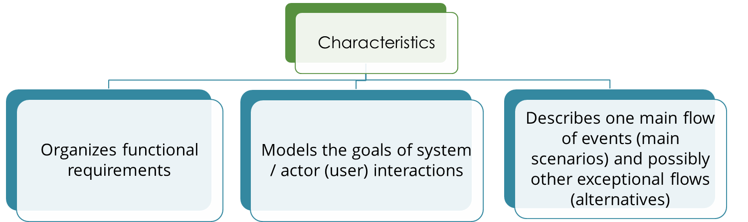

Slide 18
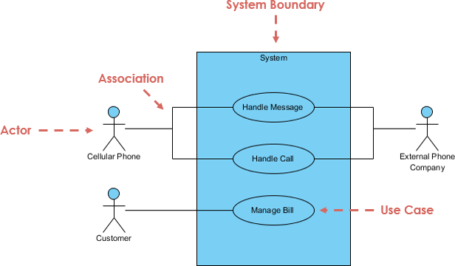
BASIC STRUCTURE OF A USE CASE DIAGRAM

Slide 19
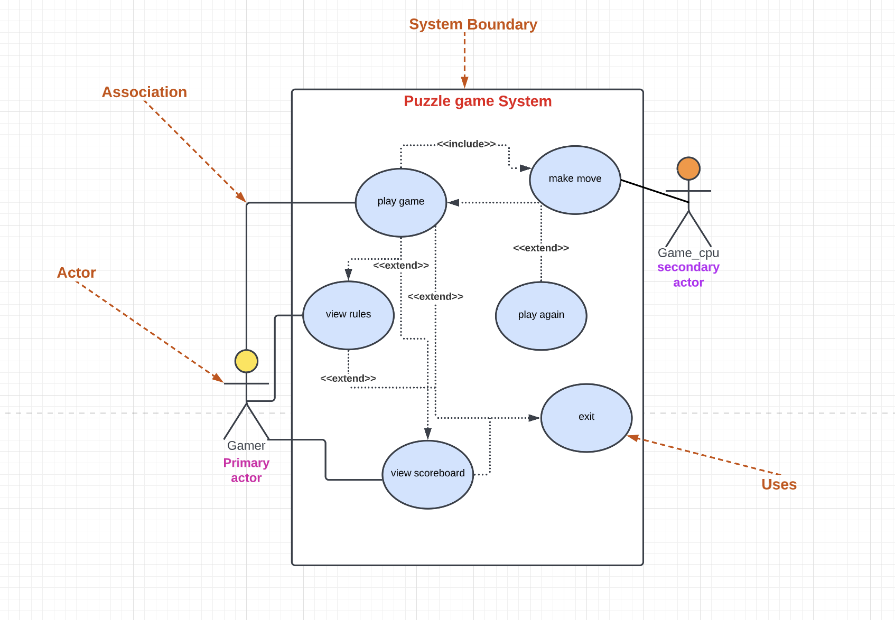
The Puzzle Box Use- Case diagram :

Slide 20
Explanation Of Use Case Diagram
PlayGame:- After clicking playGame button ,user can play easy/hard/medium
game.
MakeMove:-After clicking neighbour button of empty button GameCpu (secondary Actor) make a swap of two buttons
PlayAgain:- while checking winning status by GameCpu,if checkingwinning
status true,GameCpu display Scoreboard and Playagain option.
By clicking this user can play again.
ViewRules:-By clicking this options user can see the rules of 3*3 square Puzzle
ViewScoreboard:-By clicking this,user can see the scores of 3*3,4*4,5*5 boxes
top 10 scoreres.
Exit:-By clicking this ,user can immediately leave the game.

Slide 21
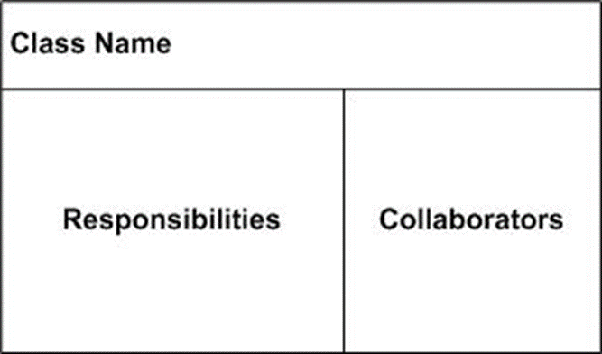
Class Responsibility Collaborator CRC DIAGRAM
A Class Responsibility Collaborator (CRC) model is a collection of standard index cards that have been divided into three sections, A class represents a collection of similar objects, a responsibility is something that a class knows or does, and a collaborator is another class that a class interacts with to fulfill its responsibilities.

Slide 22
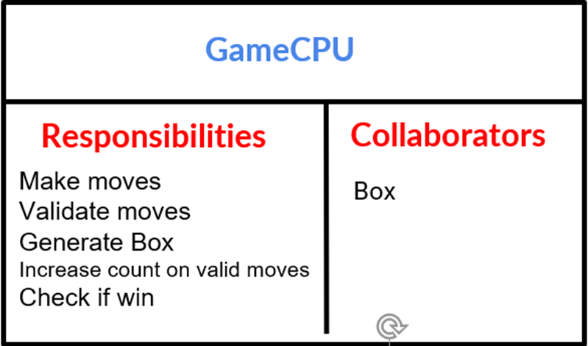
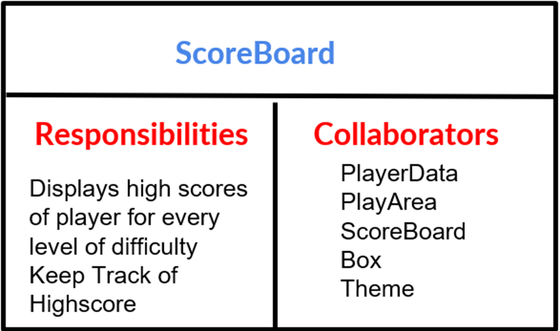
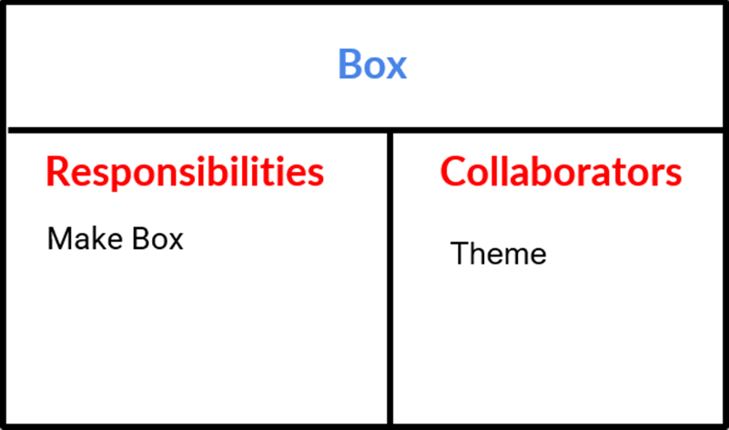
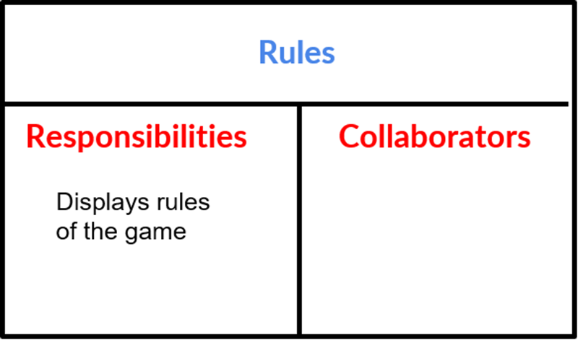

Slide 23
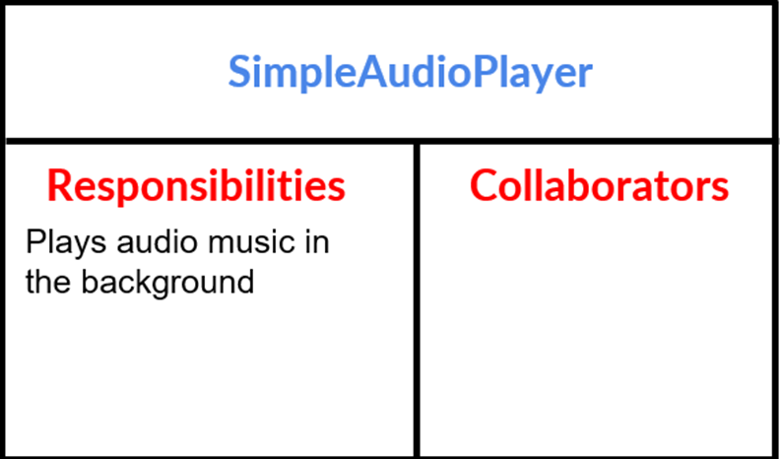
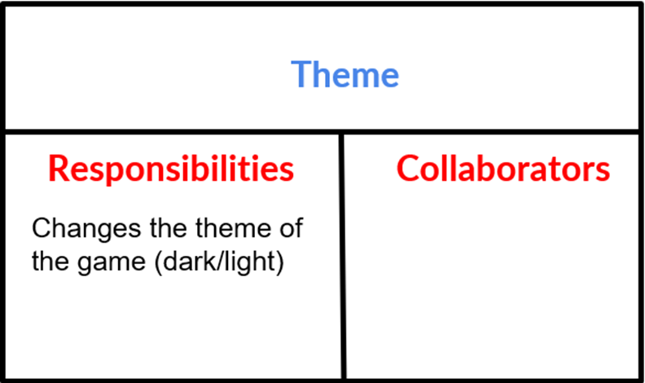
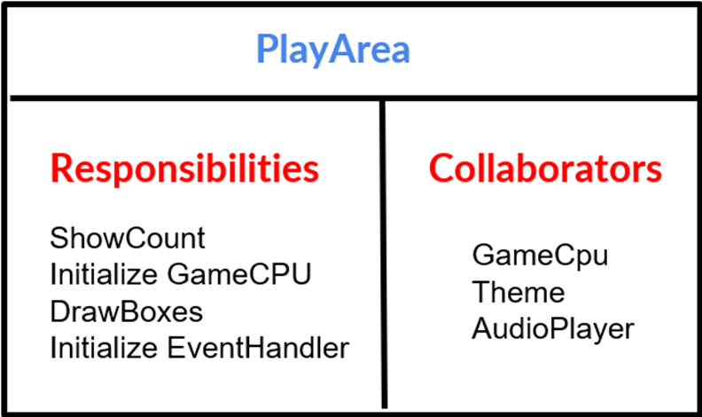
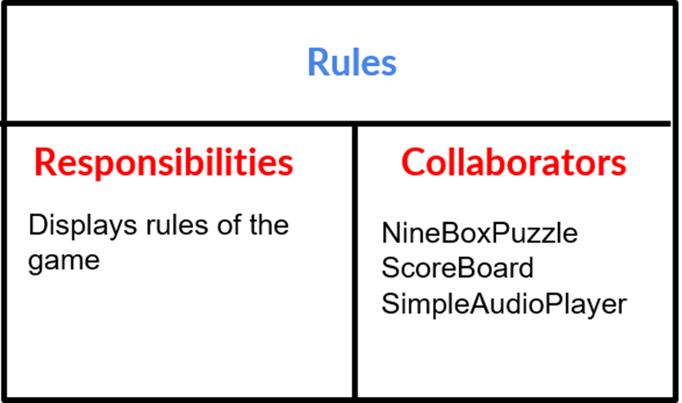

Slide 24
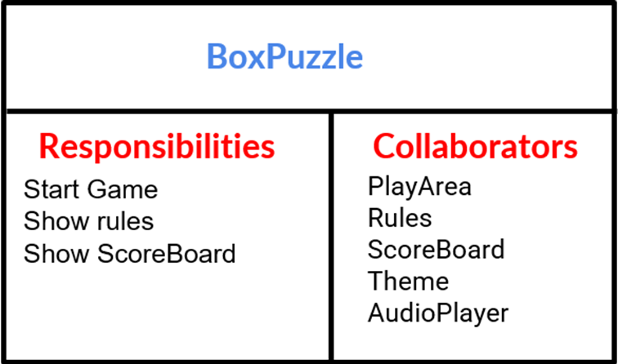
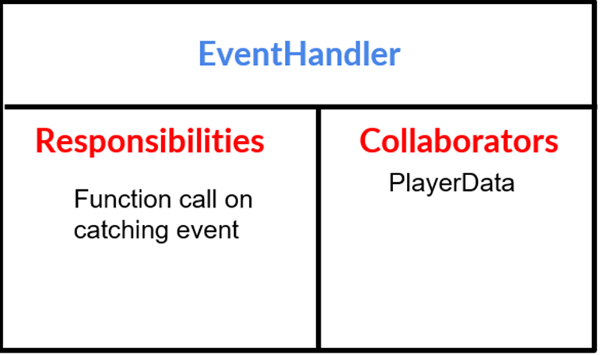
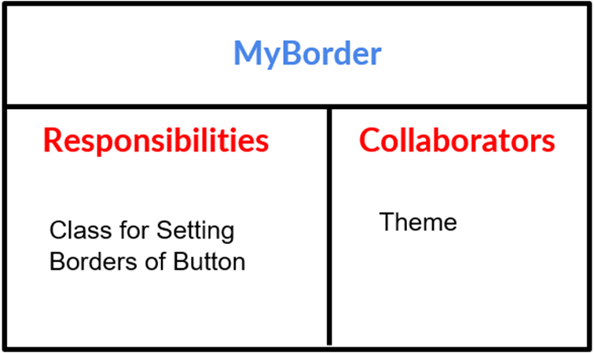

Slide 25
PuzzleBox Class
JMenuBar
JMenuBar menubar = new JMenuBar();
JMenuOptions
JMenu options = new JMenu("Theme");
JMenuItem darkTheme = new JMenuItem("Dark Theme");
darkTheme.addActionListener(
new ActionListener(){
@Override
public void actionPerformed(ActionEvent e)
{
//Change Theme
}});

Slide 26
GridBagLayout
setLayout(new GridBagLayout());//Setting layout
GridBagConstraints gridBagLayout = new GridBagConstraints();// we have to do this to add it to container
gridBagLayout.fill = GridBagConstraints.BOTH;
gridBagLayout.anchor = GridBagConstraints.CENTER;
gridBagLayout.ipady = 20;
gridBagLayout.ipadx = 40;
gridBagLayout.gridwidth = 1;
gridBagLayout.gridheight = 1;
gridBagLayout.insets = new Insets(10,10,10,10);

Slide 27
JButtons
JButton ruleButton = new JButton("rule"); //Rules or PlayGame or Scores or Exit
ruleButton.setOpaque(false);
ruleButton.setContentAreaFilled(false);
ruleButton.setBorderPainted(false);
JLabel I7 = new JLabel("");
l7.setIcon(imageIconPath("Rules"+theme)); //Setting Theme
l7.setPreferredSize(new Dimension(100, 100));
ruleButton.add(l7);
ruleButton.addActionListener(new ActionListener()
{
//Change Panel to Rules or PlayGame or Scores or Exit
}});
ruleButton.setFont(new Font("Dialog", Font.PLAIN, 40));
gridBagLayout.gridx = 0;
gridBagLayout.gridy = 2;
add(ruleButton, gridBagLayout);

Slide 28
PlayArea Class
Initialise
private void initializeComponents(int n) {
setLayout(new GridLayout(n, n));
Box[][] boxes = mygamecpu.getBoxes();
for (int i = 0; i < n; i++) {
for (int j = 0; j < n; j++){
add(boxes[i][j]);
boxes[i][j].addActionListener(new EventHandler(mygamecpu, i, j));
}
}
setVisible(true);
}
Moves Setter
protected void setCount(int movesCount) {
score.setText("Moves Count : " + movesCount);

Slide 29
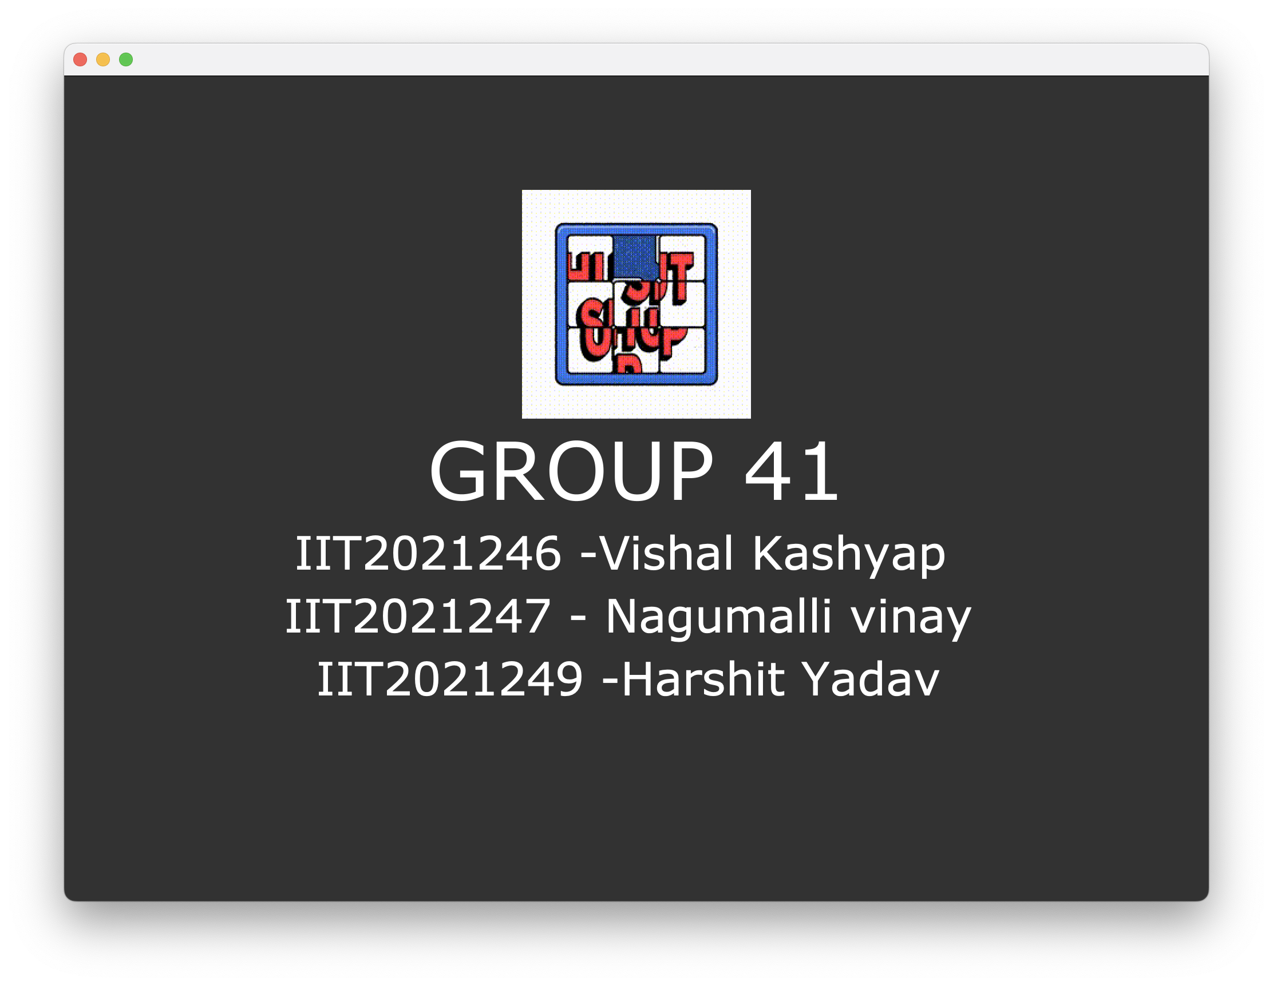
Welcome Page

Slide 30
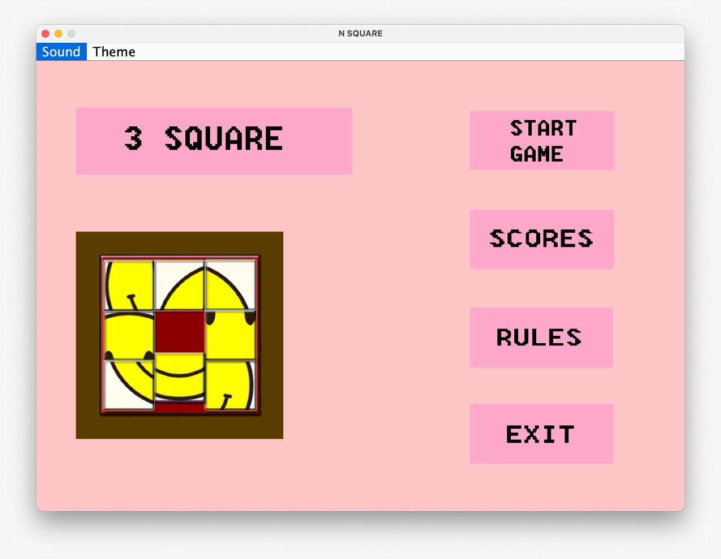
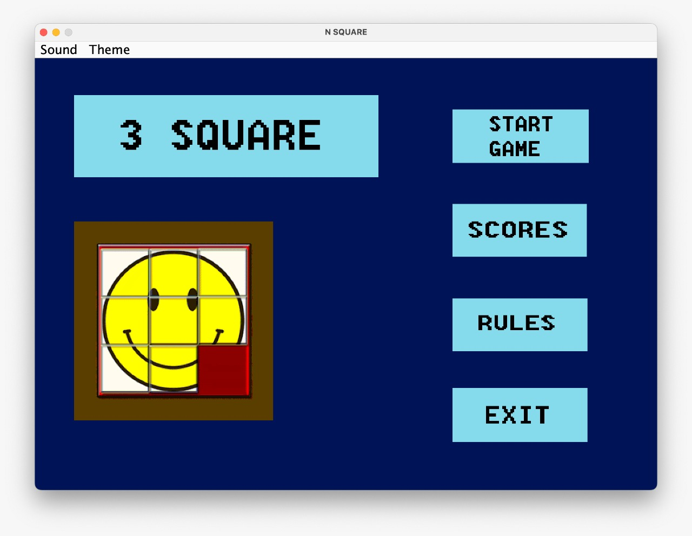
Light Theme
Dark Theme
Step 1: Start the Game

Slide 31
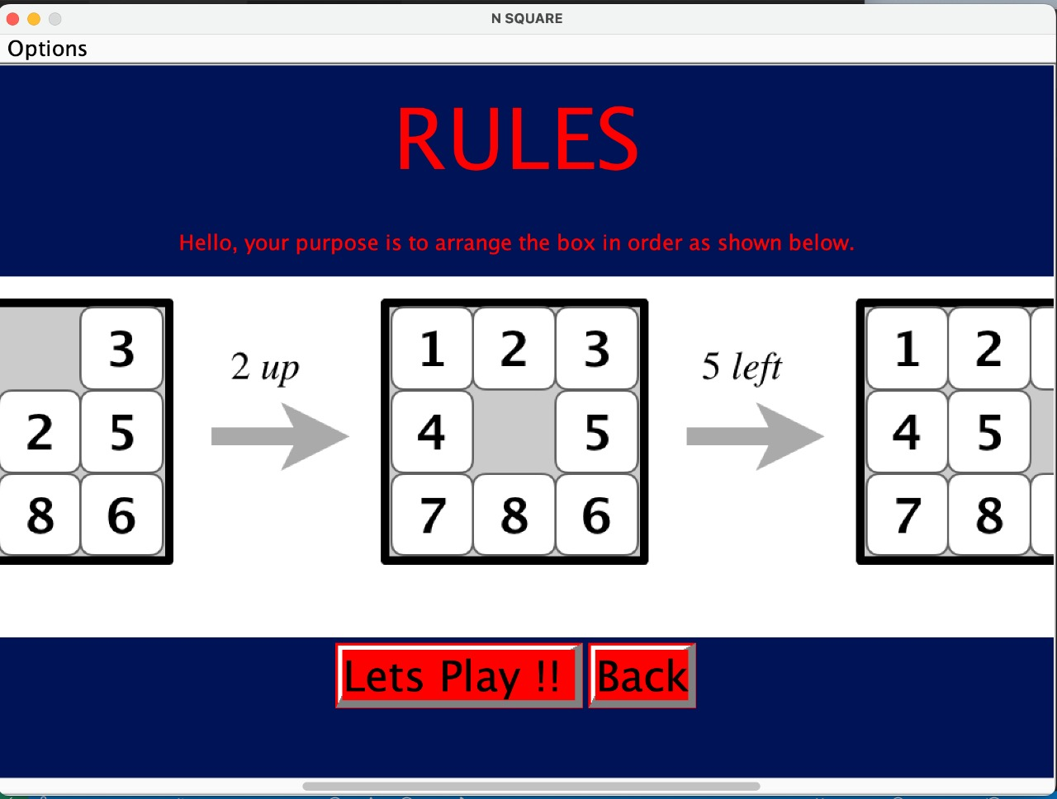
Step 2: View rules

Slide 32
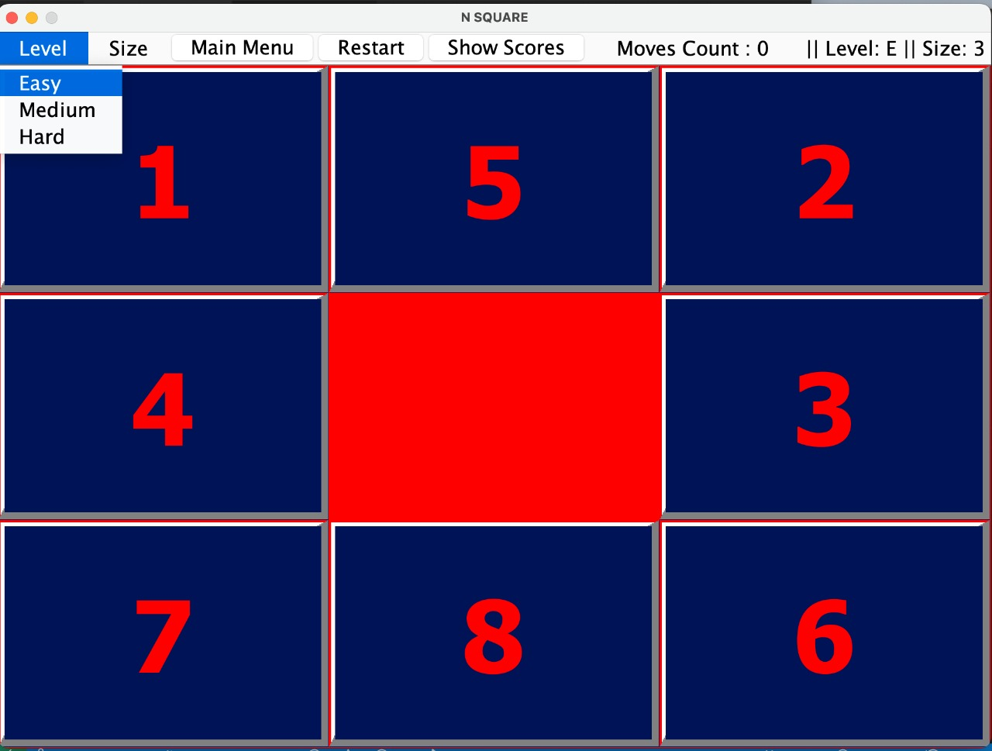
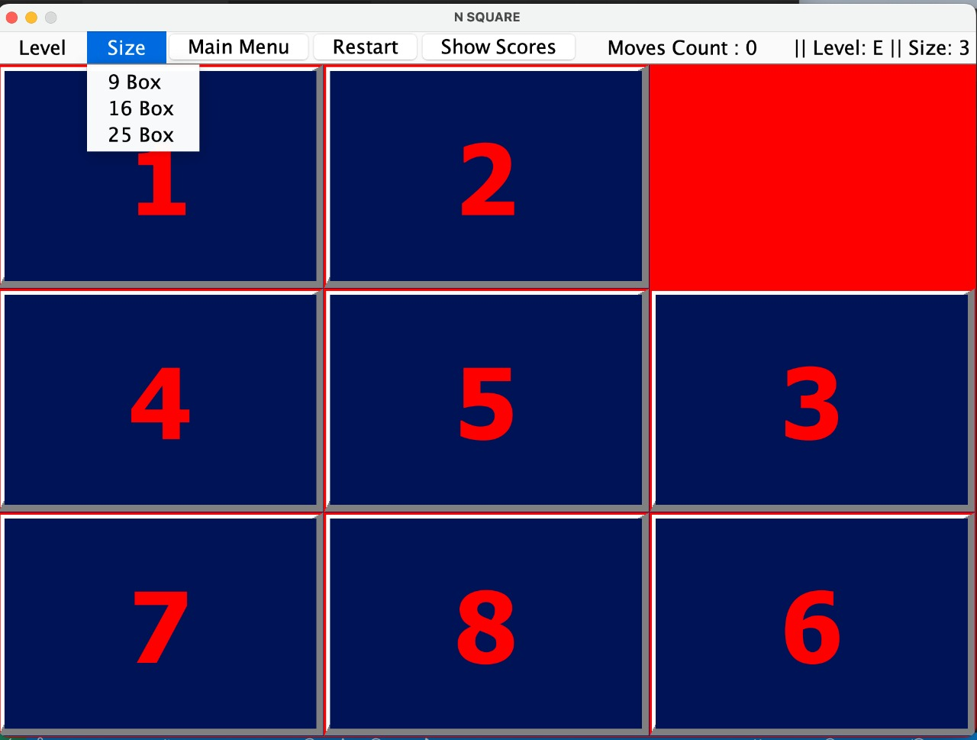
Step 3: Select the difficulty
Step 4: Choose the size.

Slide 33
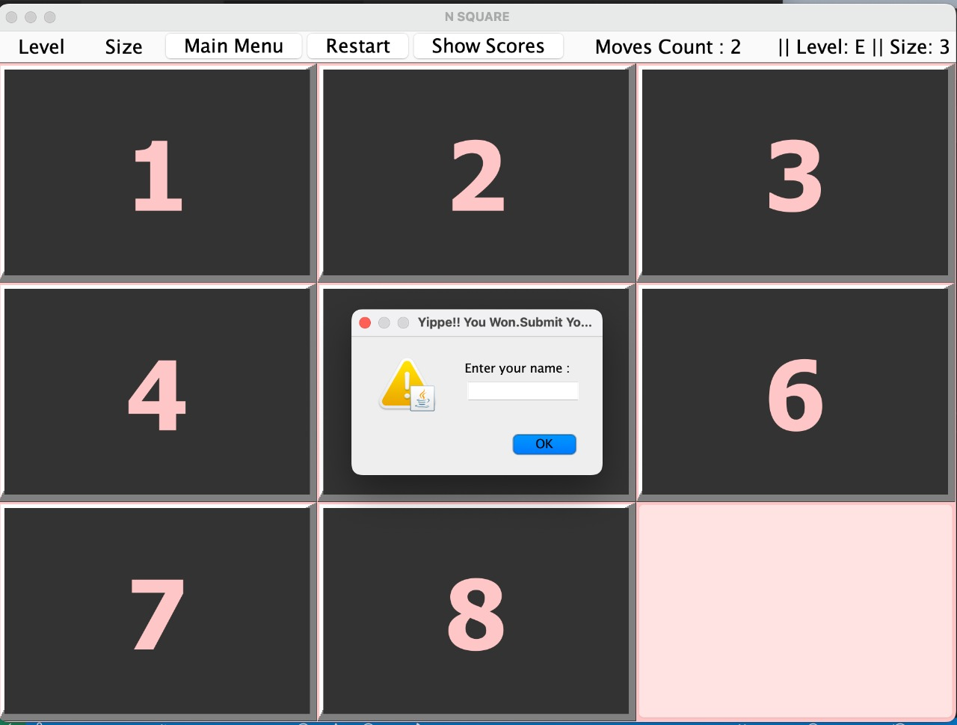
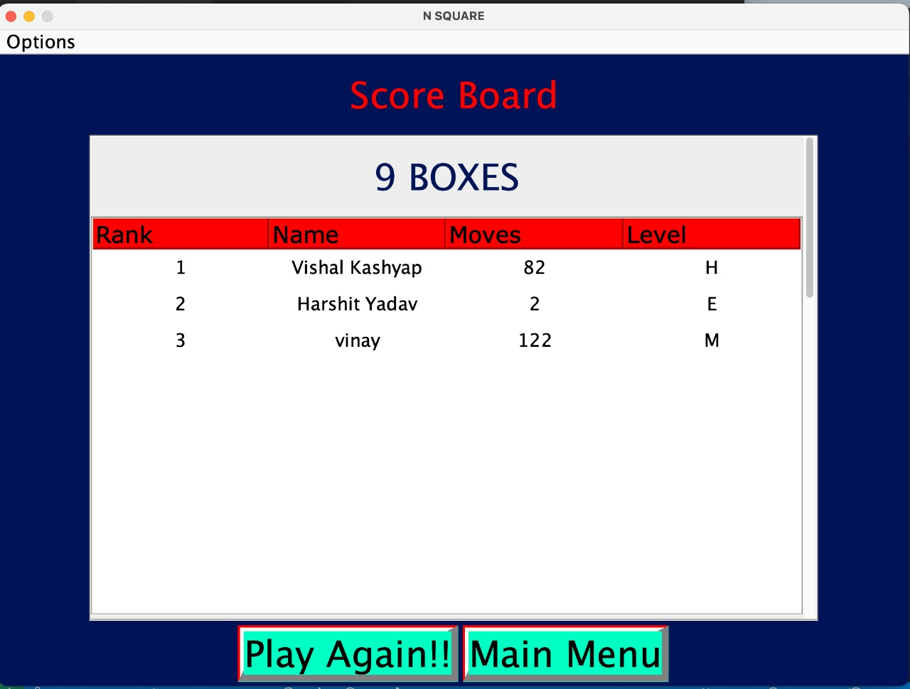
Step 5: Enter the name after winning
Step 6: View the scoreboard after
entering name.

Slide 34


