Slide 1
Author: Nagy András (HDPCPI)
Introductory
Purpose of object analysis: identify the objects, classes, operations, messages, events, activities, use-cases in the system.
There are different stretgeis for the analysis (see the previous presentaion..)
In this presenation we consider only six startgies (Identify real-word items, physical devies, key concepts, transaction, visual elements, control elements staregy)
Using two case study for this: The Vhiechle Detector and The Coyote Mission Planning and Control System

Slide 2
Apply real-word items and physical devices strtegy
Identify objects and classes thet reprsents things which have physical manifestation in the real world.
Identify phisical devices which are part of the system.
Vehicle Detector devices: subsurface passive, loop inductors (SPLIs), above-surface infrared sensors (ASIs) and, above-surface radars (ASRs ).
Image Acquisition physical devices: optical, FLIR (forward-looking infrared), and SAR (synthetic-aperture radar) sensors.

Slide 3
Apply real-word items and physical devices strtegy
Indructor provides energy, wide interface
Sensors and radars provides both wired and secure wireless communication
The seonsors could be passive or active.
Passive means: it uses the enegery emmited from the ground, it shaell be a signal
Active means: painting the targets with energy and uses the using the reflection of these pulses to geadher information

Slide 4
Apply Key Concepts and Transaction Strategies
Oppsite of real-world strategy
Find the essential concepts of a domain of discourse
For instance: an account in a banking system
Transaction: Reification of an interaction between objects
For instance: A withdrawal from a bank account is a transactional object.

Slide 5
Apply Identify Visual Elements and Scenarios Strategies
VE startegy is related to Scenarios strtagey (during considering a scenario we should gadher interfaces for the sceanrios)
The easisest way to create a working collaboration of classes to realize an use case
In small systems (like RTLC) system-level use cases are used while in bigger system subsystem-level user cases are used.
This elaboration is able to done in-line or by decomposition

Slide 6
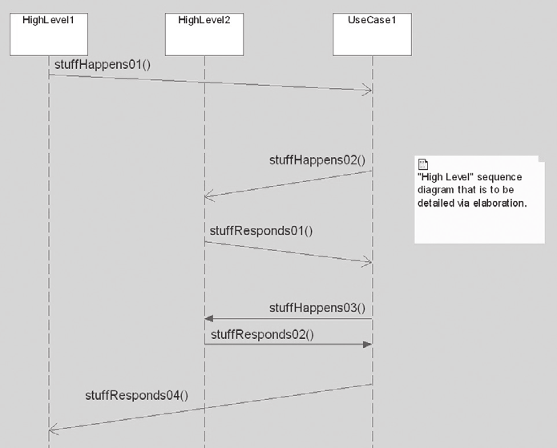
High level seqence diagram before eloberation

Slide 7
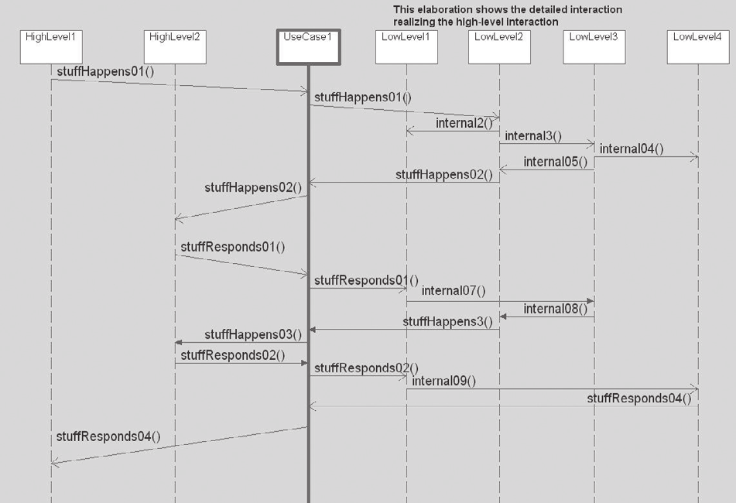
High-level sequence with elaborated detail

Slide 8
Object-level scenario elaboration
You should uncover objects, services and parameters.
What object has the information necessary to perform this service?
What object has the proper interfaces necessary to perform this service?
What object has the responsibility to perform this service?

Slide 9
Object-level scenario elaboration
Add objects, services, and relations to detail this scenario.
Start at the beginning of the scenario, or somewhere in the middle—perhaps
Add relevant classes to a class diagram, filling in the operation calls and event receptions to handle the message, attributes.

Slide 10
Merge Models from the Various Strategies
Merge together the different models that have arisen from the application of the different strategies.
The resulting the use-case collaborations should be on a single class
You should ask the following questions:
Which strategy worked best for you, and why?
Which strategy worked the least well for you, and why?
Did some strategies seem to be better identifying elements in one problem or the other?
What combination of strategies do you think will be most effective for you?

Slide 11
Looking ahead
The startegies are only partially ortogonal.
The model analysis corresponds to the idea of paltform independent model in the OMG’s model-driven architecture. (MDA)
Different optimaztion intention or technology selections result in different platform specific models from the same platform independent model.
The approach insulates you from technology churn and increases the interoperability of your system
For systems that have a long life the MDA approach is both highly practical and effective.

