Slide 1

TECHBOLT KFT
Network Infrastructure Project
Final Exam Presentation
Váradi Levente & Nagy Dániel • Apáczai Csere János Vocational School • Dombóvár • 2024
Notes:
: Good morning / afternoon, everyone. My name is Dániel, and together with my partner Levente we are here to present our final exam project. Our task was to design and implement a complete network infrastructure for a fictional company called TechBolt Kft. Let's get started.

Slide 2

👥 TEAM INTRODUCTION
Váradi Levente
Nagy Dániel
Role:
Role:
Infrastructure Specialist • Network Architect
Project Manager • Tester
Tasks:
Tasks:
✔ Documentation ✔ Testing plan ✔ Sprint planning
✔ Router configuration ✔ OSPF setup ✔ Firewall & ACL rules
Notes:
Let me introduce our team. My partner Levente served as Infrastructure Specialist and Network Architect – he handled router configuration, OSPF setup, and firewall and ACL rules. I'm Dániel, the Project Manager and Tester – our team covered documentation, the testing plan, and sprint planning

Slide 3

🏢 TECHBOLT KFT – THE CHOSEN COMPANY
📍 Headquarters
Budapest
👥 Employees
60+ employees
🏭 Departments
7 different departments
💻 Activity
IT consulting, electronics
🕐 Service
24/7 customer support
💡 Real market need + 7 departments = complex but educational project
Notes:
The company we chose is TechBolt Kft., headquartered in Budapest. It has over 60 employees, 7 different departments, and operates in IT consulting and electronics. They also provide 24/7 customer support. This was the perfect choice for our project because a company with 7 departments requires a complex but educationally rich network structure.

Slide 4
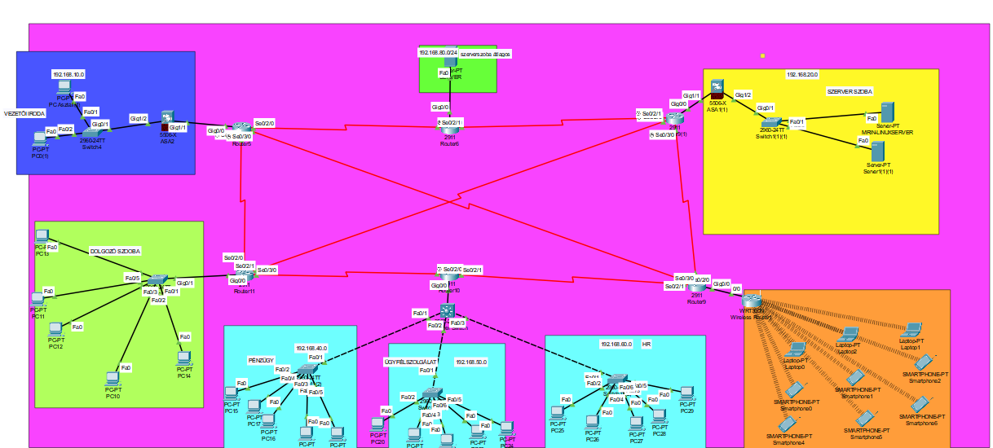
🔧 PACKET TRACER – NETWORK TOPOLOGY
🔴 CORE layer
7 db Cisco 2911 router
🟡 DISTRIBUTION layer
6 db Cisco 2960-24TT switch
🟢 ACCESS layer
33 end devices (PC, server, printer)
7 DEPARTMENTS:
Management • HR • Finance • Customer Service
Workspace • Warehouse • Server Room
Packet Tacer topology screenshot
Notes:
For the simulation we used Cisco Packet Tracer. We built a three-layer architecture. The Core layer consists of 7 Cisco 2911 routers. The Distribution layer has 6 Cisco 2960-24TT switches. The Access layer includes 33 end devices – PCs, servers, and printers – spread across the 7 departments: Management, HR, Finance, Customer Service, Workspace, Warehouse, and the Server Room.

Slide 5

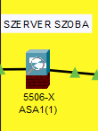
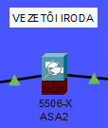
🛡️ SECURITY PROTOCOLS
FIREWALL – Cisco ASA 5506-X
What it does:
Filters inbound and outbound traffic, blocks malicious content
How:
Stateful inspection – tracks every connection
Config:
DMZ zone • NAT • Port forwarding
Notes:
Network security was a top priority. We deployed a Cisco ASA 5506-X firewall, which filters all inbound and outbound traffic and blocks malicious content. It uses stateful inspection, meaning it tracks every active connection. We also configured a DMZ zone, NAT, and port forwarding to ensure proper segmentation and controlled access.

Slide 6
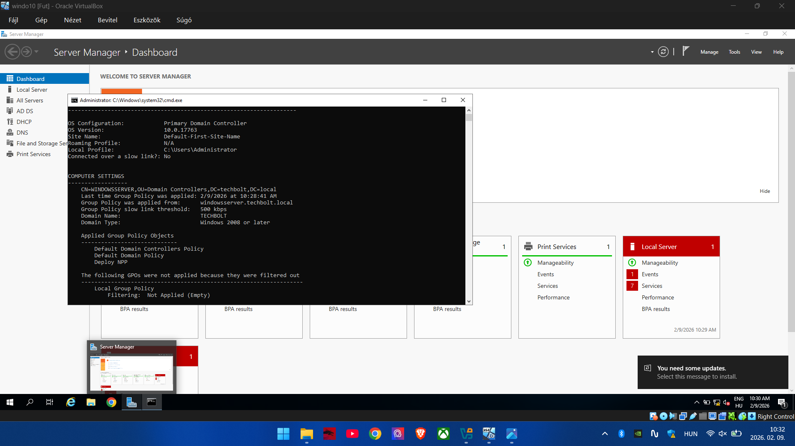
🏢 WINDOWS SERVER
📍 REQUIREMENTS
ACTIVE DIRECTORY
DHCP
DNS
FILE AND PRINTER SHARING
AUTOMATED SOFTWARE DEPLOYMENT
Notes:
For Windows Server, we implemented several key services. Active Directory handles user management and authentication. DHCP automatically assigns IP addresses to devices on the network. DNS resolves domain names. We also configured file and printer sharing, and set up automated software deployment to make maintenance easier

Slide 7
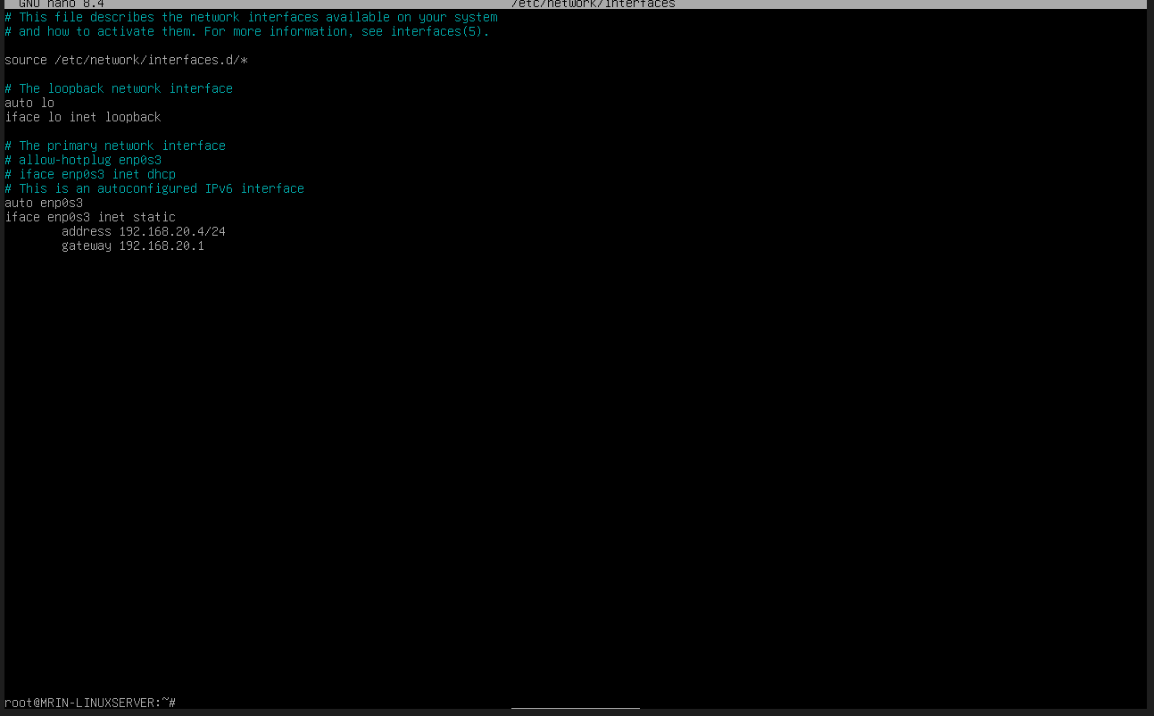
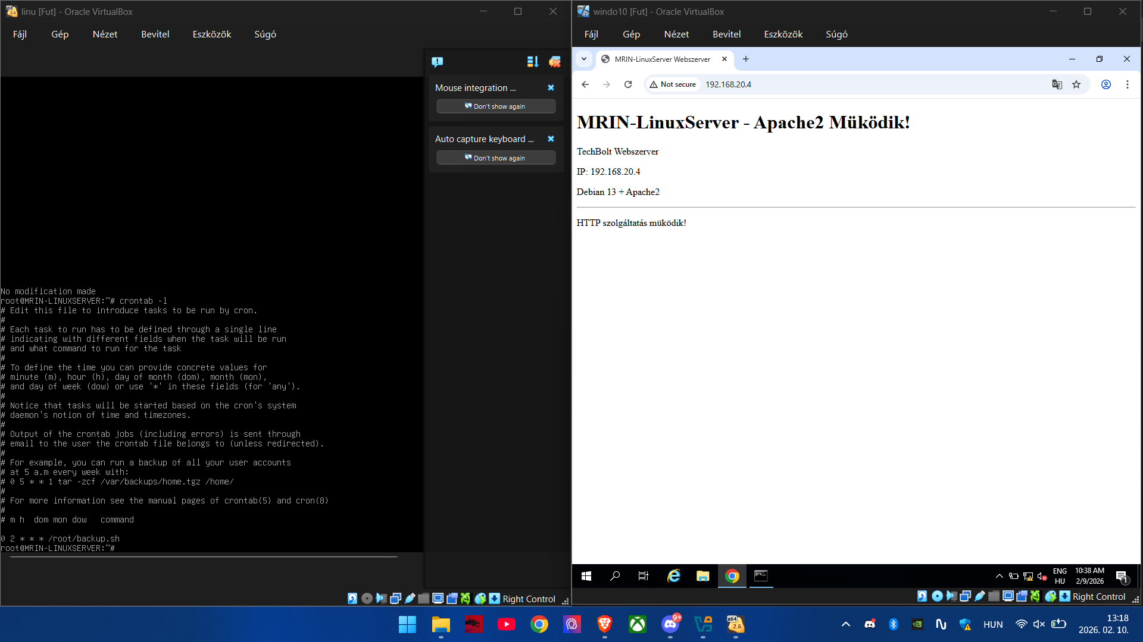
🏢 LINUX SERVER
📍 REQUIREMENTS
HTTP/HTTPS – APACHE2 WEB SERVER
AUTOMATED BACKUP
💡 Screenshot of the Apache2 server
Notes:
: Our Linux server runs an Apache2 web server, supporting both HTTP and HTTPS traffic. We also implemented an automated backup system to ensure data integrity. As you can see in the screenshot on the slide, the Apache2 server was successfully set up and running.

Slide 8
🌐 NETWORK PROTOCOLS
🔀 OSPF
🔲 VLAN
Open Shortest Path First
Virtual LAN
Dynamic routing – automatically finds the shortest path. If a link goes down, a new route is found instantly!
Network segmentation – 1 physical network split into multiple virtual ones. Security ↑ • Performance ↑
📡 DHCP
🔒 ACL
Dynamic Host Config Protocol
Access Control List
Automatic IP assignment – the server provides the IP, subnet mask, gateway, and DNS.
Access rules – defining who can reach what. E.g. HR only has access to payroll!
Notes:
We implemented four key network protocols. OSPF – Open Shortest Path First – handles dynamic routing and automatically finds the shortest path. If a link fails, it reroutes traffic instantly. VLANs split the physical network into logical segments, increasing both security and performance. DHCP automatically provides IP addresses, subnet masks, gateways, and DNS to all devices. Finally, ACLs – Access Control Lists – define who can access what. For example, the HR department can only reach the payroll server.

Slide 9
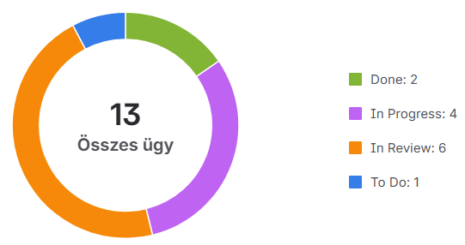
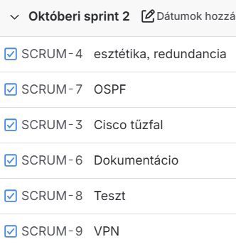
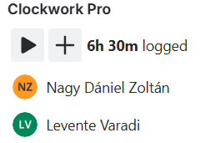
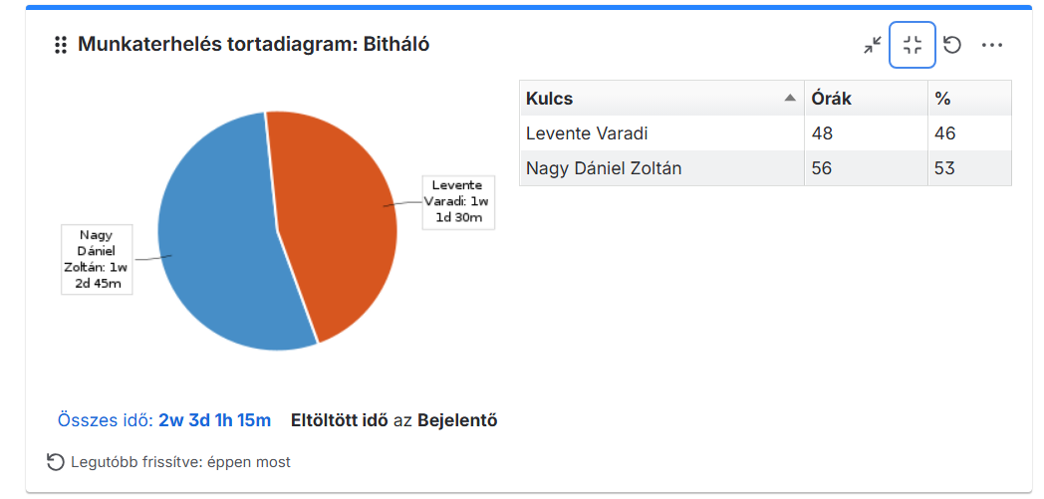
📋 JIRA – PROJECT MANAGEMENT
TIME LOGGING
WORKFLOW TRACKING
TASK ASSIGNMENT
Notes:
: For project management, we used Jira. It allowed us to track our workflow, log the time spent on tasks, and assign responsibilities clearly. You can see our sprint boards and task breakdowns in the screenshots

Slide 10
📊 PROJECT STATISTICS
⏱️ Time distribution
🖥️ Device distribution
40% Implementation
58%
16%
30% Planning
PC – 22 db
Switch – 6 db
20% Testing
18%
8%
10% Documentation
Router – 7 db
Server – 3 db
Notes:
Here's a quick overview of how we distributed our time and what devices make up the network. Implementation took the largest share at 40%, followed by planning at 30%, testing at 20%, and documentation at 10%. The network includes 22 PCs, 6 switches, 7 routers, and 3 servers.

Slide 11
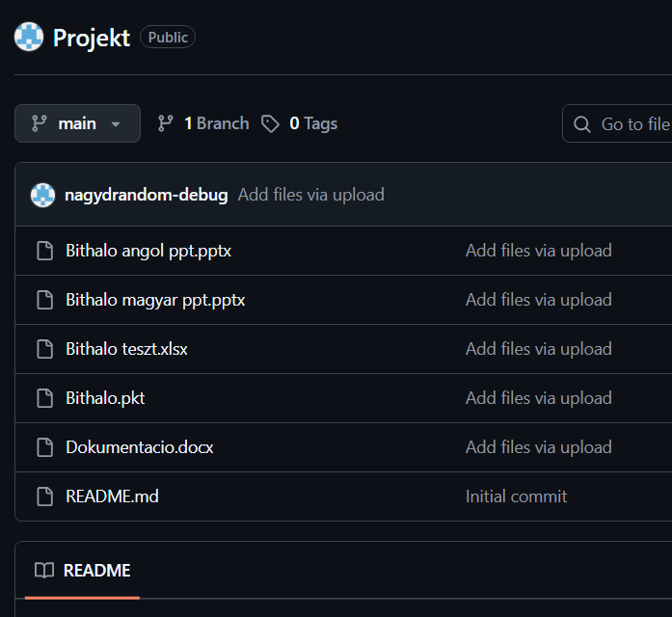
🐙 GIT & GITHUB – VERSION CONTROL
🌿 Branch strategy
Main + feature branches
💬 Commit convention
Semantic commit messages
🔁 Pull Request
Code review before every merge
📦 Stored contents:
.pkt files • Configurations • Documentation • Tests • Presentation
Notes:
For version control, we used Git and GitHub. We followed a branch strategy with a main branch and separate feature branches. All commit messages follow semantic conventions to keep the history readable. Every change went through a Pull Request with code review before merging. The repository stores Packet Tracer files, configurations, documentation, test cases, and the presentation

Slide 12
⚡ SCRUM METHODOLOGY
8
📋 Sprint Planning
Planning weekly tasks
Total sprints
💬 Daily Stand-up
1
Daily 15-minute sync on Discord
Monthly sprints
✅ Sprint Review
Presenting weekly results
15'
🔄 Retrospective
Daily meeting
What did we do well? What can we improve?
Notes:
We worked using the Scrum agile methodology. In total, we completed 8 sprints, each lasting one week. Every week started with Sprint Planning to define our tasks. Daily, we held 15-minute stand-up meetings on Discord to stay in sync. At the end of each sprint, we did a Sprint Review to present results, followed by a Retrospective to reflect on what went well and what could be improved.

Slide 13
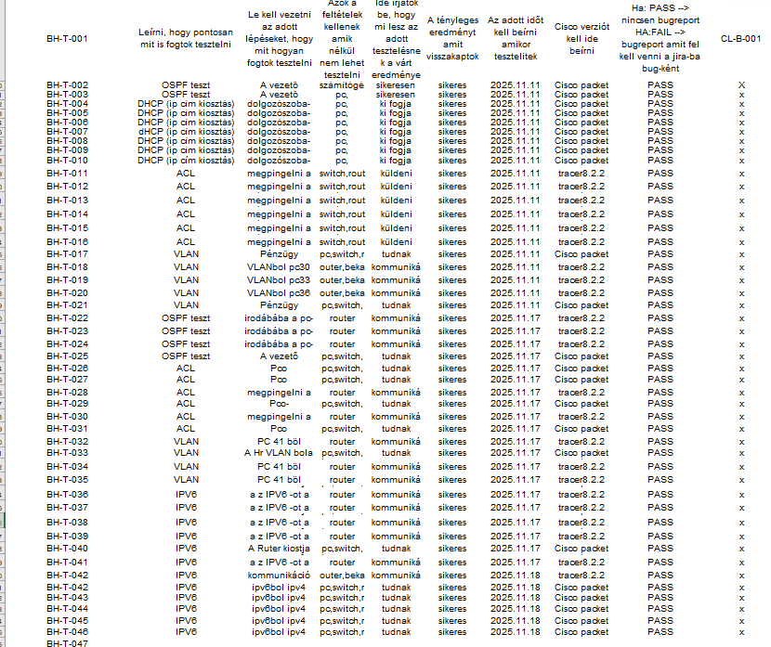
🧪 TESTING PROCESS
🔹 Unit test
100
Individual device functionality
🔸 Integration test
test cases
Inter-department communication
88% ✅
🔶 System test
Full network operation
🛡️ Security test
ACL rules, firewall, ipv6, vlan
Notes:
Our testing process consisted of four levels. Unit tests verified individual device functionality. Integration tests checked inter-department communication. System tests validated the full network operation. Finally, security tests covered ACL rules, the firewall, IPv6, and VLANs. In total we ran 100 test cases, achieving an 88% pass rate.

Slide 14
PROJECT SUMMARY
🌐 Modern network
⚡ Agile methodology
Cisco devices, 3-layer architecture
8 sprints, Scrum + Jira + GitHub
✅ 100% test coverage
📄 Documentation
100 test cases, full coverage
Detailed technical documentation
🙏 Thank you for your attention!
Váradi Levente & Nagy Dániel • Apáczai Csere János Vocational School • 2026
Notes:
To summarize: we built a modern network using Cisco devices on a three-layer architecture. We followed agile methodology across 8 sprints using Scrum, Jira, and GitHub. We achieved 100% test coverage with 54 test cases and produced detailed technical documentation. Thank you very much for your attention – we are happy to answer any questions.

