Slide 1
Ontology as a Tool for Knowledge Management
Wissensmanagement 1
Prepared by: Priscilla Nursentana
S0515957

Slide 2
Agenda
What is ontology?
Ontology and knowledge management
How does it work?
Tools
Conclusion

Slide 3

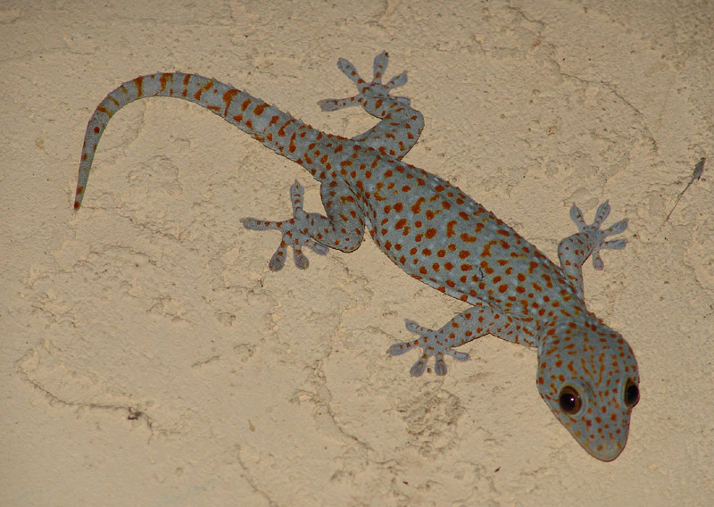


What is Ontology?

Slide 4
What is Ontology?
The study of being or existence
It seeks to describe or posit the basic categories and relationships of being or existence to define entities and types of entities within its framework
Basic questions: what‘s there?

Slide 5
What is Ontology?
What is ontology in computer science?
What does it have to do with knowledge management?

Slide 6

What is Ontology?
What is a concept?
A concept is an abstract idea or a mental symbol, typically associated with a corresponding representation, that denotes all of the objects in a given category or class of entities, interactions, phenomena, or relationships between them.
Affe
Monkey
обезьяна
Monyet

Slide 7
What is Ontology?
„An ontology is a formal, explicit specification of a shared conceptualization“ (Gruber, 1993 as cited by Fensel 2004)
An ontology provides a vocabulary of terms and relations with which to model the domain
People who agree to accept an ontology are said to commit themselves to that ontology

Slide 8
What is Ontology?
Elements of ontology
Animal
Produce milk
flurry
Is-subclass-of
Mammals
Reptiles
others
Monkey
Horse
Gecko
4-legged
herbivore
Found in warm climates
Makes chirping sound

Slide 9
What is Ontology?
Elements of ontology
  Instances
  Classes
  Attributes
  Relations

Slide 10
What is Ontology?
Types of ontology:
  Domain ontologies capture the knowledge valid for a particular type of domain (e.g. electronic, medical, mechanic)
  Meta data ontologies provide a vocabulary for describing the content of online information sources
  Generic or common-sense ontologies aim at capturing general knowledge about the world
  Representational ontologies provide representational entities without stating what should be represented

Slide 11
Ontology and Knowledge Management
Knowledge access problems:
  Searching information
  Extracting information
  Maintaining weakly structured information
  Automatic document generation
  Sharing knowledge (lack of motivation)
  Navigating

Slide 12
Ontology and Knowledge Management
What contribution does ontology make to knowledge management?
  it helps to integrate informal, semiformal and formal knowledge in order to facilitate access to knowledge, its sharing and reuse
  it provides a formal conceptualization of a particular domain shared by a group of people in an organization

Slide 13
Ontology and Knowledge Management
In which area can ontology be used?
  Semantic web searching
  Dictionary
  Data mining
  …

Slide 14
How does it work?
Go/No Go?
Sufficient
requirements?
Fulfilled
requirements?
To
operate?
Common KADS
Worksheets
Semi formal
definition
of the ontology
Ontology
Evaluated
ontology
KM- Application
Feasibility
studies
Ontology
kickoff
Refinement
Evaluation
Maintenance
and
evolution
Identify:
1. Problems and
Opportunities
2. Focus on KM-
Applications
3. Tools
4. Involved Persons
5. Requirement
Specification
6. Analyse
knowledge
resources
7. Develop semi-
formal description
of the ontology
8. Verification and
refinement of the
semiformal
description of the
ontology
9. Formalisation of
the ontology
10. Analyse typical
Queries
(unnecessary or
missing
concepts,
relations, axioms)
11. Continual process
of maintenance
and evolution
Ontology development

Slide 15
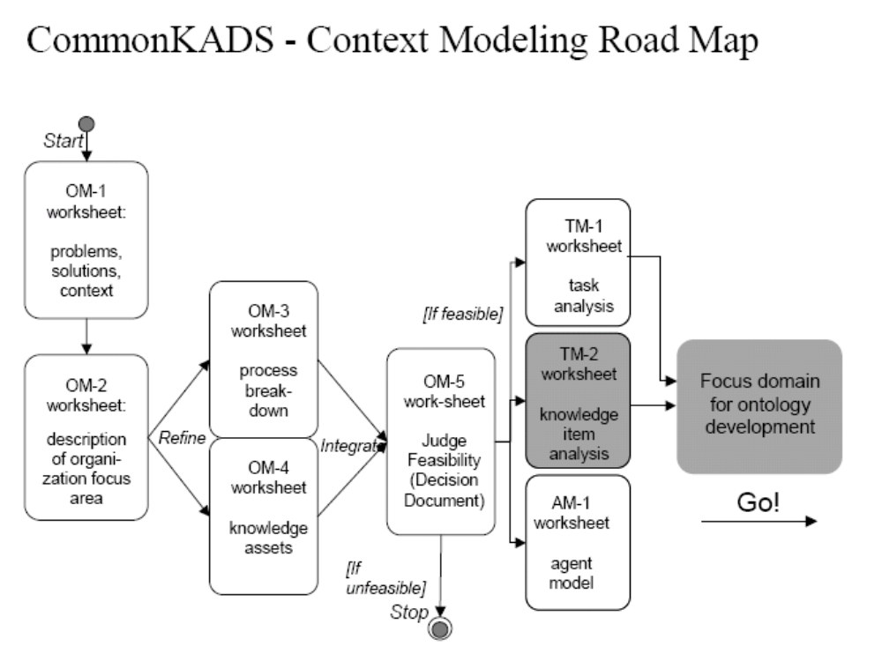
How does it work?

Slide 16
How does it work?
Kickoff phase: here begins the actual development of the ontology
ORSD: Ontology Requirement Specification Document
Main activities:
  Characterises the planned area of the application
  Defines the scope to be constructed
Result: a semiformal description of the ontology

Slide 17
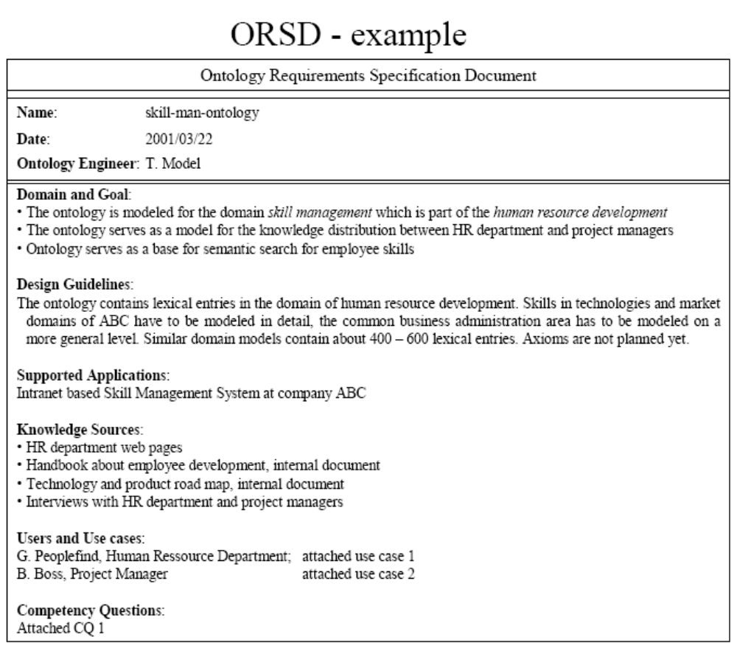
How does it work?
The objective of the planned application
Description of items, estimation of size
Specification of system environment
Where the information comes from
User scenario and identification of actors

Slide 18
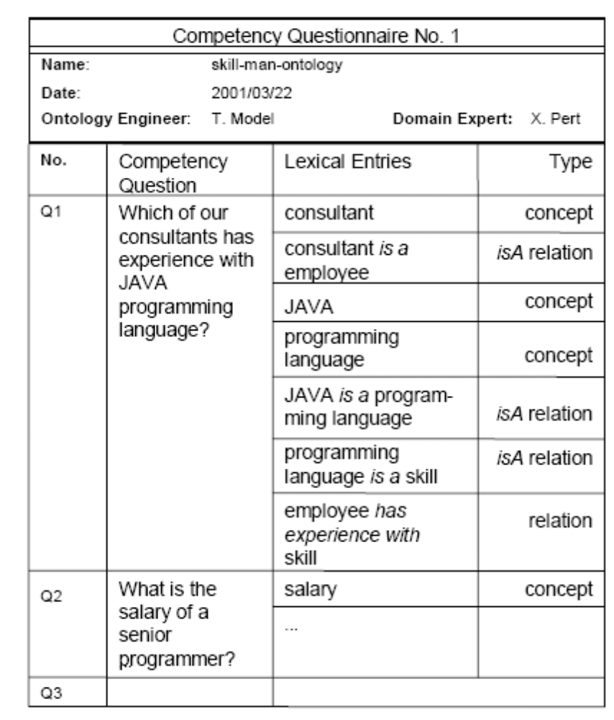
How does it work?

Slide 19
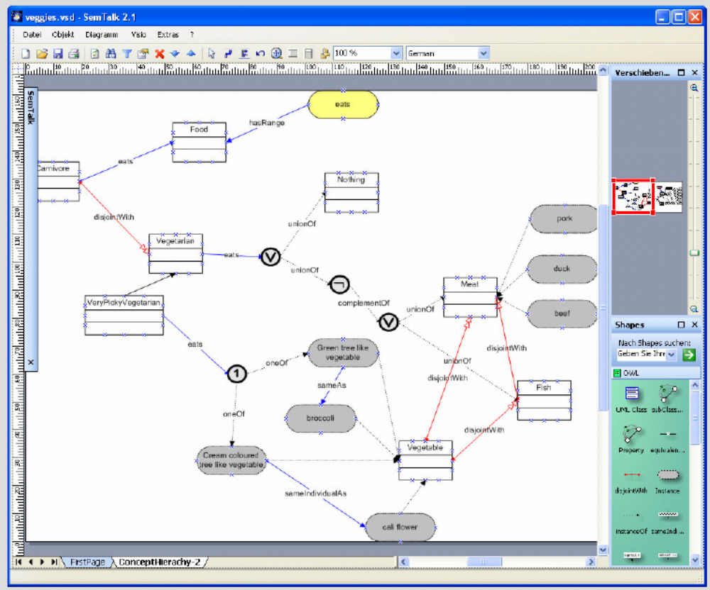
How does it work?
Visualization

Slide 20
How does it work?
Refinement phase: constructing a mature application-oriented methodology (formalise knowledge)
Main activities:
  Verify the correctness and completeness of the semiformal description of the ontology
  Formalise ontology (choosing the representative language)
  Verify fulfillment of the requirement
Result: the target ontology

Slide 21
How does it work?
Evaluation phase:
  Technology-focused evaluation
  User-focused evaluation
  Ontology-focused evaluation
Result: evaluated ontology
Feeds back to refinement phase

Slide 22
How does it work?
Maintenance and evolution phase: primarily organizational process
Important:
  Who is responsible for the ontology
  How it is performed
  At which time intervals is the ontology maintained

Slide 23
How does it work?
Programming language:
XML
RDF
Cycl
OWL
Elements
Attributes
References
Comments
etc
Constant
Predicates
Variables
Formulas
etc
OIL
DAML
Core classes:
Resource
Property
Class
Description logics
Frame-based logics
Subject
Predicate
Object

Slide 24
Tools
Semtalk
OntoStudio
OntoBroker

Slide 25
Conclusion
An ontology is a formal, explicit specification of a shared conceptualization
Ontology it helps to integrate informal, semiformal and formal knowledge in order to facilitate access to knowledge, its sharing and reuse
The phases of ontologies are: feasibility studies, kickoff, refinement, evaluation and maintenance and evolution
Some examples of tools: Semtalk, OntoEdit, OntoBroker

Slide 26
Thank you for your attention!
Have a nice day!

Slide 27
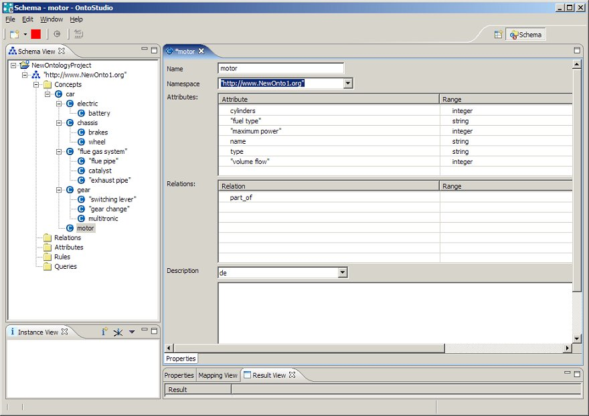
Tools

Slide 28
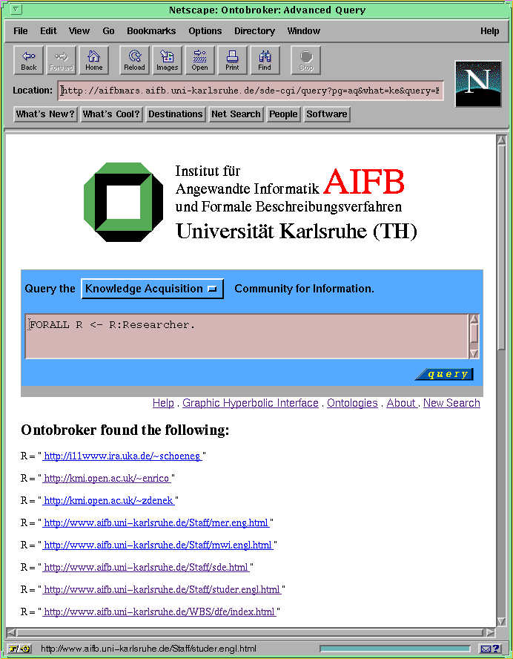
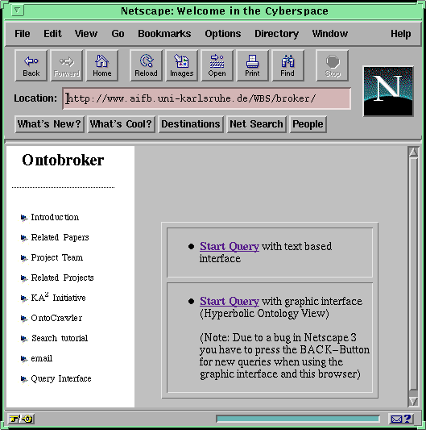
Tools

