Slide 1
Activity#1: Registration/Login

Slide 2
Activities
SplashActivity
LoginActivity
RegistrationActivity (WebView)

Slide 3
SplashActivity
Create the activity
Create the layout
Declare in manifest
Load the layout in the activity
Implement additional logic

Slide 4
Create the activity
Create the layout
Declare in manifest
Load the layout in the activity
Implement additional logic

Slide 5
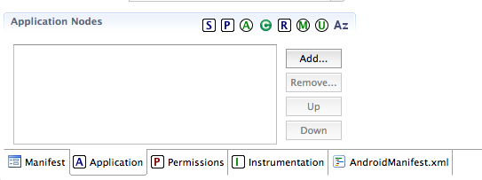
Open AndroidManifest.xml

Slide 6
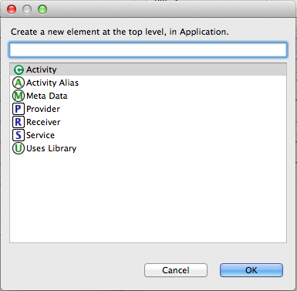

Slide 7
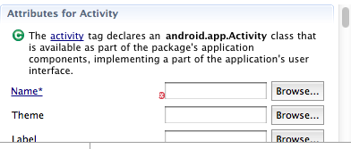

Slide 8
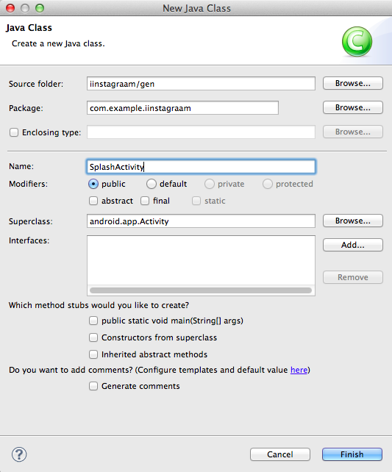

Slide 9
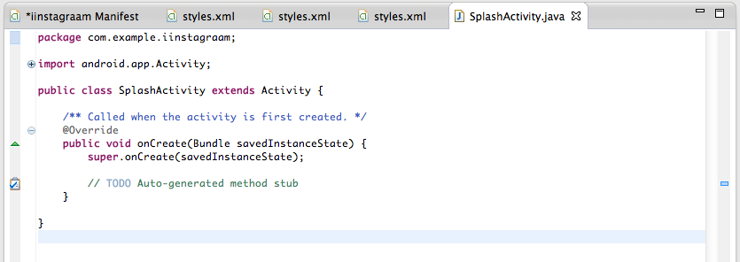

Slide 10
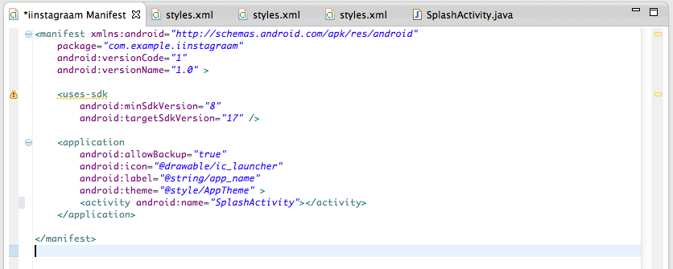

Slide 11
Create the activity
Create the layout
Declare in manifest
Load the layout in the activity
Implement additional logic

Slide 12
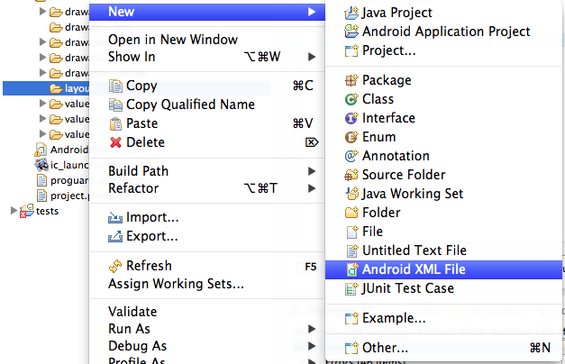

Slide 13
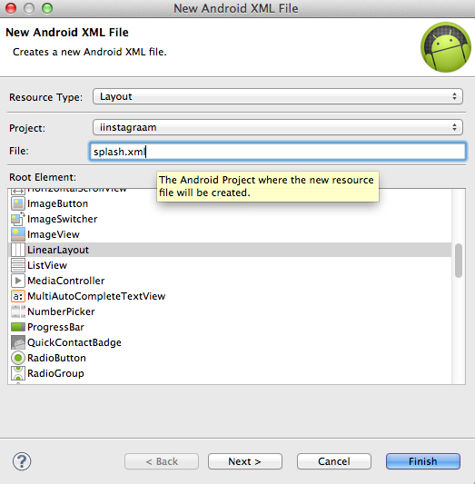

Slide 14
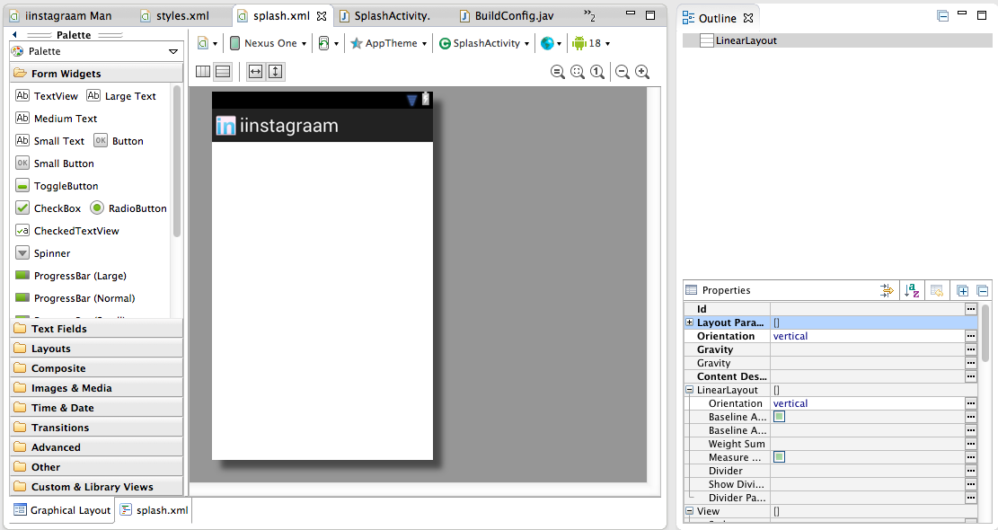

Slide 15
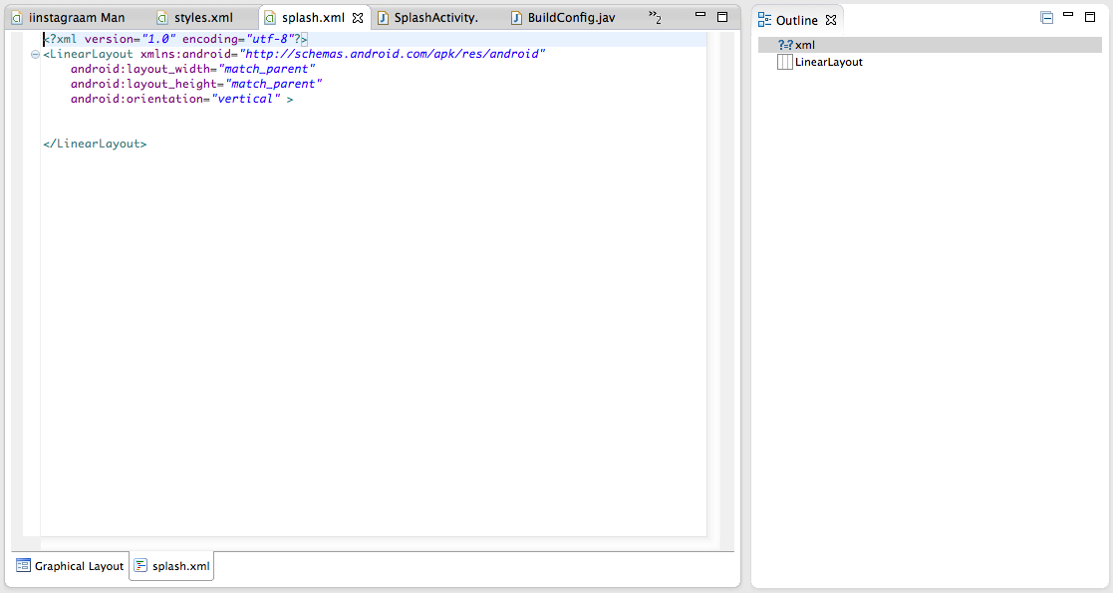

Slide 16
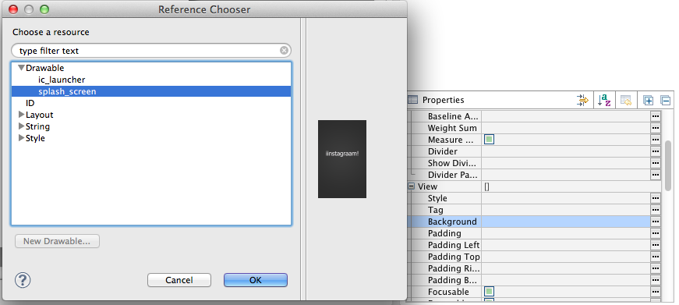

Slide 17
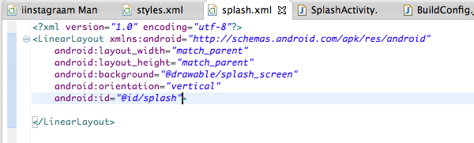

Slide 18
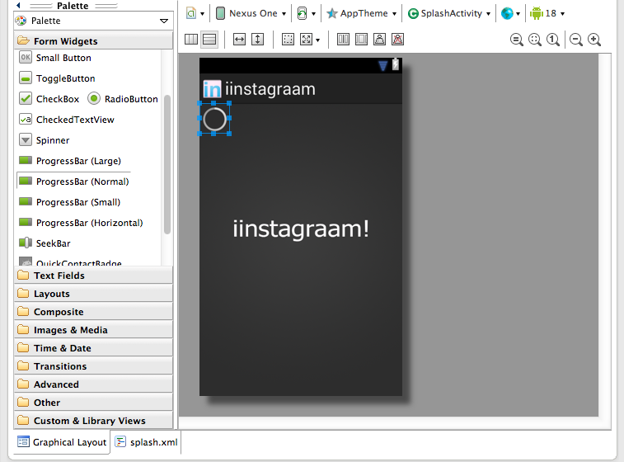

Slide 19
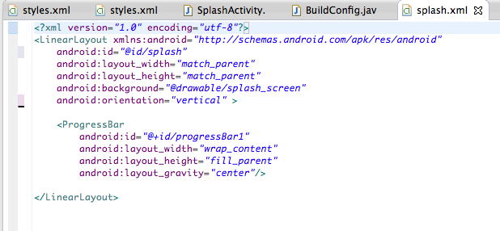

Slide 20
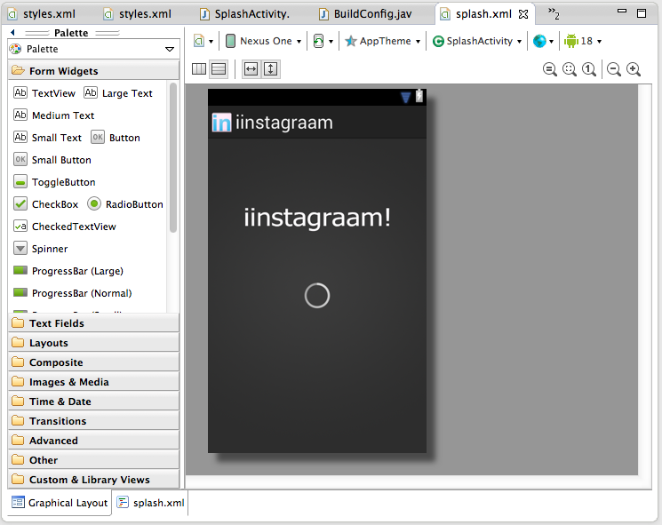

Slide 21
Create the activity
Create the layout
Declare in manifest
Load the layout in the activity
Implement additional logic

Slide 22
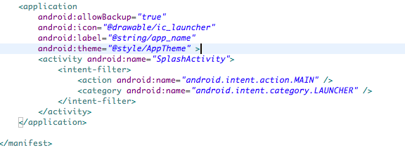
Notes:
See discussion on intent-filter

Slide 23
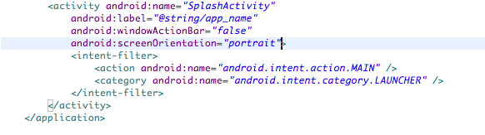

Slide 24
Create the activity
Create the layout
Declare in manifest
Load the layout in the activity
Implement additional logic

Slide 25
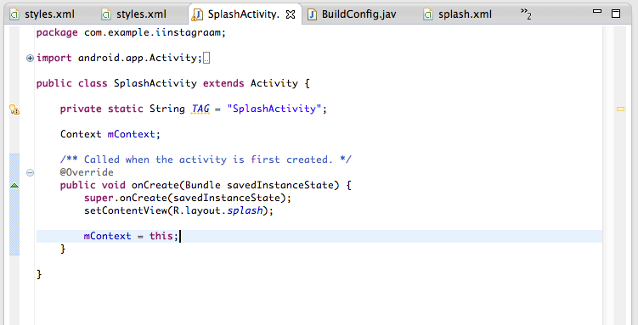

Slide 26
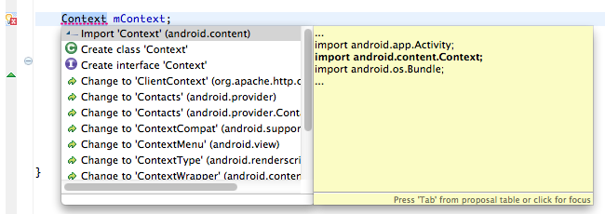

Slide 27
Create the activity
Create the layout
Declare in manifest
Load the layout in the activity
Implement additional logic

Slide 28
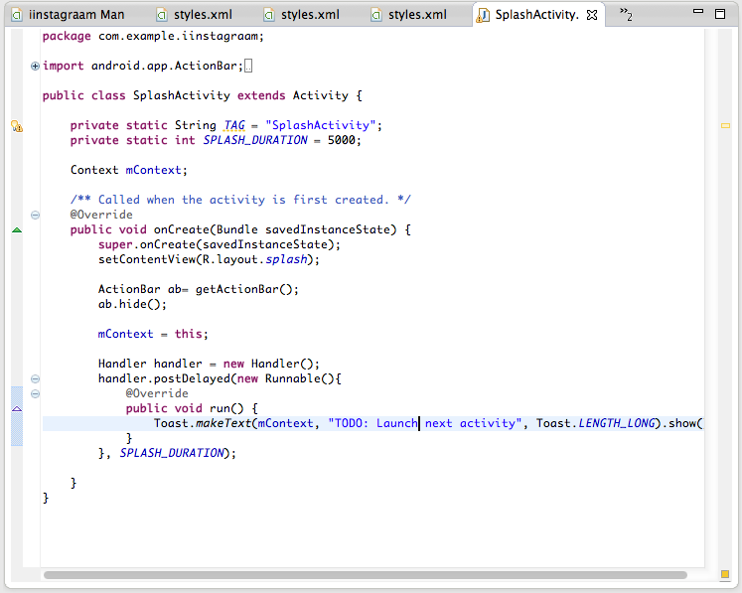
Notes:
http://developer.android.com/reference/android/os/Handler.html

Slide 29
LoginActivity (pt.1)
Create the layout
Create the activity
Start from SplashActivity

Slide 30
Create the layout
Create the activity
Start from SplashActivity

Slide 31
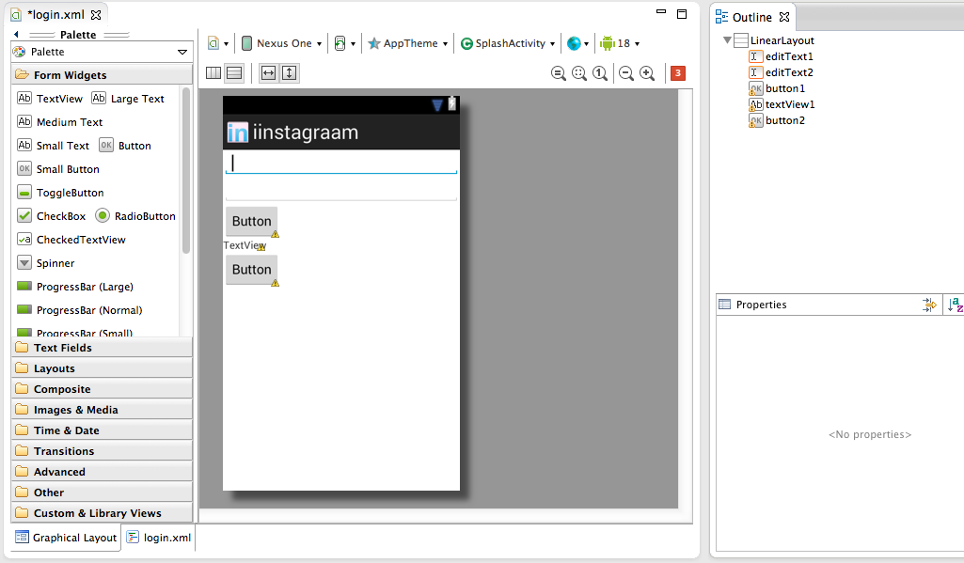

Slide 32
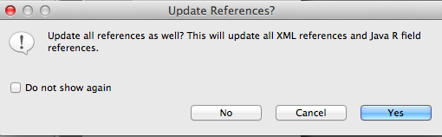

Slide 33
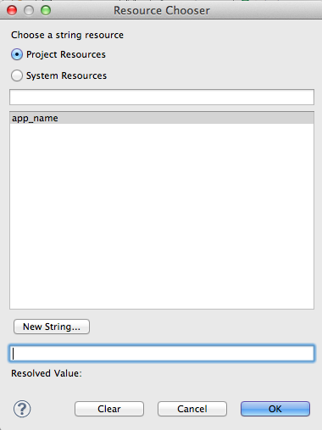

Slide 34
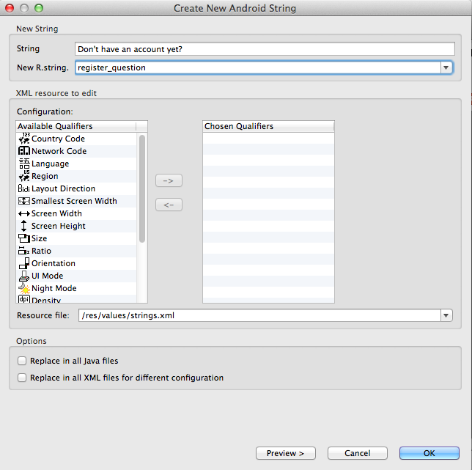

Slide 35
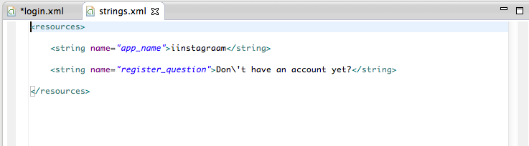


Slide 36
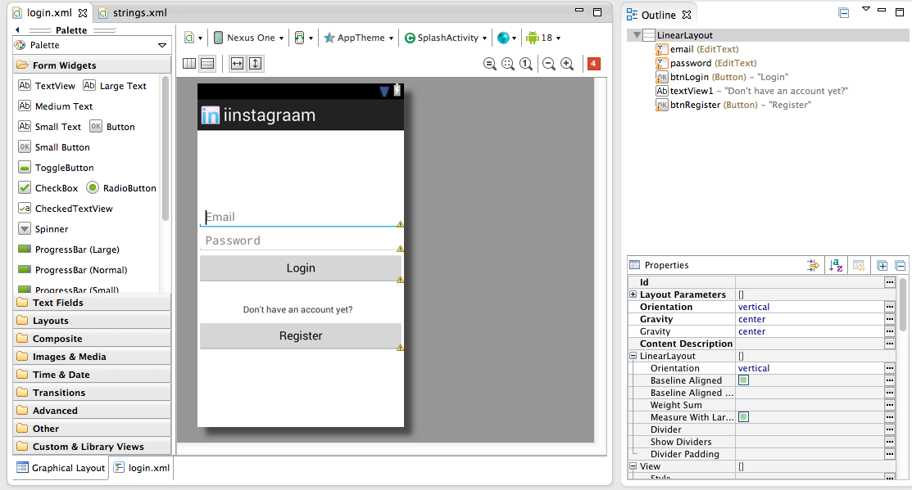

Slide 37
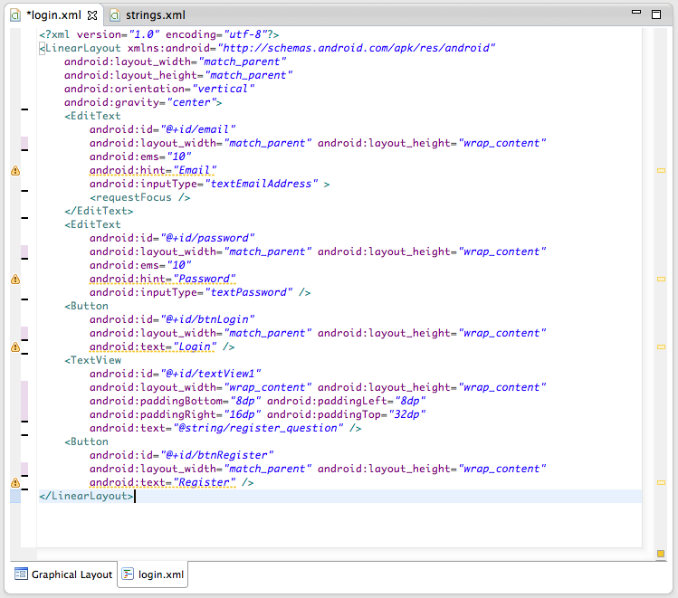

Slide 38
Remember
email (EditTxt)
password (EditTxt)
btnLogin (Button)
btnRegister (Button)

Slide 39
Create the layout
Create the activity
Start from SplashActivity

Slide 40
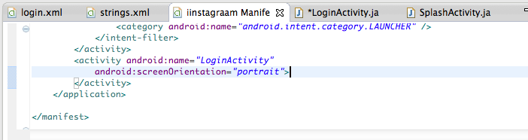
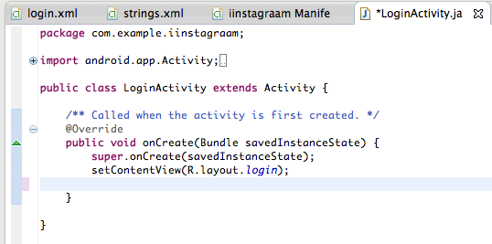

Slide 41
Create the layout
Create the activity
Start from SplashActivity

Slide 42
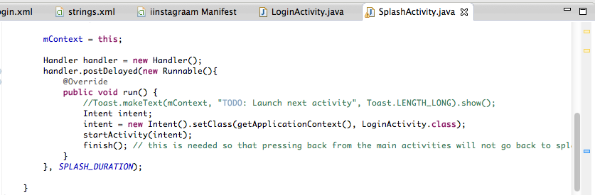

Slide 43
RegisterActivity
Create the layout (webView)
Create the activity + go to registration URL
Start from LoginActivity
Auto-close the WebView
Notes:
http://www.mkyong.com/android/android-webview-example/

Slide 44
Create the layout (webView)
Create the activity + go to registration URL
Start from LoginActivity
Auto-close the WebView
Notes:
http://www.mkyong.com/android/android-webview-example/

Slide 45
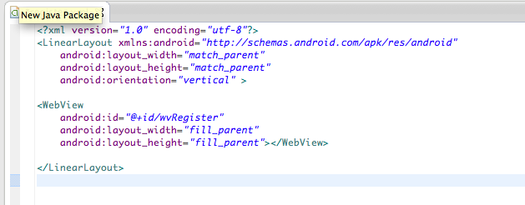
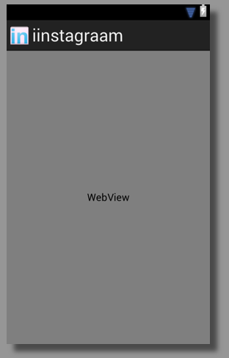

Slide 46
Create the layout (webView)
Create the activity + go to registration URL
Start from LoginActivity
Auto-close the WebView
Notes:
http://www.mkyong.com/android/android-webview-example/

Slide 47
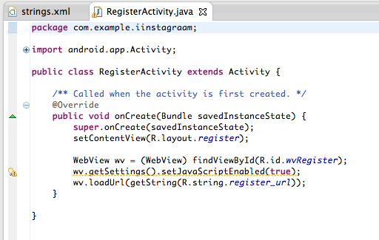

Slide 48
Create the layout (webView)
Create the activity + go to registration URL
Start from LoginActivity
Auto-close the WebView
Notes:
http://www.mkyong.com/android/android-webview-example/

Slide 49
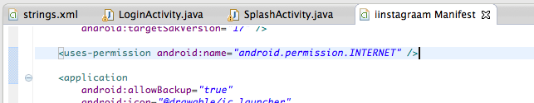
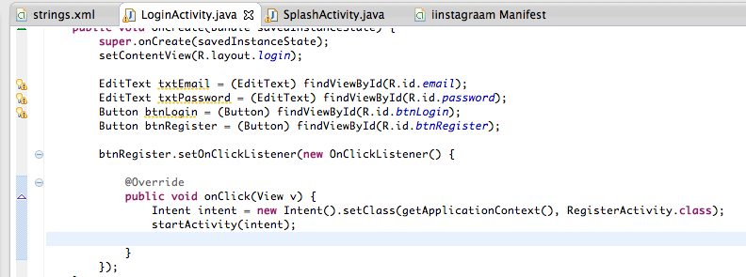

Slide 50
Create the layout (webView)
Create the activity + go to registration URL
Start from LoginActivity
Auto-close the WebView
Notes:
http://www.mkyong.com/android/android-webview-example/

Slide 51
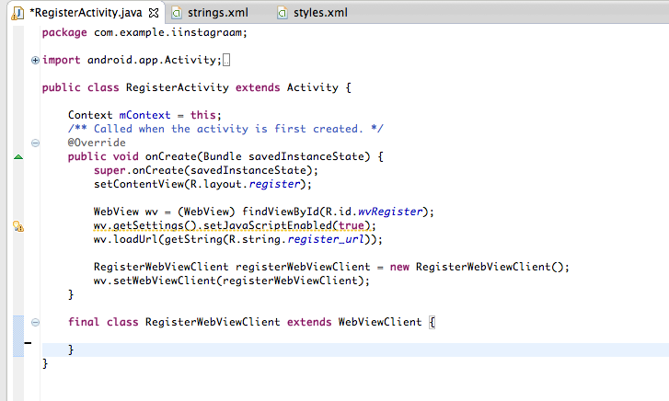
Notes:
http://developer.android.com/reference/android/webkit/WebViewClient.html#shouldOverrideUrlLoading%28android.webkit.WebView,%20java.lang.String%29

Slide 52
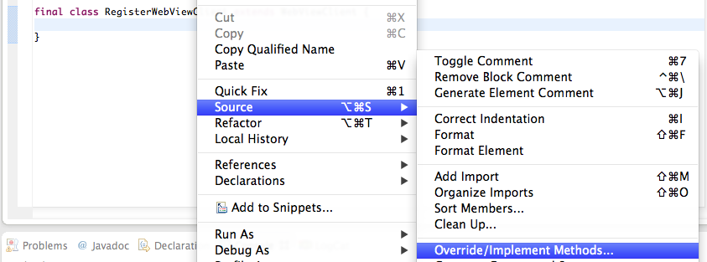

Slide 53
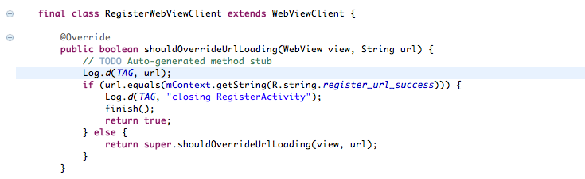

Slide 54
LoginActivity (pt.2)
Plan
Create the MainActivity (placeholder)
Notify the user of successful registration
Prepare API call to Login
Prepare AsyncTask to do Login
Create alert when login failed
Store the token to a SharedPreference and open MainActivity on success

Slide 55
LoginActivity (pt.2)
Plan
Create the MainActivity (placeholder)
Notify the user of successful registration
Prepare Objects, APIUtil, ParserUtil
AsyncLogin
Create alert when login failed
Store the token to a SharedPreference and open MainActivity on success

Slide 56
Plan
Create the MainActivity (placeholder)
Notify the user of successful registration
Prepare Objects, APIUtil, ParserUtil
AsyncLogin
Create alert when login failed
Store the token to a SharedPreference and open MainActivity on success

Slide 57
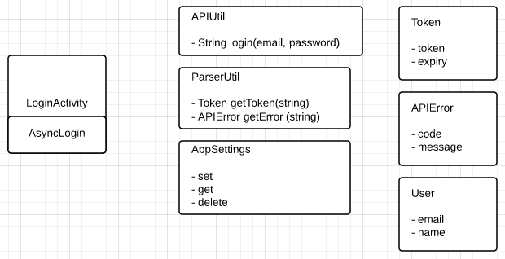

Slide 58
Plan
Create the MainActivity (placeholder)
Notify the user of successful registration
Prepare Objects, APIUtil, ParserUtil
AsyncLogin
Create alert when login failed
Store the token to a SharedPreference and open MainActivity on success

Slide 59
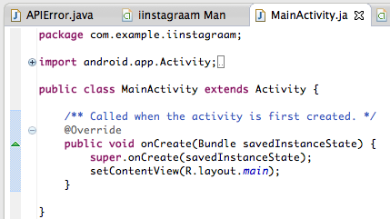

Slide 60
Plan
Create the MainActivity (placeholder)
Notify the user of successful registration
Prepare Objects, APIUtil, ParserUtil
AsyncLogin
Create alert when login failed
Store the token to a SharedPreference and open MainActivity on success

Slide 61
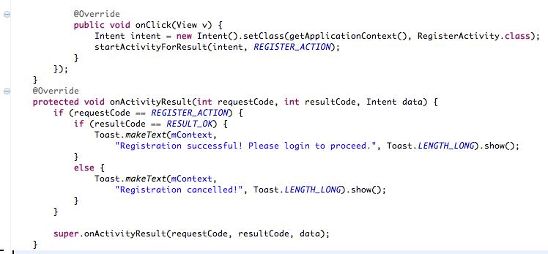
Notes:
StartingActivity expecting a result
- http://developer.android.com/reference/android/app/Activity.html
- http://stackoverflow.com/questions/10407159/android-how-to-manage-start-activity-for-result

Slide 62
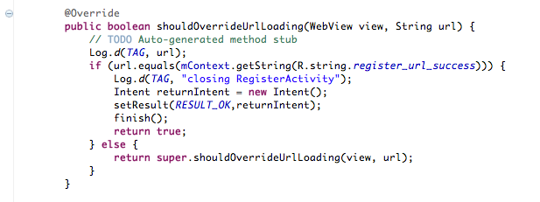
Notes:
In RegisterActivity

Slide 63
Plan
Create the MainActivity (placeholder)
Notify the user of successful registration
Prepare Objects, APIUtil, ParserUtil
AsyncLogin
Create alert when login failed
Store the token to a SharedPreference and open MainActivity on success
Notes:
http://developer.android.com/reference/java/net/HttpURLConnection.html
http://developer.android.com/reference/org/json/JSONObject.html
http://developer.android.com/reference/java/net/HttpURLConnection.html

Slide 64
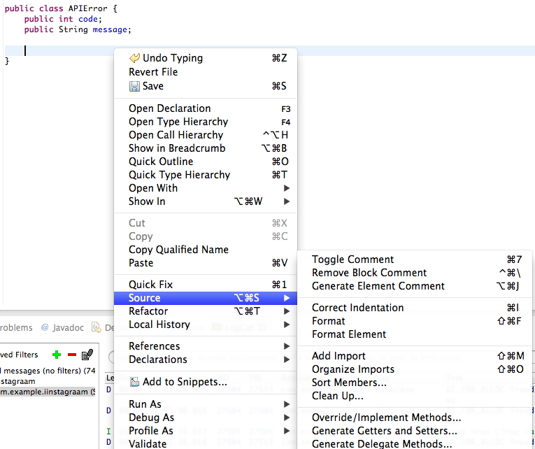

Slide 65
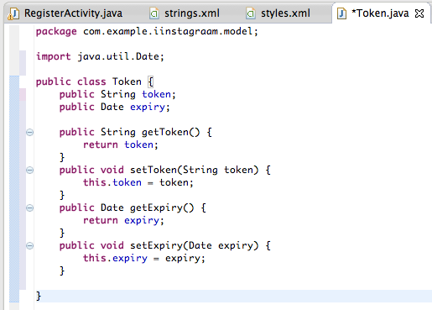

Slide 66
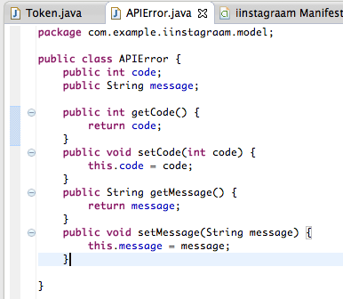

Slide 67
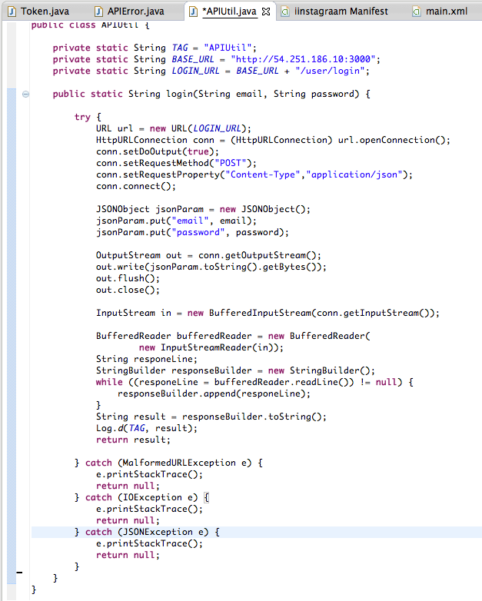

Slide 68
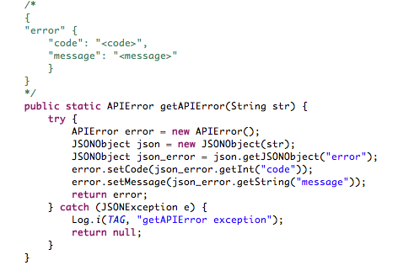

Slide 69
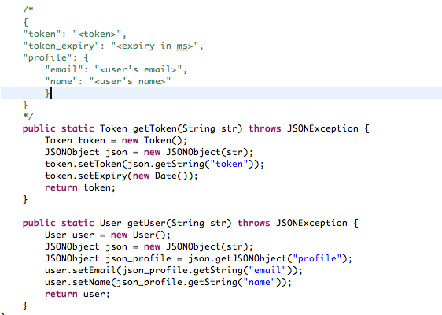

Slide 70
Plan
Create the MainActivity (placeholder)
Notify the user of successful registration
Prepare Objects, APIUtil, ParserUtil
AsyncLogin
Create alert when login failed
Store the token to a SharedPreference and open MainActivity on success
Notes:
http://developer.android.com/guide/components/processes-and-threads.html → AsyncTask
* Need to explain the underlying concept of AsyncTask

Slide 71
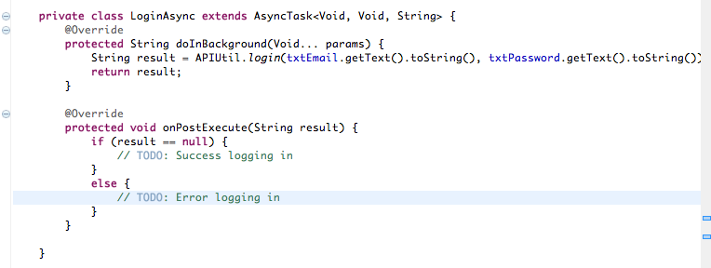

Slide 72
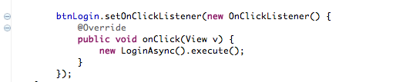

Slide 73

Notes:
You can check from the logs if what you did is correct.

Slide 74
Plan
Create the MainActivity (placeholder)
Notify the user of successful registration
Prepare Objects, APIUtil, ParserUtil
AsyncLogin
Create alert when login failed
Store the token to a SharedPreference and open MainActivity on success
Notes:
http://developer.android.com/guide/components/processes-and-threads.html → AsyncTask
* Need to explain the underlying concept of AsyncTask

Slide 75

Notes:
http://developer.android.com/reference/android/app/AlertDialog.html

Slide 76
Plan
Create the MainActivity (placeholder)
Notify the user of successful registration
Prepare Objects, APIUtil, ParserUtil
AsyncLogin
Create alert when login failed
Store the token to a SharedPreference and open MainActivity on success
Notes:
http://developer.android.com/guide/components/processes-and-threads.html → AsyncTask
* Need to explain the underlying concept of AsyncTask

Slide 77


Slide 78


Slide 79



Slide 80
Recap
Basic UI
Toast
AlertDialog
EditText
Button
ProgressBar
startActivity and startActivityForResult
WebView
JSON parsing
HTTPURLConnection
AsyncTask
SharedPreferences

