Slide 1
Activity#2: Photo Stream

Slide 2
Activities
PhotoStreamActivity

Slide 3
PhotoStreamActivity
Plan
Implement the layouts
ListView item
Activity layout
Implement the Photo Object, APIUtil, Parser and ImageUtil
Implement the activity and adapter

Slide 4
Plan
Implement the layouts
ListView item
Activity layout
Implement the Photo Object, APIUtil, Parser and ImageUtil
Implement the activity and adapter
Notes:
http://learnandroideasily.blogspot.in/2013/05/populating-listview-with-arraylist.html

Slide 5
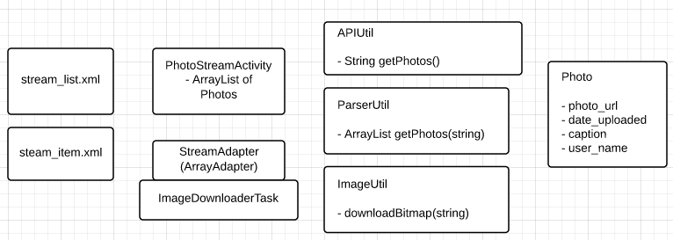

Slide 6
Plan
Implement the layouts
ListView item
Activity layout
Implement the Photo Object, APIUtil, Parser and ImageUtil
Implement the activity and adapter
Notes:
http://learnandroideasily.blogspot.in/2013/05/populating-listview-with-arraylist.html

Slide 7
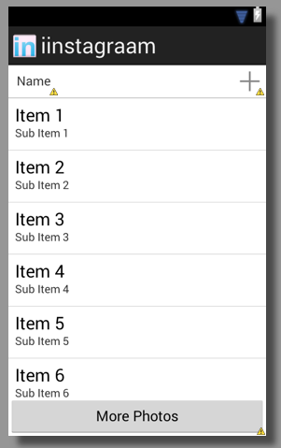

Slide 8
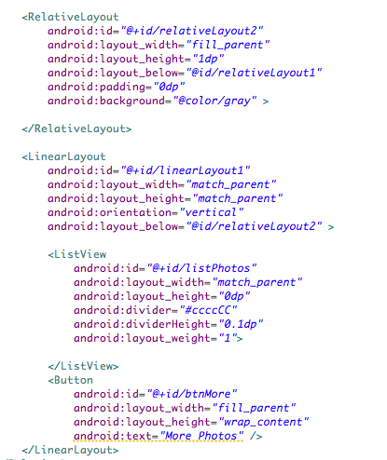
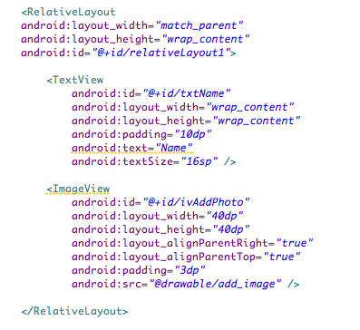
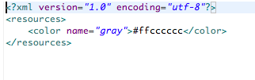

Slide 9
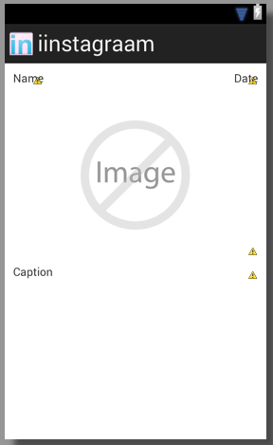

Slide 10
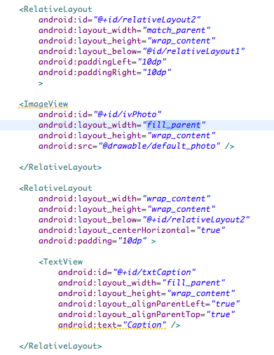
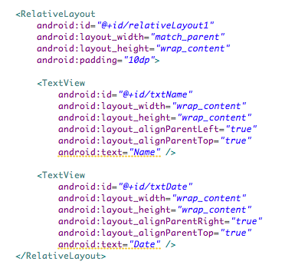

Slide 11
Plan
Implement the layouts
ListView item
Activity layout
Implement the Photo Object, APIUtil, Parser and ImageUtil
Implement the activity and adapter
Notes:
http://learnandroideasily.blogspot.in/2013/05/populating-listview-with-arraylist.html

Slide 12
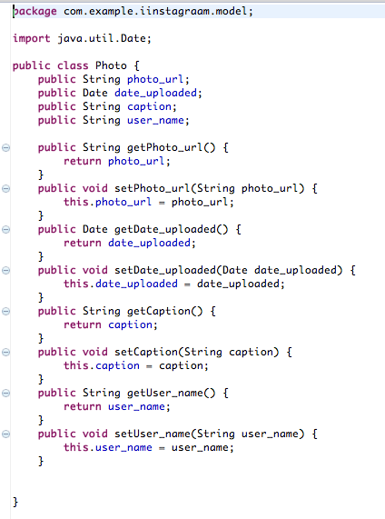

Slide 13
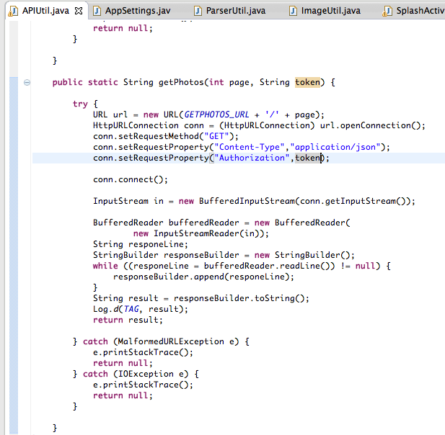

Slide 14
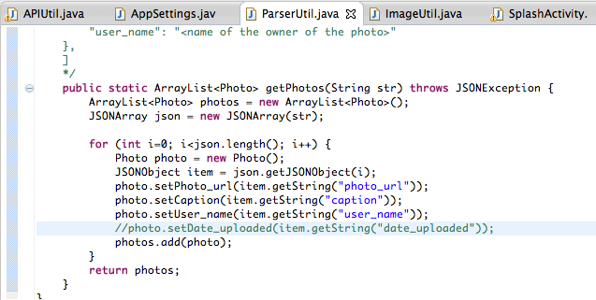

Slide 15
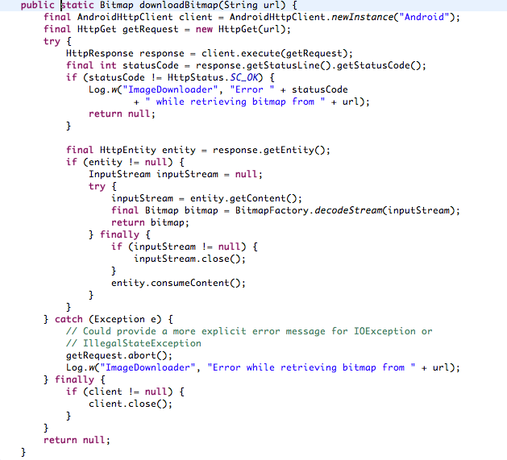

Slide 16
Plan
Implement the layouts
ListView item
Activity layout
Implement the Photo Object, APIUtil and Parser
Implement the activity and adapter
Notes:
http://learnandroideasily.blogspot.in/2013/05/populating-listview-with-arraylist.html
http://www.ezzylearning.com/tutorial.aspx?tid=1763429
- LayoutInflater
ImageDownloading while at the same time filling in the webView: http://javatechig.com/android/asynchronous-image-loader-in-android-listview/#2-creating-a-custom-listview-with-thumbnails

Slide 17
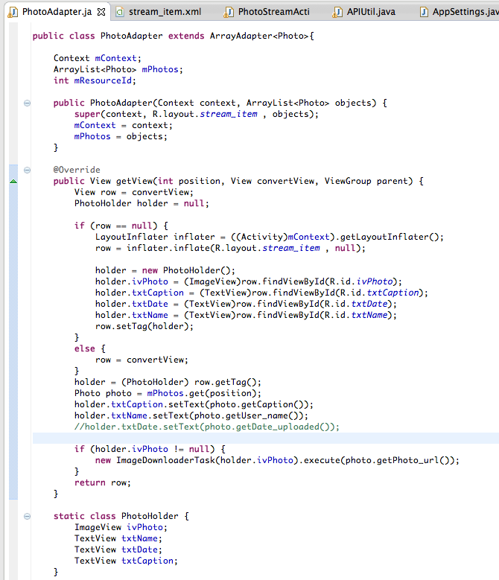

Slide 18
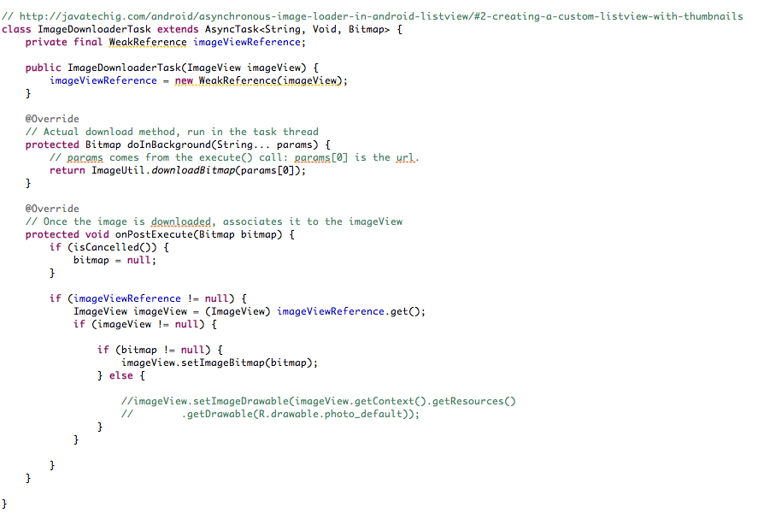

Slide 19
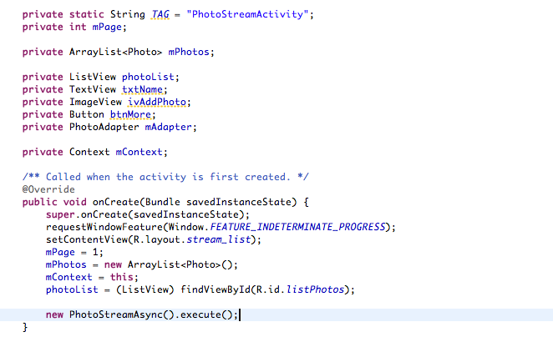

Slide 20
