Slide 1
Activity#3: Uploading Photos + More Photos

Slide 2
Plan
Camera API
Getting the results from the Camera API
Converting to Base64
Uploading the results via APIUtil
Refreshing the PhotoStream (“More Photos”)

Slide 3
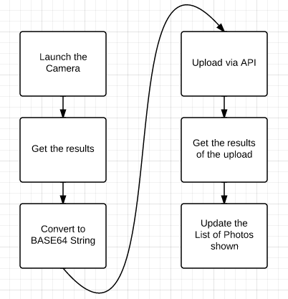
Notes:
http://developer.android.com/guide/topics/media/camera.html
→ What are the important considerations?

Slide 4
Plan
Camera API
Getting the results from the Camera API
Converting to Base64
Uploading the results via APIUtil
Refreshing the PhotoStream (“More Photos”)

Slide 5


Slide 6
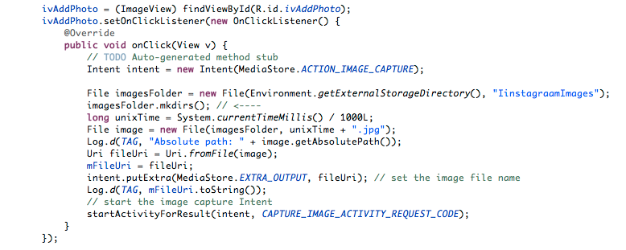

Slide 7
Plan
Camera API
Getting the results from the Camera API
Converting to Base64
Uploading the results via APIUtil
Refreshing the PhotoStream (“More Photos”)

Slide 8
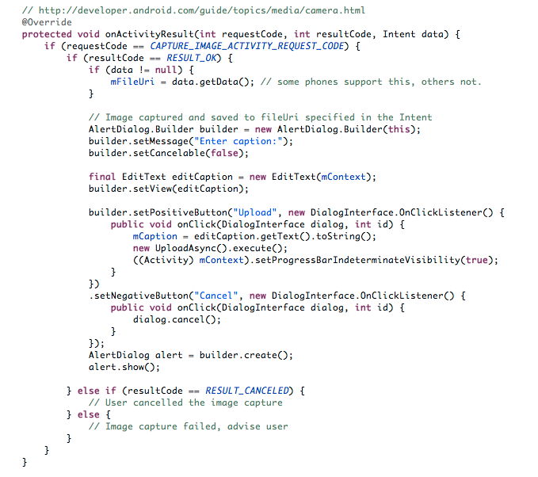

Slide 9
Plan
Camera API
Getting the results from the Camera API
Converting to Base64
Uploading the results via APIUtil
Refreshing the PhotoStream (“More Photos”)

Slide 10
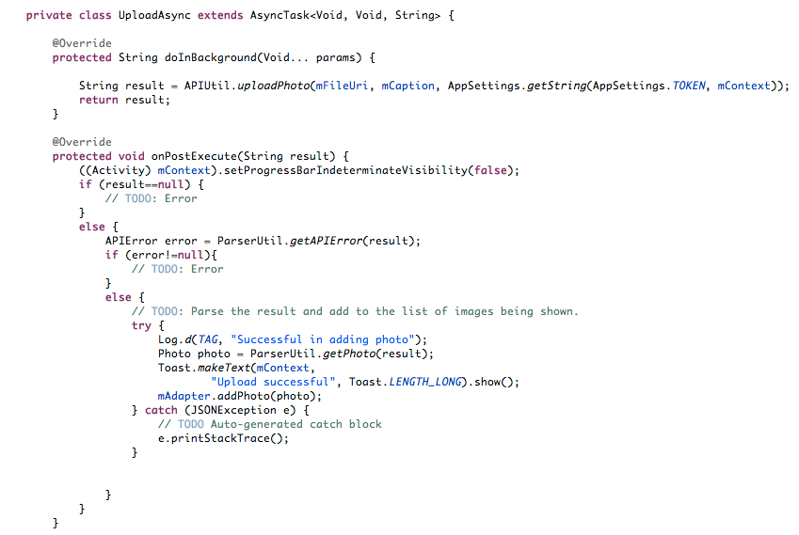

Slide 11
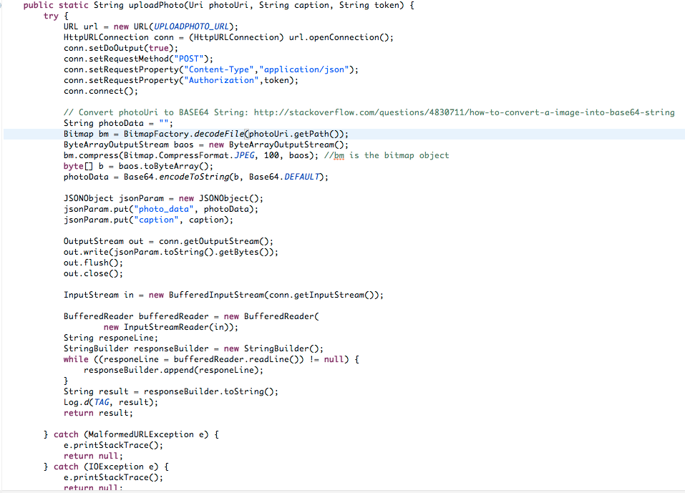

Slide 12
Plan
Camera API
Getting the results from the Camera API
Converting to Base64
Uploading the results via APIUtil
Refreshing the PhotoStream (“More Photos”)

Slide 13


Slide 14
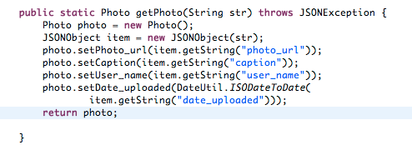

Slide 15
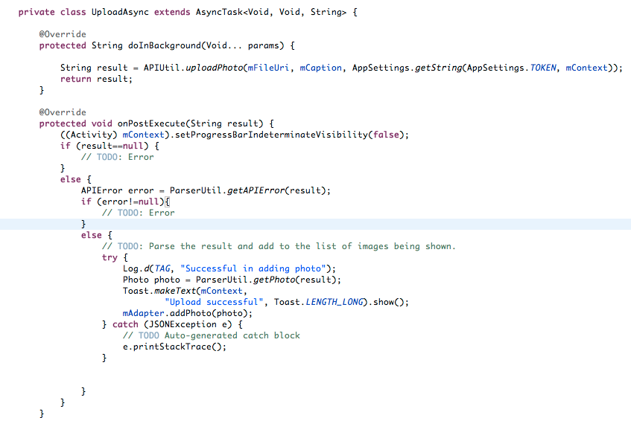

Slide 16


Slide 17
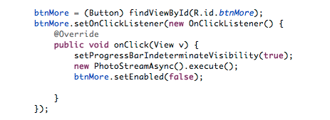

Slide 18
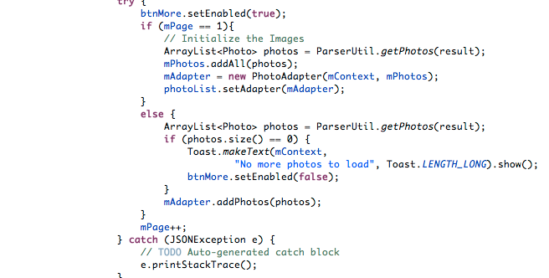
Notes:
In the postExecute method of PhotoStreamActivity

