Slide 1
Activity#4: My Photos

Slide 2
API Limitation
There is no server-side component to manage the user’s photos. We need to use a storage on the device (SQLite Database)

Slide 3
Activities
MyPhotosActivity

Slide 4
MyPhotosActivity
Implement a DBAdapter + SQLiteOpenHelper to connect to SQLite Database
Implement methods to manipulate the db
Add
Get (returns Cursor)
Use add after successful adding of photo
Create layouts
Implement a CursorAdapter to show the photos in a GridView
Notes:
http://developer.android.com/reference/android/database/sqlite/SQLiteOpenHelper.html
http://developer.android.com/guide/topics/data/data-storage.html#db
Note Pad and Searchable Dictionary applications.
The Android SDK includes a sqlite3 database tool that allows you to browse table contents, run SQL commands, and perform other useful functions on SQLite databases. See Examining sqlite3 databases from a remote shell to learn how to run this tool.
Difference between CursorAdapter and ArrayAdapter?
CursorAdapter is more appropriate when there is a database because it does not load all the records as ArrayAdapter. It loads only the visible records in the ListView is between 5 and 10. So I think if you use a CursorAdapter you will not have loading problems.
http://developer.android.com/reference/android/database/sqlite/SQLiteDatabase.html (Reference for SQLiteDatabase)
http://developer.android.com/reference/android/widget/SimpleCursorAdapter.html
Methods:
execSQL
query
delete
Insert

Slide 5
Implement a DBAdapter + SQLiteOpenHelper to connect to SQLite Database
Implement methods to manipulate the db
Add
Get (returns Cursor)
Use add after successful adding of photo
Create layouts
Implement a CursorAdapter to show the photos in a GridView
Notes:
http://developer.android.com/reference/android/database/sqlite/SQLiteOpenHelper.html
http://developer.android.com/guide/topics/data/data-storage.html#db
Note Pad and Searchable Dictionary applications.
The Android SDK includes a sqlite3 database tool that allows you to browse table contents, run SQL commands, and perform other useful functions on SQLite databases. See Examining sqlite3 databases from a remote shell to learn how to run this tool.
Difference between CursorAdapter and ArrayAdapter?
CursorAdapter is more appropriate when there is a database because it does not load all the records as ArrayAdapter. It loads only the visible records in the ListView is between 5 and 10. So I think if you use a CursorAdapter you will not have loading problems.
http://developer.android.com/reference/android/database/sqlite/SQLiteDatabase.html (Reference for SQLiteDatabase)
http://developer.android.com/reference/android/widget/SimpleCursorAdapter.html
Methods:
execSQL
query
delete
Insert

Slide 6
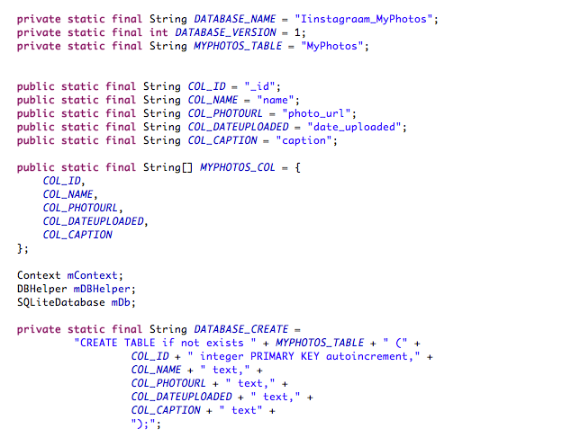

Slide 7
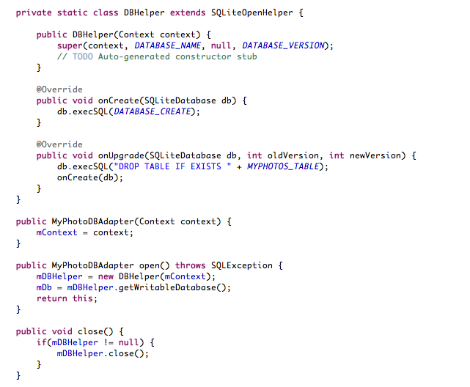

Slide 8
Implement a DBAdapter + SQLiteOpenHelper to connect to SQLite Database
Implement methods to manipulate the db
Add
Get (returns Cursor)
Use add after successful adding of photo
Create layouts
Implement a CursorAdapter to show the photos in a GridView
Notes:
http://developer.android.com/reference/android/database/sqlite/SQLiteOpenHelper.html
http://developer.android.com/guide/topics/data/data-storage.html#db
Note Pad and Searchable Dictionary applications.
The Android SDK includes a sqlite3 database tool that allows you to browse table contents, run SQL commands, and perform other useful functions on SQLite databases. See Examining sqlite3 databases from a remote shell to learn how to run this tool.
Difference between CursorAdapter and ArrayAdapter?
CursorAdapter is more appropriate when there is a database because it does not load all the records as ArrayAdapter. It loads only the visible records in the ListView is between 5 and 10. So I think if you use a CursorAdapter you will not have loading problems.
http://developer.android.com/reference/android/database/sqlite/SQLiteDatabase.html (Reference for SQLiteDatabase)
http://developer.android.com/reference/android/widget/SimpleCursorAdapter.html
Methods:
execSQL
query
delete
Insert

Slide 9
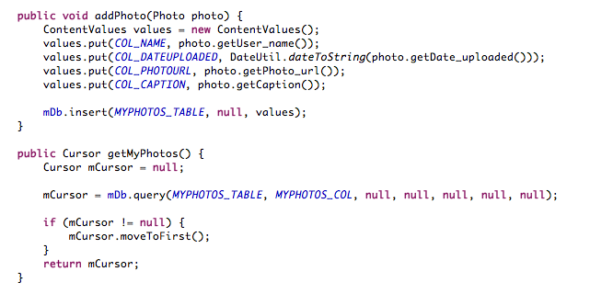

Slide 10
Implement a DBAdapter + SQLiteOpenHelper to connect to SQLite Database
Implement methods to manipulate the db
Add
Get (returns Cursor)
Use add after successful adding of photo
Create layouts
Implement a CursorAdapter to show the photos in a GridView
Notes:
http://developer.android.com/reference/android/database/sqlite/SQLiteOpenHelper.html
http://developer.android.com/guide/topics/data/data-storage.html#db
Note Pad and Searchable Dictionary applications.
The Android SDK includes a sqlite3 database tool that allows you to browse table contents, run SQL commands, and perform other useful functions on SQLite databases. See Examining sqlite3 databases from a remote shell to learn how to run this tool.
Difference between CursorAdapter and ArrayAdapter?
CursorAdapter is more appropriate when there is a database because it does not load all the records as ArrayAdapter. It loads only the visible records in the ListView is between 5 and 10. So I think if you use a CursorAdapter you will not have loading problems.
http://developer.android.com/reference/android/database/sqlite/SQLiteDatabase.html (Reference for SQLiteDatabase)
http://developer.android.com/reference/android/widget/SimpleCursorAdapter.html
Methods:
execSQL
query
delete
Insert

Slide 11
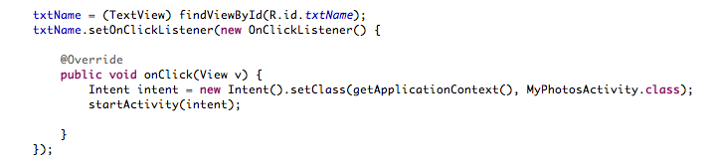
Notes:
This launches the activity

Slide 12
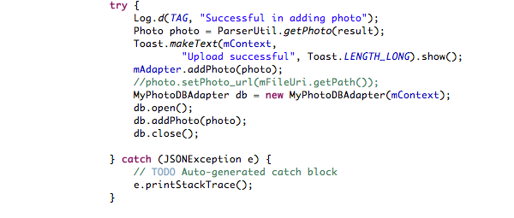
Notes:
onPostExecute of UplooadPhotoAsync:

Slide 13
Implement a DBAdapter + SQLiteOpenHelper to connect to SQLite Database
Implement methods to manipulate the db
Add
Get (returns Cursor)
Use add after successful adding of photo
Create layouts
Implement a CursorAdapter to show the photos in a GridView
Notes:
http://developer.android.com/reference/android/database/sqlite/SQLiteOpenHelper.html
http://developer.android.com/guide/topics/data/data-storage.html#db
Note Pad and Searchable Dictionary applications.
The Android SDK includes a sqlite3 database tool that allows you to browse table contents, run SQL commands, and perform other useful functions on SQLite databases. See Examining sqlite3 databases from a remote shell to learn how to run this tool.
Difference between CursorAdapter and ArrayAdapter?
CursorAdapter is more appropriate when there is a database because it does not load all the records as ArrayAdapter. It loads only the visible records in the ListView is between 5 and 10. So I think if you use a CursorAdapter you will not have loading problems.
http://developer.android.com/reference/android/database/sqlite/SQLiteDatabase.html (Reference for SQLiteDatabase)
http://developer.android.com/reference/android/widget/SimpleCursorAdapter.html
Methods:
execSQL
query
delete
Insert

Slide 14
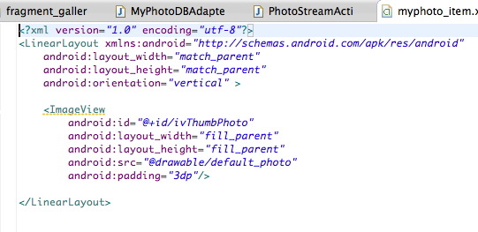

Slide 15
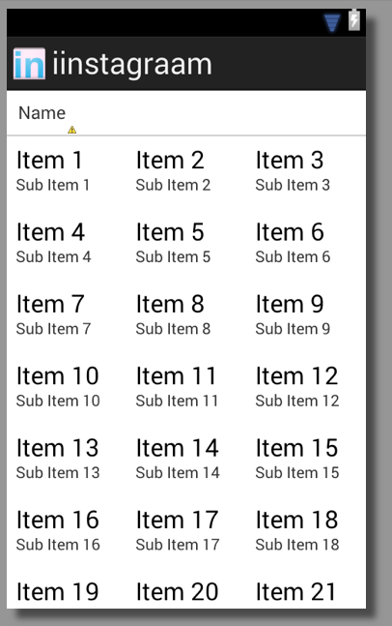

Slide 16
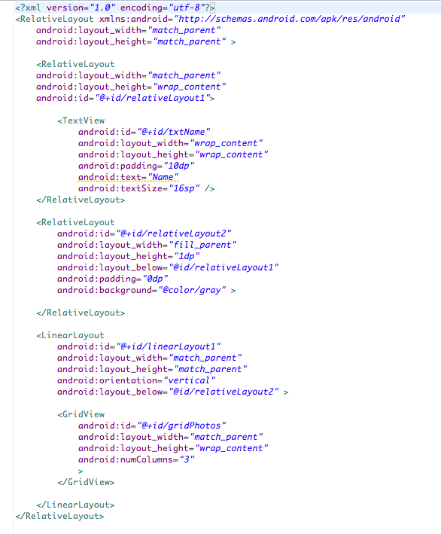

Slide 17
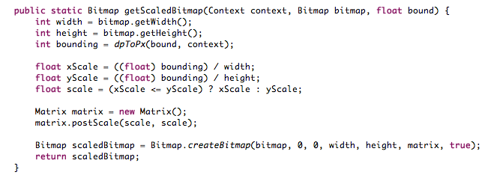
Notes:
Create a squared bitmap

Slide 18
Implement a DBAdapter + SQLiteOpenHelper to connect to SQLite Database
Implement methods to manipulate the db
Add
Get (returns Cursor)
Use add after successful adding of photo
Create layouts
Implement a CursorAdapter to show the photos in a GridView
Notes:
http://developer.android.com/reference/android/database/sqlite/SQLiteOpenHelper.html
http://developer.android.com/guide/topics/data/data-storage.html#db
Note Pad and Searchable Dictionary applications.
The Android SDK includes a sqlite3 database tool that allows you to browse table contents, run SQL commands, and perform other useful functions on SQLite databases. See Examining sqlite3 databases from a remote shell to learn how to run this tool.
Difference between CursorAdapter and ArrayAdapter?
CursorAdapter is more appropriate when there is a database because it does not load all the records as ArrayAdapter. It loads only the visible records in the ListView is between 5 and 10. So I think if you use a CursorAdapter you will not have loading problems.
http://developer.android.com/reference/android/database/sqlite/SQLiteDatabase.html (Reference for SQLiteDatabase)
http://developer.android.com/reference/android/widget/SimpleCursorAdapter.html
Methods:
execSQL
query
delete
Insert

Slide 19
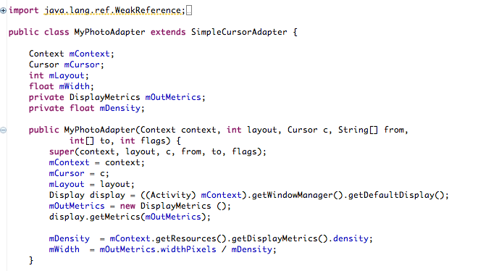

Slide 20
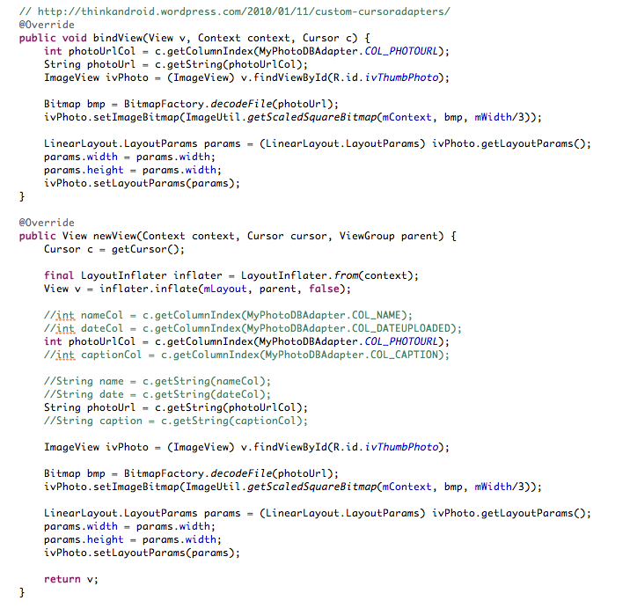

Slide 21
