Slide 1
Basic Android
Rod Michael Coronel

Slide 2
Development Setup
Our first application
Workflow
Application Fundamentals
Target application to develop

Slide 3
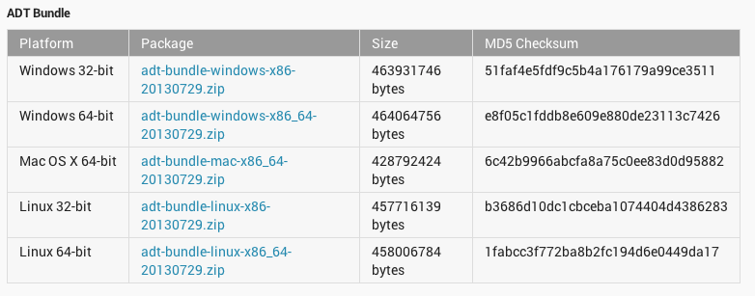

Development Setup
http://developer.android.com/sdk/index.html

Slide 4
Our first application
Check if we have a working installation
Look at some codes that we can discuss later on

Slide 5
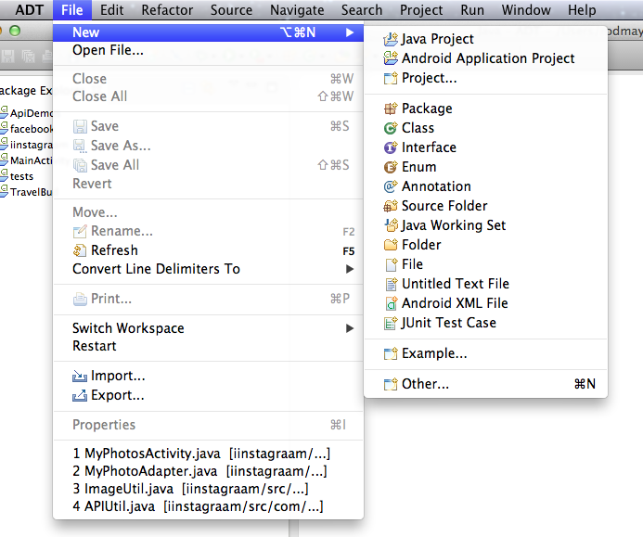

Slide 6
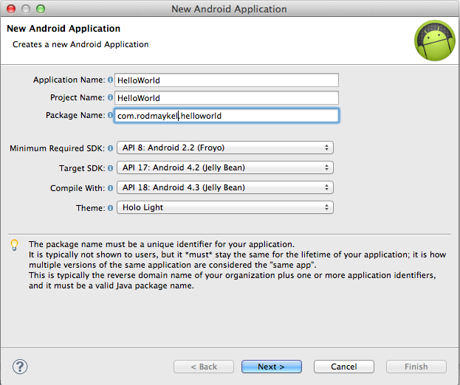

Slide 7
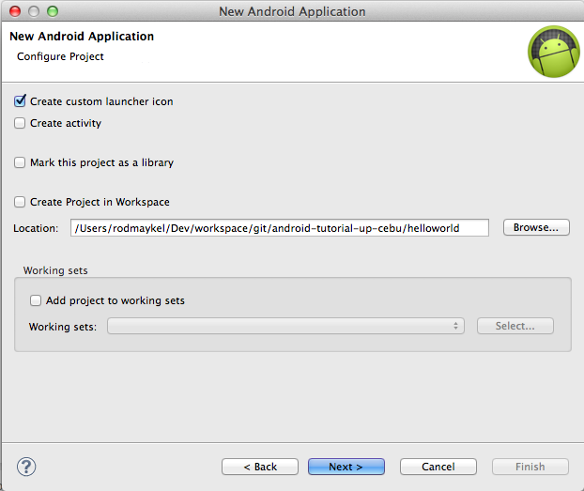

Slide 8
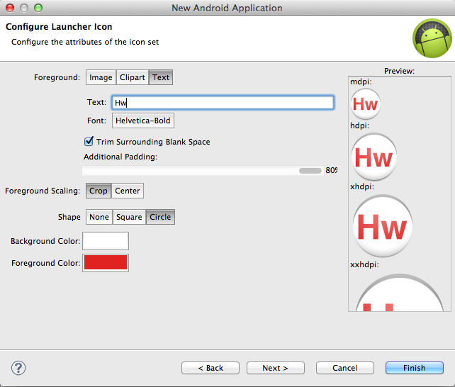

Slide 9
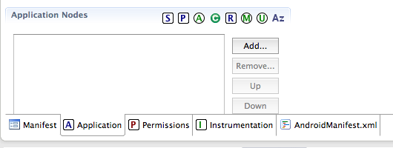
Create the activities
MainActivity
HelloActivity

Slide 10
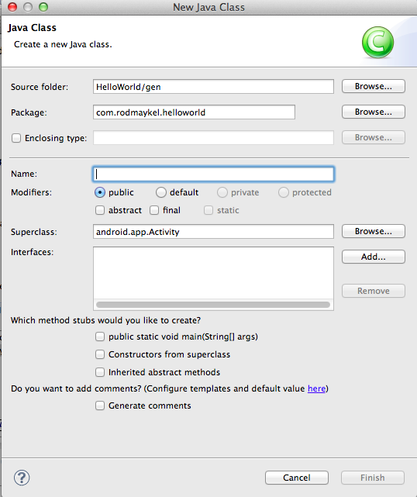

Slide 11
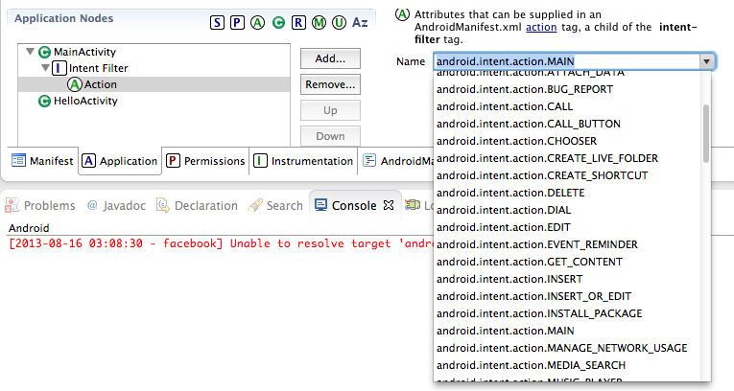
Add Intent Filter to MainActivity

Slide 12
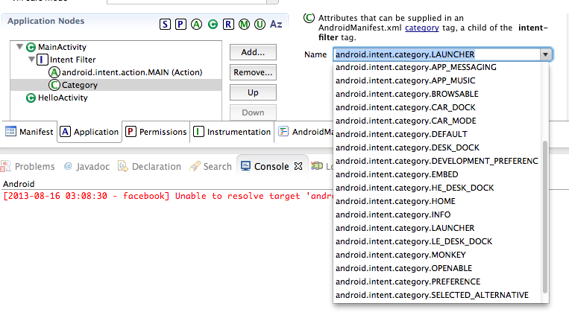

Slide 13
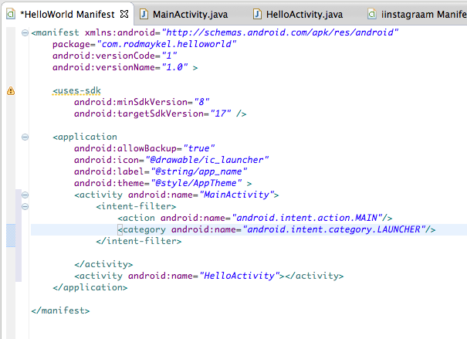

Slide 14
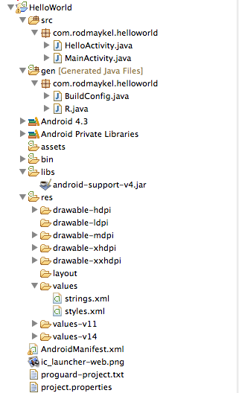

Slide 15
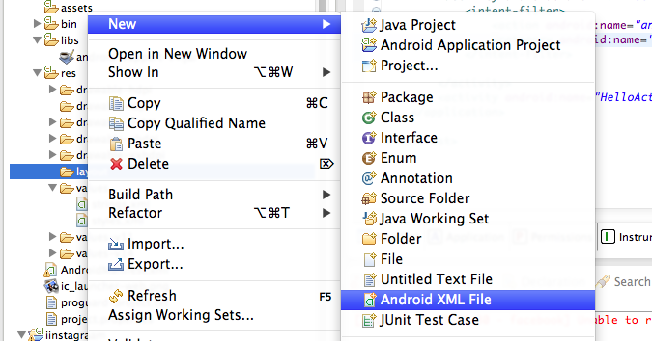

Slide 16
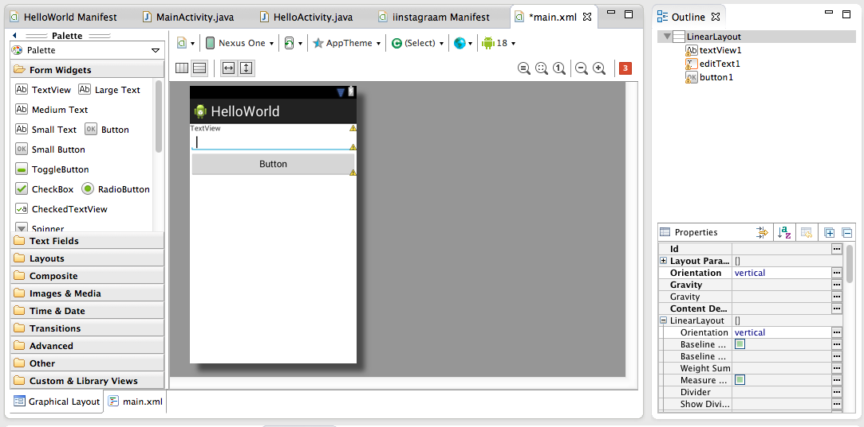

Slide 17
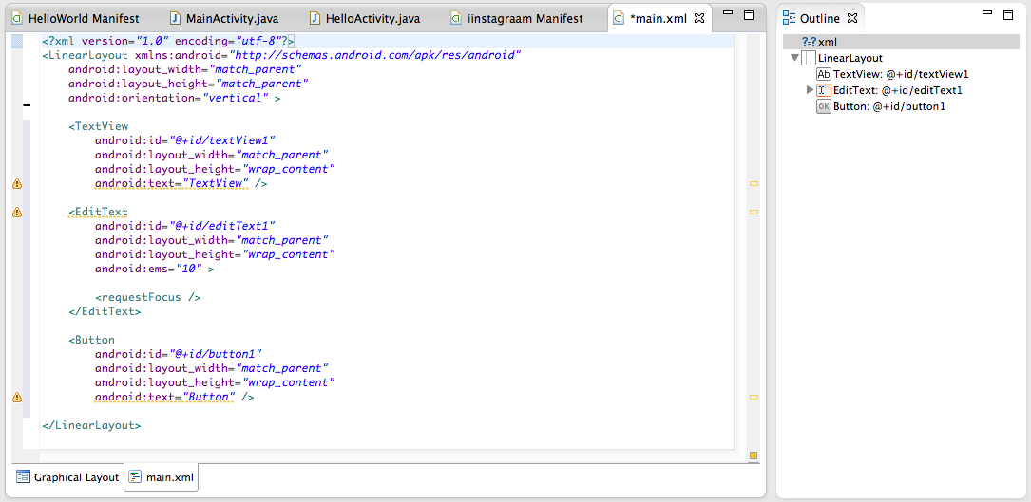

Slide 18
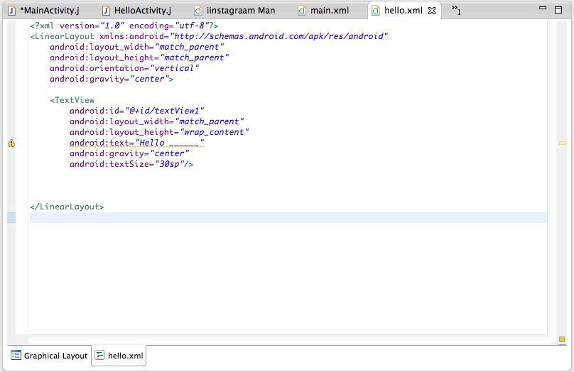

Slide 19
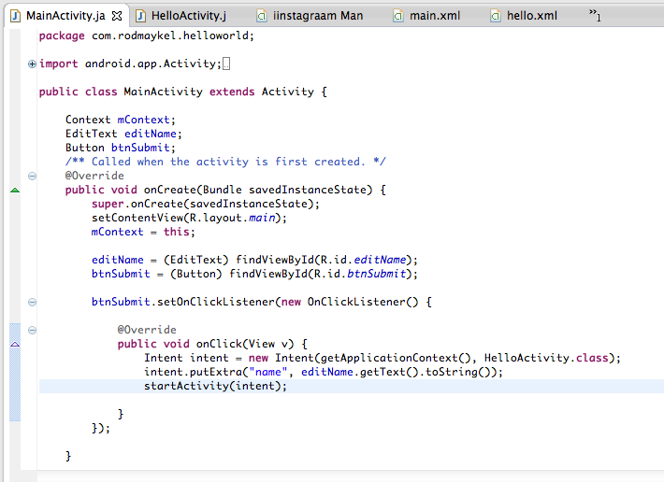

Slide 20
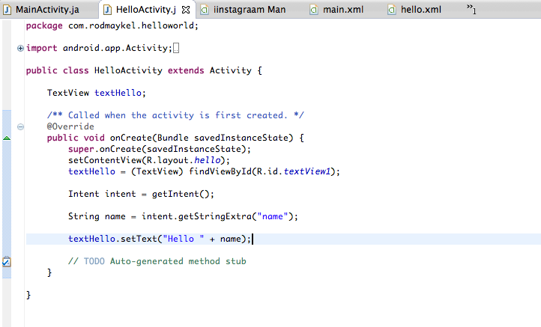

Slide 21
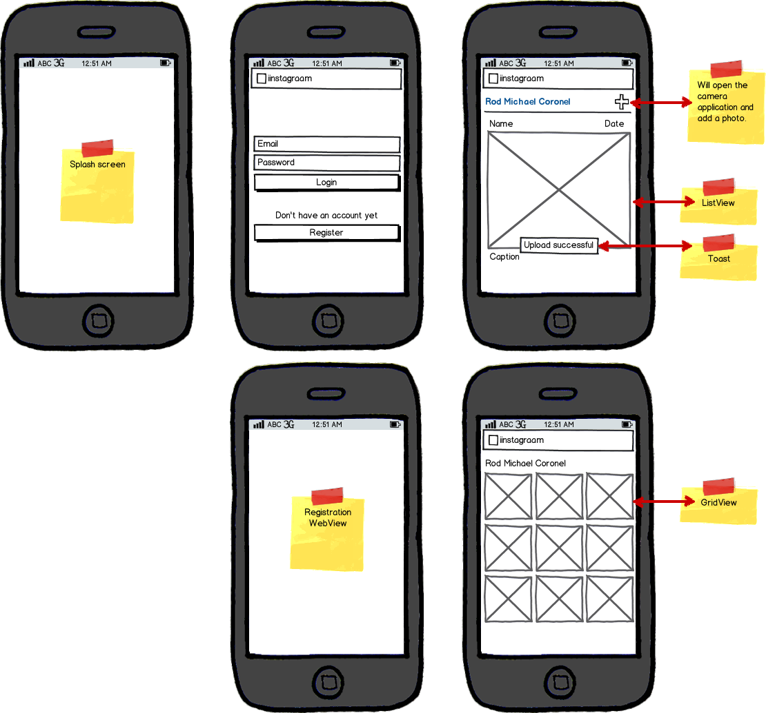
Workshop project
Mini Instagram
https://github.com/rodmaykel/android-tutorial-up-cebu/wiki

Slide 22
Workflow
Setup
Development
Debugging and Testing
Publishing
Notes:
http://developer.android.com/tools/workflow/index.html

Slide 23
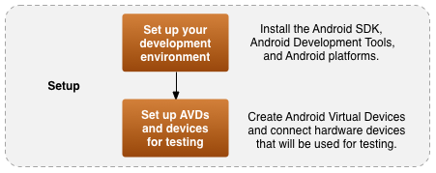
Setup

Slide 24

Development

Slide 25
Development
App components
Activity
Service
Content Provider
Receivers
Intents and Intent filters
Processes and Threads
Permissions
UI

Slide 26
Development
Accessing device features
Camera
Location and sensors
GPS
NFC
Bluetooth
Storage

Slide 27
APIDemos
/sdk/samples/android-18/legacy/APIDemos

Slide 28
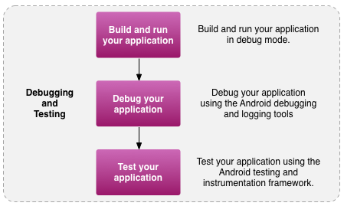
Debugging and Testing

Slide 29
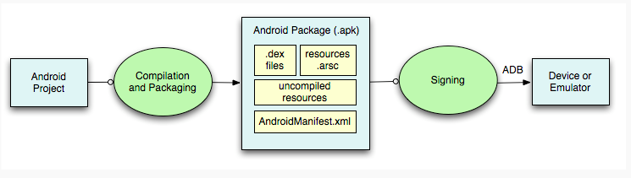
Build and run

Slide 30
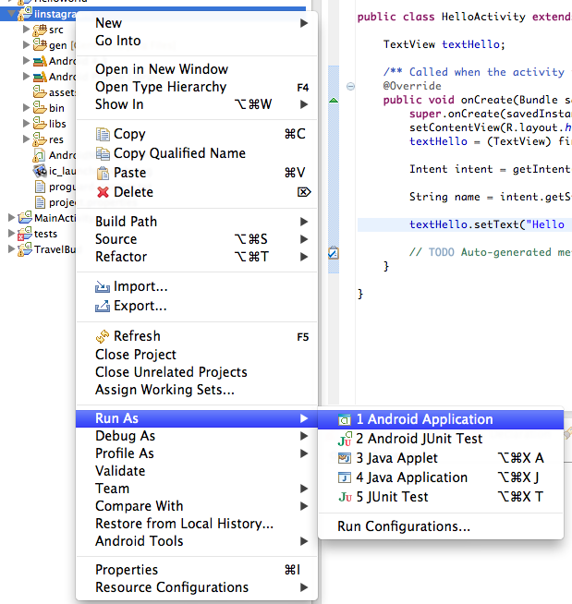
Build and Run

Slide 31
Testing
http://developer.android.com/tools/testing/testing_android.html
DDMS (Dalvik Debug Monitor Server)
Logging via Logcat
AndroidTestCase class based on Junit TestCase and InstrumentationTestRunner
MonkeyRunner

Slide 32
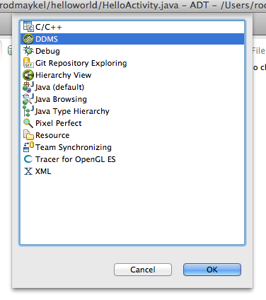
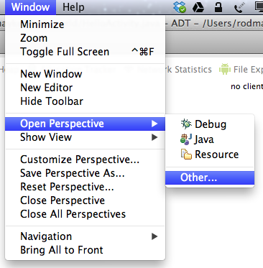

Slide 33
DDMS
Threads
Heap
Network Statistics
Explore files (also works for databases)
Emulator control
Call/text
Mock locations

Slide 34
Logging
Log.v
Log.d
Log.i
Log.w
Log.e

Slide 35
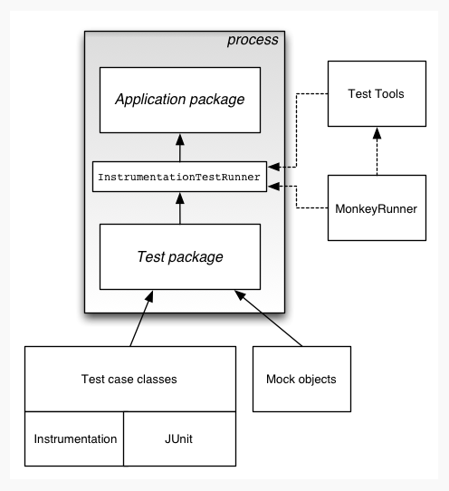

Slide 36
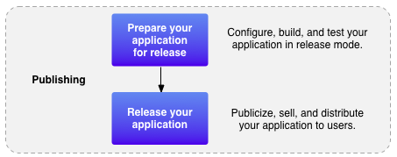
Publishing

Slide 37
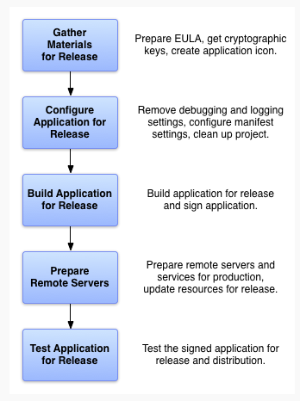
Preparing for release
Remove logs
Sign a release version of your app
Prepare materials for Google Play
Marketing materials and assets
Description

Slide 38
Application Fundamentals

Slide 39
App Fundamentals
APK (Android package) – one full application installed on an Android device
It runs on its own sandbox environment (principle of least privilege)
Access managed through “permissions”

Slide 40
AndroidManifest.xml
Application components
Permissions required by the application
Minimum API level
Hardware and software features
http://developer.android.com/guide/topics/manifest/manifest-intro.html

Slide 41
App Components
Activity - <activity>
Service - <service>
Content Provider - <provider>
Broadcast Receiver - <receiver>

Slide 42
Permissions
http://developer.android.com/guide/topics/security/permissions.html
<uses-permission android:name="android.permission.RECEIVE_SMS" />
List of android permissions: http://developer.android.com/reference/android/Manifest.permission.html

Slide 43
Minimum API level
<uses-sdk android:minSdkVersion="4" android:targetSdkVersion="17" />
minSDK: The Android system will prevent the user from installing the application if the system's API Level is lower than the value specified in this attribute.
targetSDK: informs the platform that you have tested against the target version and the platform should not perform any extra work to maintain forward-compatibility with the target version.

Slide 44
Declaring requirements
<supports-screens android:resizeable=["true"| "false"]
android:smallScreens=["true" | "false"]
android:normalScreens=["true" | "false"]
android:largeScreens=["true" | "false"]
android:xlargeScreens=["true" | "false"]
android:anyDensity=["true" | "false"]
android:requiresSmallestWidthDp="integer"
android:compatibleWidthLimitDp="integer"
android:largestWidthLimitDp="integer"/>

Slide 45
Declaring requirements
<uses-configuration
android:reqFiveWayNav=["true" | "false"]
android:reqHardKeyboard=["true" | "false"]
android:reqKeyboardType=["undefined" | "nokeys" | "qwerty" | "twelvekey"]
android:reqNavigation=["undefined" | "nonav" | "dpad" | "trackball" | "wheel"]
android:reqTouchScreen=["undefined" | "notouch" | "stylus" | "finger"] />

Slide 46
Declaring requirements
<uses-feature android:name="android.hardware.bluetooth" />
<uses-feature android:name="android.hardware.camera" />

Slide 47
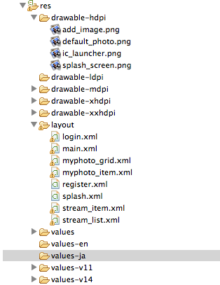
Application Resources
Layouts
Drawables
Values
Strings
Colors
Styles
Accessed through R.resource_type.resource_name

Slide 48
Activity

Slide 49
Activity
application component that provides a screen with which users can interact
Each activity is given a window in which to draw its user interface

Slide 50
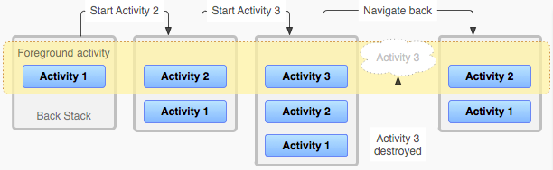
Activity
Typically, one activity in an application is specified as the "main" activity, which is presented to the user when launching the application for the first time

Slide 51
Creating an Activity
Subclass of Activity
Most important callback methods are:
onCreate() - initialize the essential components and setContentView
onPause() - first indication that the user is leaving your activity

Slide 52
Starting an Activity
startActivity(intent)
Intent specifies the exact activity you want to start or an intent action you want to perform (wherein the system selects the Activity for you)
The intent can also carry small amounts of data through putExtra() in which the target activity extracts through getIntent().getExtra()

Slide 53
Starting an Activity for Result
Use startActivityForResult()
Implement onActivityForResult() which receives an intent, together with the result code and request code
The activity that was started should call setResult with a result code and Intent

Slide 54
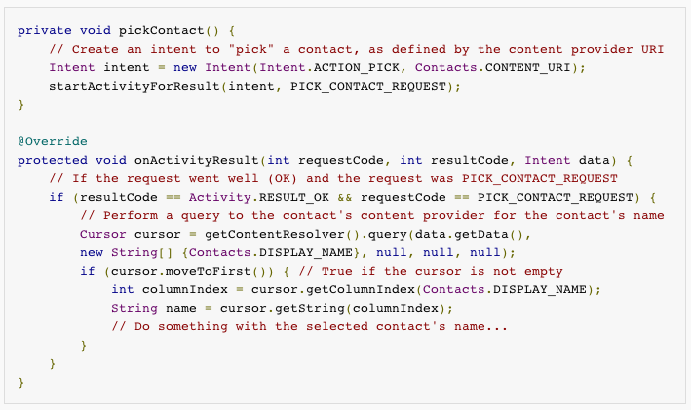
Sample

Slide 55
Stopping the Activity
Call finish()

Slide 56
Activity states
States of an existing activity
Resumed/running - activity is in the foreground of the screen and has user focus
Paused - activity is in the foreground of the screen and has user focus. It is still attached to the window manager; can be killed by the system in extremely low memory situations.
Stopped - the activity is now in the "background”; can be killed by the system when memory is needed elsewhere.

Slide 57
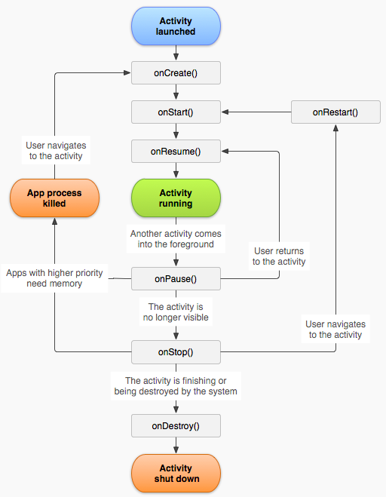
Activity Lifecycle
Entire lifetime:
onCreate() - perform setup of the activity’s global state
onDestroy() – release all remaining resources (e.g. stop unfinished threads)

Slide 58
Activity Lifecycle
Visible lifetime:
onStart() to onStop()
maintain resources that are needed to show the activity to the user

Slide 59
Activity Lifecycle
Foreground lifetime:
onResume() – onPause()
Happens a lot (device goes to sleep, dialog appears) so this has to be lightweight.

Slide 60
Saving activity state
onPause() onward, the application can be killed by the Android OS and the Activity object destroyed
onSaveInstanceState() – called by the system when it is about to destroy an activity. Put all state information in a bundle and restore from onCreate().

Slide 61
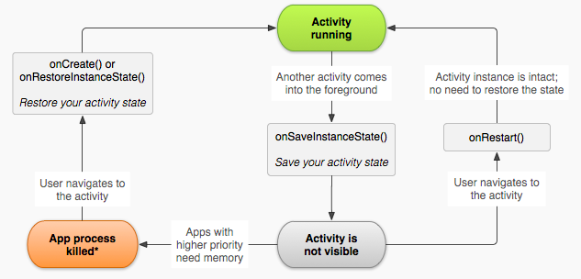
Saving Activity State

Slide 62
Short Exercise (lifecycle)
FirstActivity
SecondActivity
Log.d(TAG, String)

Slide 63
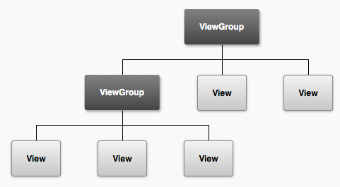
Implementing the UI
Your app's user interface is everything that the user can see and interact with.

Slide 64
Views and ViewGroups
While you can manipulate views programatically, the best way to declare layouts is with an XML file.
ViewGroups are elements that can contain other Views.
Views are actual elements in the UI.
Android also provides other components that have unique set of APIs (Toast, Dialog, Status Notification and Action Bar)

Slide 65
Advantages of using XML files
better separation of the presentation of your application from the code that controls its behavior.
you can create XML layouts for different screen orientations, different device screen sizes, and different languages
makes it easier to visualize the structure of your UI

Slide 66
Layouts
ADT provides a graphical layout tool to generate XML
Typical XML layout workflow involves using both graphical tool and hand-coding the XML

Slide 67
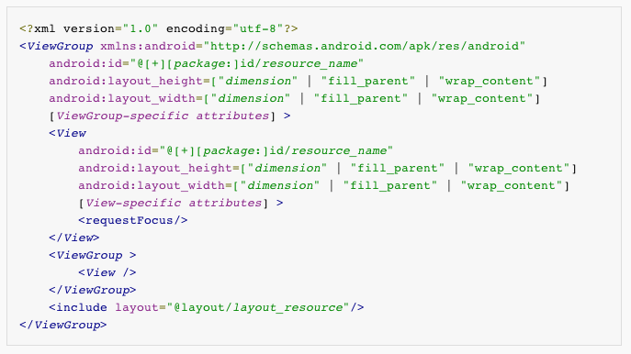
XML Syntax
http://developer.android.com/guide/topics/resources/layout-resource.html

Slide 68
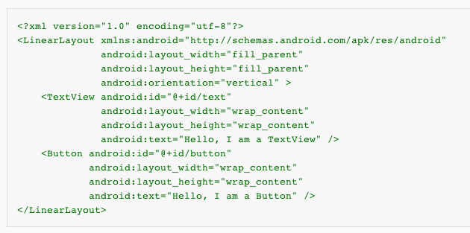
Sample view hierarchy

Slide 69
Loading the layout
setContentView(R.layout.layout_name);

Slide 70
Attributes
Every View and ViewGroup object supports their own variety of XML attributes
other attributes are considered "layout parameters," which are attributes that describe certain layout orientations of the View object, as defined by that object's parent ViewGroup object

Slide 71
IDs
Any View object may have an integer ID associated with it
android:id="@+id/my_button »
@ - the XML parser should parse and expand the rest of the ID string and identify it as an ID resource
+ - this is a new resource name that must be created and added to our resources

Slide 72
Use of IDs
To manipulate the View, an instance of the object must be created and captured from the layout using findViewById
Button myButton = (Button) findViewById(R.id.my_button);
In RelativeLayouts, ids are used to reference other views
android:layout_below=“id/textView1”

Slide 73
Layout Parameters
parameters for the View that are appropriate for the ViewGroup in which it resides.
layout_something
layout_width
layout_height
Etc…
Do not use px; use dp instead
layout_width/layout_height (required)
match_parent/fill_parent
wrap_content
*dp

Slide 74
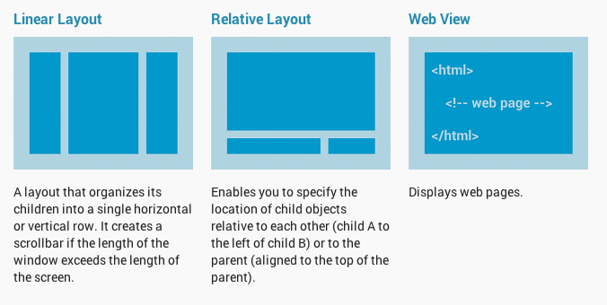
Common Layouts

Slide 75
Adapters
A subclass of the AdapterView class uses an Adapter to bind data to its layout.
The Adapter behaves as a middle-man between the data source and the AdapterView layout—the Adapter retrieves the data (from a source such as an array or a database query) and converts each entry into a view that can be added into the AdapterView layout.

Slide 76
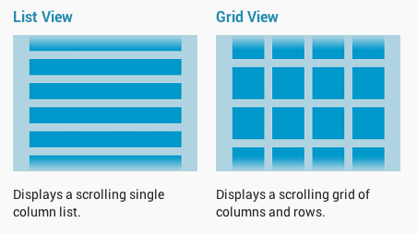
AdapterView Layout

Slide 77
Adapters
ArrayAdapter – for Arrays
SimpleCursorAdapter – for Cursors
To create the layout for each item in the AdapterView, a separate layout file must be created (e.g. list_item.xml)

Slide 78


ArrayAdapter
ArrayAdapter supports array of Strings
If you want to customize (e.g. add images), you can extend ArrayAdapter

Slide 79
SimpleCursorAdapter
For Cursors (SQLite query results)
For customization, extend the SimpleCursorAdapter class

Slide 80
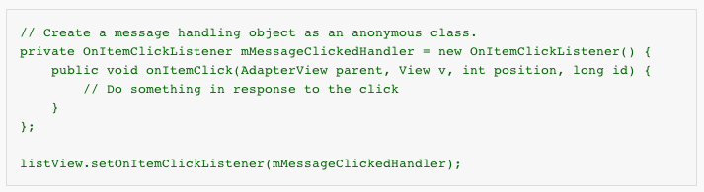
Handling click events

Slide 81
LinearLayout
view group that aligns all children in a single direction, vertically or horizontally (android:orientation)
layout_weight
An attribute assigns an "importance" value to a view in terms of how much space is should occupy on the screen
http://developer.android.com/guide/topics/ui/layout/linear.html

Slide 82
RelativeLayout
view group that displays child views in relative positions.
Positions are specified relative to other elements or relative to the parent RelativeLayout
Example positions:
layout_alignParentTop
layout_centerVertical
layout_below
http://developer.android.com/guide/topics/ui/layout/relative.html

Slide 83
WebView
A View that allows you to display web pages.
Requires an INTERNET permission
http://developer.android.com/reference/android/webkit/WebView.html

Slide 84
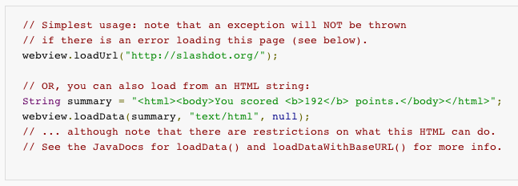
WebView

Slide 85
WebView
Can be assigned custom WebViewClient by creating an extension of the WebViewClient class and overriding its methods
e.g. shouldOverrideUrlLoading, etc.

Slide 86
Views
Button (http://developer.android.com/guide/topics/ui/controls/button.html)
TextView
EditText (http://developer.android.com/guide/topics/ui/controls/text.html)
ImageView
Etc…

Slide 87
ShortActivity
splash
login
register
stream_list
stream_item
myphoto_grid
myphoto_item

Slide 88
API
Each component has its specific set of APIs to manipulate the view
Developers can also set event listeners for various events

Slide 89
Events
onClick
onLongClick
onFocusChange
onKey
onTouch
onCreateContextMenu
http://developer.android.com/guide/topics/ui/ui-events.html

Slide 90
Two ways
Creating new listeners
Implementing the listener within the Activity

Slide 91
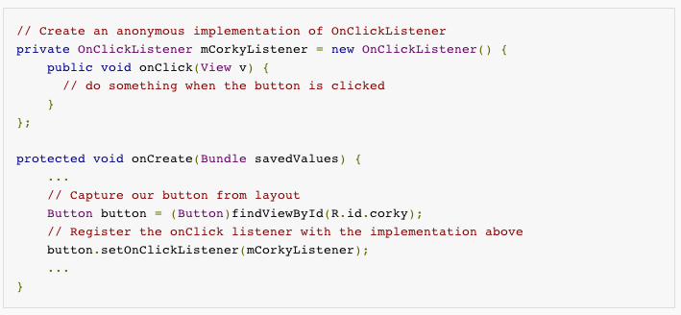

Slide 92
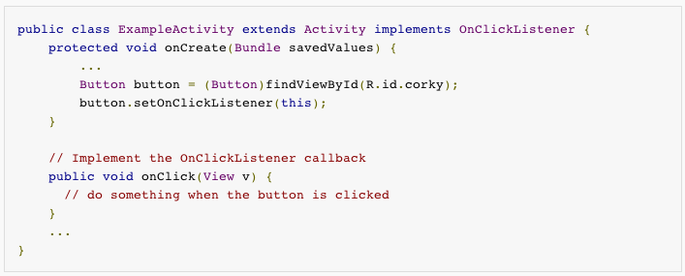

Slide 93
Other components
Toast
Dialog
Status notification

Slide 94
Toast
Context context = getApplicationContext();
CharSequence text = "Hello toast!";
int duration = Toast.LENGTH_SHORT;
Toast toast = Toast.makeText(context, text, duration);
toast.show();
Toast.makeText(context, text, duration).show();

Slide 95
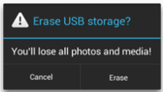
Dialog
AlertDialog
ProgressDialog (no longer recommended)

Slide 96
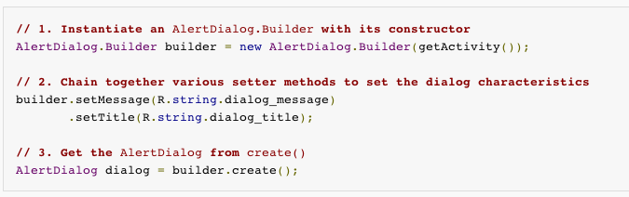
AlertDialog

Slide 97
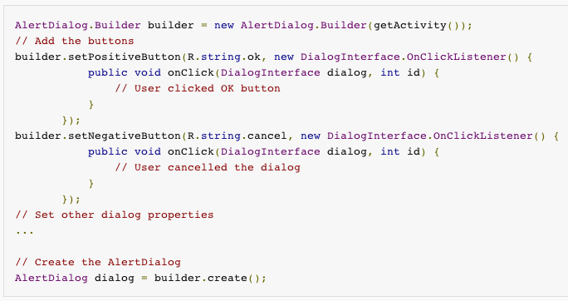
AlertDialog with buttons

Slide 98
AlertDialog
mDialog.show()
mDialog.dismiss()

Slide 99
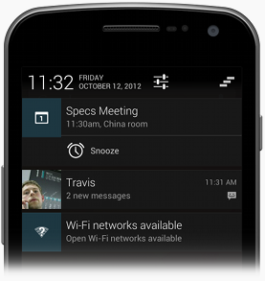
Status Notification
Notifications outside of your UI
Normally used by a Broadcast receiver or a Service
Must have an action to open an activity of your application

Slide 100
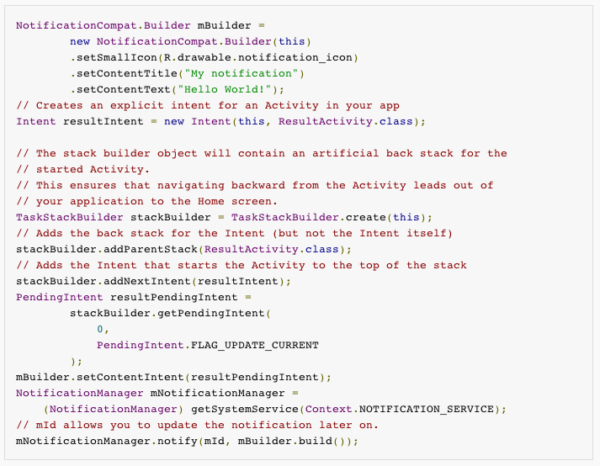

Slide 101
Short Exercise
Create an app with three buttons, each using Toast, Dialog(Alert) and Status Notification

Slide 102
Processes and Threads

Slide 103
UI Thread
Thread of execution created by the application; also called “main”
System calls to each component are dispatched from the UI thread
Must not perform long operations in the UI thread (e.g. Network calls or database operations)
Android UI toolkit cannot be accessed from outside the UI thread

Slide 104
Worker threads
Non-instantaneous operations should be executed in worker threads
new Thread(new Runnable() {
public void run() {
Bitmap b = loadImageFromNetwork("http://example.com/image.png");
mImageView.setImageBitmap(b);
}
}).start();

Slide 105
Worker threads
Previous example accesses a UI element (mImageView)
Android provides a mechanism to access the UI thread from other threads:
Activity.runOnUiThread(Runnable)
View.post(Runnable)
View.postDelayed(Runnable, long)

Slide 106
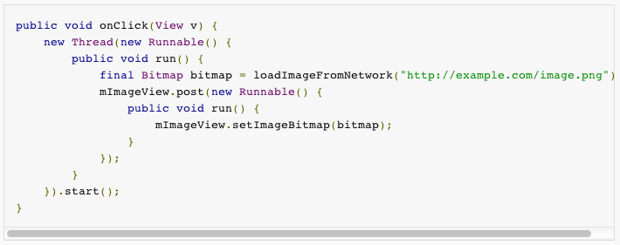
Worker threads

Slide 107
AsyncTask
Android class that allows you to perform asynchronous work on the UI
Performs blocking operations in a worker thread and then publishes the result on the UI thread
Must extend the base class AsyncTask

Slide 108
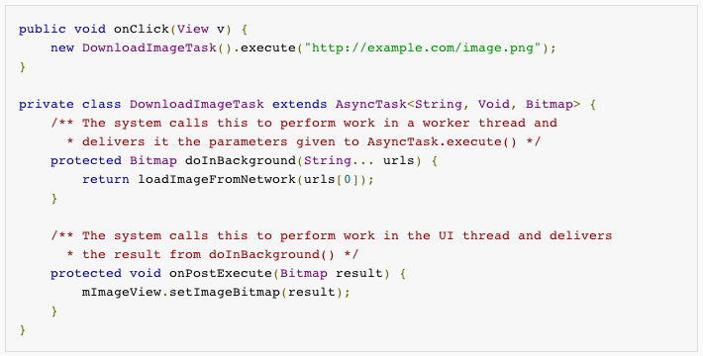
AsyncTask Example

Slide 109
Exercise
Create SplashActivity of our Project
onCreate executes a SplashAsync class that Sleeps for 3 seconds and then launches the LoginActivity

Slide 110
Communicating with the Network
Done through the HttpURLConnection class

Slide 111
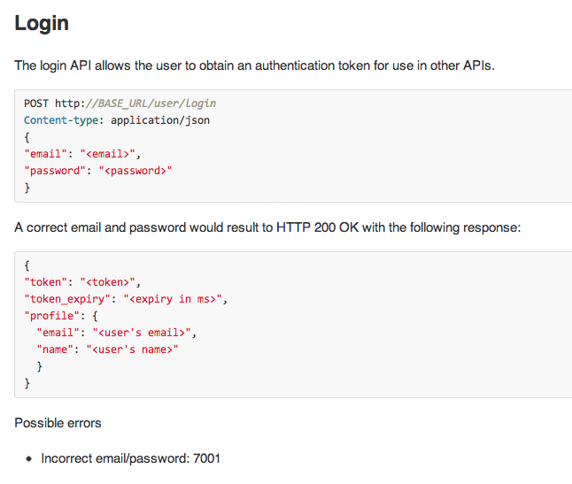
Example: Login API
http://54.251.186.10:3000/
https://github.com/rodmaykel/android-tutorial-up-cebu/wiki/Server-specifications

Slide 112
public static String login(String email, String password)
try {
URL url = new URL(LOGIN_URL);
HttpURLConnection conn = (HttpURLConnection) url.openConnection();
conn.setDoOutput(true);
conn.setRequestMethod("POST");
conn.setRequestProperty("Content-Type","application/json");
conn.connect();
JSONObject jsonParam = new JSONObject();
jsonParam.put("email", email);
jsonParam.put("password", password);
OutputStream out = conn.getOutputStream();
out.write(jsonParam.toString().getBytes());
out.flush();
out.close();
InputStream in = new BufferedInputStream(conn.getInputStream());
BufferedReader bufferedReader = new BufferedReader(
new InputStreamReader(in));
String responeLine;
StringBuilder responseBuilder = new StringBuilder();
while ((responeLine = bufferedReader.readLine()) != null) {
responseBuilder.append(responeLine);
}
String result = responseBuilder.toString();
Log.d(TAG, result);
return result;
} catch (MalformedURLException e) {
e.printStackTrace();
return null;
} catch (IOException e) {
e.printStackTrace();
return null;
} catch (JSONException e) {
e.printStackTrace();
return null;
}
}

Slide 113
JSON
JSONObject(str)
getJSONObject
getJSONArray
getInt
getString
…
JSONArray(str)
getJSONObject(i)

Slide 114
Storage
SharedPreferences
SQLiteDatabase
Internal/External Storage

Slide 115
SharedPreferences
provides a general framework that allows you to save and retrieve persistent key-value pairs of primitive data types
This data will persist across user sessions (even if your application is killed).

Slide 116
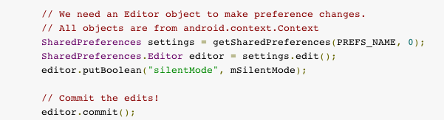
Setting

Slide 117

Getting

Slide 118

SQLiteDatabase
Accessed in Android through an SQLiteOpenHelper class

Slide 119
SQLiteDatabase
Android recommends the use of an auto-increment ‘_id’ for use in Android components such as CursorAdapter
Common design pattern is to use DBAdapter to manage the SQLiteOpenHelper instance (e.g. open()/close())
The DBAdapter also provides methods to access the database.
Let’s look at an example.

Slide 120

Exercise (activity#1)
Implement RegisterActivity
Google how to close the webview automatically when the success URL is detected.

Slide 121
Exercise (activity#1)
Implement LoginActivity
Attempt Login via API call
Parse the results to check if login is successful or not.
Use an AlertDialog to warn the user
Proceed to PhotoStreamActivity (with setContentView for now)

Slide 122
There is a step-by-step procedure
Docs/activity_1

Slide 123
Activity#2: Photo stream
Implementing Adapter (ArrayAdapter)

Slide 124
Activity#3: Uploading photos
Camera API
Image manipulation

Slide 125
Activity#3: My Photos
SQLite Database

