Slide 1
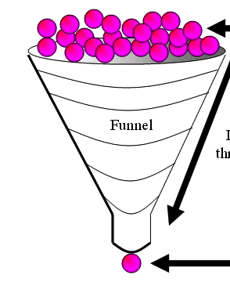
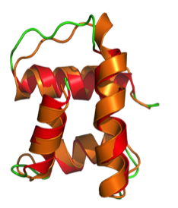
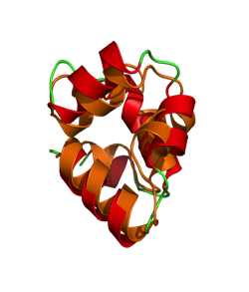
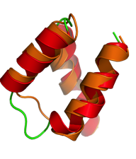
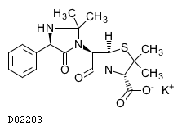
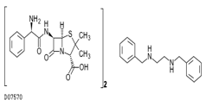
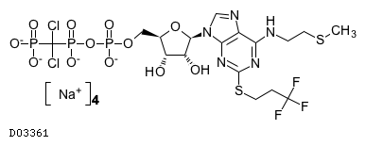
When do you need HPC workflow? Example application: protein-ligand docking for drug screening
O(100K)
drug
candidates
O(10) proteins implicated in a disease
X
…
= 1M
docking
tasks…
…then hundreds of detailed MD models to find
10-20 fruitful
candidates for wetlab & APS crystallography
(B)
Notes:
"docking" is the identification of the low-energy binding modes of a small molecule (ligands) within the active site of a macromolecule (receptor) whose structure is known
A compound that interacts strongly with (i.e. binds) a receptor associated with a disease may inhibit its function and thus act as a drug
Typical Workload:
Application Size: 7MB (static binary)
Static input data: 35MB (binary and ASCII text)
Dynamic input data:10KB (ASCII text)
Output data: 10KB (ASCII text)
Expected execution time: 5~5000 seconds
Parameter space: 1 billion tasks

Slide 2
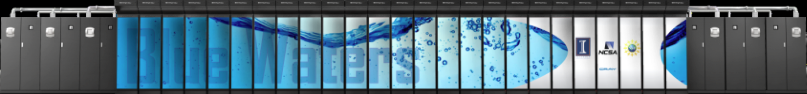


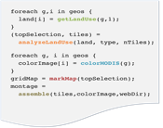




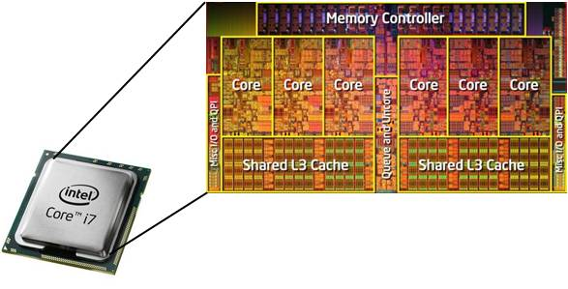

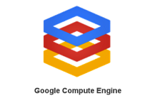


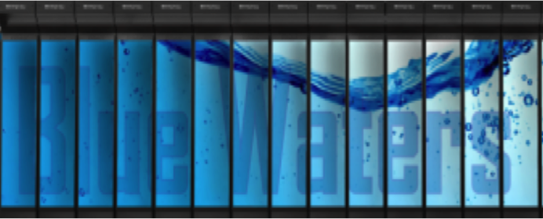
Fig 1
Petascale systems
script.swift
National infrastructure
mark
Site info
Local data
mark
App
swift.conf
Campus systems
Swift host: login node, laptop, …
Cloud resources
The Swift runtime system has drivers and algorithms to efficiently support and aggregate diverse runtime environments
analyze
colorize
analyze
assemble
colorize
analyze
mark
assemble
colorize
apps
analyze
mark
assemble
colorize
apps
analyze
mark
assemble
colorize
apps
mark
assemble
apps
mark
apps
Notes:
2
Swift is a Java ap – untar or module load,and run
Data can be on client or remote (GirdFTP, ) – soon Globus Online.
Overlaps staging and computing wherever possible
Main role is to efficiently run Swift tasks on allocated compute nodes, local and remote
Handles short tasks efficiently without re-scheduling
Runs on distributed infrastructure: Condor, GRAM, AWS
Also runs with few infrastructure dependencies
Can optionally perform data staging
Provisioning can be automatic or external (manually launched or externally scripted)
Dynamically grows and shrinks worker pools
Handles failures through retry and restart

Slide 3
Swift enables execution of simulation campaigns across multiple HPC and cloud resources
Data servers
Data servers
Data servers
Petascale systems
National infrastructure
Scripts
Campus systems
Local data
mark
Apps
Swift host: login node, laptop, …
Cloud resources
The Swift runtime system has drivers and algorithms to efficiently support and aggregate diverse runtime environments
analyze
colorize
analyze
assemble
colorize
analyze
mark
assemble
colorize
apps
analyze
mark
assemble
colorize
apps
analyze
mark
assemble
colorize
apps
mark
assemble
apps
mark
apps
Notes:
3
Swift is a Java ap – untar or module load,and run
Data can be on client or remote (GirdFTP, ) – soon Globus Online.
Overlaps staging and computing wherever possible
Main role is to efficiently run Swift tasks on allocated compute nodes, local and remote
Handles short tasks efficiently without re-scheduling
Runs on distributed infrastructure: Condor, GRAM, AWS
Also runs with few infrastructure dependencies
Can optionally perform data staging
Provisioning can be automatic or external (manually launched or externally scripted)
Dynamically grows and shrinks worker pools
Handles failures through retry and restart

