Slide 1
pUML phunctional UML editor
<< pow >>

Slide 2
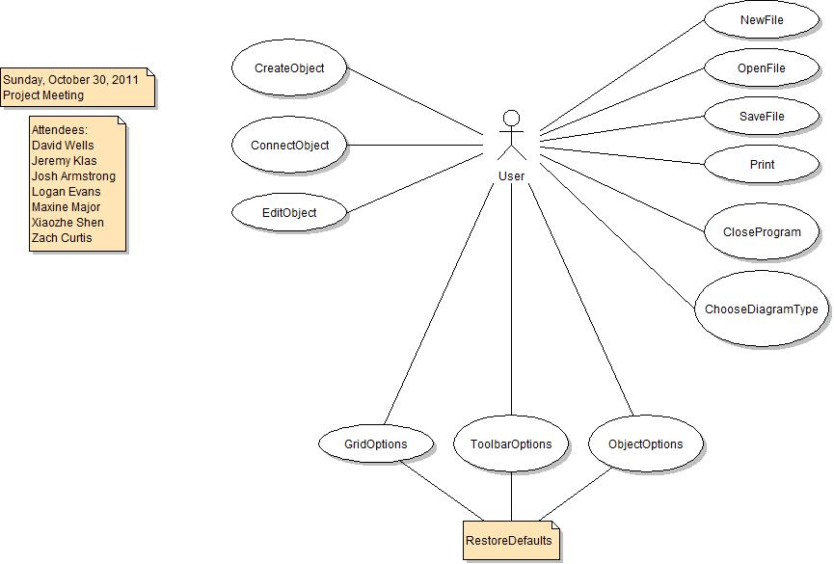
Use Case Diagram

Slide 3
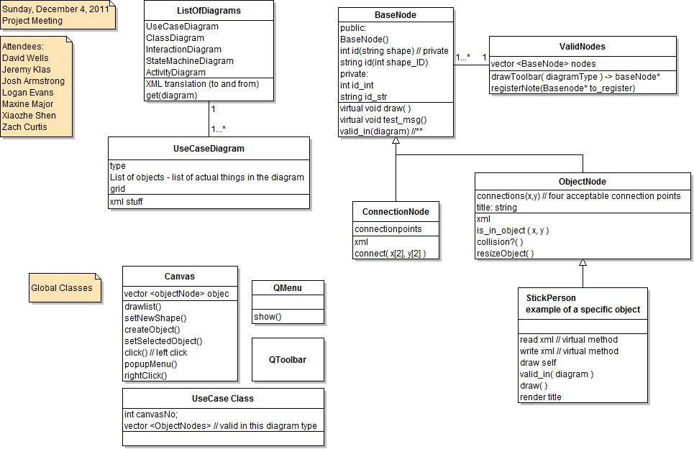
Class Diagram

Slide 4
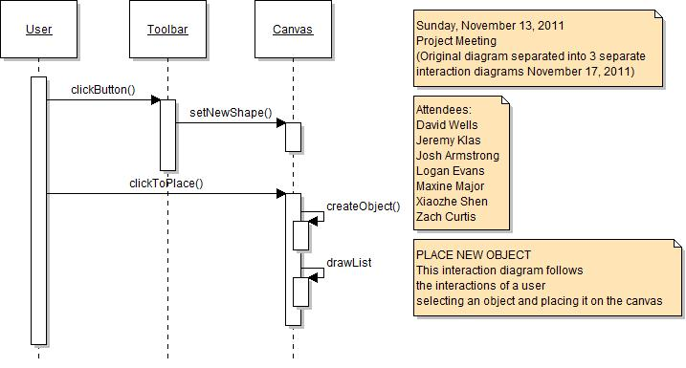
Interaction Diagram Placing an Object

Slide 5
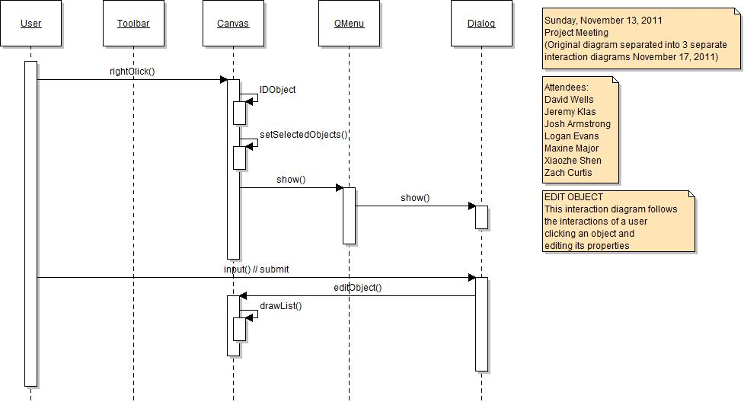
Interaction Diagram Editing an Object

Slide 6
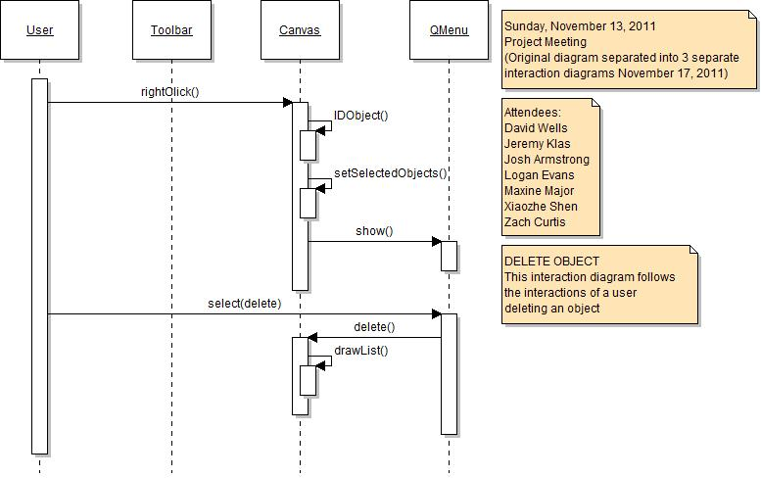
Interaction Diagram Deleting an Object

Slide 7
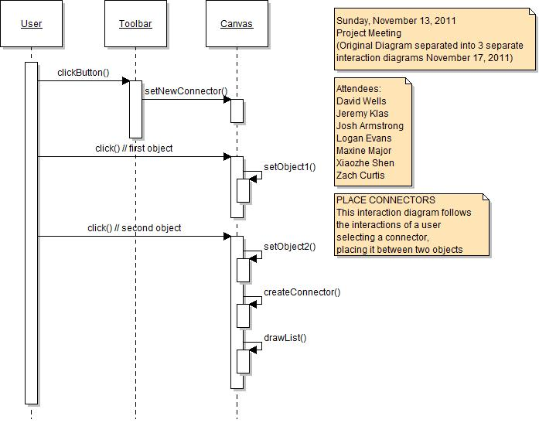
Interaction Diagram Placing a Connector

Slide 8
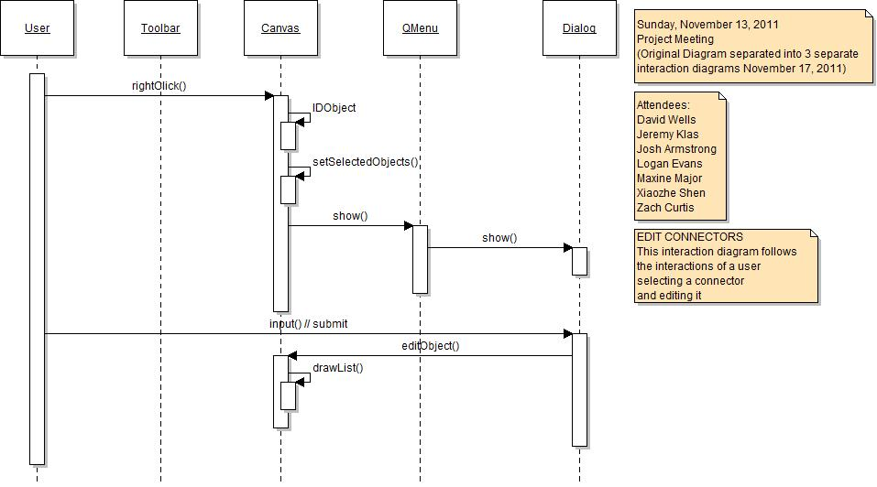
Interaction Diagram Editing a Connector

Slide 9
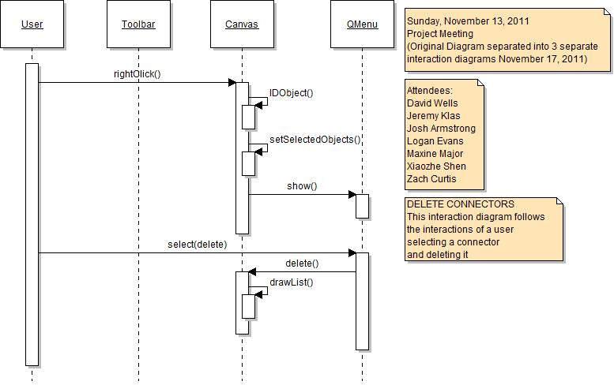
Interaction Diagram Deleting a Connector

Slide 10
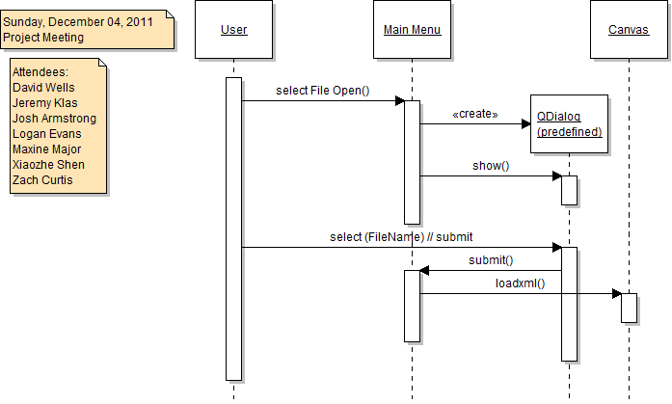
Interaction Diagram Opening a File

Slide 11
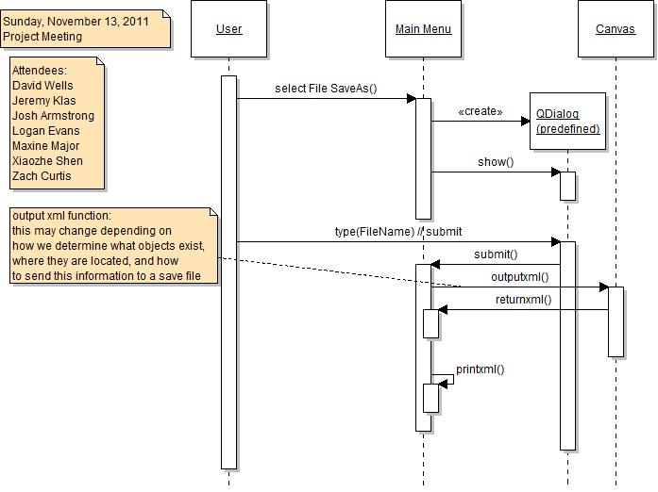
Interaction Diagram Saving a File

Slide 12
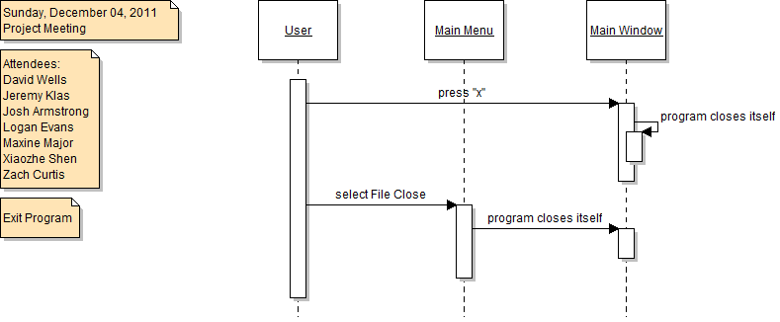
Interaction Diagram Exiting the Program

Slide 13
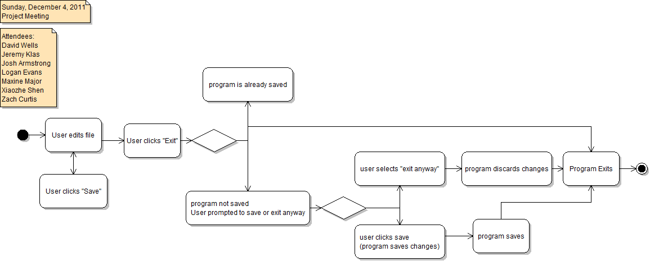
Activity Diagram Program Activities

Slide 14
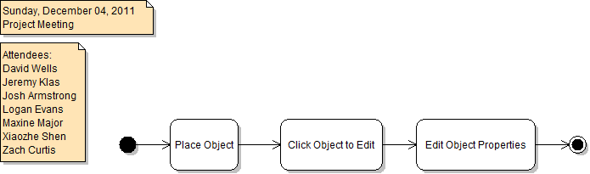
Activity Diagram Object Activities

Slide 15
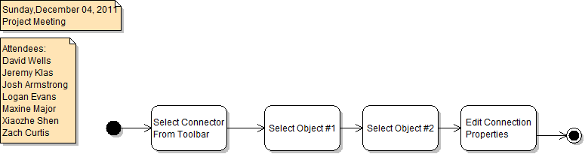
Activity Diagram Connector Activities

Slide 16
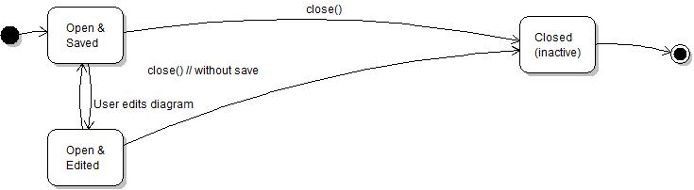
State Diagram

Slide 17
