Slide 1
Design and Implementation of a C Code Generator Module for the Gamma Statechart Composition Framework
Nagy Levente Márk
Advisor: Graics Bence

Slide 2
Fancy title, but..
What is the Gamma Statechart Composition Framework?
Why do we need Code Generators?
From where do we generate code?
What technologies are being used?
How do we achieve platform independence?
Especially in timing
How do we utilize the generated code?

Slide 3
The Gamma Framework
What is Gamma?

Slide 4
Code Generators
Why do we need?
Efficiency - no need for manual coding
Accuracy - reduce the risk of human error
Consistency - enforcing model-code behavior consistency
Maintainability - code maintenance by regenerating code
Portability - can generate code for different platforms
Potential presence of bugs in code generators, could we verify the results?

Slide 5
Technologies used
What technologies?
The XSTS language
Eclipse EMF
Xtend

Slide 6
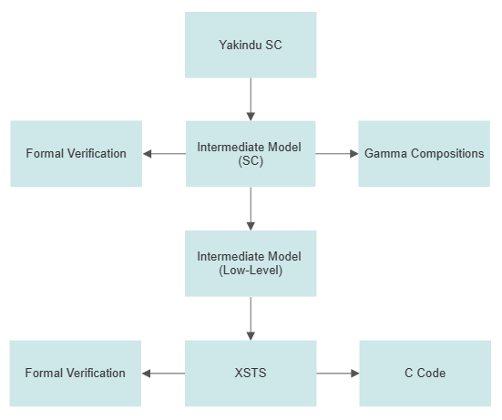
Model Transformation
From where?
Yakindu Statecharts
Transformed into gamma composite definition language.
Gamma Components
Transformed into XSTS with an extra intermediate step.
XSTS Model
Used to generate C code.
Can be used to formally verify the component.

Slide 7
Implementation
What technologies?
For each component..
2 source & 2 header files are being generated
Statechart component
Implements the behavior of its model
Resets in-, outputs between cycles
Declares all required structure
Wrapper component
Handles timing
Hides the internal mechanism
Provides Ports (in the form of setters/getters)

Slide 8
Platform independence
How do we achieve?
ISO Standard - standards for the C programming language
Extensive support from compilers.
Timing - measure time elapsed
Little-to-no overlap between platforms.
Similar structure between platforms
One class for each platform, contains the implementation
Central platform manager
Solution
Introduce a package for customized platform & timing handling.

Slide 9
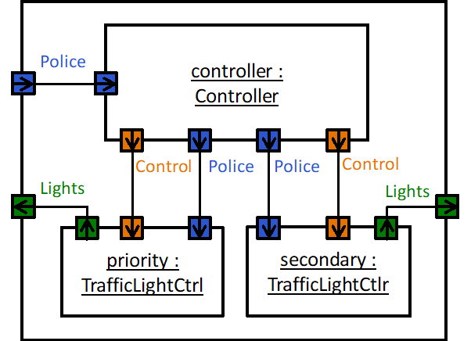
Case Study
The Crossroad Example

Slide 10
Utilization

Slide 11
Results

Slide 12
Summary
C Code Generation from XSTS Models
Portability, accuracy, consistency, etc.
Ensure platform independent code.
Case Study: The Crossroad Example
Future work
Support more platforms.
Formal verification of the generated code using model-checkers.
Generation
Generate accurate and consistent code from gamma compositions
Accuracy: fewer logical mistakes during coding
Consistency: the generated code will reflect the behavior of its models

