Slide 1
Second Project Work
Kulesh Zhuldyzay
Sarsenova Nagima

Slide 2
Web-site’s purpose
This web-site constructed for National Kazakh dresses’ online-ordering system which designed by Aisana Qasteeva
With the help of the site you can know information about “Qasteeva”’s works, materials and company, partners.
There included all the criteries and site designed by our owns.
In this presentation we will explain you how all functions works and what you can do with this web-site.

Slide 3
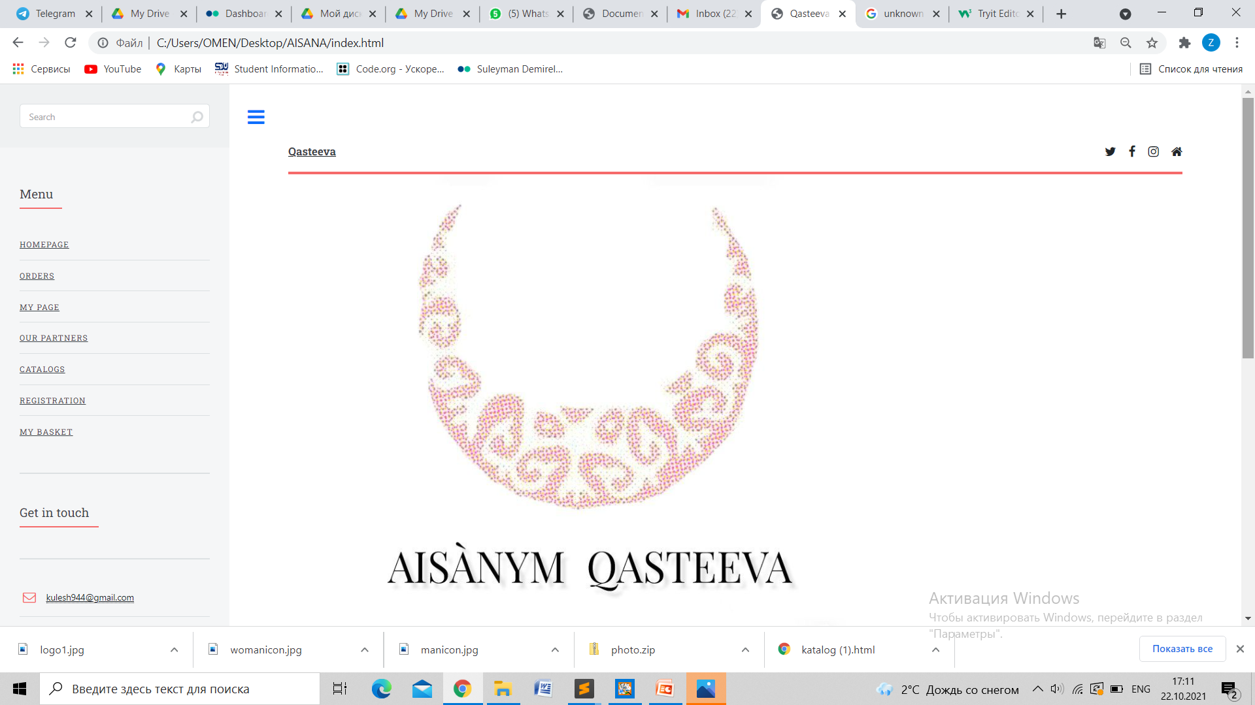
Home Page

Slide 4
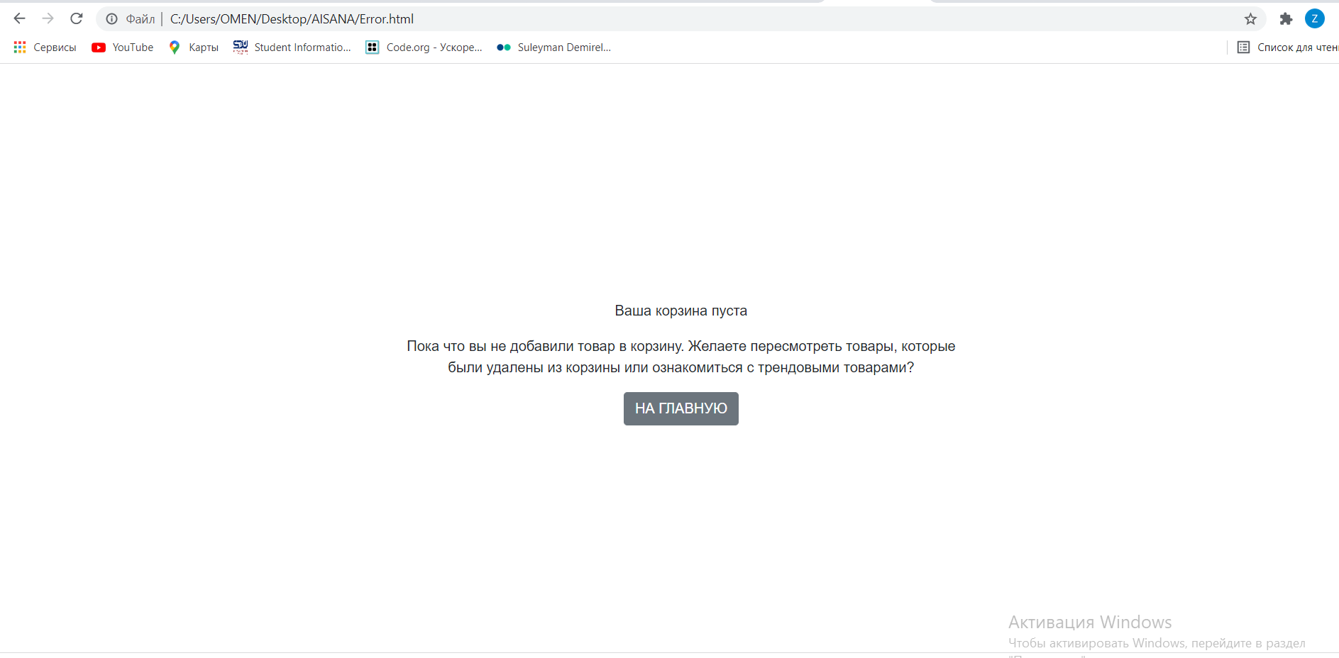
Page with an Error

Slide 5
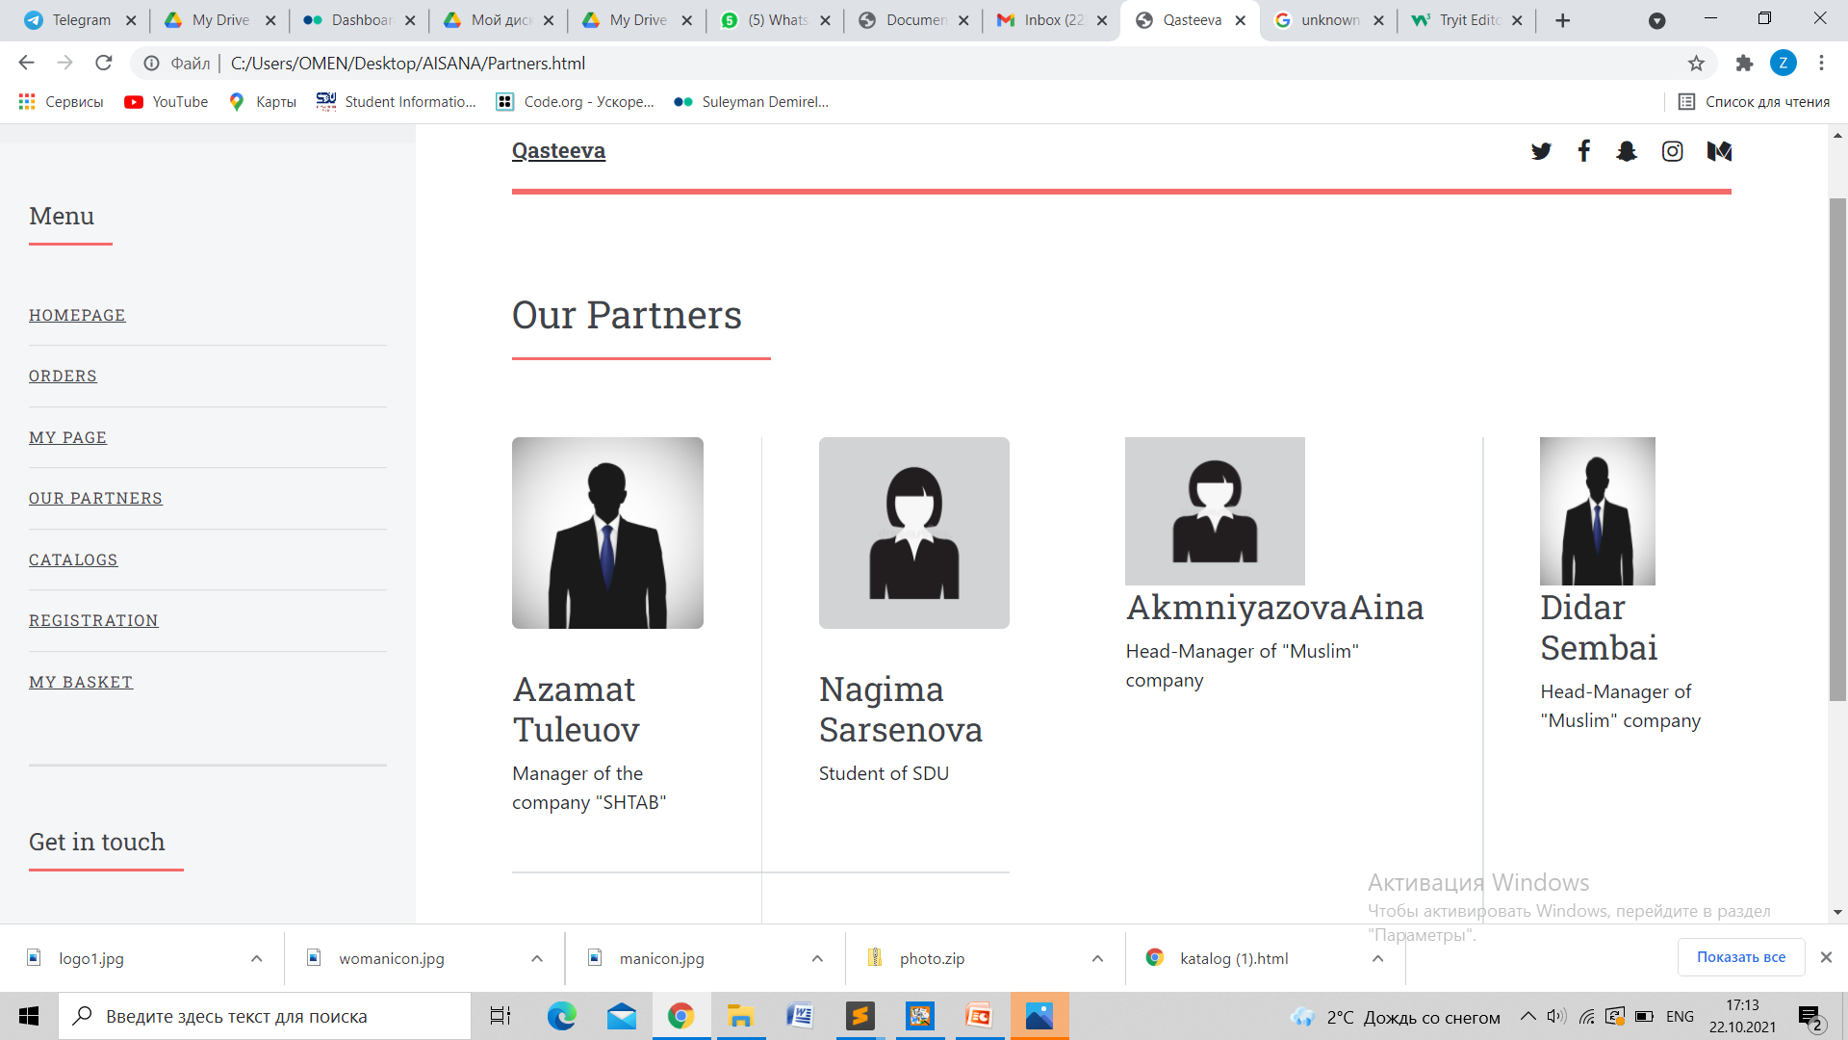
Page with information about Partners

Slide 6
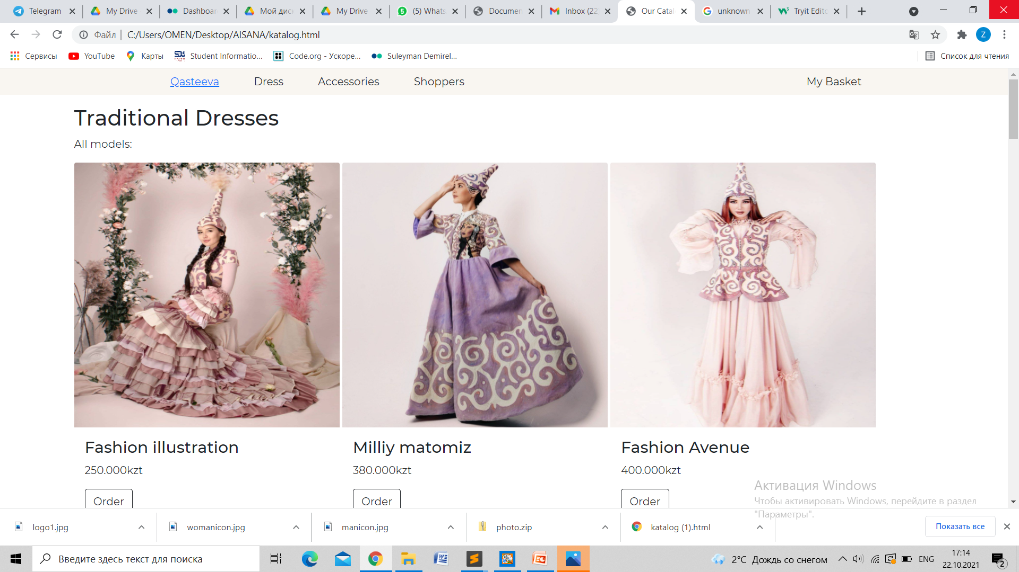
Catalog Page

Slide 7
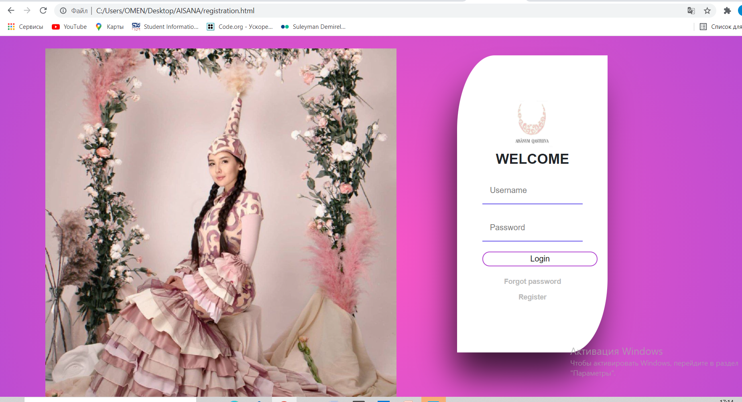
Registration

Slide 8
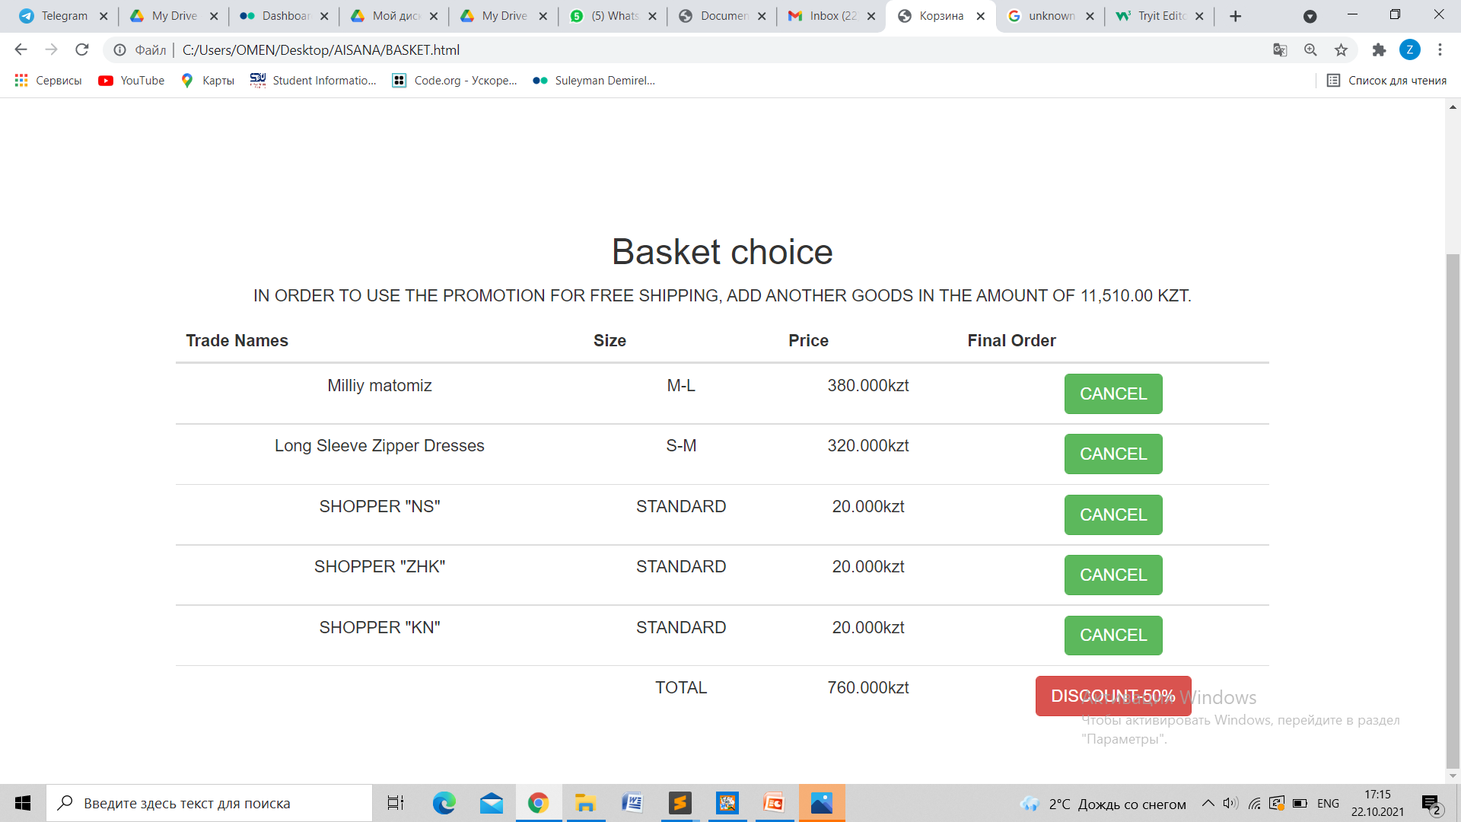
Basket Page

Slide 9
Conditions
1)Number of web pages must be at least 5.
2)The project must contain at least two flexbox containers with elements.
3)Some HTML elements in project must be aligned by bootstrap grid system.
4)In your project you should have at least five buttons and two tables. They should have bootstrap classes.
5)Colors should be defined by rgb, rgba, hsl, hsla functions and by hexadecimal numbers.
6)Web pages must be mobile adaptable.
7)Push your work in github repository.
8)Explain your work(for 5 minutes for one team) by slides during the practice class.

