Slide 1
news recommendation system
Akademi
Woodnalie S. JOSEPH
October 2025

Slide 2
01
introduction
data processing
table of contents
credibility assessment
recommendation system
02
03
04
05
recommendations

Slide 3
01
introduction

Slide 4
overview
A credibility-aware news recommendation system that delivers relevant AND trustworthy content to readers
Unlike standard systems that prioritize relevance alone, our solution integrates credibility assessment to filter misinformation while maintaining content relevance

Slide 5
problem statement - stakeholders
Standard recommendation systems promote fake news as easily as verified content
This erodes user trust and damages platform reputation
Readers make less informed decisions due to misinformation exposure
Primary stakeholder
The end user, specifically news readers who rely on digital platforms for information that are directly affected by exposure to misinformation
Secondary stakeholders
News platforms and aggregators seeking to maintain credibility and retain users

Slide 6
dataset description
WELFake dataset: 72,134 news articles from multiple sources
Created by merging Kaggle, McIntire, Reuters, and BuzzFeed Political datasets
Balanced distribution: 48.6% real news, 51.4% fake news
Final cleaned dataset: 63,121 unique articles after removing duplicates and missing values

Slide 7
02
data processing

Slide 8
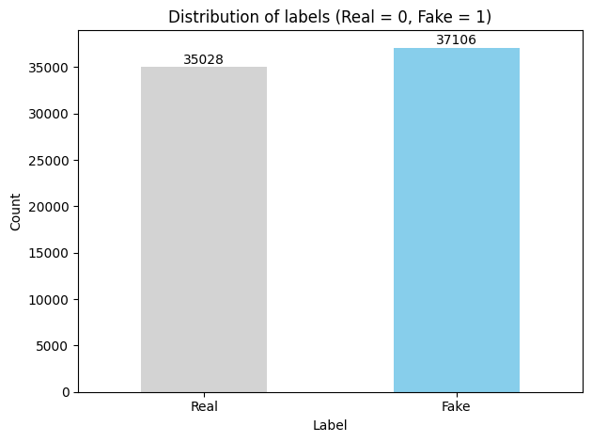
label distribution
Near-perfect balance: 48.6% real news, 51.4% fake news
No artificial data manipulation required
Ensures unbiased credibility assessment
Reflects real-world news ecosystem proportions
This balanced dataset enables reliable credibility scoring without overemphasizing either news type

Slide 9
feature engineering
Title Length: Fake news headlines are 14 characters longer on average
Real: 68.8 characters | Fake: 82.9 characters
Most powerful single indicator (66.2% accuracy)
Exclamation Count: Fake news uses 50x more exclamation marks
Real: 0.002 per headline | Fake: 0.107 per headline
Question Marks: Fake news uses 2.6x more questions
Real: 2.5% of headlines | Fake: 6.5% of headlines
Capitalization Ratio: Fake news uses nearly 2x more ALL-CAPS text
Real: 1.0% capitalization | Fake: 1.9% capitalization
These headline patterns serve as early warning signals that help identify misinformation before readers click through to full articles

Slide 10
03
credibility assessment

Slide 11
how we measure trustworthiness
Uses out-of-sample prediction to prevent data leakage
Scores represent probability that an article is real (0 = fake, 1 = real)
Maintains original dataset balance through stratified cross-validation
what we analyze in headlines
Punctuation patterns (exclamation marks, question marks)
Capitalization usage
Structural elements and length
Unlike standard systems, our credibility scores come from models that never saw the specific article during training, ensuring unbiased, reliable assessments

Slide 12
transparent explanations
SHAP Explainability reveals why articles receive specific credibility scores:
Identifies exact words/phrases that influence trustworthiness
Shows how "CDC" increases credibility or "BREAKING!!!" decreases it
Uses game theory approach for mathematically sound explanations
Reader-friendly output
Clear "High/Moderate/Low" credibility labels
Specific reasons like "Reputable health authority mentioned"
Actionable guidance: "Check sources before sharing"
This transforms opaque credibility scores into actionable insights readers can understand in seconds, not technical details

Slide 13
04
recommendation system

Slide 14
how we match content to readers
Content-based similarity
Analyzes headlines to find topically related articles
Uses advanced text analysis to understand what makes articles similar
Focuses on what interests readers (not just popularity)
Why this matters
89% of news consumption happens on mobile devices
Readers need relevant content in seconds, not minutes
Standard systems often recommend similar but misleading content
Hybrid scoring algorithm combines two factors
50% Content Relevance: What interests you
50% Source Credibility: Is it trustworthy?
Smart topic-sensitive filtering
Health topics: 45% credibility minimum
Political topics: 40% credibility minimum
Standard topics: 30% credibility minimum

Slide 15
perfect balance
Rigorous testing
Tested multiple weight combinations (50-80% similarity)
Measured impact on fake news reduction and relevance
The winning formula: 50/50 balance
Achieved 91% precision@5 (91 out of 100 top recommendations are real news)
Reduced fake news in recommendations by 38 percentage points (from 46% to 9%)
Maintained strong relevance (0.42-0.61 topic match)
This balance delivers the best protection against misinformation while keeping content relevant to readers

Slide 16
real-world results
When users view fake news (0.04 credibility)
System recommends articles with 0.63 average credibility while maintaining 0.42 topic relevance
When users view credible content (0.99 credibility)
System maintains high standards (0.97 average credibility) with 0.61 topic relevance

Slide 17
real-world results
1. Dynamic Credibility Thresholds
Problem: Fixed thresholds can't adapt to evolving misinformation tactics Solution: Automatically adjust scrutiny levels during emerging threats (e.g., health crises) Business Value: Stay ahead of misinformation without manual intervention while maintaining the 50/50 relevance/credibility balance

Slide 18
04
recommendations

Slide 19
1. Dynamic credibility
thresholds
2. Personalized credibility settings
3. Cross-platform credibility sharing
Problem: Fixed thresholds can't adapt to evolving misinformation tactics
Solution: Automatically adjust scrutiny levels during emerging threats
Business value: Stay ahead of misinformation without manual intervention while maintaining the 50/50 relevance/credibility balance
Problem: One-size-fits-all approach ignores different user needs and contexts
Solution: Simple slider for users to adjust relevance/credibility balance (70/30 to 30/70)
Business value: Increase user satisfaction while maintaining system integrity: breaking news seekers prioritize relevance, health researchers prioritize credibility
Problem: Misinformation spreads across platforms while systems operate in isolation
Solution: Privacy-preserving protocol to share anonymized credibility signals across platforms
Business value: Collective defense against coordinated misinformation campaigns through shared linguistic fingerprint detection

Slide 20
THANKS!
EMAIL : woodnaliesjoseph@gmail.com
LINKEDIN : www.linkedin.com/in/woodnalie-s-josephaa0011175
GITHUB : https://github.com/nah-yah

