Slide 1
Time Evolution of our Solar System
(with a twist)
Gerardo Ayes – University of Pittsburgh
Nick Hopkins – University of Pittsburgh

Slide 2
Objectives
Simulate 2-D Solar System using homework 8 code as starting point
Modify Solar System to take into account collisions
Create Animation function
Find initial conditions such that an Asteroid collides with Earth and orbit is significantly affected
Have some fun colliding asteroids with the Earth

Slide 3
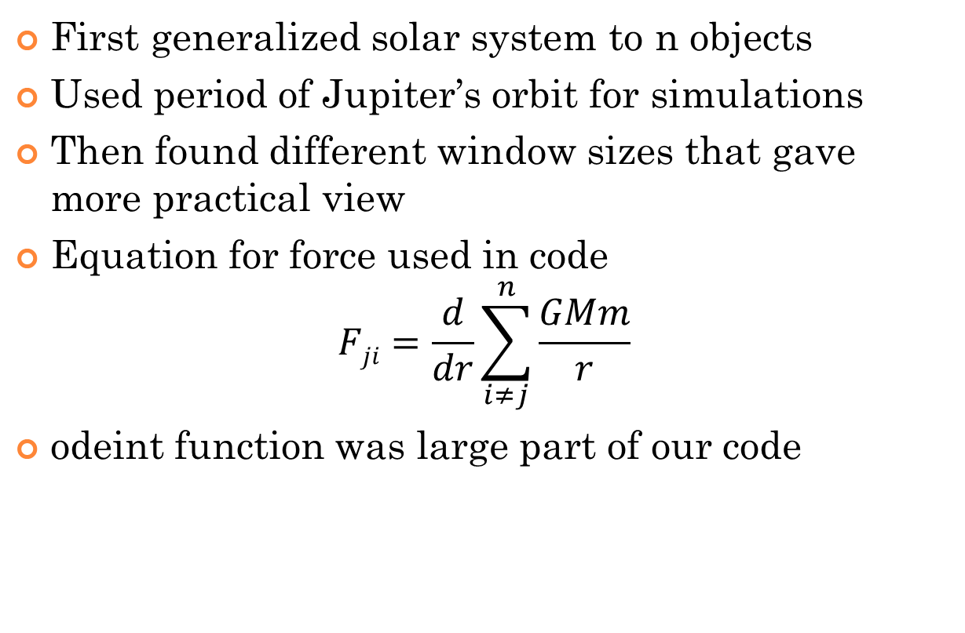
Simulation of our Solar System
First generalized solar system to n objects
Used period of Jupiter’s orbit for simulations
Then found different window sizes that gave more practical view
Equation for force used in code
$$Fji=\frac{d}{dr}\sum_{i≠j}^{n}{\frac{GMm}{r}}$$
odeint function was large part of our code
Notes:
Here open up basic_solar_system_animation.mp4
Then open basic_solar_system_animation_closeup.mp4 to illustrate size of window

Slide 4
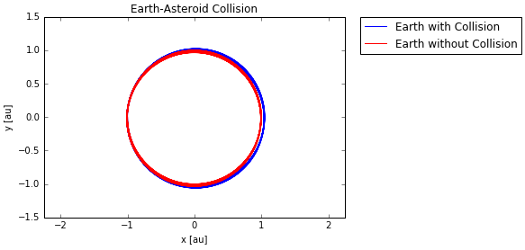
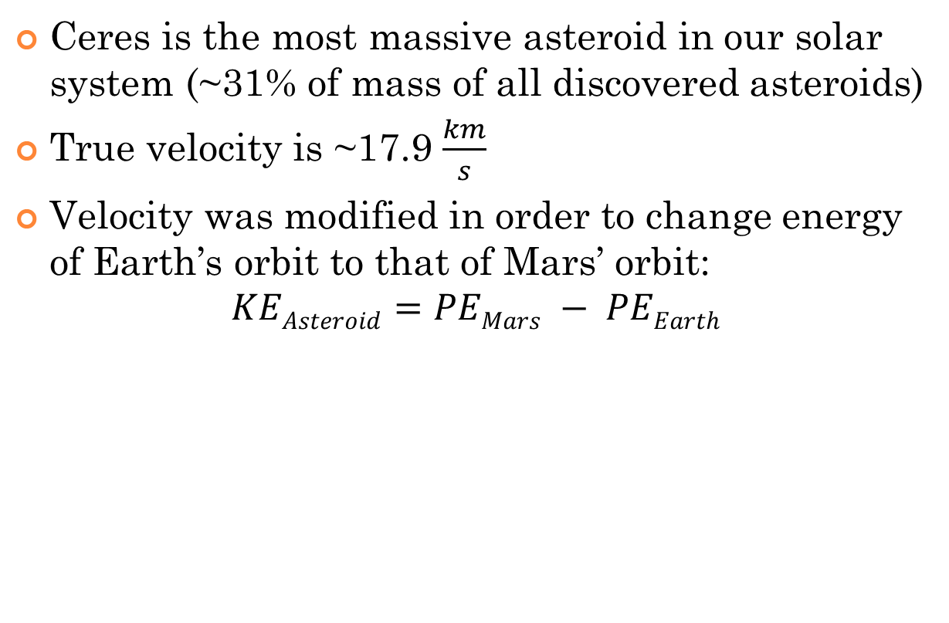
First Test Case
Ceres is the most massive asteroid in our solar system (~31% of mass of all discovered asteroids)
True velocity is ~17.9 $\frac{km}{s}$
Velocity was modified in order to change energy of Earth’s orbit to that of Mars’ orbit:
$$KEAsteroid=PEMars − PEEarth$$

Slide 5
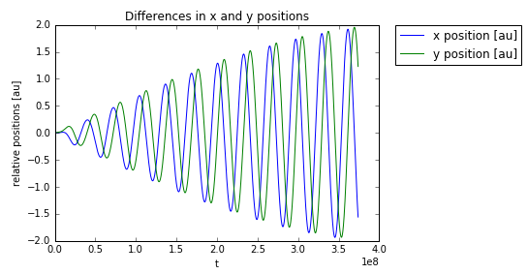
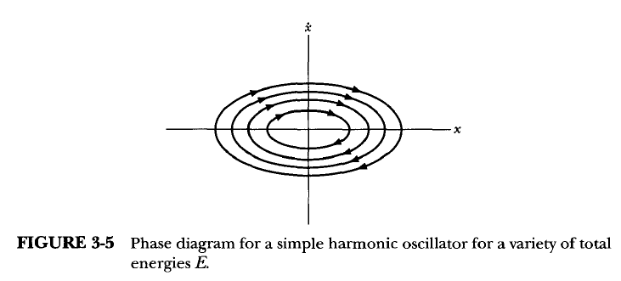
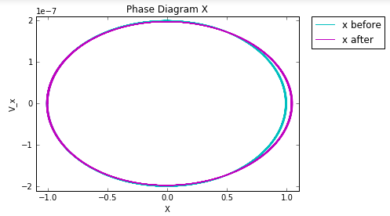
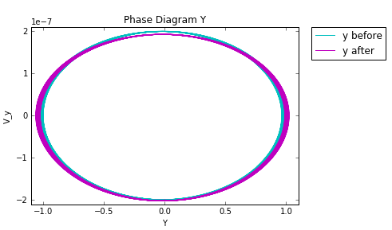
First Test Case (Analysis)

Slide 6
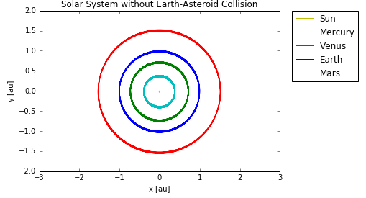
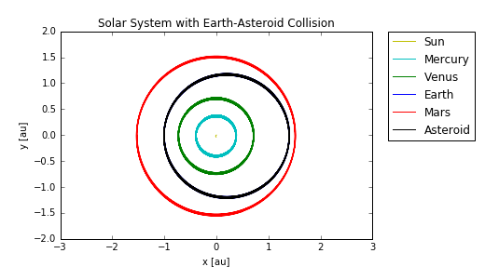

Second Test Case
Now consider a Moon-sized object
Gave it an initial velocity such that
$$KEAsteroid=0.7265∗PEEarth$$
This was arbitrary, in order to see huge change in Earth’s orbit

Slide 7
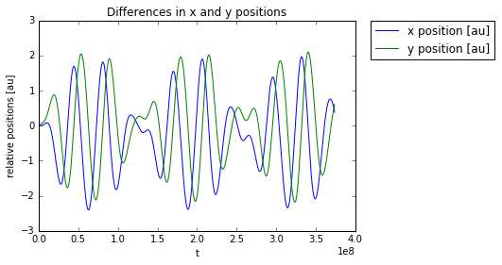
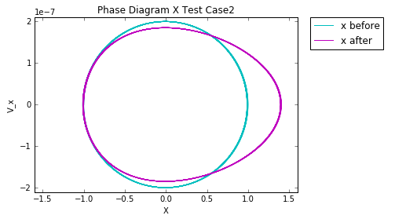
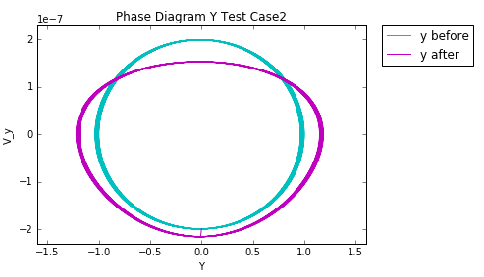
Second Test Case (Analysis)

Slide 8
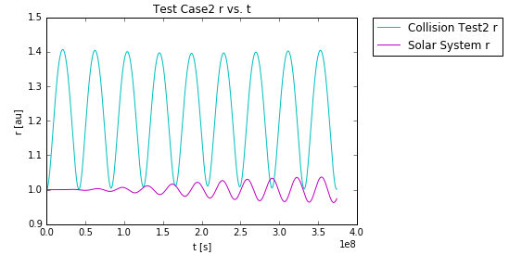
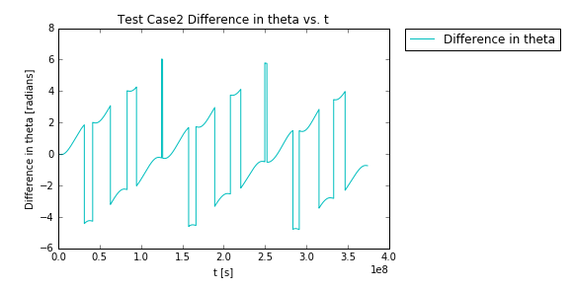
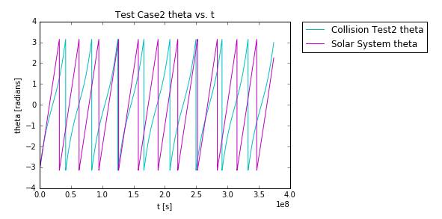
Second Test Case (Analysis Cont.)

Slide 9
Possible Follow up Material
Optimize functions for speed
Additional test cases
Perhaps more realistic test cases and iterate over longer period of time to see affect on system
Analyze why plot of theta vs. time gives a Sawtooth wave
Confirm that our code produces stable orbits by iterating over much longer periods

Slide 10
Thank You
Special thanks to Dr. Wood-Vasey
for his help developing the code presented
today

