Slide 1
Films & Series
Made by: Han Solo and Luke Skywalker

Slide 2
Topic
Films and series
My task: films
Mobile Application
Web page (responsive)
https://github.com/nahajia/mobilfrontend
https://github.com/nahajia/mobilbackend
https://github.com/nahajia/webfrontend
https://github.com/nahajia/webbackend

Slide 3
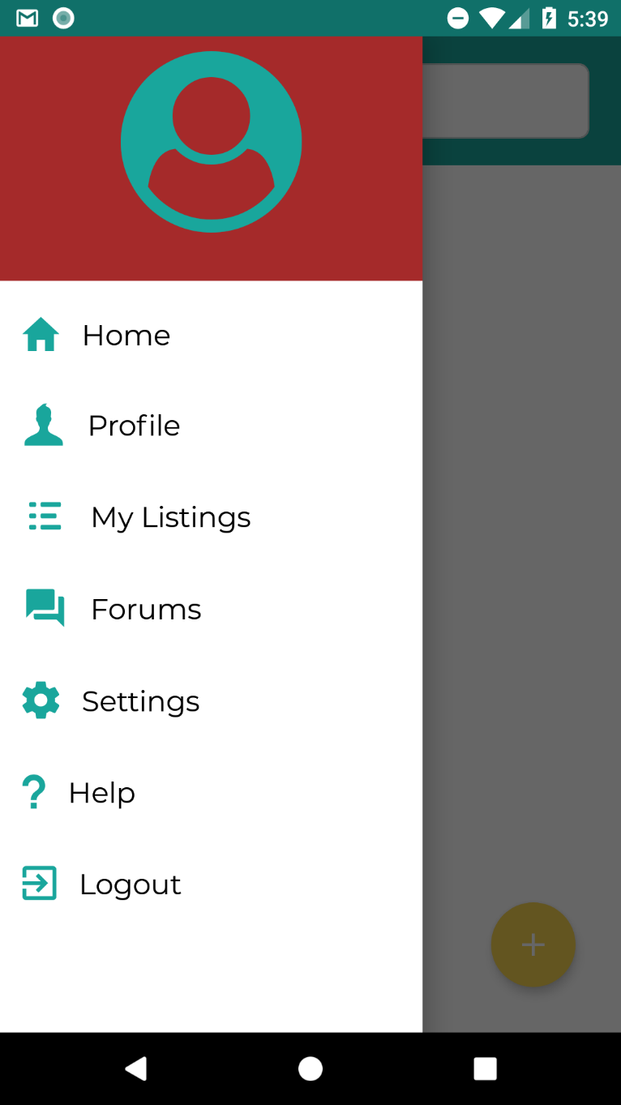
Functions in Mobile App (első ember)
Browse films
Search films by keyword
Search films by type
Comment films

Slide 4
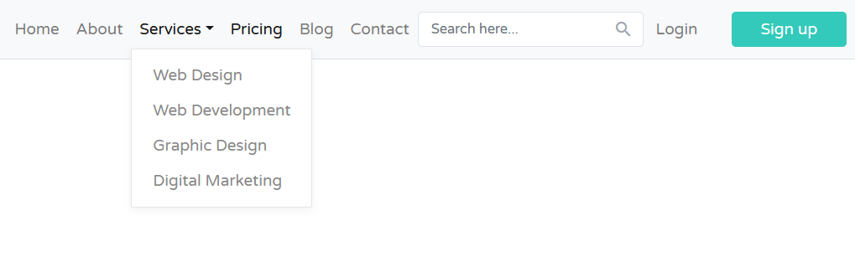
Functions on Web page
Browse films (Mobile)
Search films by keyword (Mobile)
Search films by type (Mobile)
Comment films (Mobile)
User login and registration
Admin functions:
Delete films
Insert films
Statistics of user clicks

Slide 5
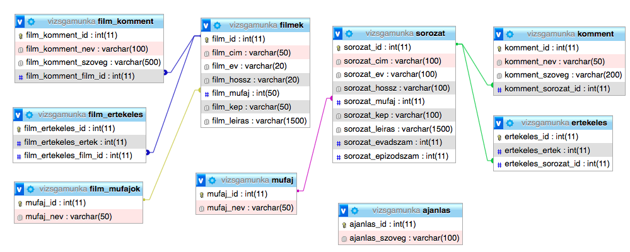
Database

Slide 6
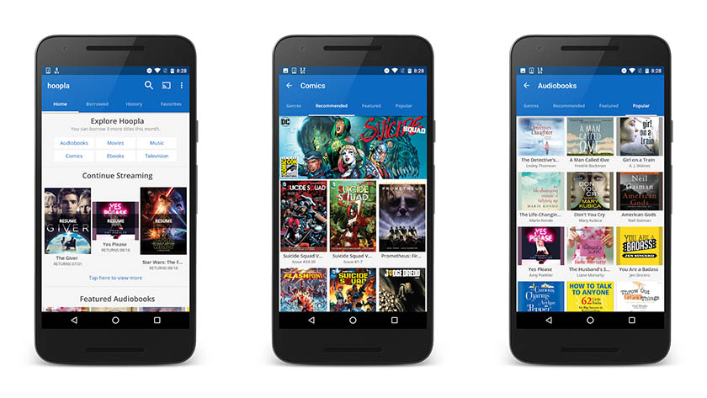
Mobile- Browse films

Slide 7
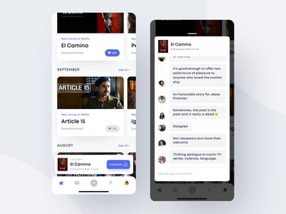
Mobile- Comment films

Slide 8
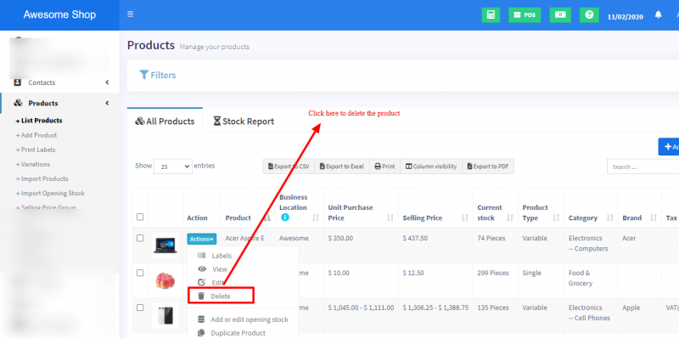
Web page – Admin functions Delete films

Slide 9
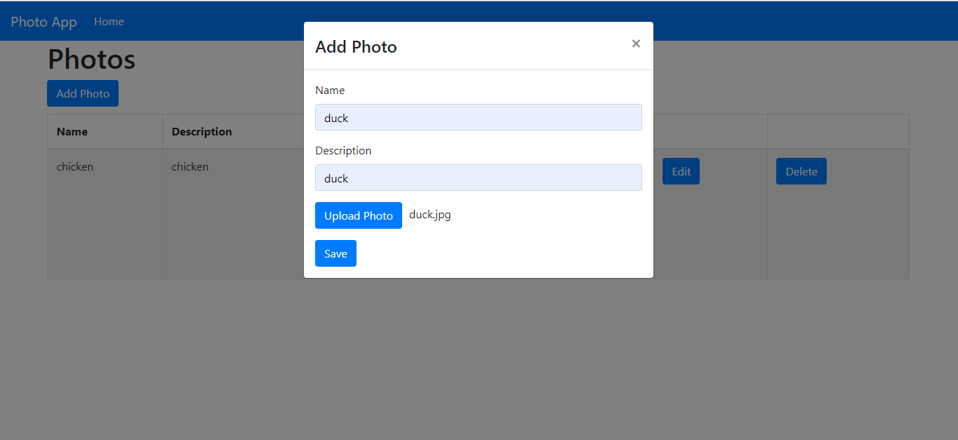
Web page – Admin functions Insert films

Slide 10
(második ember adatb, ha kell)

Slide 11
(második ember funkciók, képernyőképek)

Slide 12
Development tools:
Softwares:
Node.js
Phpmyadmin
VS Code
Postman
Frameworks:
Express (Backend)
React Native Expo (Frontend)
Modules (Frontend): datetimepicker, ….

