Slide 1

CST 456 - Embedded Systems Testing
Lecture #4

Slide 2
Outline
Constrained Pseudo-random Testing

Slide 3
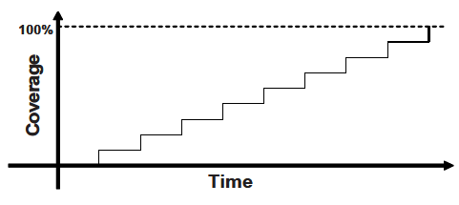
Directed Testing
Pro: Measurable progress against the design specification.
Cons: Does not scale well with increasing design complexity. Only finds bugs you expect to be there.

Slide 4
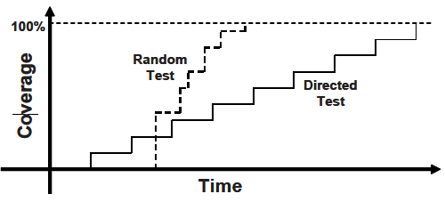
Random Testing
Pro: Scales with increasing design complexity. Finds bugs you wouldn’t expect.
Cons: High time / cost to start testing.

Slide 5
What to Randomize
Device configuration.
Many directed tests do not stray far from post-reset device configurations.
Environment configuration.
If device has two SPI buses, test all four possible configurations.
Input data.
Protocol errors, exceptions, and violations.
Delays and synchronization.

Slide 6
Simulation Phases
Build phase.
Randomize the configuration of the DUV.
Allocate and connect the test bench components.
Reset the DUV.
Configure the DUV.
Run phase.
Start environment.
Run the test.
Wrap-up phase.
Wait for final transactions to be completed.
Analyze data and report whether test passed or failed.

Slide 7
Constrained PRN Generation
SystemVerilog has two main ways to work with PRN.
Classes with random variables.
Use of the std::randomize() function.
In the most basic sense you can think of a class as a struct with functions (methods) that manipulate the data (objects) within.
Two type modifiers within a class with random variables.
Rand randomizes with replacement.
Randc randomizes without replacement.

Slide 8
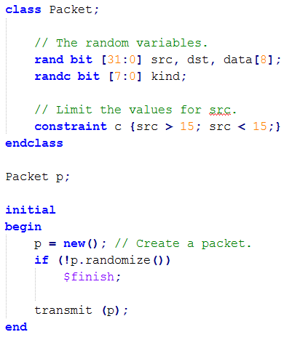
Class with Random Variables

Slide 9
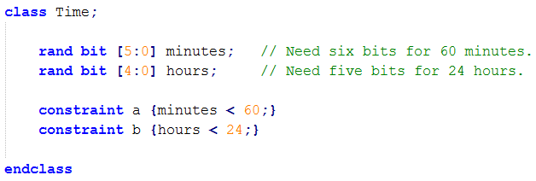
Class with Random Variables

Slide 10
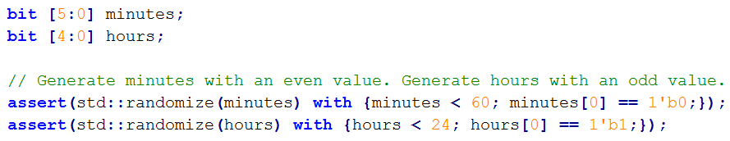
Std::randomize () Function

Slide 11
Constraint Solver
Solver chooses values that satisfy constraints.
Values come from a pseudo-random number generator provided with a seed.
Same seed and testbench will yield same random sequence.
Testbench run on different EDA tools may yield different sequence.

Slide 12
What can be Randomized?
Only integral variables can be randomized.
Reg, logic, bit, int, byte, etc.
Even enum.
Strings and real numbers cannot be randomized, although random integral variables can be converted to strings or real numbers.
Example: randomize value then use $bitstoreal(value).

Slide 13
Weighted Distributions
Weighted distributions allow randomization but instead of a having a uniform distribution the distribution can be customized to focus attention on certain configurations / data / protocols / designers.
The := operator specifies that the weight is the same for every specified value in the range.
The :/ operator specifies that the weight is to be equally divided between all values.

Slide 14
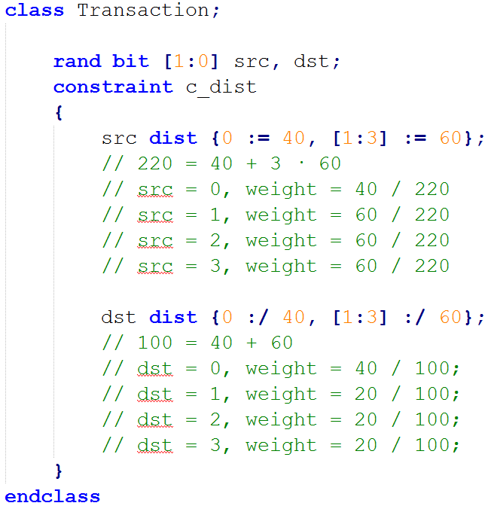
Weighted Distributions

Slide 15
Common Distributions
SystemVerilog has functions that generate common distributions.
$dist_exponential
$dist_normal
$dist_poisson
$dist_uniform

Slide 16
Scoreboard
The scoreboard is the component of the test bench that monitors the values of the inputs to and outputs from the DUV and provides temporary storage for them.
Certain events cause the scoreboard to store information. For example a signal might be asserted, a beginning or end of transmission packet is read, or a certain number of clock cycles have passed.

Slide 17
Monitor
Beyond the scoreboard the monitor records the values of signals and states of interest for use in coverage checking or debugging.
If the DUV is entirely black box then only the input and output signals can be recorded.
If the DUV is grey or white box then key signals and states within the DUV can be recorded. This aids greatly in the debugging process if a bug is found.

Slide 18
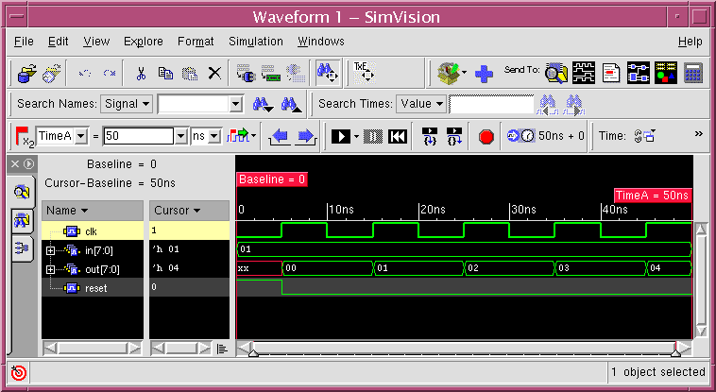
Checker
In the old days checking for correct functionality was a manual process. The DUV was stimulated to produce a series of input and output waveforms which were checked by the verification engineer or designer.

Slide 19
Checker
A modern checker reads the scoreboard and determines if the DUV is behaving correctly based on the input and output values.
It tends to be one of the more difficult components to create. The verification engineer might need to conceive of all the required checking cases.
If a failure occurs the test simulation can be halted, or it can be allowed to continue to find other bugs.

Slide 20
Checker
Three types of checkers.
Golden vectors.
Reference model.
Transaction based.

Slide 21
Golden Vectors
A golden vector test environment is a simple environment where, for a given set of input vectors, the output vectors are known ahead of time.
Golden vectors work well when the output is easy to predict.
Used in regression testing to make sure any design changes did not impair the functionality of the design.
Also used during post-silicon verification testing and manufacturing test.

Slide 22
Reference Model
The reference model calculates all expected outputs based on the input stimulus. The reference model re-implements the function of the DUV, usually in a high level programming language or HVL.
Reference models work well when it is difficult to predict the output based on a set of inputs.
Reference models can be provided by the architect who might have created one during the high level design.

Slide 23
Transaction Based
A transaction-based environment is used for DUVs that have identifiable transactions in which commands and data are acted on and forwarded to appropriate output signals.
This type of checking environment uses a scoreboard to track commands and data driven on the inputs of the DUV.
The scoreboard keeps a record of all current transactions that have entered the DUV but have not been completed.

