Slide 1

CST 456 - Embedded Systems Testing
Lecture #6

Slide 2
Outline
Manufacturing Process
Manufacturing Testing
Quality and Reliability
Post-Silicon Verification / Validation

Slide 3
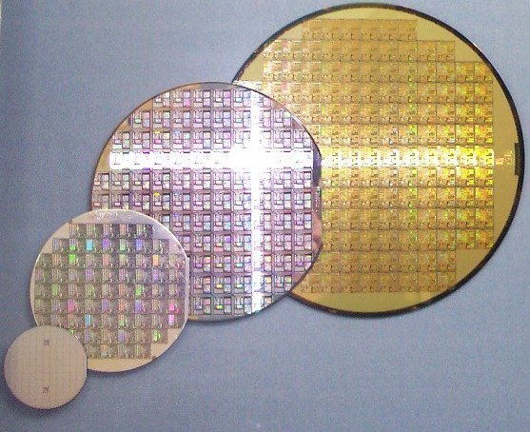
IC Fabrication

Slide 4
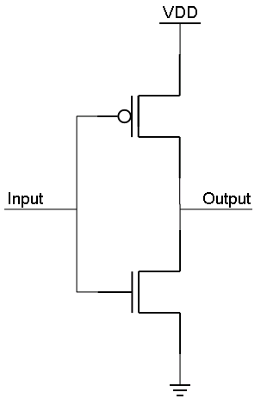
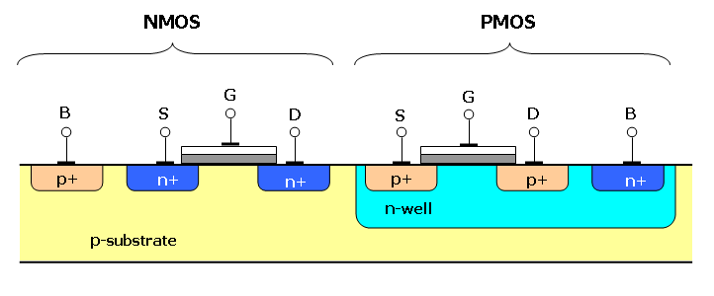
Static CMOS Logic

Slide 5
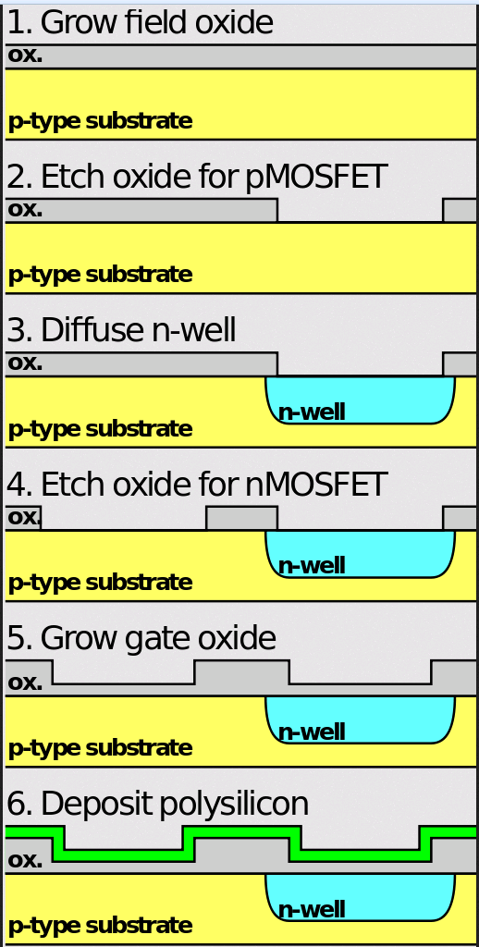
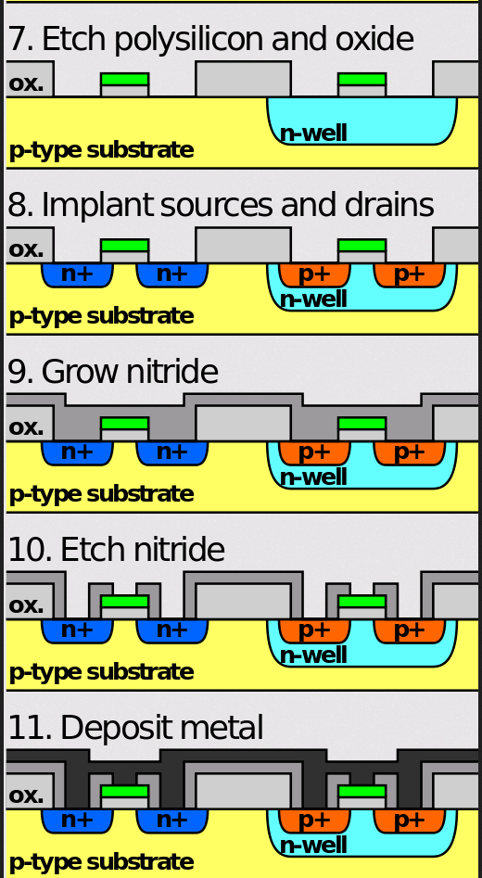
CMOS Fabrication

Slide 6
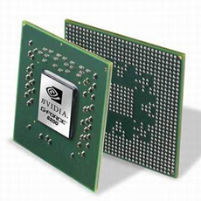
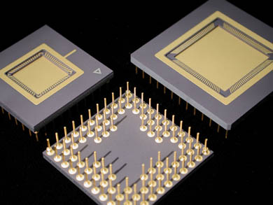
IC Packaging

Slide 7
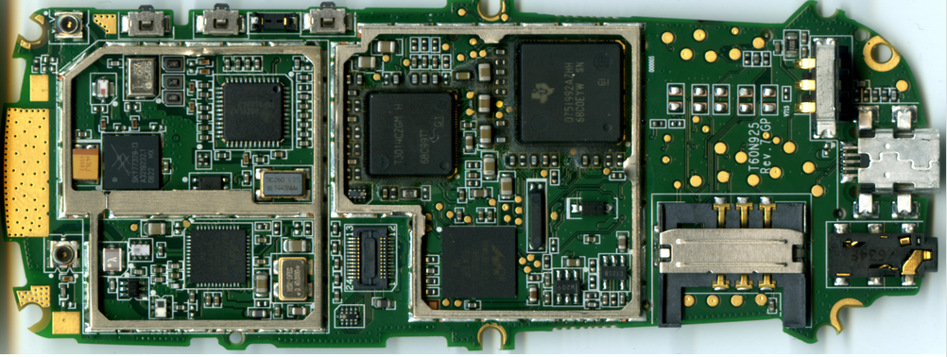
System Board

Slide 8
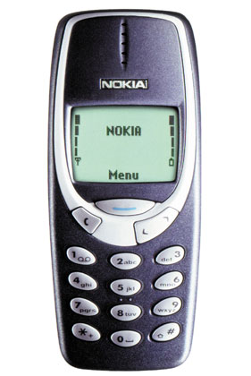
Final Product

Slide 9
Wafer Test
IC fabrication houses (should) do their best to manufacture ICs without defects. However manufacturing defects will always occur.
Purpose of wafer test is to remove defective ICs from the manufacturing process flow.
Yield: (# good die) / (total # die)
In general it is cheaper to discard ICs at the wafer level than later on in the manufacturing process.

Slide 10
JTAG
JTAG stands for Joint Test Action Group and its standard is IEEE 1149.1.
JTAG allows outside access to device internals for test and debugging.
A JTAG port consists of up to 5 signals.
TDI (Test Data In)
TDO (Test Data Out)
TCK (Test Clock)
TMS (Test Mode Select)
TRST (Test Reset) optional.

Slide 11
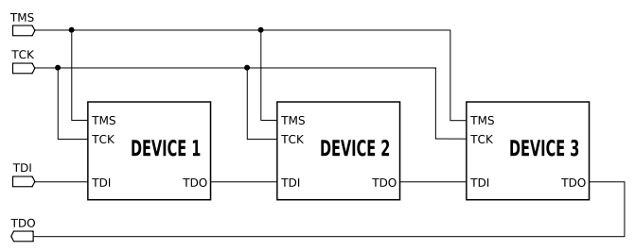
JTAG

Slide 12
Scan Chain
A scan chain is used to test the structural integrity of sequential and combinational logic. Scan chains are primarily used to detect opens and shorts.
Design for test (DfT) tools automatically insert multiplexers in front of flip-flops in the design, allowing the flip-flop to operate in either test or normal mode.
When used in test mode the flip-flops act as a long shift-register. A test pattern is loaded into each flip-flop, the pattern is processed by the combinational logic, and then the result is shifted to the scan output.
Test patterns can also be generated automatically.

Slide 13
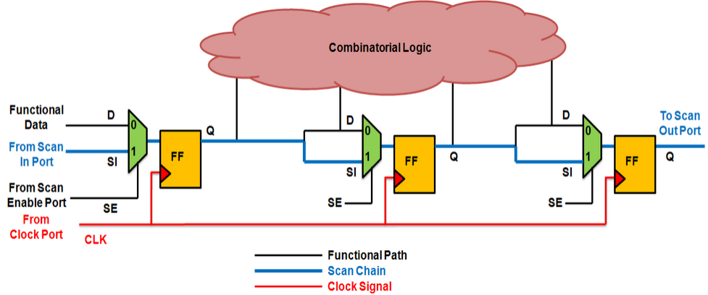
Scan Chain

Slide 14
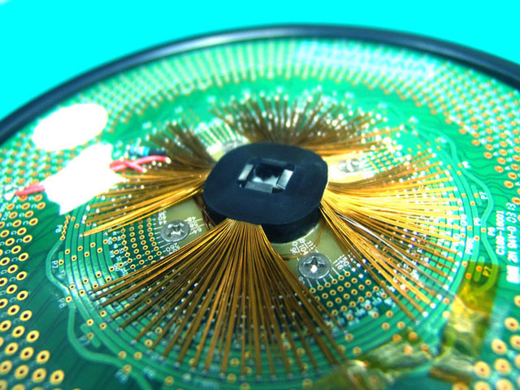
Wafer Probe Card

Slide 15
Package and Burn-in
After the IC is placed in its package it is commonly subjected to a burn-in process to thermally and electrically stress the part.
Once the part has been burned-in it is again tested to screen out package and latent manufacturing defects.
Due to system-on-chip and system-in-package designs, the package test is becoming more complex.

Slide 16
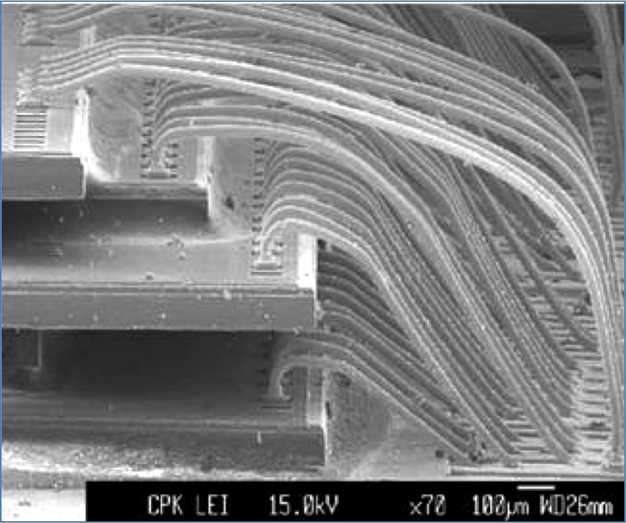
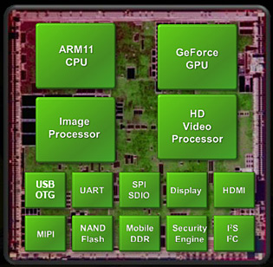
Package Technology

Slide 17
System Board Test
At the system board level, most of the components should have already been tested (ICs, capacitors, resistors, etc).
Defects can affect the system board through heat (soldering), humidity, electro-static discharge, and foreign materials.
The system board test is usually the last comprehensive test before the product is shipped, so it needs to be thorough.

Slide 18
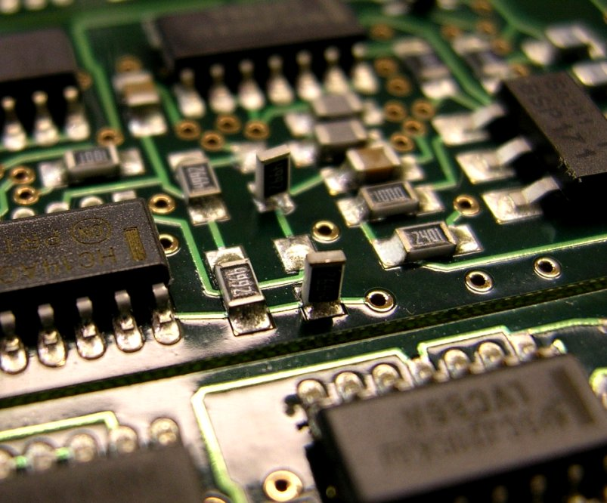
System Board Defect

Slide 19
Full System Test
Once the final product has been assembled the device needs to be tested one last time before being shipped.
For simple devices it might just be turning on the power. For more complex devices test firmware can be run to do a final check of the system.
To find a failure at this level is very expensive.

Slide 20
Manufacturing and Test
Ideally the entire manufacturing chain would find an ideal balance between limits, coverage, and test time.
Unfortunately the various test and manufacturing groups are typically within their own information silos and only cross-communicate when they have to.
Manufacturing tests are able to detect many design defects that should have been caught earlier in the verification cycle, but it is a very expensive method to find these.

Slide 21
Quality and Reliability
Quality is ensuring that the product shipped to the customer is functional.
Reliability is ensuring that the product shipped to the customer stays functional.

Slide 22
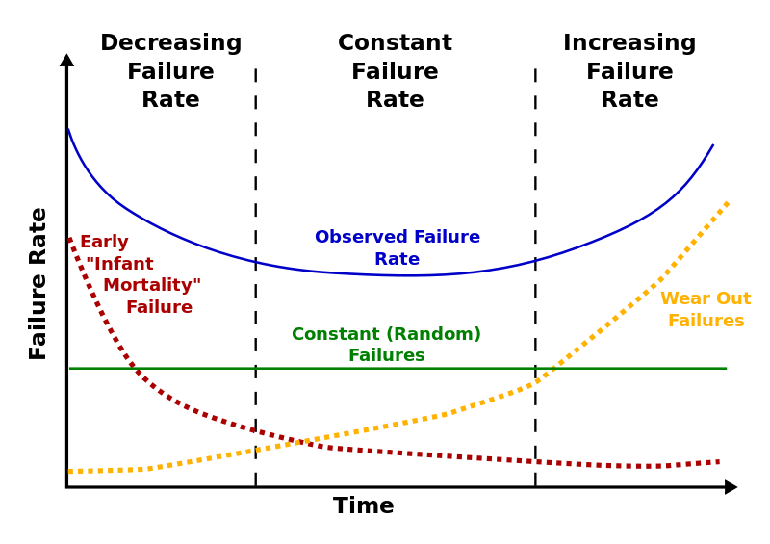
Quality and Reliability

Slide 23
Role of Burn-in
Burn-in prematurely ages the device so that failures that might occur a month or two later (while being used by the customer) occur sooner and can be screened.
The ways most electronics are prematurely aged is through high temperature (~ 140 C – 160 C) and high voltage.
A balance must be achieved between burn-in time and total lifetime of the part. If the burn-in is too long then the part will fail sooner due to wear out.
Burn-in typically occurs after ICs are packaged.

Slide 24

Burn-in Oven

Slide 25
Post-Silicon Functional Verification
The process of post-silicon functional verification (PSFV) is concerned with verifying that the realized hardware is able to meet the design requirements.
Chip-level pre-silicon verification tests can be reused as post-silicon tests. Anecdotally, 98% of design bugs are found pre-silicon, the rest are found post-silicon.
Emulators help fill the gap between pre-silicon and post-silicon activities. They offer the observability and controllability of simulation with the speed of final hardware.

Slide 26
Design for Verification
Some designs are created with an eye towards PSFV. This area of design is know as design for validation / verification (DFV).
DFV functionality is not enabled during normal operation of the system. It is a special mode for testing and debugging.
Implementing DSV helps expose internal signals that can then be monitored and controlled.
Through increased controllability and observability, internal design blocks can be targeted and thoroughly stressed and tested.

Slide 27
Pre-Silicon and Post-Silicon Trade-offs
Area | Pre-Silicon | Post-Silicon
Signal Controllability and Observability | + | -
Test Time | - | +
Debugging | + | -
Hardware Modeling | - | +
Cost of Discovering Bugs | + | -

Slide 28
Electric Characteristics
Since the design is now realized as hardware it is susceptible to all the noise and uncertainty of the analog domain.
Clock speed, jitter, and skew.
Signal delays and edge rise and fall times.
External and internal noise, ground bounce, and IR drops.
Crosstalk between wires.
Race conditions.

Slide 29
Shmoo Plot
Shmoo plots show how the device behaves over a range of varying conditions and parameters like clock speed, voltage, temperature, etc.
Typically digital devices can operate correctly at a higher clock speed if the supply voltage is increased or the temperature is decreased.
Shmoo plots can reveal anomalies in the behavior of the device.
Device does not work at a specific supply voltage, or cannot work at low frequencies, etc.

Slide 30
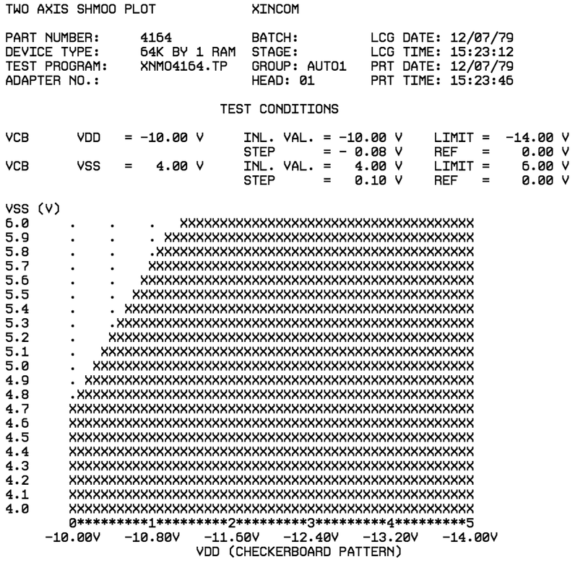
Shmoo Plot

Slide 31
Post-Silicon Electrical Validation
Electrical validation testing includes:
Verifying the absence of latch-up.
Verifying resistance to electro-static discharge.
Power consumption as a function of supply voltage, clock speed, and temperature.
Life testing.

