Slide 1

CST 456 - Embedded Systems Testing
Lecture #1

Slide 2
Outline
Class Overview
Lecture – Case Studies, Why Test?, Testing Today. Freescale 68HC11.

Slide 3
Overview
Class is designed with a bottom-up approach: HW -> FW -> System.
Hardware testing is split into design verification and manufacturing test.
Firmware testing focuses on final production code.
Systems testing focuses on testing the embedded device as it would be used by an end-user.

Slide 4
Overview
Many concepts in testing are universal and not unique to embedded systems.
Will try to focus attention on embedded systems through full system development from hw level to system level, and by using technology designed specifically for embedded systems: simulators, compilers, and software frameworks.

Slide 5
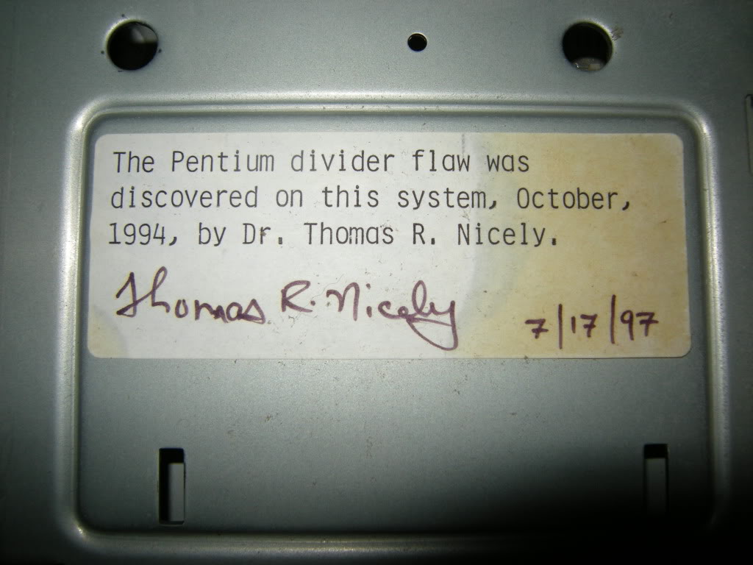
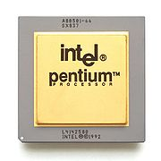
Case Studies

Slide 6
Pentium FDIV Bug
Discovered by Thomas Nicely, a number theorist, as he was computing prime numbers.
Problem was in a floating point lookup table.
Official Intel statement: Script error.
Other sources: design error.
For the most part it was a minor bug but cost Intel over a billion dollars.

Slide 7
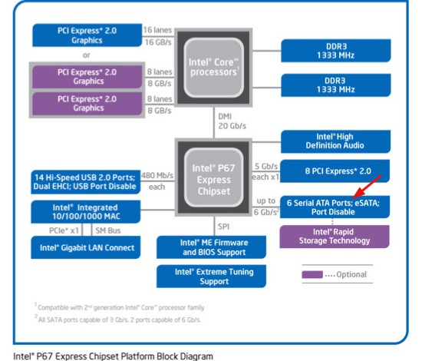
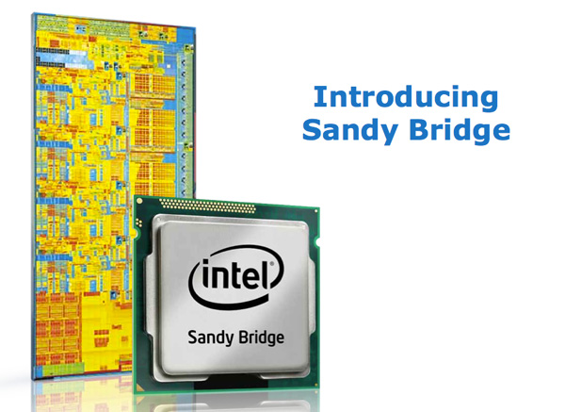
Case Studies

Slide 8
Cougar Point Reliability
I/O transistor voltage rating was less than recommended, causing degradation of the transistors over months of use.
Warning from design tools was actually reported to engineers, but was ignored due to an excess number of warnings.
Cost Intel many hundreds of millions of dollars in replacement and loss of sales. Allowed AMD to gain market share.

Slide 9
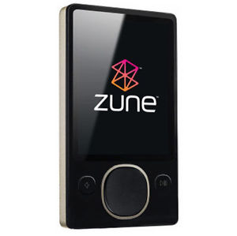
Case Studies

Slide 10
Zune New Years Bug
On December 31st, 2008 all 30 GB Zune devices stopped working.
Originally assumed to be a hardware failure but was actually firmware stuck in an infinite loop.
A FW patch was released to fix the issue.
A recall was not needed, but it did not help Microsoft in competing with the ipod.

Slide 11
Zune New Years Design Flaw
year = ORIGINYEAR;
while (days > 365)
{
if (IsLeapYear(year))
{
if (days > 366)
{
days -= 366;
year += 1;
}
}
else
{
days -= 365;
year += 1;
}
}

Slide 12
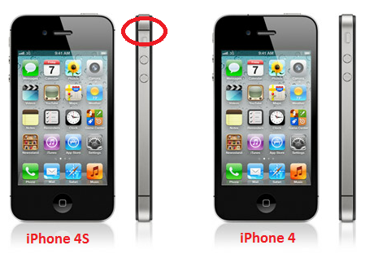
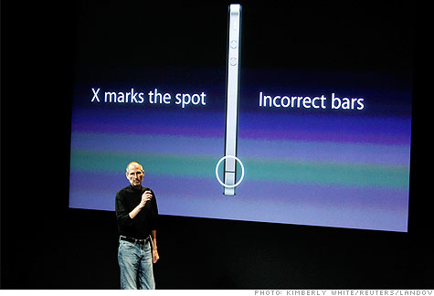
Case Studies

Slide 13
iPhone 4s Antenna Bug
It was reported immediately upon release that holding the phone a certain way resulted in dropped bars and signal strength.
Apple stated that users were holding the phone incorrectly.
Was confusing because not all iphones were affected.
Apple eventually solved the problem with a special case that shielded the antenna from the user’s hand.

Slide 14
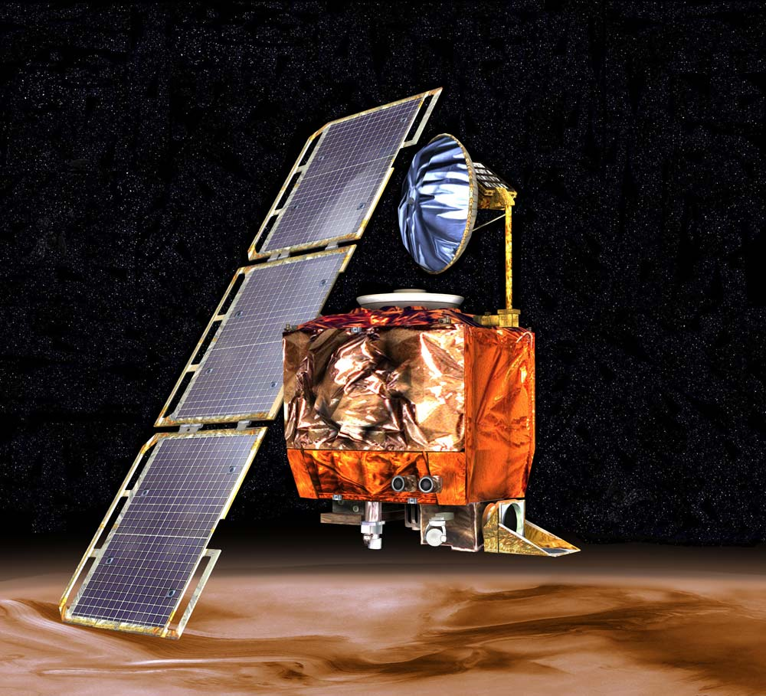
Case Studies

Slide 15
Mars Climate Orbiter
On September 23, 1999 NASA lost contact with the climate orbiter as it had disintegrated upon entering the Martian atmosphere.
Cause of the error was found to be due to inconsistent use of thrust units (force).
The orbiter was using metric Newtons while the NASA software was using pound-force.
NASA has gone to great lengths to make sure this doesn’t happen again.

Slide 16
Case Studies
Large companies can learn and grow from these debacles if they have the financial reserves to weather the storm.
Small companies might not be so lucky. One badly designed product can spell the end of the company.

Slide 17
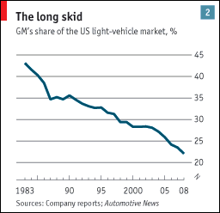
Case Studies
Sometimes companies don’t learn until it’s too late…

Slide 18
Why Test?
Design engineers and developers aren’t perfect; they are human and can make mistakes.
Today’s embedded designs can be extraordinarily complex. Design reviews, lint, and compiler error checking (static analysis) cannot take the place of exercising the device.
The longer a design flaw travels up the production path, the more expensive it becomes, resulting in schedule delays.

Slide 19
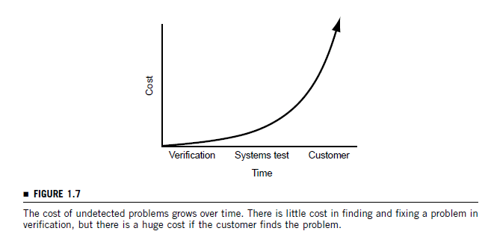
Why Test?

Slide 20
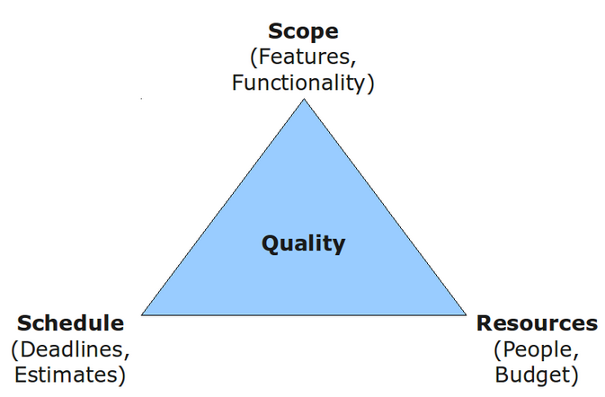
Why Test?

Slide 21
Correct Balance
Schedule - product success depends heavily on hitting the marketplace at the right time.
Cost – lower costs can mean more profit.
Quality – customers have certain expectations for the quality of a good or service they are receiving.
More often than not you can’t have all three.

Slide 22
State Space Explosion
Consider a 64-bit adder: c = a[63:0] + b[63:0].
To exhaustively test the adder would take 2⁶⁴ * 2⁶⁴ = 2¹²⁸ different combinations of inputs.
If you verified a billion combinations a second it would take 10,783,136,712,444,456,314,256 years to test.
End users will explore the state space much quicker than can be tested in simulation or on actual hardware / firmware.
One of the goals of today’s testing environments is to intelligently navigate this state space.

Slide 23
State Space Explosion
The two main methods used to verify correctness of a design are simulation / emulation and formal verification.
Verification through simulation / emulation is performed by driving inputs and checking outputs for the correct response.
Formal verification uses mathematics to prove that a logic function or algorithm is implemented correctly.
Simulation / emulation is the most widely used. Formal verification in industry is slowly being adopted, but still has some hurdles to overcome.
For this class we will only look at simulation / emulation.

Slide 24
Test / Verification Engineers
In the “old days” test and verification engineers were seen as those who could not make it as a designer, and test and verification activities were seen as a necessary evil in product development.
Nowadays test and verification engineers are playing an increasingly vital role in product development to reduce cost, speed up schedule, and improve product quality.
The mindset to test a device is different than the mindset to design a device.

Slide 25
Test / Verification Engineers
Ideally companies should have independent verification teams: separate but working closely with designers.
Designers look at their design differently than an end user would.
Designers make assumptions about specifications that may not be what was intended.
The ratio of verification engineer to designer can vary by industry. From 1:5 for non-critical applications (web development) to 5:1 for critical applications (medical devices).

Slide 26
Test / Verification Engineers
Good verification engineers:
Like people.
Are skeptical.
Have technical knowledge.
Like to troubleshoot.
Enjoy finding bugs.

Slide 27
Embedded Systems Testing
With computers there is a great deal of abstraction and separation between hardware and software.
Embedded systems require a unique kind of test / verification engineer: one that understands how HW and FW interact together.
Embedded systems and the need to test them are becoming more and more important as we move away from PCs.

Slide 28
What is Testing?
Testing is comparing the abstract design to the realized design and seeing how closely their behaviors match.
Abstract design can be in different forms: an idea in one’s head, written specifications, or a model.
Most abstract designs in HW / embedded development use written specifications to document how the device should be behave.

Slide 29
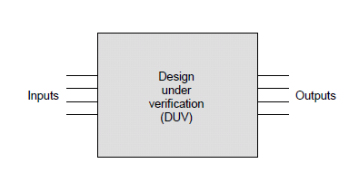
How to Test
Testing is easy. Just wiggle the inputs to your device and observe the outputs.

Slide 30
Verification, Validation, and Testing
Validation: Are we building the right system?
Verification: Are we building the system right?
Testing (hw): Is the system produced right?
Validation is more philosophical and subjective.
Verification is more concrete and objective.
http://www.easterbrook.ca/steve/2010/11/the-difference-between-verification-and-validation/

