Slide 1

CST 456 - Embedded Systems Testing
Lecture #5

Slide 2
Outline
Coverage

Slide 3
Verification Coverage
Verification engineers need metrics for the quality and completeness of verification activities over time.
Verification coverage reports on how thoroughly the design is being explored and tested.
100 per cent verification coverage is unachievable due to the state space explosion of modern designs, but it can be effectively approached given enough time and resources.

Slide 4
Verification Coverage
With directed testing, the concept of coverage is built-in with the verification plan and chosen stimuli.
With constrained pseudo-random testing, the use of coverage not only shows how much of the design is being tested, but more importantly what is not being tested.
A test’s constraints can be modified or new tests can be created to fill gaps that are reported by coverage analysis.

Slide 5
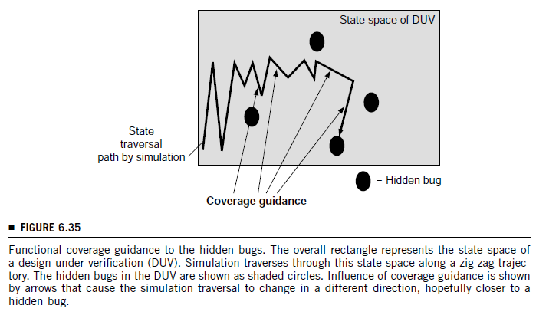
Coverage Guidance

Slide 6
Types of Coverage
Two main types of coverage.
Structural (implementation, code) coverage.
Functional (specification) coverage.
Structural coverage reports on what is already in the design and how thoroughly it is being tested. Most simulators can collect structural coverage statistics automatically.
Functional coverage is tied to the design intent and specifications / requirements.

Slide 7
Structural Coverage
Toggle – number of times the value of a signal changes.
Statement – number of lines of HDL code that are exercised.
Branch – looks at conditional statements in the design to reports on which conditions the simulator encountered.
FSM – number of times a FSM is in a particular state; a count of the different transitions between states.

Slide 8
Functional Coverage
The use of functional coverage allows verification engineers to gauge how closely the design matches the design intent.
Currently there is no (useful) automated way to create functional coverage models within the HVL.

Slide 9
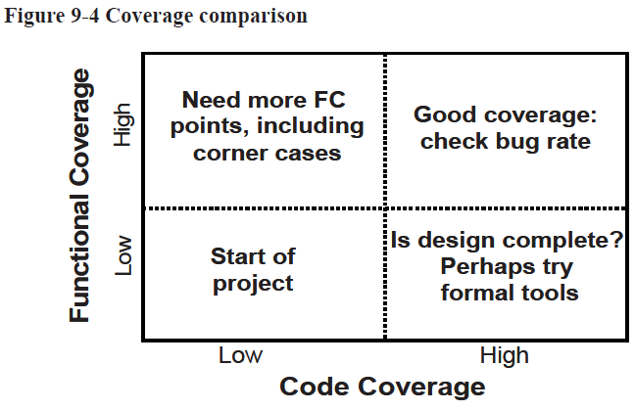
Functional and Structural Coverage

Slide 10
SystemVerilog Cover Groups
SystemVerilog contains cover groups to compile and report structural and functional statistics.
The syntax of cover groups is similar to classes.
A cover group can contains constructs such as:
Clocking event: a trigger to initiate coverage sampling.
Coverage points: a variable or expression.
Cross coverage: binding two or more coverage points.
Coverage options: miscellaneous controls of the cover group.

Slide 11
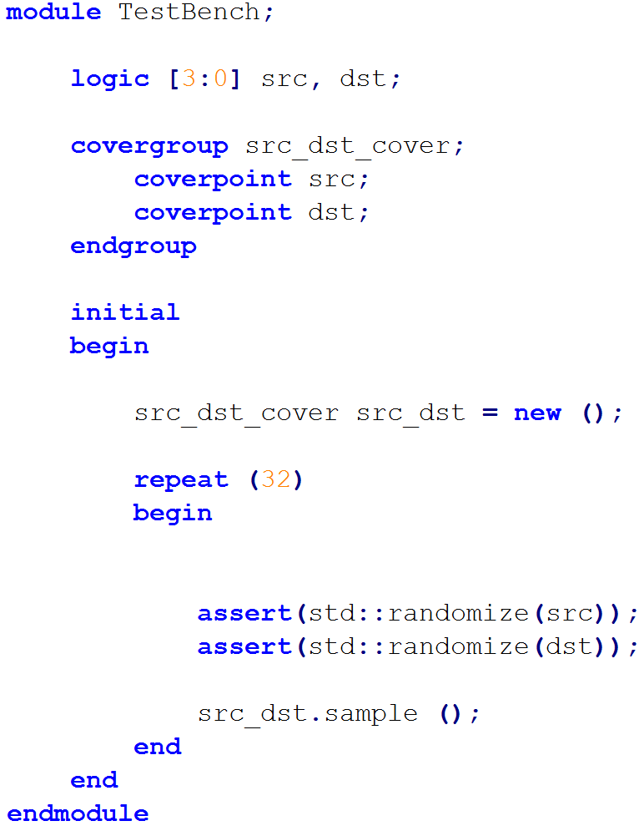
Simple Covergroup
The covergroup is unclocked. Need to use the sample () method to trigger coverage sampling.

Slide 12
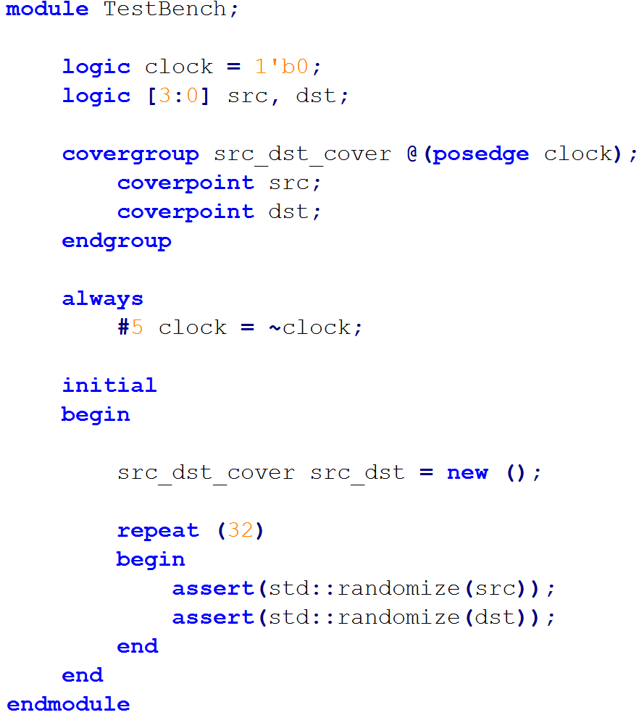
Simple Covergroup with Event Trigger
The covergroup is clocked and its statistics are updated at each rising clock edge.

Slide 13
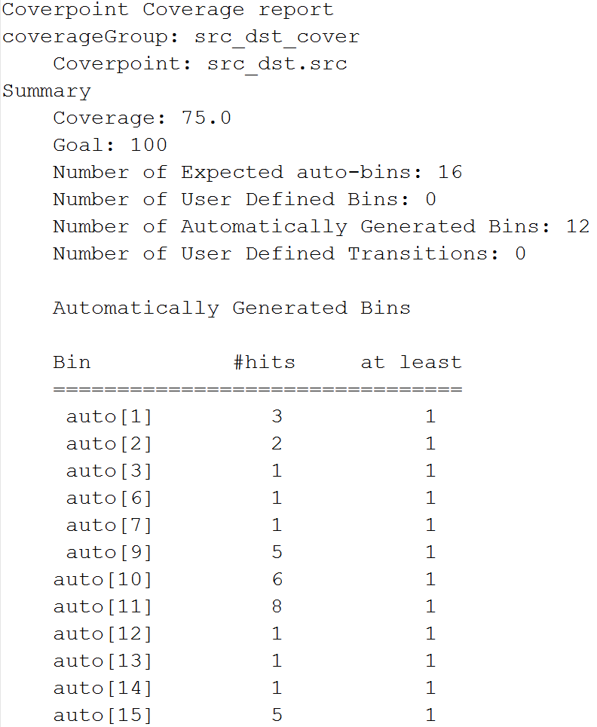
End of Simulation Report

Slide 14
Bin Creation
Bins can be created automatically or they can be specified by the user.
Creating bins automatically allocates one bin for each possible value.
A 16-bit signal has 65536 different possible values. That means 65536 bins if using automatic bin creation.
Automatically created bins can be grouped together to provide more concise reporting using the auto_bin_max option.

Slide 15
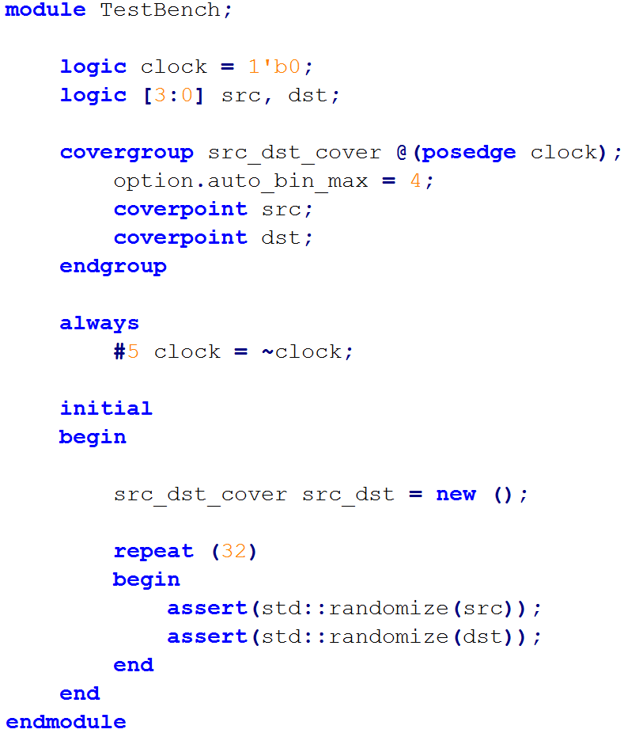
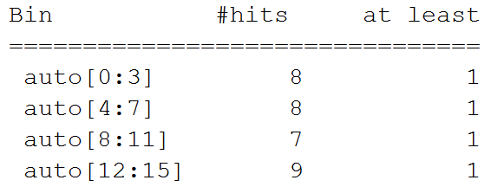
Limiting Bin Creation

Slide 16
User-Defined Bins
User-defined bins allow the verification engineer to restrict the values used for coverage collection.
Only the specified bins are used to calculate coverage.
Conditional expressions can also be used to start / stop the collection of coverage data.

Slide 17
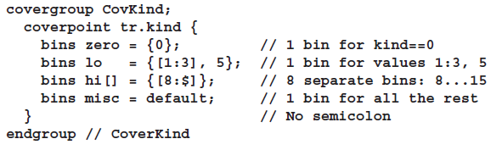
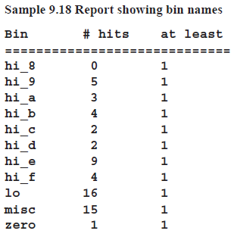
User-Defined Bins

Slide 18
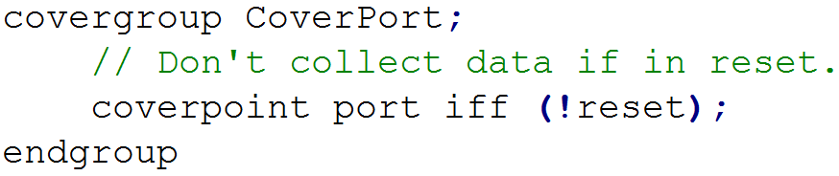
Conditional Coverage

Slide 19
Cross Coverage
A single coverpoint only gathers data for one signal.
Cross coverage allows the collection of data for multiple signals at the same instant of time.
If signal A has M possible values and signal B has N possible values then there are M x N different cross coverage combinations.

Slide 20
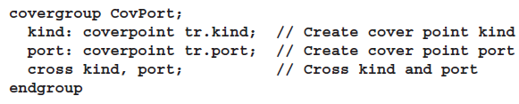
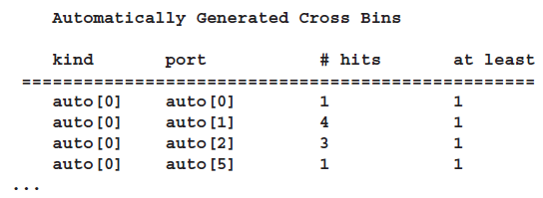
Cross Coverage

