Slide 1

CST 456 - Embedded Systems Testing
Lecture #6

Slide 2
Outline
Test-Driven Development for Embedded Systems
Test-Driven Development Example

Slide 3
Test-Driven Development
Test driven development is a software development methodology that emphasizes the creation and execution of tests before writing production code.
Small amounts of production code are tested so that bugs can be identified and remedied quickly and easily before writing more production code.
The philosophy behind TDD is that it is better to incrementally confirm the correct operation of a software module rather than create the entire module and then test and debug it.

Slide 4
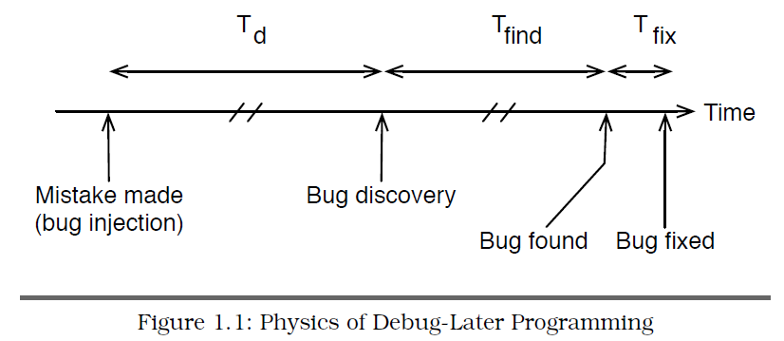
Debug Later-Programming

Slide 5
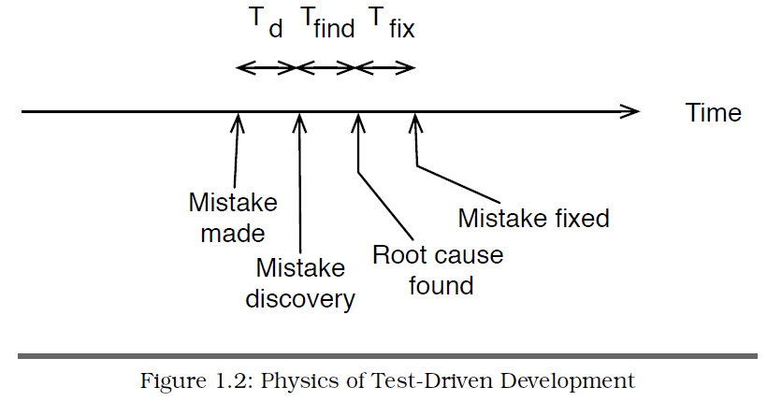
Test-Driven Development

Slide 6
Test-Driven Development
Rather than having software development and software test being separate processes, TDD emphasizes the integrated nature of the two.
TDD can be done entirely by the development team or in conjunction with a test team.
While TDD makes use of short feedback loops, short feedback loops can exist independently of TDD.

Slide 7
TDD Pros and Cons
Pros
If done correctly TDD and unit testing can produce a more robust and bug-free application in less time than the traditional waterfall / code-then-fix methodologies.
Acts as a form of functional documentation for how the production code should function, rather than how it does function.
Aids in the maintenance and updating of production code throughout the lifetime of the application.
Cons
Larger up-front costs when utilizing TDD, with savings coming later in the development cycle.
The unit tests themselves need to maintained and debugged.

Slide 8
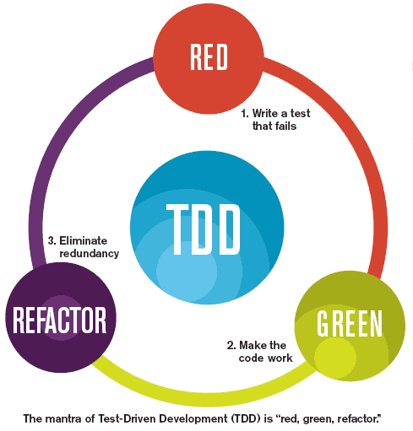


TDD

Slide 9
TDD for Embedded FW
TDD for embedded FW is still in its infancy. While TDD for software applications is a recommended practice in the agile community, the choice of whether to use TDD for FW depends on a variety of factors.
Is the FW programmed in assembly? Unit testing software for assembly language programs is rare/non-existent, due to assembly being bound to the hardware; ie, you would need a separate testing framework for each microcontroller family. Most embedded unit testing software is written for C.
Does the FW contain sufficient complexity to warrant unit tests?
Is the FW sufficiently modular to allow testing of small modules? A flat design (one or two large functions) can be difficult to test.
Is the FW sufficiently removed from the hardware to be tested on a PC? If the FW contains assembly code or uses compiler extensions it might not port well to a unit test framework on a PC.

Slide 10
LED Driver Spec
The LED driver controls 16 two-state LEDs.
The driver can turn on or off any individual LED without affecting the others.
The driver can turn all LEDs on or off with a single interface call.
The user of the driver can query the state of any LED.

Slide 11
LED Driver Spec
At power-on, the hardware default is for LEDs to be latched on. They must be turned off by the software.
LEDs are memory-mapped to a 16-bit word.
A 1 in a bit position lights the corresponding LED; 0 turns it off.
The least significant bit corresponds to LED 1; the most significant bit corresponds to LED 16.

Slide 12
Create a Test List
Traditionally, once the specification for a design has been defined the design is then coded from the specification.
In TDD, once the specification for a design has been defined a list of simple tests is derived from the specification.

Slide 13
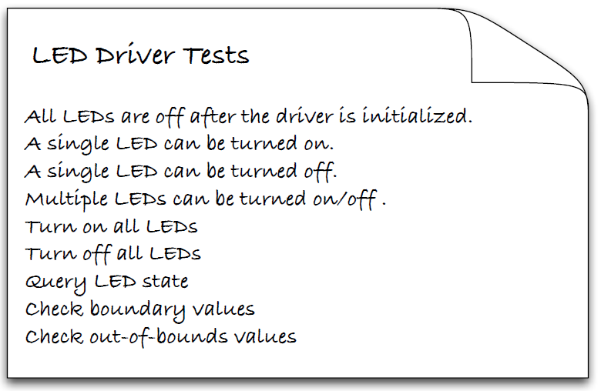
LED Driver Tests

Slide 14
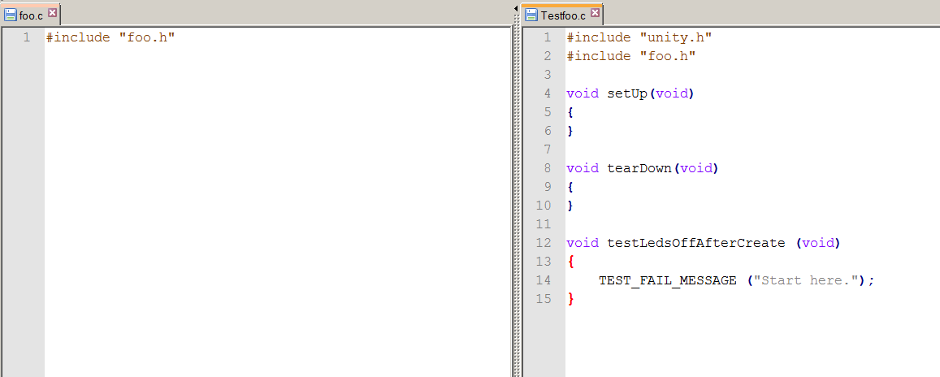
Create Initial Failing Test

Slide 15
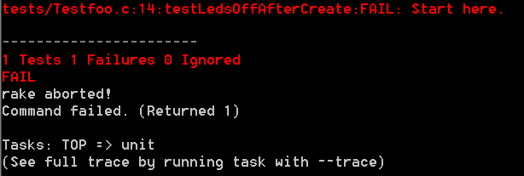
Create Initial Failing Test

Slide 16
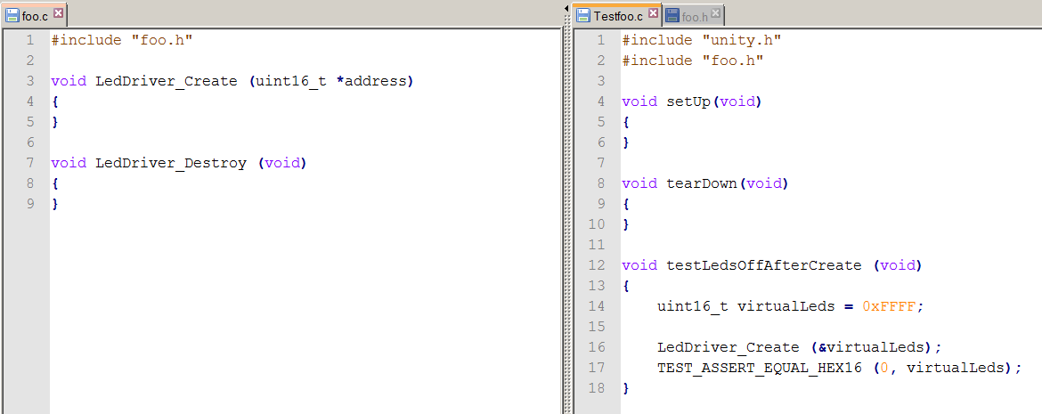
Write First Failing Test

Slide 17
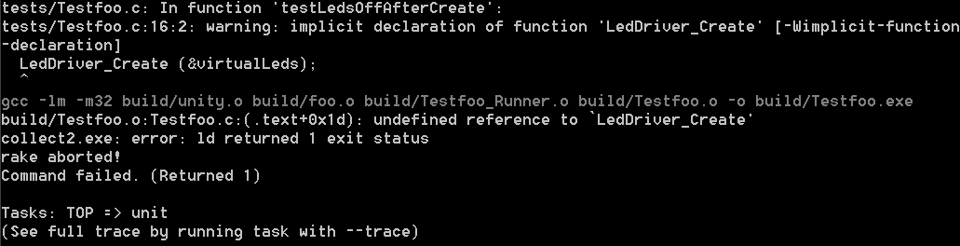
Write First Failing Test

Slide 18
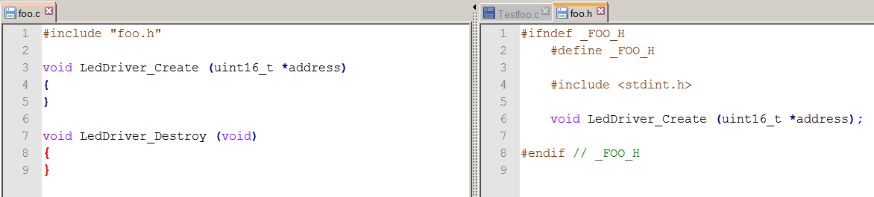
Get Rid of Compile / Link Errors

Slide 19
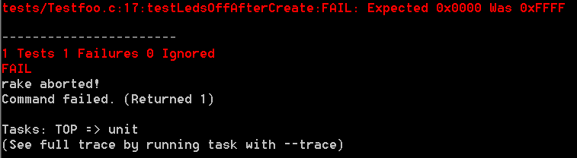
Get Rid of Compile / Link Errors

Slide 20
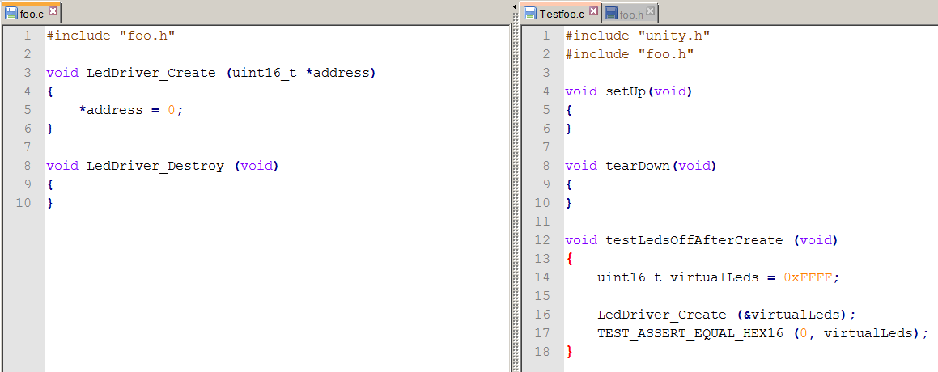
Pass the Test

Slide 21
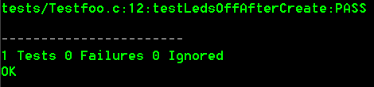
Pass the Test

Slide 22
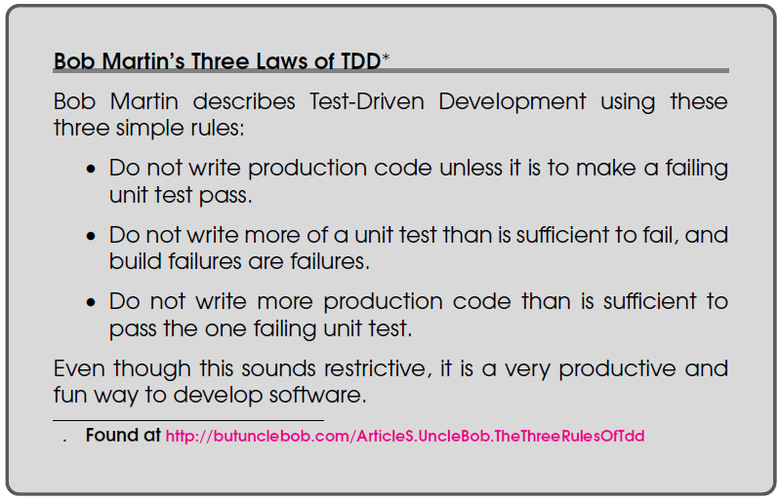
Three Laws of TDD

Slide 23
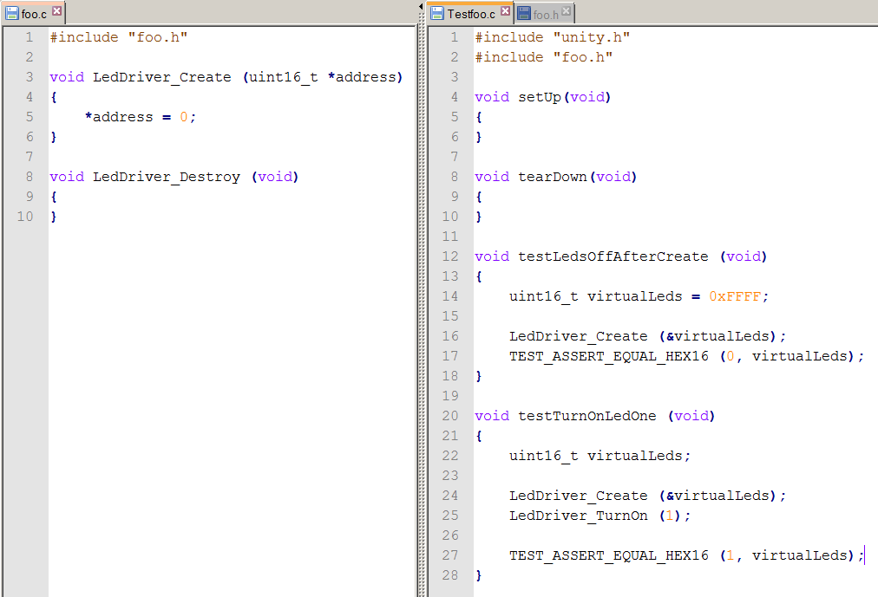
Write New Failing Test

Slide 24
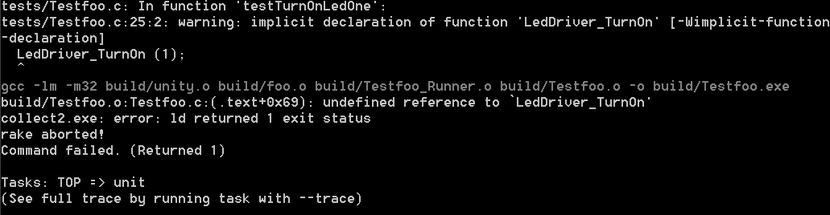
Write New Failing Test

Slide 25
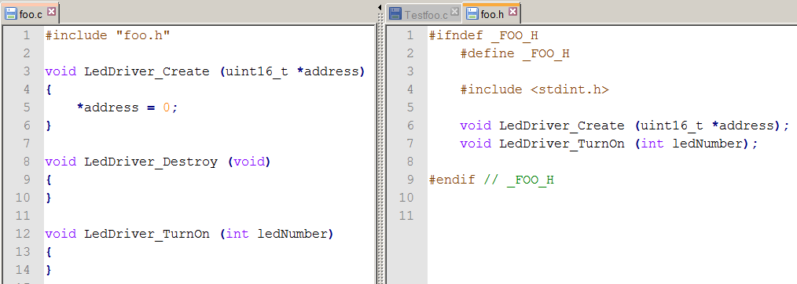
Get Rid of Compile / Link Errors

Slide 26
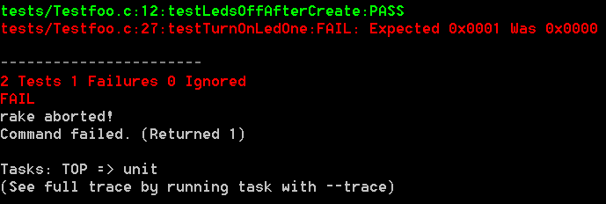
Get Rid of Compile / Link Errors

Slide 27
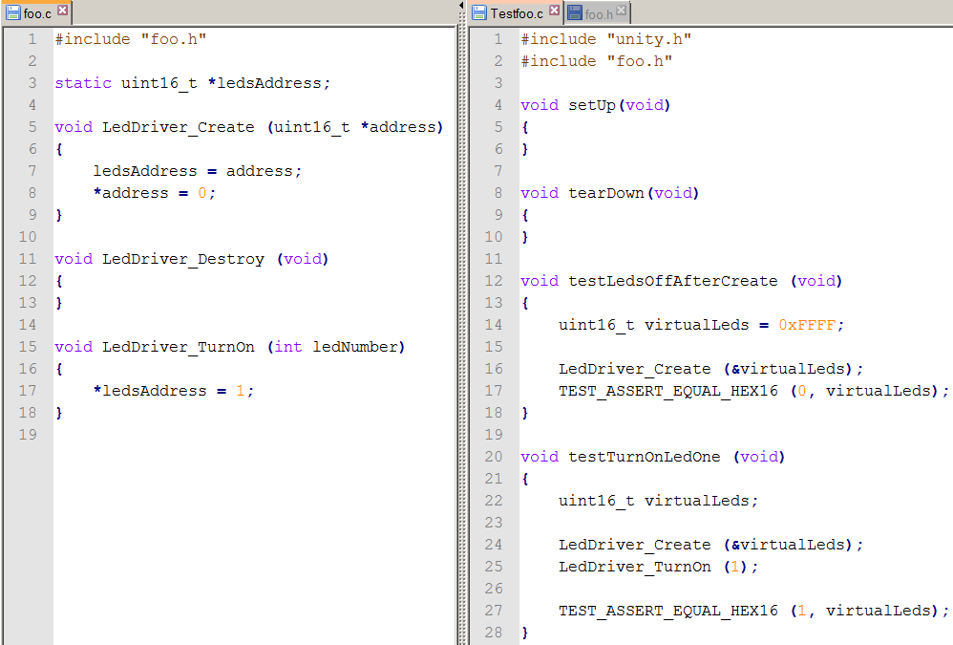
Pass the Test

Slide 28
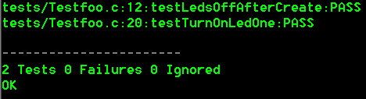
Pass the Test

Slide 29
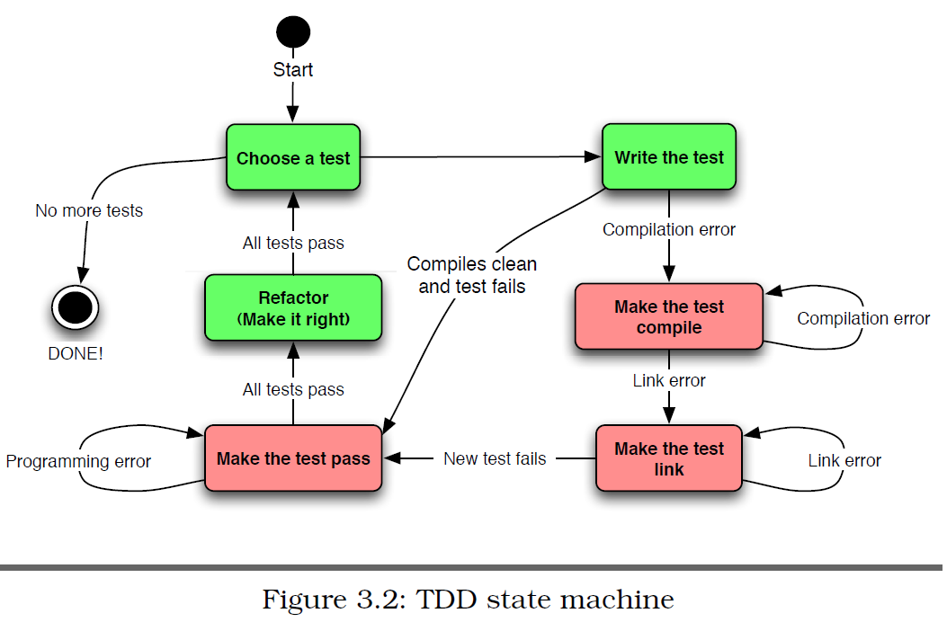
TDD State Machine

Slide 30
Concurrent HW and FW Development
HW and FW co-development has become the norm in the industry.
The FW development team can no longer wait for final HW before beginning the FW design.
Embedded TDD methods make use of dual-targeting to write FW that can be run on both the final HW and the development system (PC).

Slide 31
Benefits and Drawbacks of Dual-Targeting
Benefits of dual-targeting include:
Avoid bugs in the target HW.
Forces distinction between “pure” code and “HW-specific” code which increases portability and modularity.
Drawbacks of dual-targeting include:
The development compiler and target compiler might behave differently (bugs).
Primitive data types might have different sizes; for example a word might be 12-bits.
Runtime libraries and include filenames might be different.

Slide 32
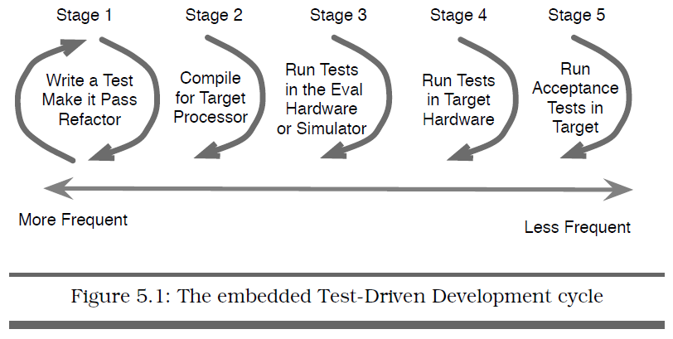
Embedded TDD Development Cycle

