Slide 1

CST 456 - Embedded Systems Testing
Lecture #7

Slide 2
Outline
Firmware Test Environments
Embedded C
Unity Test Harness

Slide 3
Embedded FW
Both HW and FW are used in the creation of most embedded devices. What functionality is included in HW or FW forms the basis of HW/SW co-development.
In theory the functionality of the entire embedded device can be realized in HW. This is never done in practice as having FW provides many advantages.

Slide 4
Embedded FW
Hardware
Benefits: fast, low power, and small footprint.
Drawbacks: expensive for development, manufacture, and test; difficult / impossible to update once in the field.
Firmware
Benefits: flexible, inexpensive to develop and deploy compared to HW.
Drawbacks: can be highly complex, higher power consumption.

Slide 5
Zune Bug Revisited
The Microsoft Zune bug was able to be fixed without a product recall through the use of a firmware patch.
Luckily the bug did not destroy the device, unlike the Mars climate orbiter.
Bugs found in ROM or even a HW design flaw can oftentimes be fixed in FW, though usually accompanied by a loss of system performance.

Slide 6
HW Design Flaw Workaround
For example, suppose the 68HC11 ORA (inclusive OR) instruction does not work correctly. We can work around it using DeMorgan’s law and the AND and COM instructions.
A | B = ~(~A & ~B)
ldaa A
coma
com B
anda B
coma

Slide 7
FW Test
Even though FW can be updated in the field, it still needs to be tested extensively before the end-user exercises the device.
Testing firmware can be done in a variety of ways, depending on many factors.
Whether the FW is programmed in assembly language, C, or a mixture of both.
Whether the FW is tested directly on a PC, through a simulator, through an emulator, or on the target hardware.

Slide 8
Assembly Language Testing
Directly testing code written entirely in assembly can be difficult. While high level languages strive to be hardware independent, assembly language is hardware dependent; all of the microcontrollers have their own assembly instructions, whereas there is only one C or C++.
x86: mov ax, [var]; not ax; mov [var], ax
68HC11: ldaa VAR; coma; staa VAR
Since FW written in assembly is usually small in size, it is often tested functionally on a simulator and/or target HW.

Slide 9
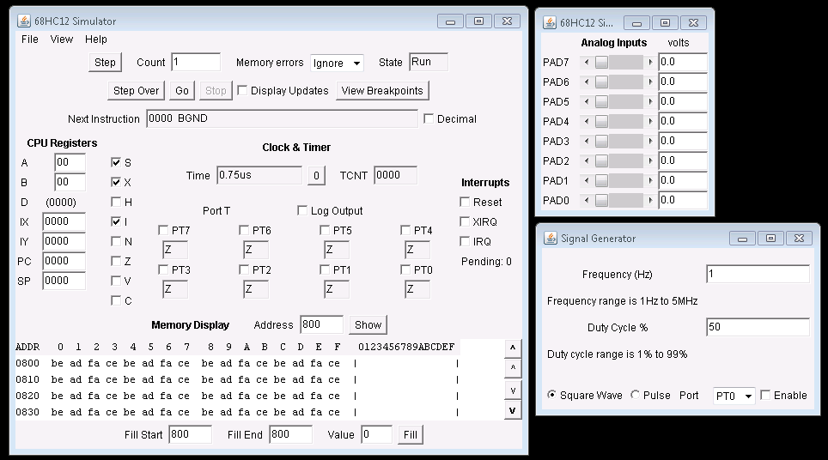
68HCS12 Assembly Simulator

Slide 10
C Language Testing - PC
More options are available for testing FW written in C.
A computational algorithm defined as a function with inputs and outputs can be run on a PC to test if it is correct.
Can be tested quickly and more thoroughly; 2 GHz on a PC versus 5 MHz on a microcontroller.
The FW should not use C data types directly, as the size of a data type might vary between PC and microcontroller. Use appropriate typedefs instead: typedef unsigned char t_UI8;

Slide 11
Emulator
Microcontroller emulators offer a powerful but expensive way to debug and test FW.
The emulator is an external piece of hardware that takes the place of the microcontroller, giving simulation quality information in real time.
The emulator can also passively interface with the microcontroller via a communication protocol to provide debug and trace capabilities.

Slide 12
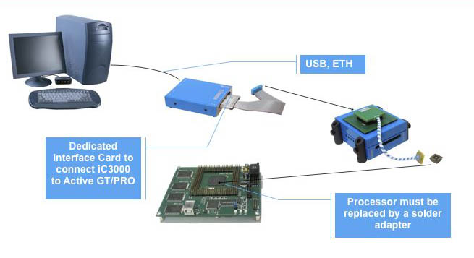
Emulator

Slide 13
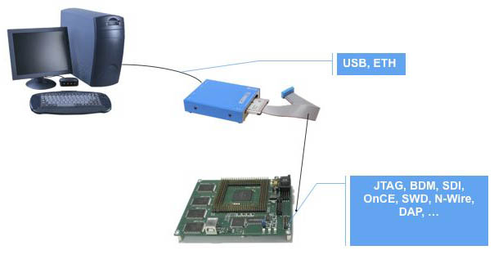
Emulator

Slide 14
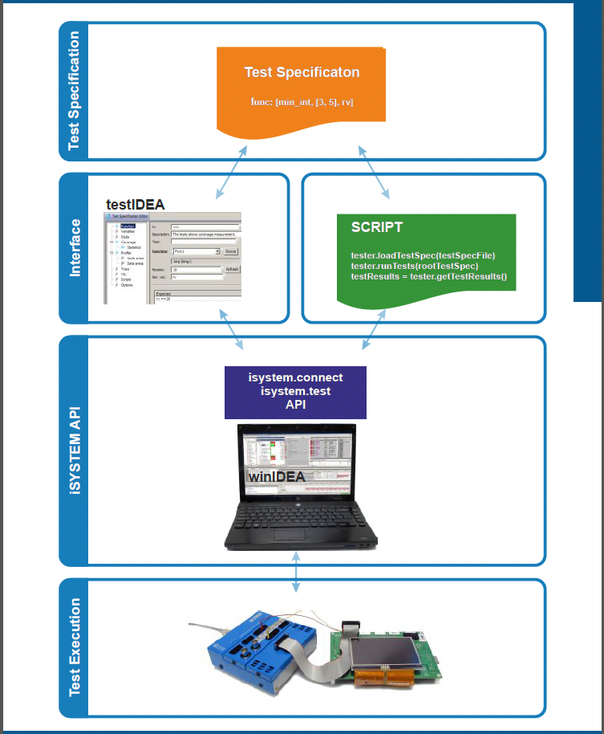
C Language Testing - Emulator

Slide 15
C Language Testing - Simulator
Testing C FW with a simulator allows complete control over the program flow.
Simulator can run slow depending on the underlying microcontroller and its model.
Like the emulator, the model should faithfully represent the microcontroller hardware.

Slide 16
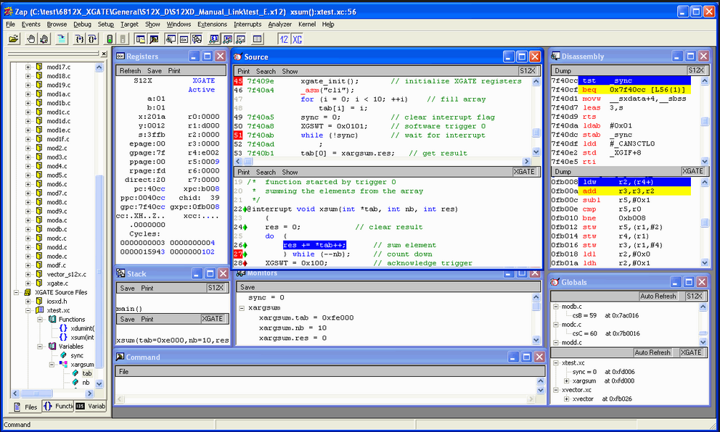
C Language Testing - Simulator

Slide 17
Embedded C
In theory, there is an “official” Embedded C which consists of extensions to ISO/IEC C99. It is contained in the ISO/IEC 18037 technical report.
ISO 18037 contains support for fixed-point (fractional) arithmetic, I/O hardware addressing, and address and named-register storage classes.
The proposed standard is a response to the proprietary nature of embedded C compilers; most embedded C code can only be compiled by the compiler it was developed for.
Very few compilers support the Embedded C extensions.

Slide 18
Embedded C
The ANSI C standard already provides some support for embedded-specific applications.
Bit fields allow access to individual bits.
struct bitfield
{
bit1 : 1;
bit2 : 1;
byte1 : 8;
}
Though not part of the C standard, many popular compilers support binary literals.
uint8_t thing = 0b1110;

Slide 19
Embedded C
The volatile keyword is used to specify a register or memory location that is able to change independently of the microcontroller CPU core. It prevents compiler optimization for that register or memory location.
Suppose register comm is connected to a RS-232 transciever. comm takes a value of 1 while communication is occurring, and it becomes 0 when communication has finished. To wait for end of communication you might code:
while (comm != 0)
{
}
A compiler with optimization enabled will not implement the while-loop. It will look at comm’s value once. If comm is 0 then it does nothing, but if comm is a value other than 0 it will enter an infinite loop.
The volatile keyword (volatile t_UI8 comm;) tells the compiler not to optimize code around comm.

Slide 20
Embedded C
Although the ANSI/ISO C standard provides some accommodation for embedded programming, companies that make embedded C compilers add their own extensions to give developers more control over the operation of the microcontroller.
For example the Cosmic C compiler provides a handful of extensions:
t_UI8 var @ 0x100; a standalone @ allows for absolute memory addressing.
@interrupt defines an interrupt service routine.
@eeprom specifies that a variable resides in non-volatile memory. When a value is written to an @eeprom register the compiler injects a NV write function to permanently store the value.
Mixed C / assembly language constants and macros.
Support for zero page direct addressing in C.

Slide 21
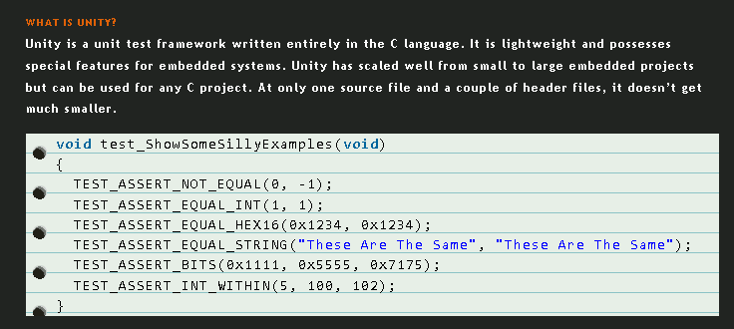
Unity C Test Harness

Slide 22
Unity C Test Harness
Unity facilitates the automated testing of embedded C code, and by itself consists of three files:
unity.c : where the underlying C code for all the test procedures is kept.
unity.h : the master header file which contains macros for all the test entry vectors; ie TEST_ASSERT_EQUAL_INT(expected, actual).
unity_internals.h : contains typedefs for C variables and maximum and minimum values, as well as function prototypes for unity.c.
The FW to be tested will reside in its own file of your naming: fw.c.
There will be also be a test file (testfw.c) that contains the tests to be run on fw.c.
When unity is executed it will create a master test file (Testfw_Runner.c) that interfaces with all five files and is the executable file for the test suite.

Slide 23
Unity C Test Harness
To run Unity in a Windows environment (like in our lab) a few programs need to be installed:
MinGW that includes GCC so that the files can be compiled and linked.
Ruby for executing scripts.
Rake should be included with Ruby to execute rakefiles.
To execute the tests you simply execute the rakefile with “unit” as an input parameter: “rake unit”. The test will execute and give a list of passing and failing tests.

Slide 24
Unity C Test Harness
When Unity is used for testing embedded C the comparisons tend to be simple numerical comparisons.
Are two integers equal?
Is this expression true of false?
Is an integer within a given range?
Are the specified bits high or low?
Unity provides support for strings and floating point calculations, but these are not often used in embedded systems.

