Slide 1

CST 456 - Embedded Systems Testing
Lecture #3

Slide 2
Outline
Design and Verification Languages
SystemVerilog
Basic Verification Environment

Slide 3
HDL / HVL Overview
HDLs
Verilog / SystemVerilog
VHDL
SystemC
HVLs
OpenVera
e
SystemVerilog
C / C++

Slide 4
Verilog
Verilog was created at Gateway Design Automation in 1983. GDA was acquired in 1989 by Cadence.
In 1995 Cadence allowed Verilog to be standardized.
IEEE standards before becoming SystemVerilog (HDL only):
1364-1995
1364-2001
1364-2005
SystemVerilog (HDVL) standards:
1800-2005
1800-2009
1800-2012

Slide 5
Verilog
Verilog is a reasonably compact, weakly typed language.
The user can get very close to the hardware: create gates and wires used in the netlist directly.
No custom types for enumeration names: most everything is fixed bit width.
Non-deterministic in its execution; has a lot of ‘gotchas.’ Can be difficult for beginners to implement correctly.

Slide 6
VHDL
Very high speed integrated circuits hardware description language.
Created for U.S. department of defense with syntax borrowed from Ada.
IEEE standards:
1076-1987
1076-1993
1076-2000 and 1076-2002 (minor revisions.)
1076-2008

Slide 7
VHDL
VHDL is a verbose, strongly typed language.
Much more deterministic in its behavior than Verilog.
Supports custom types.
type state_type is (wait, fetch, execute, stop)
Due to its verbosity, VHDL source code files can be extremely large.
Used more in academia and the military than in private industry.

Slide 8
SystemC
Developed at Synopsys starting in 1999 with the intention to replace Verilog and VHDL.
Proprietary “language” without a standard.
It is a collection of C++ libraries and shares the same syntax as C++.
It is at a higher level of abstraction than Verilog and VHDL and is more often used for system modeling than hardware synthesis.
Can be non-deterministic in simulation and synthesis.

Slide 9
HDL Comparison
HDL | Comparable Programming Language
Netlist | Assembly
Verilog and VHDL | C
SystemC | C++

Slide 10
OpenVera
Developed in 1995 at Systems Science as a language for writing Verilog test benches. Acquired by Synopsys in 1998 and released to the public in 2001.
Contains superior pseudo-random pattern generation and coverage checking.
Many of its features were incorporated into SystemVerilog. The language is falling out of use.

Slide 11
e
Developed in 1992 by Yoav Hollander for his Specman software package. Yoav founded the company Verisity which was later acquired by Cadence.
Allows object-oriented verification practices.
Good random pattern generation.
Syntax is unusual and would probably be foreign to VHDL and Verilog developers.

Slide 12
SystemVerilog
SystemVerilog is both a design and verification language.
It has become the dominant language for digital design and verification.
It takes the best parts of Verilog, VHDL, OpenVera, C, and C++.
Interoperability between vendors is still an issue for synthesis and simulation.

Slide 13
C / C++
Test benches can be created in C and C++ using APIs to the simulator.
(VHDL: VHPI) (Verilog: VPI) (SystemVerilog: DPI)
Using C / C++ completely separates the test from what is being tested. Little chance for design bugs to affect both.
VHPI and VPI can be painful to work with. DPI provides a better interface to C / C++.

Slide 14
SystemVerilog
SystemVerilog is maintained by the Accellera Systems Initiative.
“Accellera Systems Initiative is an independent, not-for profit organization dedicated to create, support, promote, and advance system-level design, modeling, and verification standards for use by the worldwide electronics industry.”
Before becoming standardized by IEEE:
Version 3.0 – June 2002
Version 3.1 – May 2003
Version 3.1a – May 2004

Slide 15
Data Types
Data types can be divided into two groups: 2-state and 4-state data types.
Verilog originally supported only 4-state data types.
0, 1, X (unknown value), Z (high impedance)
SystemVerilog added 2-state data types.
0, 1
Improves simulator performance and reduces memory usage over 4-state types.

Slide 16
Data Type Conversion
Converting from a 2-state to a 4-state data type is straightforward.
0 -> 0.
1 -> 1.
Converting from a 4-state to a 2-state data type has a gotcha.
0 -> 0.
1 -> 1.
X -> 0.
Z -> 0.
Use 2-state data type for driving inputs to a block or for loops.
Use a 4-state data type for design and for reading the output of a block.

Slide 17
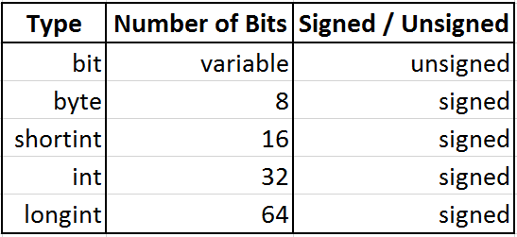
2-state Data Types

Slide 18
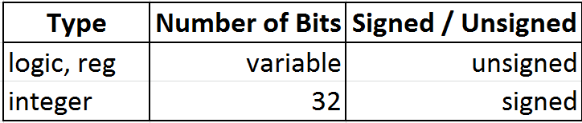
4-state Data Types

Slide 19
Data Types
4-state variables initialize with a value of X.
2-state variables initialize with a value of 0.
Verilog had many confusing rules on the use of reg and wire.
SystemVerilog simplifies these rules considerably. Now logic can be used in almost all situations.

Slide 20
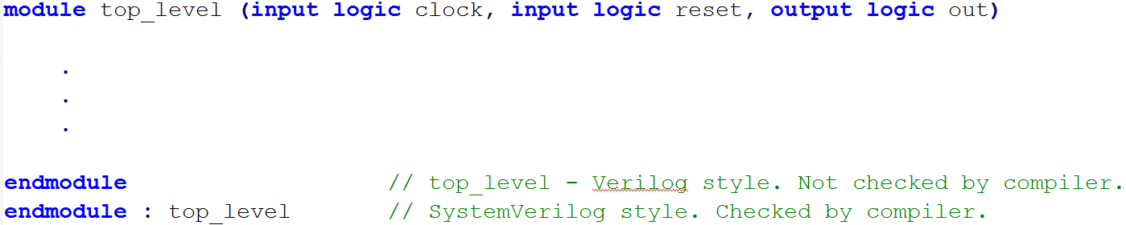
Modules
Where C has functions and VHDL has entities, SystemVerilog has modules.

Slide 21
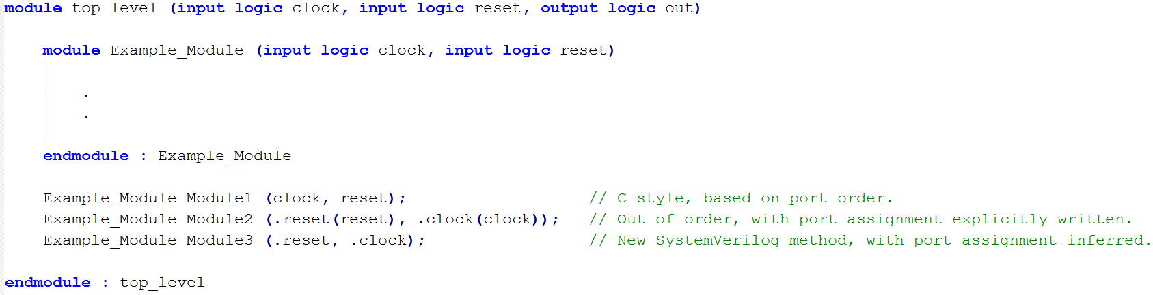
Module Instantiation
Three different ways to instantiate a module and connect signals.

Slide 22
Always Blocks
Where VHDL has processes SystemVerilog has always blocks for combinational and sequential logic.
VHDL and Verilog inferred the type of logic (combinational or sequential) based on the behavior of the code inside the block.
Always blocks in SystemVerilog explicitly specify whether the logic is combinational or sequential, allowing compiler checking.

Slide 23
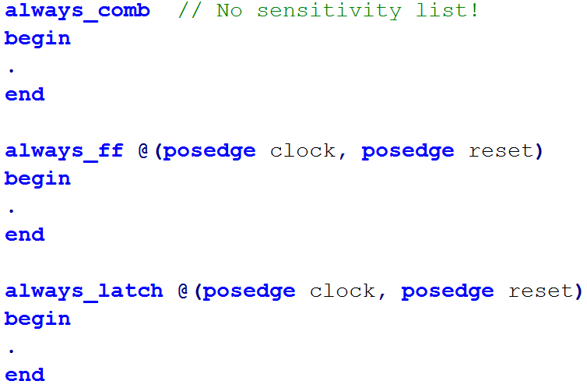
Always Blocks

Slide 24
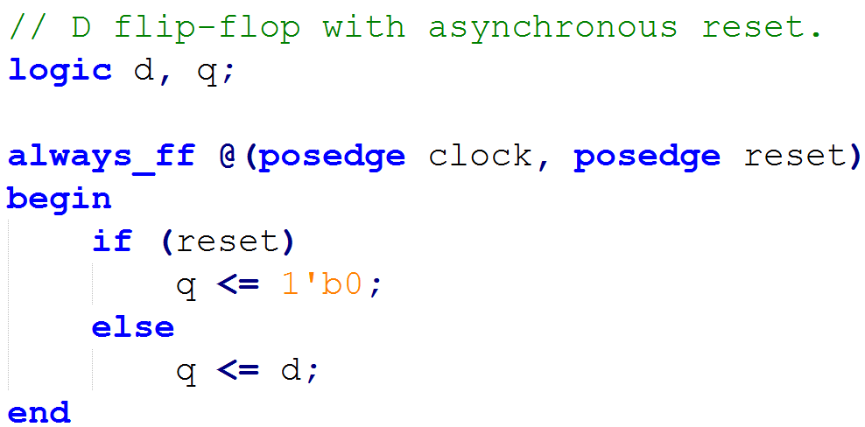
Always_ff Block

Slide 25
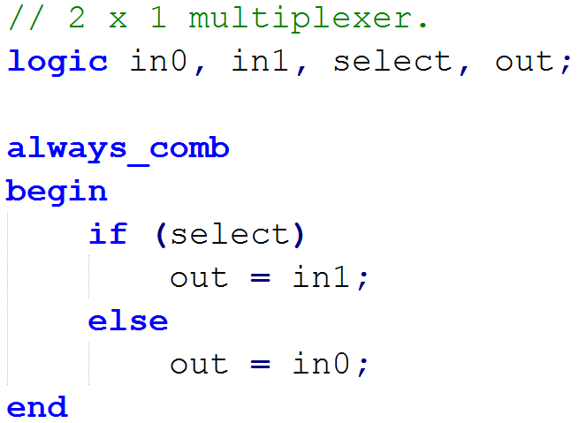
Always_comb Block

Slide 26
C-style Data Structuring
SystemVerilog borrows and extends the struct, typedef, enum, and union keywords from C.
struct allows signals to be grouped together, where they can be accessed individually or as a group (vector array).
Use typedef to (among other things) avoid hard-coding bit sizes.
typedef logic [15:0] word;
enum allows human-readable values to be assigned to signals, such as state machine state names.

Slide 27
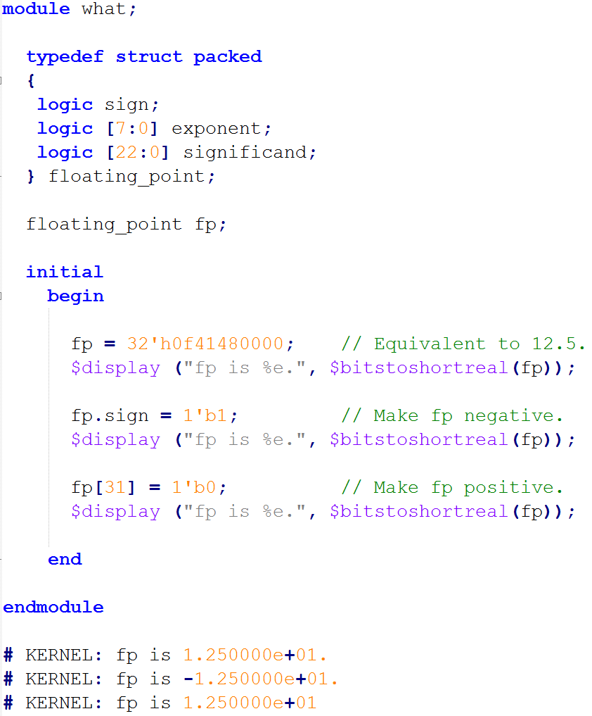
Typedef and Struct

Slide 28
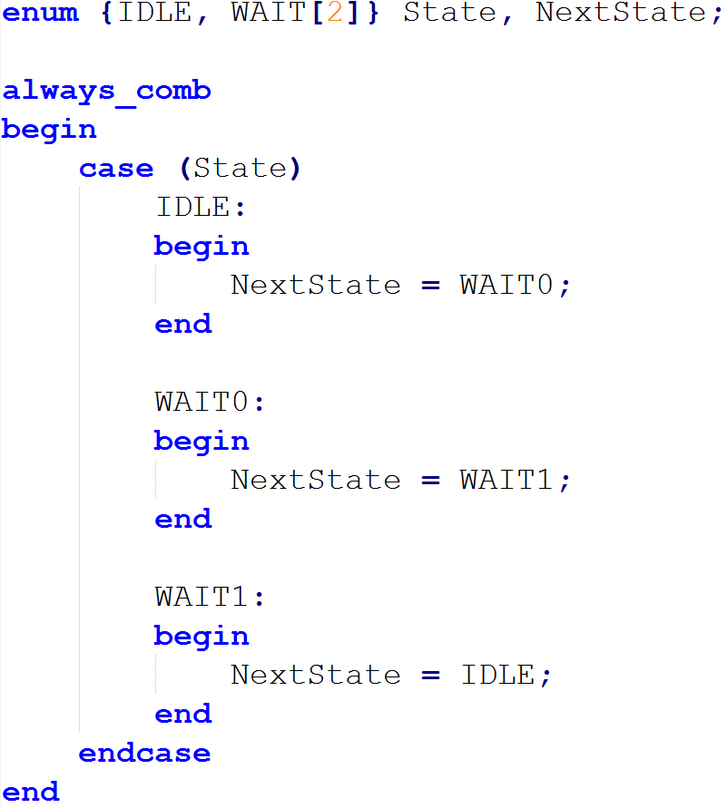
Enum

Slide 29
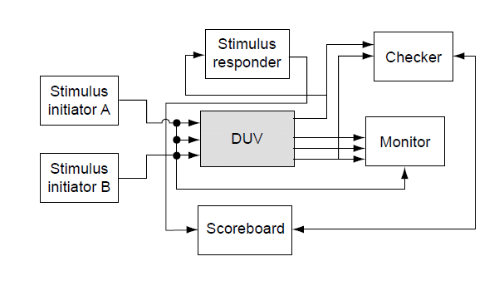
Verification Environment

Slide 30
Stimulus
Deterministic versus (pseudo)-random stimulus generation.
Deterministic stimuli are used to target specific and critical areas and exhaustively test a block; 8-bit adders, 8-bit registers.
Pseudo-random generation helps explore the large state space. Most modern verification languages have support for pseudo-random pattern creation.
Pregenerated versus on-the-fly cases.
Pregenerated stimuli are created before the test is run and are most often used with deterministic testing.
Stimuli created on-the-fly are often determined by simple AI that looks at the inputs and outputs of the DUV and adjusts the stimuli to create different states within the block.

Slide 31
Checker
The checker determines if the outputs from the DUV contain the correct data.
The type of stimuli generation determines the type of checker.
Stimuli generated on-the-fly require a checker that can test the outputs on-the-fly.
Pregenerated stimuli often require pregenerated results checking.

Slide 32
Monitor and Scoreboard
The monitor observes the inputs, outputs, and internal signals of the DUV and reports on their behavior, highlighting interesting states and errors.
Example: A input data stream with an incorrect CRC would be rejected by the DUV. The monitor can report on the DUV state and whether or not the data stream was properly rejected.
The scoreboard is a temporary location that holds data for use by the checker. It is most often used when the DUV contains a “non-deterministic” queue.

