Slide 1

CST 456 - Embedded Systems Testing
Lecture #2

Slide 2
Outline
Verification Cycle
Levels of Verification
Black/White/Grey Box Testing
SystemVerilog

Slide 3
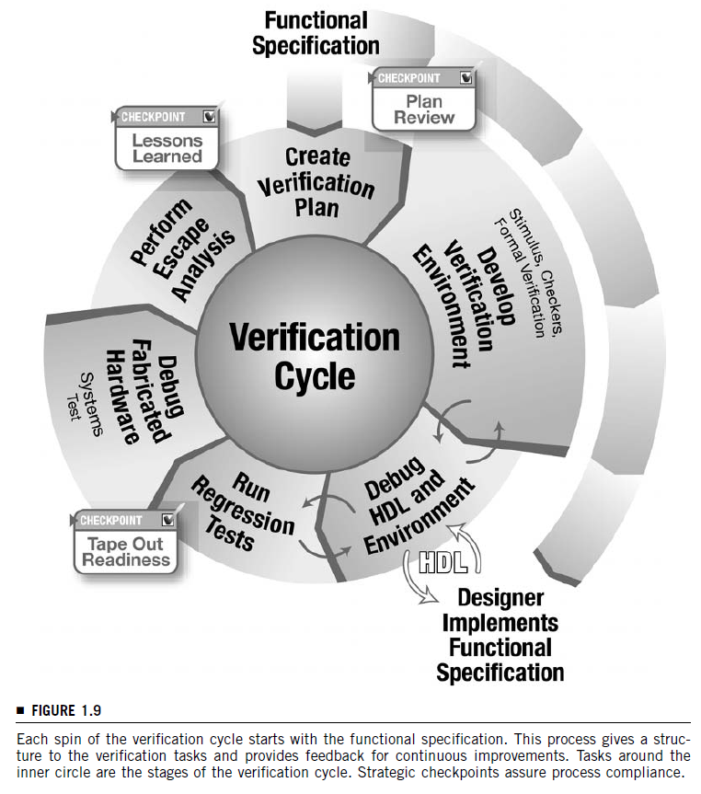
Verification Cycle

Slide 4
Design Specifications
The ultimate goal of embedded system design and testing is to create a functional device.
Validation – Are we designing the right system?
Verification – Are we designing the system right?
The design specification can take on different forms: an idea in someone’s head, a requirements document, or a model.
Complex HW design and test requires a written specification and requirements document.

Slide 5
Design Specifications
The three agents in creating and testing an embedded HW design are: architect / requirements engineer, design engineer, and verification engineer.
In small organizations these three agents might be one person. In large organizations they might consist of hundreds of people.
Who contributes input to the creation of the design / requirements document? Ideally everybody! (Doesn’t always happen.)

Slide 6
Design Specifications
The requirements, design, and verification engineers will have the most input into the requirements document.
Requirements engineer asks: do these requirements create the system we want?
Design engineer asks: can I design hardware to match these requirements?
Verification engineer asks: can I verify the requirements in the hardware design?

Slide 7
Verification Plan
The verification plan is the answer to the questions “What am I verifying?” and “How am I going to verify it?”
Who contributes input to the creation of the verification plan? Ideally everybody! (Doesn’t always happen.)
It is best to break down the design hierarchically and have the verification plan contain sections for each component at each level of the hierarchy.

Slide 8
Verification Plan
Verification plans may include:
Specific tests and tests methodologies.
Tools.
Completion criteria.
Required resources (people, hardware, and software) and schedule details.
Functions or design blocks to be verified.
Functions or design blocks that won’t be verified.

Slide 9
Develop Environment
While the design engineers are translating the functional requirements into HDL code, the verification engineers should be creating the infrastructure to test the design.
The verification environment is the set of software code and tools that enable the verification engineer to identify flaws in the design.
Different types of environments.
Deterministic (directed).
Constrained pseudo-random.
Formal verification.

Slide 10
Test the Design and Debug the Environment
Once the initial designs are complete they can be tested by the verification environment.
Near the beginning of the project there will be bugs in both the design and the verification environment. Such scenarios can be difficult to sort out.
Bugs can mask bugs.
Failing tests means there’s a discrepancy between the design, the design specification, and the test.

Slide 11
Regression Testing
As the design continues to mature verification tests should be run with each design increment, even on blocks or functions that have previously passed.
During regression testing the failure occurrence rate should drop as most of the obvious bugs have been found. The focus becomes more on the hard-to-find bugs.

Slide 12
Hardware Fabrication
At a certain point the design will be released to the fabrication facility to be built into an IC.
While the IC is being fabricated the design can still be tested to hunt out harder-to-find bugs.
Tests used for pre-silicon verification can be converted to run as post-silicon verification tests.

Slide 13
Test Fabricated Hardware
Once the IC arrives it can be tested at speed. Post-silicon verification testing is significantly faster than pre-silicon verification testing.
The IC can now interact with other ICs in the system.
Debugging silicon is much more difficult than debugging in a verification environment, due to lack of visibility of internal nodes.

Slide 14
Escape Analysis
Bugs that were first discovered post-silicon should trigger an escape analysis discussion within the verification team.
How did the bug get through the verification tests?
What improvements can be made to prevent such escapes in the future?
How can the bug be reproduced in the verification environment to confirm that the design change fixes the bug?

Slide 15
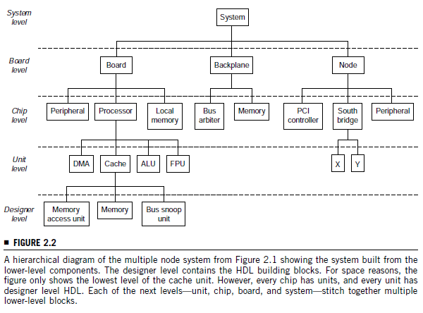
Levels of Verification

Slide 16
Levels of Verification
Breaking up a design into different levels and standalone blocks helps tackle the state space explosion issue encountered during test.
Where to start testing?
Choose the lowest level that completely contains the targeted function.
New or complex components need focus.
Design errors tend to cluster around certain designers.

Slide 17
Levels of Verification
The designer is in charge of his/her block, and should have tested it thoroughly before releasing to the next level and to the test group.
Assertions allow a designer to document assumptions about the inputs to the block.
If (read = 1’b1 and write = 1’b1) assert$(“Error!”);
Friendly rivalries between designers and testers can be beneficial, but don’t forget about the customer.
When there is a disagreement about the design, go to the spec / architect.

Slide 18
Levels of Verification
When testing specific blocks, it is better to provide “custom” inputs to a block rather than the “natural” inputs from adjacent blocks.
Why?

Slide 19
Levels of Verification
At the chip level, system integration issues arise.
If system integration awareness is not present during the design of lower level blocks, the lower level blocks might need to be changed considerably following chip level testing.
The chip level provides the first level that can eventually be tested physically, so verification tests can be adapted and used on actual hardware. (Code reuse!)

Slide 20
Levels of Verification
At the board level, external components are connected to the IC.
These usually include RAM, ROM, and other microcontrollers or FPGAs.
These levels conclude at HW / FW coverification, where any inconsistencies between HW and FW compilers are resolved.

Slide 21
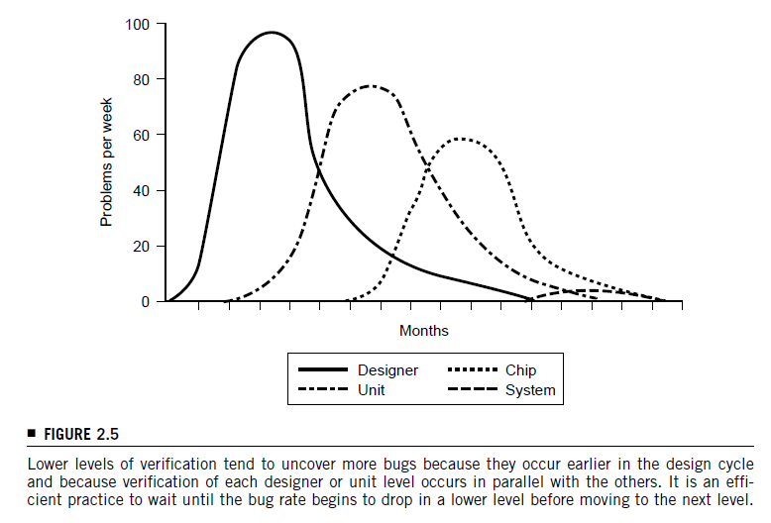
Levels of Verification

Slide 22
Multishaded Boxes
When testing a functional block it is often classified as a black, grey, or white box.
A black box offers the least amount of visibility into a functional block, while a white box offers complete visibility.
A grey box merges the two and is the type of testing most used.

Slide 23
Black Box Testing
A black box has only inputs and outputs.
When testing a black box the design specification is used to determine behavior.
Advantage: internal changes to the block do not affect the test environment.
Disadvantage: Oftentimes have to mentally reconstruct the inside based on functional behavior.

Slide 24
White Box Testing
When given a white box to test, you have full access to all signals, registers, and wires within the design.
Advantage: can find and locate design errors quickly.
Disadvantage: test environment is tightly coupled to the block it is testing.
Disadvantage: Knowledge of the internal workings of a block might negatively influence the verification engineer in his/her test activities.

Slide 25
Grey Box Testing
The most practical and widely used testing style meets in the middle of black box and white box testing.
The input / output signals are key, but critical signals can be monitored within the block.
Verification engineer also has access to the design engineer to learn about the design and functionality of the block.

