Slide 1
CST: Cheap Secure Terminal
Cal Barkman
Notes:
Show the hardware itself if there is time to get a case together

Slide 2
Notes:
Hardware Block Diagram
- Terminal Pattern
-(another way of looking at it) division of I/O from computers only to people only
- Go over each piece briefly, relate it to hardware pieces
- input to output feedback loop for user
- network interface could easily be replaced with any number of hardware devices such as
- A/D conversions
- SPI
- I2C
- CAN bus

Slide 3
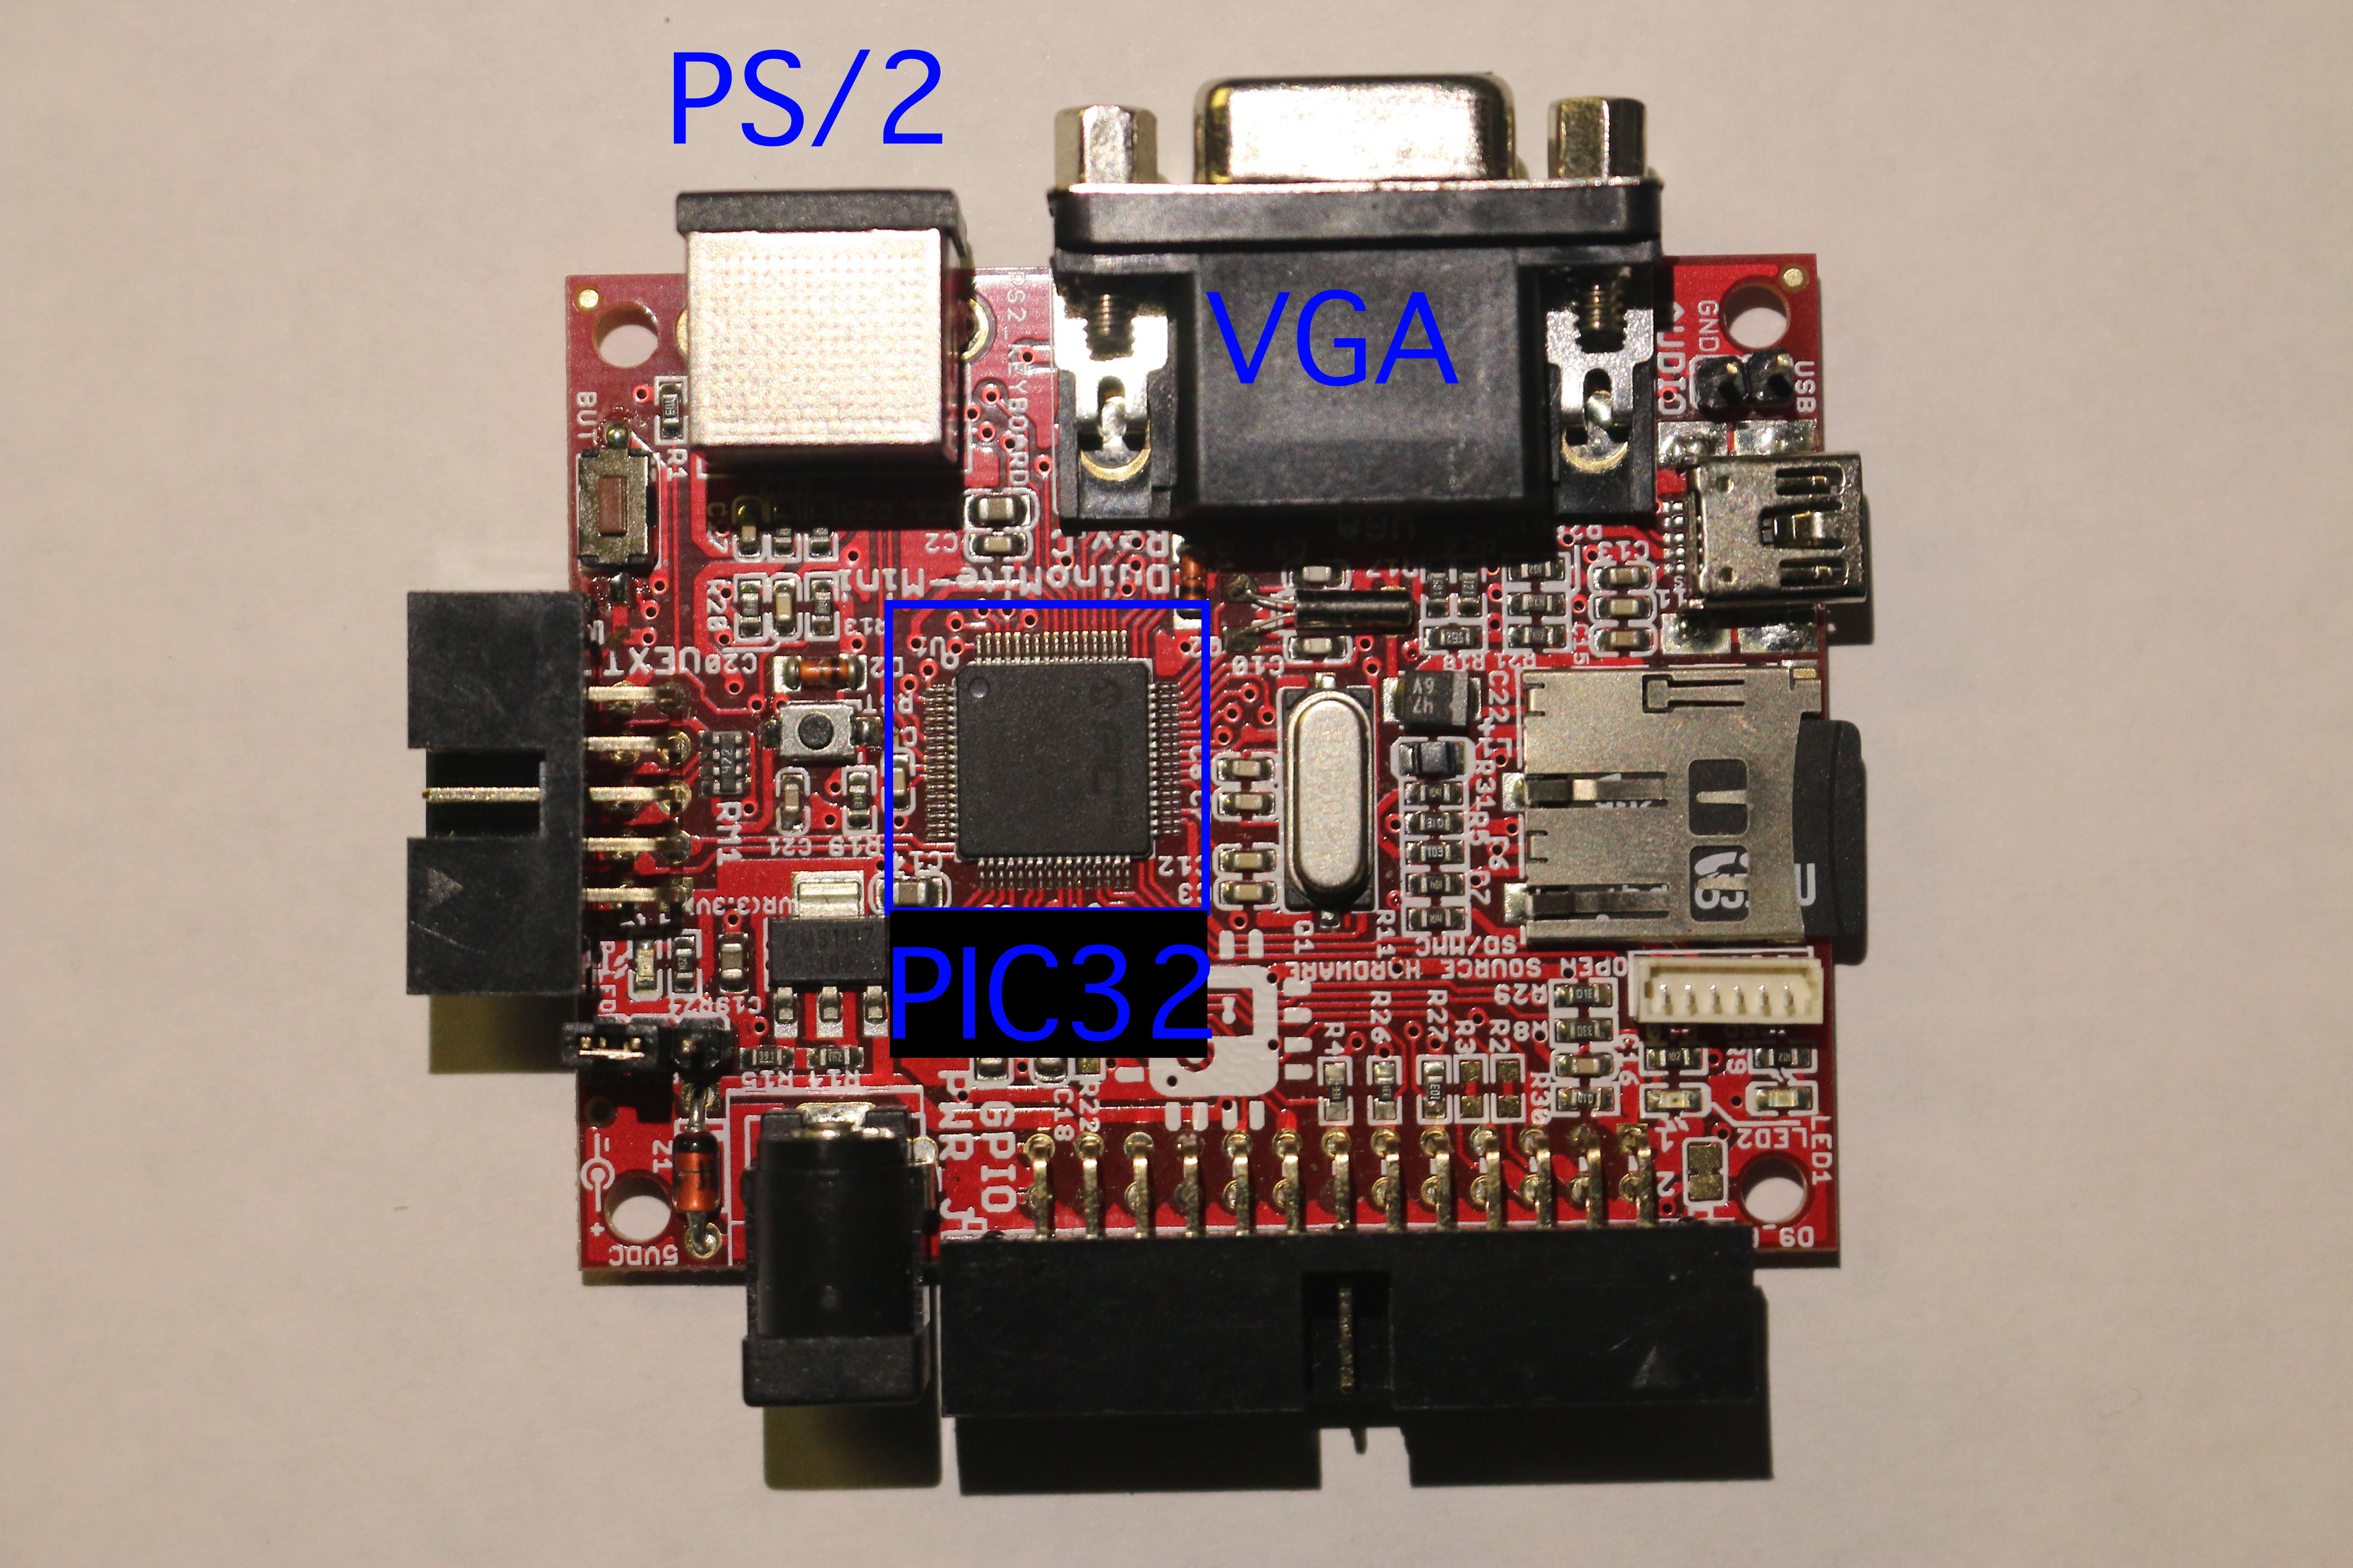

Slide 4
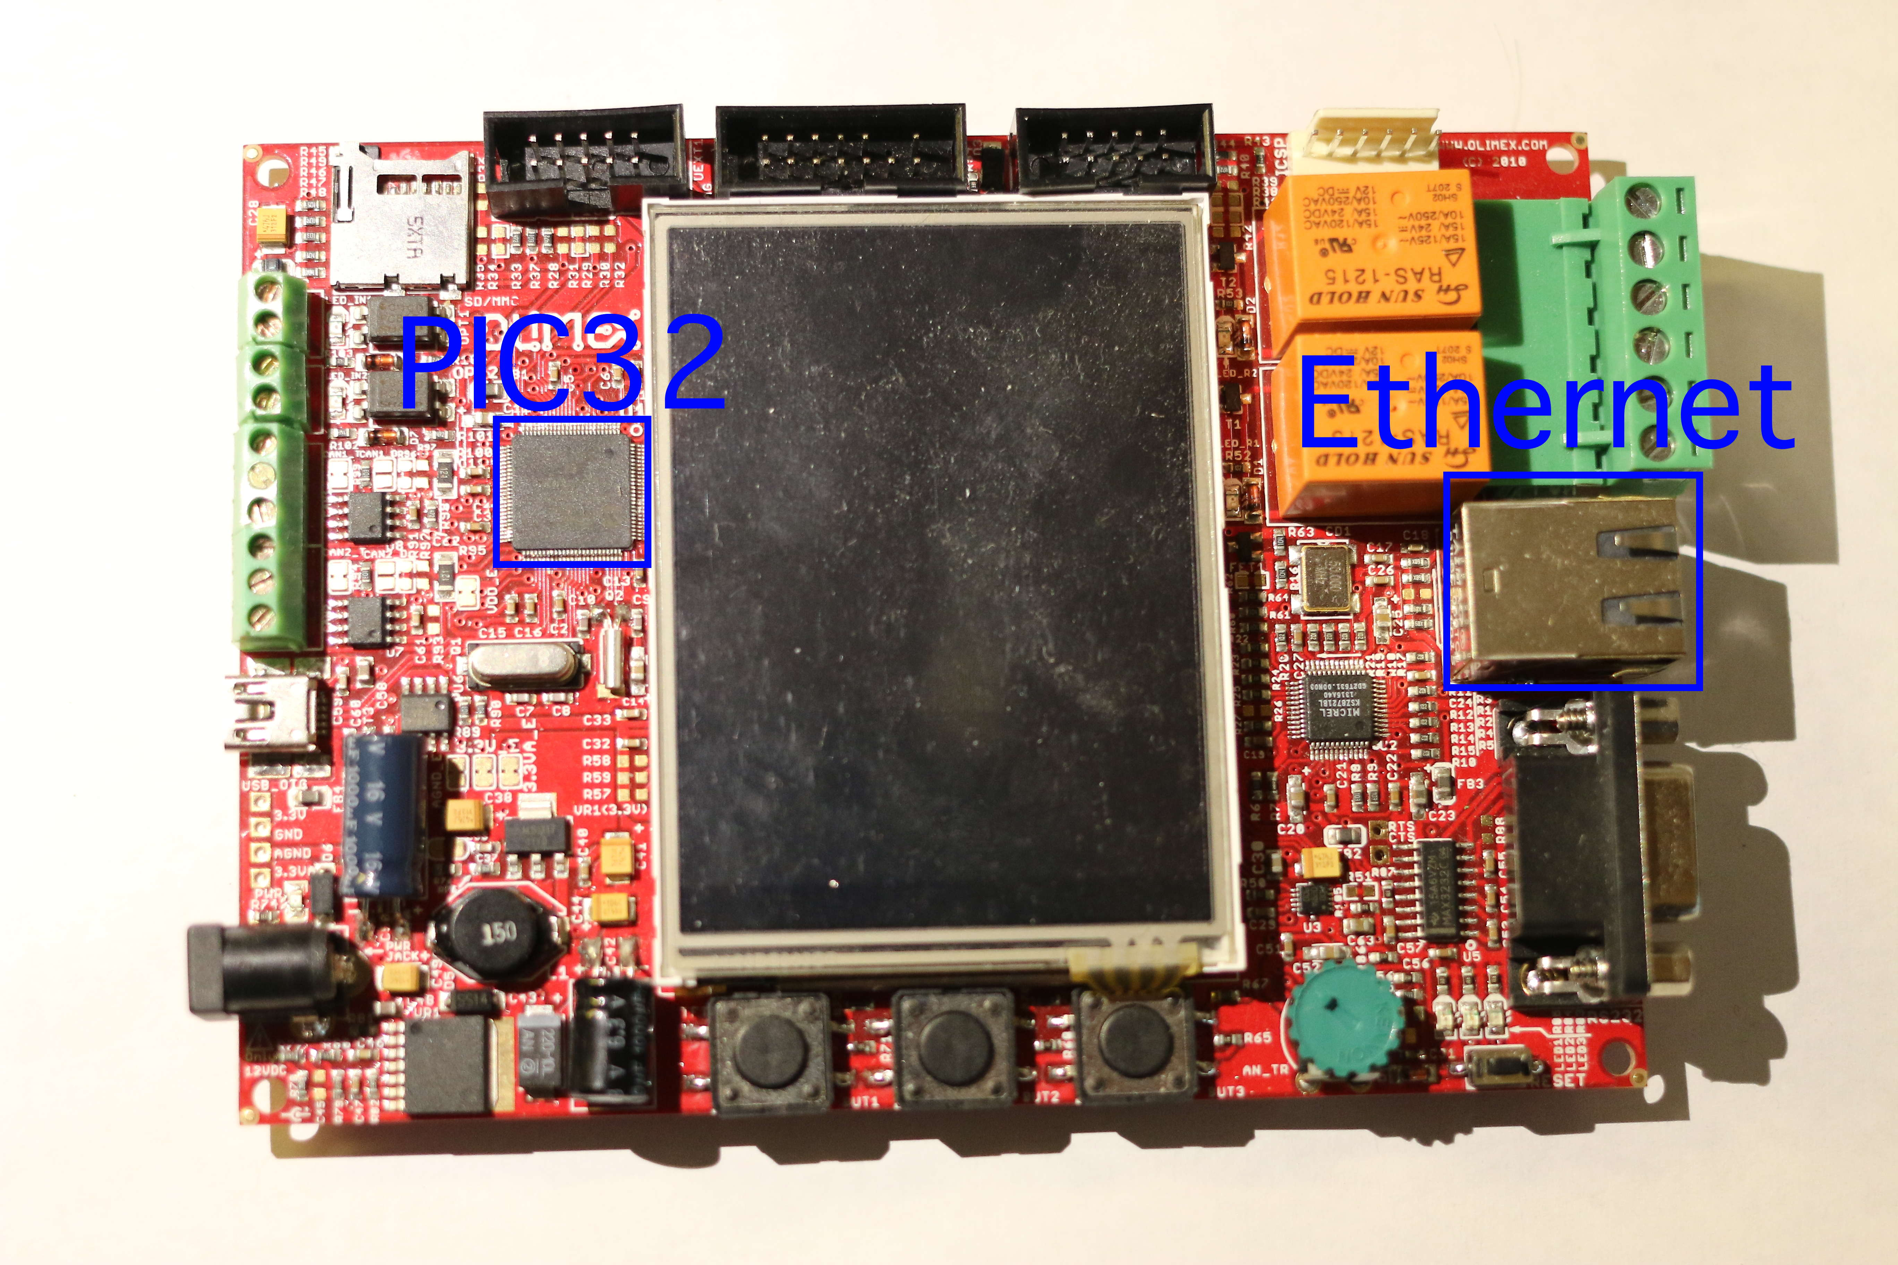

Slide 5
Bidirectional
Keyboard State change
detector
communication
Network
Stack
Sends key
Pressed signal
PIC
32
OS
/
Control
Software
Video
Writes
Lines to
Output
Notes:
Currently implemented software diagram

Slide 6
Notes:
Software Block Diagram
Show this second and say this is the planned software diagram

Slide 7
Horizontal Sync
Control
:
Timer
+
ISR
Vertical Sync
Control
:
Timer
+
ISR
Video pin
control
:
Port pin
Notes:
Currently Implemented video output module

Slide 8
Horizontal Sync
Periodically
Control
:
Video buffer
reads data
Timer
+
ISR
Vertical Sync
Control
:
DMA channel
Timer
+
ISR
Video pin
Feeds
Fill SPI
control
:
Data
SPI device
TX buffer
Port pin
Serially
when empty
Notes:
Planned video output module
SPI device has 2 x 128 bit (16 bytes) shift register
SPI device can cut output rate by factors of 2 for halving, or quartering the effective resolution
DMA channel can periodically shift the output buffer into the SPI device for continuous transmission
Can replicate the video output controls, one for each color (RGB)

