Slide 1
Static Testing at Design Level
by
Dr. Rizwan

Slide 2
Static Testing and Dynamic Testing the Code
Static analysis techniques, such as structured walkthroughs and inspections, are used to ensure the proper form of the program code and documentation.
This is accomplished by checking adherence to coding and documentation conventions and type checking.
Notes:
Adherence → faithfulness, obedience, Compliance

Slide 3
Executing the Test Plan
By the end of this phase, all the items in each section of the test plan should have been completed.
The actual testing of software is accomplished through the test data in the test plan developed during the requirements, logical design, physical design, and program unit design phases.
Because results have been specified in the test cases and test procedures, the correctness of the executions is ensured from a static test point of view; that is, the tests have been reviewed manually.
Dynamic testing or time-dependent techniques, involve executing a specific sequence of instructions with the computer.

Slide 4
Executing the Test Plan
Dynamic testing or time-dependent techniques are used to study the functional and computational correctness of the code.
Dynamic testing proceeds in the opposite order of the development life cycle.
It starts with unit testing to verify each program unit independently and then proceeds to integration, system, and acceptance testing.
After acceptance testing has been completed, the system is ready for operation and maintenance.

Slide 5
Static Testing of Logical Design
The logical design phase refines the business requirements in preparation for a system specification that can be used during physical design and coding
Three major deliverables from this phase are the data model (ER diagram), a process model, and the linkage between the them.
A data model is a representation of the information needed or data object types required by the application.
A data model is a graphical technique used to define the entities and the relationships.
  An entity is something about which we want to store data.

Slide 6
Static Testing of Logical Design
A process is a business activity together with the associated inputs and outputs.
  Examples of processes are accept order, update inventory, ship orders, and schedule class.
A process model is a graphical representation and should describe what the process does but not refer to why, how, or when the process is carried out.
A process model is a decomposition of the business.
Process decomposition is the breakdown of the activities into successively more detail.

Slide 7
Static Testing of Logical Design
An association diagram, often called a CRUD matrix or process/data matrix, links data and process models.
It identifies and resolves matrix omissions and conflicts, and helps to refine the data and process models, as necessary.
It maps processes against entities, showing which processes create, read, update, or delete the instances in an entity.
This is often called “entity life-cycle analysis.”
It analyzes the birth and death of an entity and is performed by process against the entity.

Slide 8
Static Testing of Logical Design
The analyst first verifies that there is an associated process to create instances in the entity.
If there is an entity that has no associated process that creates it, a process is missing and must be defined.
It is then verified that there are associated processes to update, read, or delete instances in an entity.
If there is an entity that is never updated, read, or deleted, perhaps the entity may be eliminated.

Slide 9
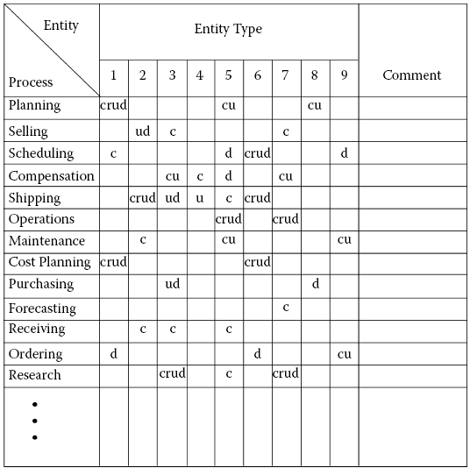
The CRUD Matrix

Slide 10
Static Testing of Logical Design with Technical Reviews
The same static testing techniques used to verify the requirements are used in the logical design phase.
The work products to be reviewed include the data model, the process model, and CRUD matrix.
Each defect discovered during the logical design review should be documented.
A defect trouble report is designed to assist in the proper recording of these defects.
It includes the defect category and defect type.
The description of each defect is recorded under the missing, wrong, or extra columns.
Notes:
Most frequently occurring defects are listed in the checklist.

Slide 11
Static Testing of Physical Design
The logical design phase is verified with static techniques, that is, non execution of the application.
As with the requirements and logical design phases, the static techniques check the adherence to specification conventions and completeness, with a focus on the architectural design.
The basis for physical design verification is design representation schemes used to specify the design.
Notes:
Adherence → faithfulness, obedience, compliance
A Warnier/Orr diagram (also known as a logical construction of a program/system) is a kind of hierarchical flowchart that allow the description of the organization of data and procedures.

Slide 12
Static Testing of Physical Design
Various inconsistencies are possible in specifying the control flow of data objects through the modules.
For example, a module may need a particular data item that another module creates but is not provided correctly.
  Static analysis can be applied to detect these types of control flow errors.
Loose coupling is considered a good design practice.
Examples of coupling include content, data coupling etc.
  Content coupling occurs when one module refers to or changes the internals of another module.
  Data coupling occurs when two modules communicate via a variable (s) that is passed directly as a parameter between the two modules.

Slide 13
Static Testing of Physical Design
Static analysis techniques can determine the presence or absence of coupling.
Static analysis of the design representations detects static errors and semantic errors.
Semantic errors involve data decomposition, functional decomposition, and control flow.
Each defect uncovered during the physical design review should be documented, categorized, recorded, presented to the design team for correction, and referenced to the specific document in which the defect was noted.

