Slide 1
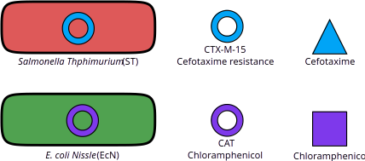
Schematic overview

Slide 2
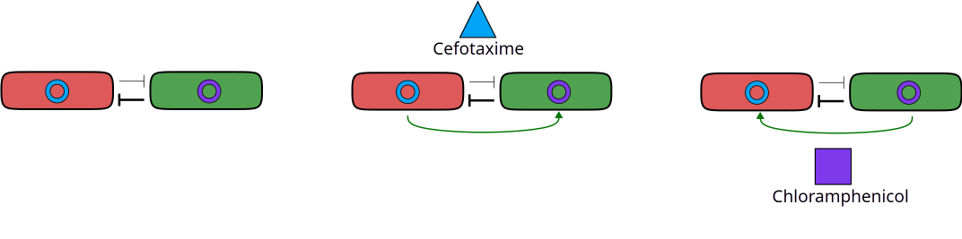
Interactions
No antibiotics
E. coli excludes ST
ST protects E. coli
Co-existence
E. coli protects ST
E. coli excludes ST

Slide 3
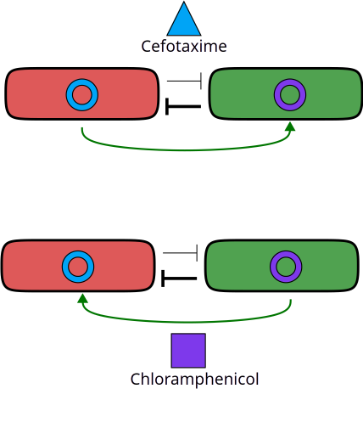
One-sided protection
Opposing signs (co-existence):
  E. coli relies on partner species for protection
  Can not exclude partner
Matching signs (exclusion):
  Even if E. coli fully detoxifies the environment the negative interaction causes extinction of ST

Slide 4
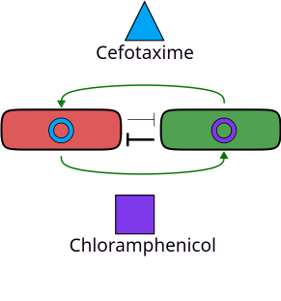
Two sided protection
ST protects E. coli
E. coli protects ST
Both species go extinct

Slide 5

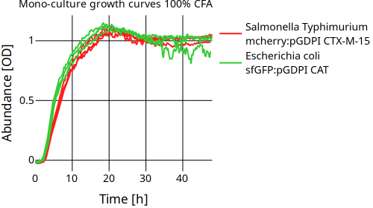
No antibiotics – Exclusion of ST
Mechanism of exclusion unknown
Fran created growth curves across CFA gradient for all strains
  All curves look very similar
Modeling interactions as resource competition not suitable

Slide 6
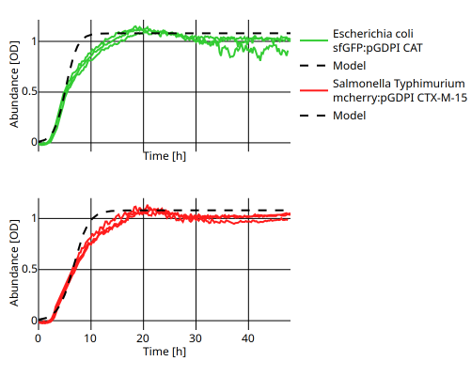
Growth model
 | E. coli | St
r [1/h] | 0.9 | 0.7
K [OD] | 1.1 | 1.1

Slide 7
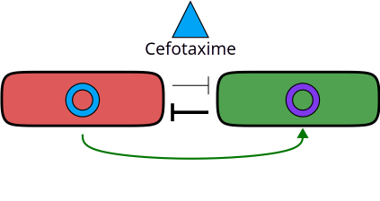
One-sided protection - opposing signs
Co-existence observed
Cefotaxime is bactericidal
Fran did dose response curves to measure the IC50
Also did a kill curve to measure the maximum death rate J

Slide 8
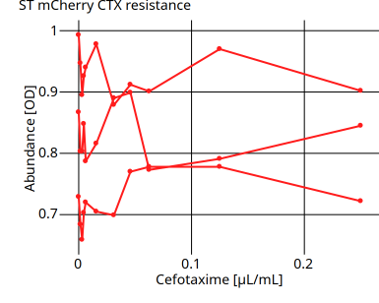
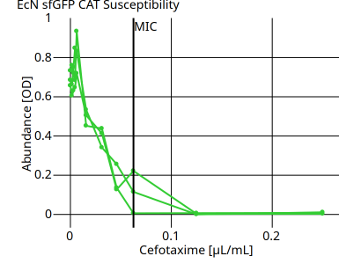
ST is resistant against Cefotaxime, E. coli susceptible

Slide 9
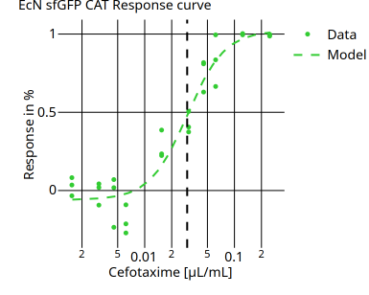
IC50 for E. coli
IC50: How much drug is needed to inhibit half of a biological process
Fitted sigmoid model
IC50: 0.03 µg/mL
MIC: 0.0625 μg/mL

Slide 10
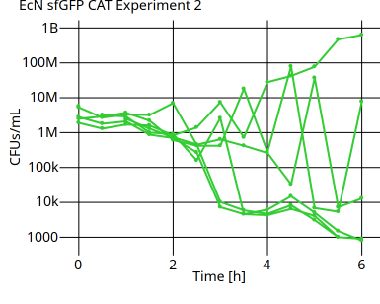
Maximum death rate
4x MIC of Cefotaxime was added after 2 hours
Variety in repeats
  In some repeats population manages to resist
Standing variation:
  Mutations that are present before treatment

Slide 11
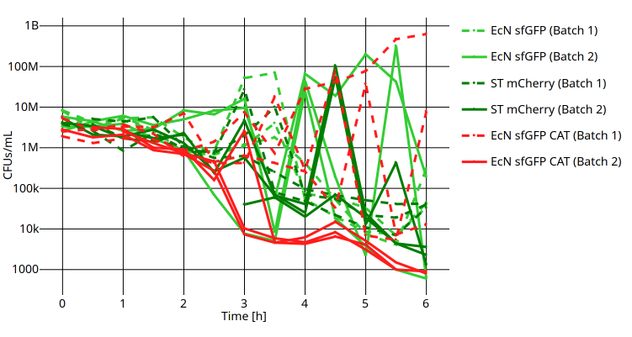
Death rates all strains

Slide 12
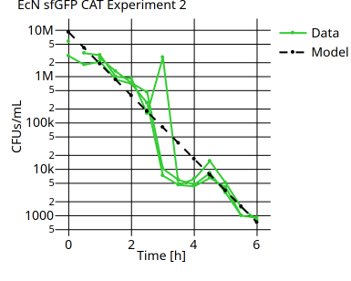
Maximum death rate
Maximum death rate J = -1.57 1/h for repeats that are killed by Cefotaxime
Part of the population that does not go extinct could be important for co-existence
  Only little detoxification needed

Slide 13
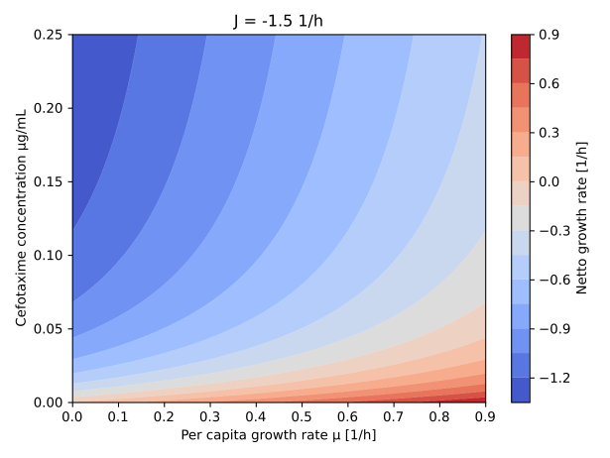
Variation affects netto growth rate
netto growth rate

Slide 14
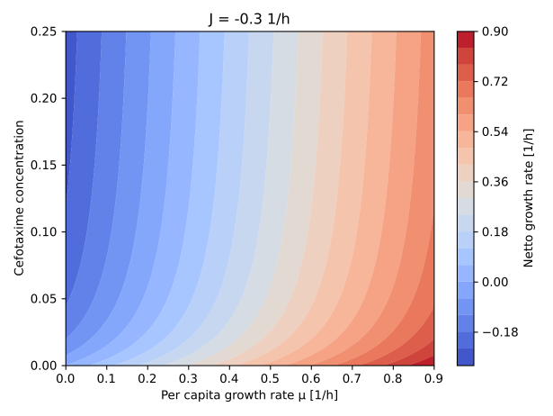
Variation affects netto growth rate
netto growth rate

Slide 15
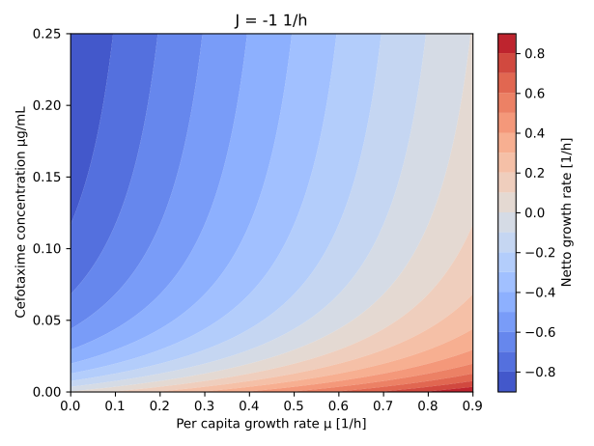

Slide 16
Variation affects netto growth rate
Variation in maximum death rate
Already little detoxification will enable E. coli to grow close to its maximum growth rate
Co-existence feasible

Slide 17
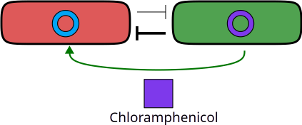
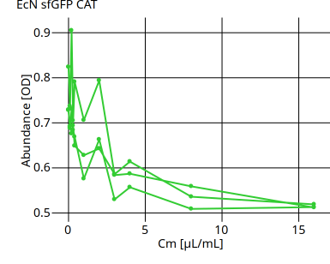
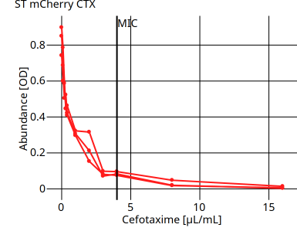
Chloramphenicol

Slide 18
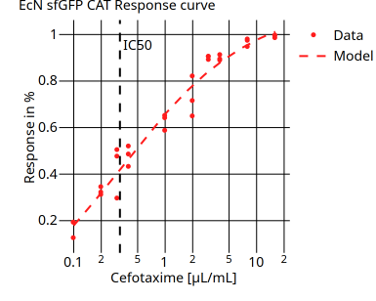
IC50 Chloramphenicol
IC50 for Chloramphenicol:
0.32 μg/mL
MIC: 4 μg/mL
Chloramphenicol is still effective at 0.025x MIC

Slide 19
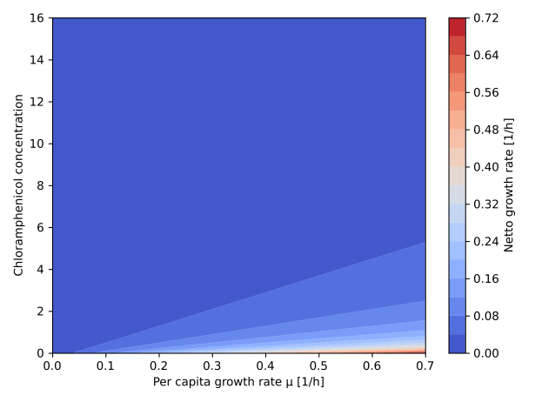
Chloramphenicol is very effective
netto growth rate

Slide 20
What does that mean for cross-protection
ST is effectively getting killed by Chloramphenicol
E. coli looses its partner species
E. coli goes extinct in absence of the partner
In every transfer experiment Chloramphenicol susceptible strains go extinct

