Slide 1

Universal Rental
Car
Team 4:
Tzu Ching Chou, Jinisha Kande, Prateek Naharia
(Simulation Run)

Slide 2
Universal Rental Car will earn $471 million in revenue and $68.6million in profit next year
Tampa
Orlando
Miami
 | Revenue | Profit
Q1 | 11M | 1.6M
Q2 | 10M | 1.5M
Q3 | 10.2M | 1.5M
Q4 | 10.8M | 1.6M
 | Revenue | Profit
Q1 | 65M | 9.4M
Q2 | 60M | 8.8M
Q3 | 59M | 8.6M
Q4 | 67M | 9.8M
 | Revenue | Profit
Q1 | 46.4M | 6.7M
Q2 | 43.8M | 6.4M
Q3 | 42.4M | 6.1M
Q4 | 45.4M | 6.6M
Assumptions:
Assuming a similar pattern in customer and competitors’ behaviors as we have observed in the third simulation
Premium pricing at lower end, to also focus market share for upcoming fiscal year.
Assuming a 5 percent increase in revenue and a stable profit margin
Calculations based on previous year’s earned cumulative revenue of $450 million and profit of $65.12 million.

Slide 3
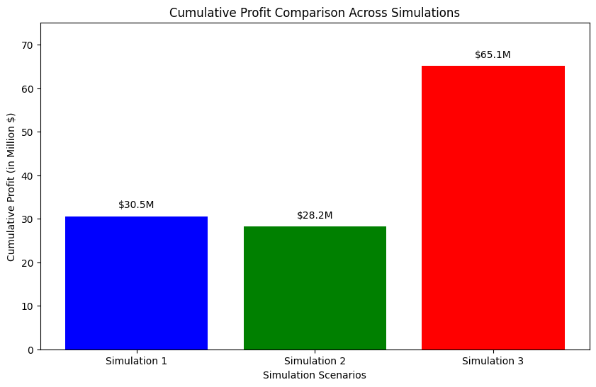
Overview & Key Metrics Over The Simulations
($65.1 M Cumulative Profit)
Pricing Strategy Overview
Our choice to adopt a approach for premium pricing, reduced fleet size, and increased utilization.
Simulation Run By Prateek Naharia
Simulation | Strategy | Key Outcome
1 | Moderate Price Strategy | Stable demand with a 5-8% variation
2 | Market Aligned Pricing | Uniform demand with less than 5% fluctuation
3 | Premium Pricing Strategy | 12-15% decrease in market demand & Increase in Utilization
Simulation | 1 | 2 | 3
Cumulative Profit | $30.5M | $28.2M | $65.1M
Final Market Share | 44.7% | 47.2% | 41.8%
Cumulative Unit Sales | 12.8M | 13.4M | 12.0M
Capacity Utilization | 59% | 66% | 82%
Final Month's Profit | $1.45M | $1.13M | $5.93M

Slide 4
Premium Pricing Strategy In Florida,
highlighting the city-specific pricing strategies,
utilization targets, and demand response.
City | Weekday Pricing | Weekend Pricing | Utilization Targets | Market Demand Response | Inventory Costs & Revenue
Tampa | $43 - $56 (Above Comp.) | $32 - $41 (Above Comp.) | 70 - 86% (Wkdy) / Up to 53% (Wknd) | High Demand Met, Room for Growth | Moderate Costs, High Revenue
Orlando | $41 - $52 (Above Comp.) | $30 - $37 (Above Comp.) | Up to 100% (High Demand) | Fully Meeting Market Demand | Lower Costs, Premium Revenue
Miami | $45 - $59 (Luxury Market) | $33 - $42 (Above Comp.) | 100% Utilization (High-End Demand) | High Demand, Luxury Focus | High Costs, Highest Revenue
Pricing Strategy: Premium pricing to attract high-value customers and ensure profitability.
Demand and Sales: Focused on meeting market demand while maintaining high standards.
Cost Management: Balancing vehicle inventory costs with revenue generation for optimal profitability.

Slide 5
Strategically Elevated Premium Pricing in Tampa, Orlando, and Miami Maximizes Profitability Through Enhanced Utilization and Market Positioning
City | Pricing Strategy | Target Utilization | Market Demand Response | Profit Impact
Tampa | Premium pricing above competitors, focusing on business travelers during weekdays and leisure travelers during weekends. | Aim for 70-80% utilization to balance demand and premium positioning. | High demand from business sector, with moderate elasticity. | Increased revenue per unit, with a focus on high-value customers.
Orlando | Align prices slightly above market average, targeting both business and leisure segments. | Target near 100% utilization in peak seasons, leveraging tourist influx. | Strong demand throughout the year, especially in tourist seasons. | Consistent profitability, leveraging seasonal demand spikes.
Miami | Highest premium pricing, capitalizing on luxury and leisure markets. | Maintain 90-100% utilization, emphasizing quality over quantity. | Sensitive to seasonal changes, with a focus on high-end leisure travelers. | Maximized profits per transaction, with a focus on high spending customer segments.
The pricing strategy for each city, considering the balance between premium pricing, market demand, and desired utilization rates to maximize profitability and market positioning.

Slide 6
Profit Strategy For Florida Markets
Tampa
Orlando
Miami
Weekday Focus: A significant portion of revenue comes from weekday rentals.
No unfilled orders
Premium Pricing was our profit strategy here.
Avg Market Demand for Tampa - 181.4K
Utilization: 70 - 86% (Wkdy) / Up to 53% (Wknd)
Weekend Focus: Orlando sees a higher contribution from weekend (leisure) rentals,
Strongest demand response observed in Orlando, indicating higher sensitivity to pricing and marketing strategies.
Unfulfilled orders, hence there is a market demand which was unfulfilled,which we will look into.
Utilization: Upto 100% (High Demand)
Avg Market Demand of Orlando - 1.07M
Balanced Approach: Miami shows consistent revenue from both weekdays and weekends.
Suggesting Premium Pricing worked best.
Unfulfilled orders, hence there is a market demand which was unfulfilled.
Avg Market Demand for Miami - 560K
Utilization: 100% (High Demand) , Luxury Focus
FLORIDA
Efficient Inventory Management:
High fleet utilization in the simulation signaled effective inventory control.
Contributed to cost control and operational efficiency.
Profitability Focus:
Premium pricing aligned with a profitability-focused approach.
Balanced vehicle inventory costs to maximize revenue.
Prioritized profitability over sheer market presence.
Premium Pricing and Fleet Optimization:
Emphasized on premium pricing.
Reduced fleet size for optimal utilization.
Prioritized value over volume, not fixated on market share.
Market Dynamics in Florida:
Average market demand in Florida: 1.82 M.
Pricing strategy: Premium to attract high-value customers.
Focus on meeting demand with high-quality service.

Slide 7
Premium Pricing Based on Seasonality and Customer Segmentation
TAMPA
ORLANDO
MIAMI
Tampa’s industries include Shipping, Retail,Finance, Insurance and Defense.
7th Largest port in the US, hence we have a higher demand on weekdays, especially from business travelers.
Vacation Destination - 50 million footfall annually.
Higher Weekend Usage.
Business and Conference
Gateway to Latin America
Biggest Shipping Destination in the world
Premier destination for Spring Break for students hence increased tourist activity.
Customer Segmentation
TAMPA:
Business Travelers (Weekdays):
Higher demand on weekdays, especially from business travelers. Business during weekend was only 1%. So focused on leisure.
Weekend Explorers (Weekends):
Slightly lower demand on weekends, possibly local residents or leisure travelers.
ORLANDO:
Weekend Families (Weekends):
Higher utilization on weekends, probably from families.
Business and Conference Travelers (Weekdays):
Weekday demand probably from business and conference travelers.
MIAMI:
Tourists (Weekdays and Weekends):
Consistent demand throughout weekdays, likely due to tourist activity & utilization during weekend 52%, during weekdays its 96%
Business and Leisure Travelers (Weekdays and Weekends):
Balanced demand from both segments, requiring flexible pricing models.

Slide 8
Demand, Price Response & Competitor Behavior Analysis
( Demand & Price Response) Price Range / per sims | Demand Response | Price Elasticity
1. Tampa & Miami: $41-$49 (Wkdy), $34-$45 (Wknd) || Orlando: $37-$45 (Wkdy), $31-$37 (Wknd) | Stable, 5-8% variation || Orlando: 10-15% increase | Moderate
2. Aligned with market avg. within $3 variance | Uniform, <5% fluctuation | Low
3. Increased by 10-15% from previous sims (Premium Pricing) | Decrease of 12-15% | High
Strategic Insights
Fleet Management: Efficient fleet size management, key to maximize profitability, keeping inventory cost (low )control.
Cost Efficiency: A focus on operational efficiency led to reduced variable costs, especially in Simulation 3.
Profitability Enhancement: Adaptability and effective response to market dynamics improved profitability across simulations.
Note : Also overpricing can lead to significant unfilled orders, & low utilization while aligned pricing stabilizes demand.
(Competitor Behaviour) Pricing Strategy / sims | Market Share Response | Strategic Response
1. Stable or slightly lower than Universal | Steady market share | Minimal aggressive changes
2. Slightly reduced prices in response to Universal | Fluctuating market share | Responsive to Universal's strategy
3. More aggressive pricing in peak seasons but on lower level. | Notable changes in some cities | Proactive, possibly using data-driven insights
Strategy Implication
Elastic Markets: Adapt pricing strategies in elastic markets like Orlando and Miami, shows sensitivity to price increase.
Competitive Analysis: Regularly monitor competitor pricing and market share.
Demand Forecasting: Using demand data for informed pricing decisions.

Slide 9
Role of Inventory and Costs in Market Dynamics
Reduced Inventory & Cost , Increased Utilization
Cost Reduction Strategy
Reduction in fleet size: Average reduction of approximately 6% in Tampa, 30% in Orlando, and 22% in Miami.
Significant increase in capacity utilization, especially in Orlando and Miami, indicates more efficient use of the fleet.
Inventory cost reduction by 24% in Simulation 3 compared to Simulations 1 and 2.
Impact of Premium Pricing Strategy (Final)
Enhanced utilization rates allowed for a successful premium pricing strategy.
Despite a reduced fleet size, revenue remained robust due to higher utilization and premium pricing.
The strategy led to a substantial increase in cumulative profit to $65.1M (from $30.5M in Sim 1 and $28.2M in Sim 2).
Strategic Decision
The analysis of customer and market dynamics, along with the role of inventory and costs, informs the decision to continue with a premium pricing strategy.
Focus on maintaining high utilization rates with a leaner fleet to maximize profitability.
Adjust fleet size dynamically based on seasonal demand and market trends.
Fleet Size and Utilization Analysis || Fleet Size (Avg.)/Sims | Utilization Rate | Inventory Cost (Annual)
1. Tampa: 3.9K || Orlando: 21.7K || Miami: 12.8K | 59% | $13.934M
2. Tampa: 3.9K || Orlando: 21.7K || Miami: 12.8K | 66% | $13.932M
3. Tampa: 3.8K || Orlando: 15.2K || Miami: 10.0K | 82% | $11.19M
Quantitative Insights
Capacity Utilization Increase: Improved from 59% in Sim 1 to 82% in Sim 3.
Inventory Cost Efficiency: Reduction in fleet size contributed to lower inventory costs, enhancing overall profitability.
Revenue Maintenance: Successfully maintained revenue levels despite fleet size reduction, validating the premium pricing approach.

Slide 10
Tailoring pricing through segmentation, informed market research, Yield Management, Advanced Analytics & AI
Customer Segmentation
Yield Management
Market Research
AA & AI
Purpose: To understand more different customer segments in-depth (e.g., business vs. leisure travelers).
Application: Tailored pricing strategies for each segment, maximizing revenue from high-value customers, maintaining market share in more price-sensitive segments.
Purpose:
To maximize revenue through dynamic pricing based on demand fluctuations.
Application: Adjusting prices in real-time for different days, seasons, or even times of day, especially for last-minute bookings.
Conduct surveys to identify customer preferences and buying behaviors during weekday and weekend for better pricing decisions.
Analyze the competitors thoroughly each market in Florida to position our offerings strategically in the market.
Purpose:
To leverage big data for predictive modeling and customer insights.
Application: Using AI-driven tools for dynamic pricing, customer segmentation, and demand forecasting.

Slide 11
Proactively mitigating risks & forecasting economic trends
Techniques from The Course
Pricing Tools
Cost Plus
Psychological Pricing
Customer Value Analysis
Economic Forecast
Apply pricing techniques such as value-based pricing, dynamic pricing, cost plus/component based pricing to respond to real time market changes promptly.
Utilize advanced analytic techniques to analyze market data for data-driven pricing strategies.
Purpose:
To have a detailed understanding of fixed and variable costs.
Application:
Ensuring prices cover costs and contribute to profitability; identifying opportunities for cost reduction.
Purpose:
To understand how pricing affects customer perception and buying behavior.
Application:
Implementing pricing strategies that make prices appear more attractive (e.g., $49.99 vs. $50.00).
Purpose:
To understand the value customers place on different aspects of the service
.
Application:
Aligning pricing with the perceived value, potentially introducing tiered pricing models.
Conduct analysis beyond current market conditions to forecast upcoming economic trends.
Conduct analysis on global market trends, govt policies and their potential impacts on local markets.

Slide 12
THANK YOU!

