Slide 1

Healthcare
Persistency of a drug
Exploratory Data Analysis
Jan 30th, 2023.
Submitted by Nahari Terena
LISUM15 – Data Science Specialization

Slide 2
Outline
Business Understanding
Decision Tree
Random Forest
Logistic Regression
SVM
Conclusion
App concept

Slide 3
Business Understanding
ABC Pharma contacted us to analyze the patients' data to have a better understanding of the factors that significantly impact the persistence of their drug. The aim is to know if a patient, based on private information, will follow the prescription and continue taking the medication for all the treatment time or not.
We aim to develop a web app to predict if a patient will get or not a drug schedule.

Slide 4
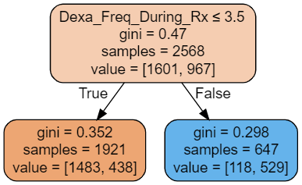
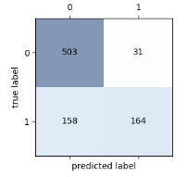
Decision Tree
In the first scenario, the best parameter was a tree of depth 1. Therefore, the results were:
Accuracy of 78.35% for training data.
Accuracy of 77.92% for testing data.
“Dexa_Freq_During_Rx” is the variable that has the most value in terms of predictive power. It could be interesting to see if we can get similar results without it. Considering “Dexa_Freq_During_Rx” is kind of another type of treatment. It would be interesting to be able to predict persistence without it.

Slide 5
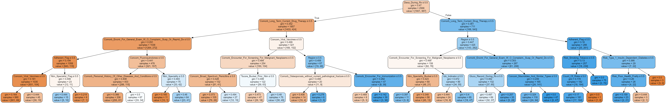
Decision Tree
In the second scenario, the best parameter was a tree of depth of 5. Therefore, the results were:
Accuracy of 81.77% for training data.
Accuracy of 79.32% for testing data.
“Dexa_Freq_During_Rx” is the variable that has the most value in terms of predictive power. It could be interesting to see if we can get similar results without it. Considering “Dexa_Freq_During_Rx” is kind of another type of treatment. It would be interesting to be able to predict persistence without it.

Slide 6
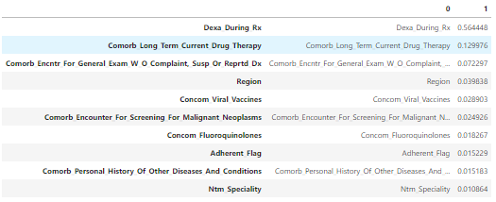
Decision Tree
Besides “Dexa_Freq_During_Rx” and “Dexa_During_RX”, in order to predictive power of persistence in taking the drug is Comorbidity factors, Region and viral vaccines.

Slide 7
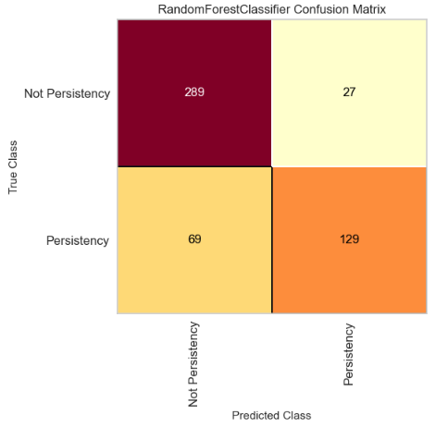
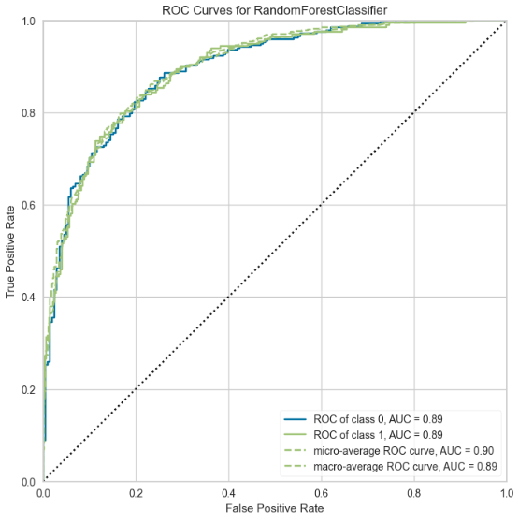
Random Forest
Using the chi-square statistic, some variables were eliminated.
Accuracy of 88.52% for training data.
Accuracy of 80.74% for testing data.

Slide 8
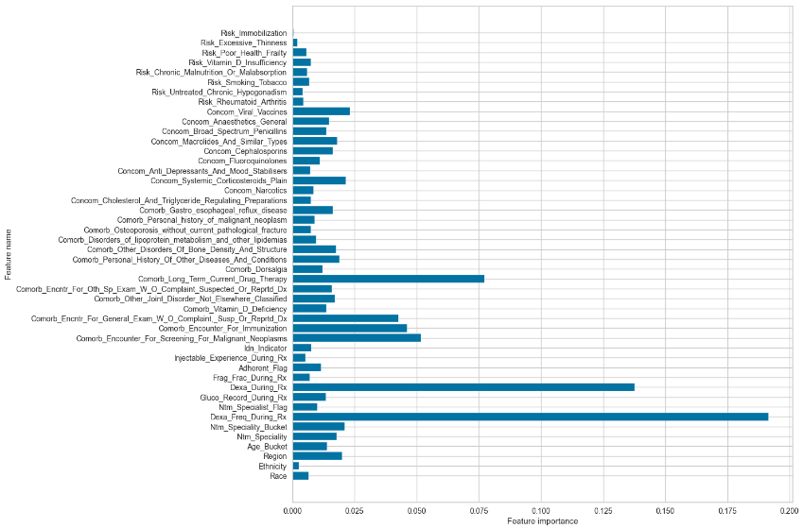
Random Forest
The influence of the variables on the target variable is shown below:

Slide 9
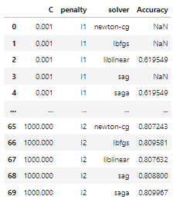
Logistic Regression
Differents parameters and their values when using exhaustive search (GridSearchCV) for tuning the hyperparameters.
The bottom screenshot displays the different combinations of set hyperparameters and the resulting accuracy when using GridSearchCV. Next slide the best parameters and score will be shown.

Slide 10
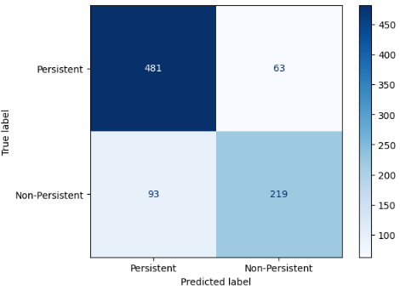
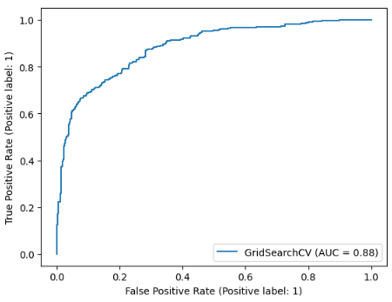
Logistic Regression
F1 score is used to evaluate the logistic regression model. Along with the confusion matrix and ROC curve.
F1-score: 0.8156

Slide 11
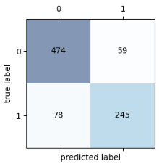
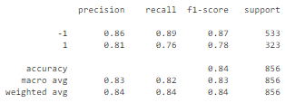
Support Vector Machine
Support Vector Machines algorithm to classify the persistence of patients (1 for positives and -1 for negatives). A linear kernel has been used, obtaining an accuracy of 84.0% over testing data (25 % out of the whole dataset).

Slide 12
Conclusion
The “Dexa_freq_during_rx”, is the variable with greater power to predict persistent and non-persistent results. This variable if followed in importance by “Dexa_During_RX” and “Comorb_Long_Term_Current_Drug_Therapy”.
After those the following chart summarize the importance of other variables to predict the target variable.
The best model to be used to make predictions is the SVM model with 83.5 % of accuracy.

Slide 13
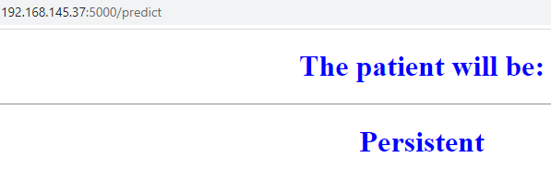
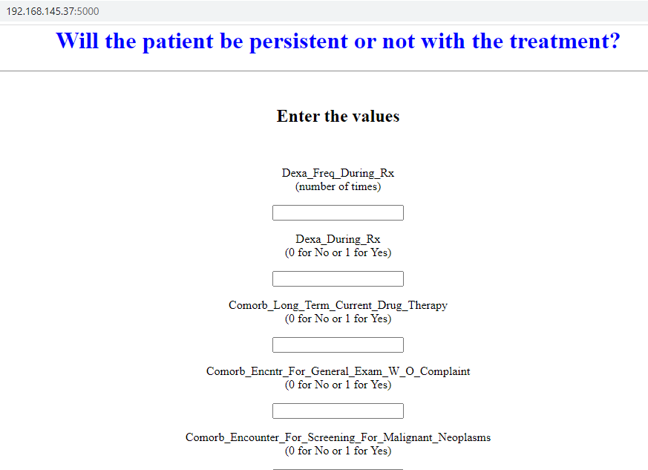
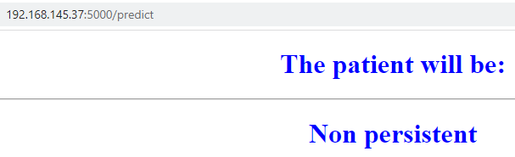
App Concept
We may check a version of the App with the 5 most important predictors at an 78.27% of accuracy in the prediction.

Slide 14
Thank You
Github Repo https://github.com/naharift/DataGlacier/tree/main/Week13

