Slide 1

G2M Case Study
Virtual Internship
Submitted by: Nahari Terena
07-11-2022

Slide 2






Outline
Problem
Statement
Datasets
Information
Exploratory
Data Analysis
Multiple Hypothesis Test
Summary
Next Steps

Slide 3
Problem Statement
XYZ is a private equity firm in US. Due to remarkable growth in the Cab Industry in last few years and multiple key players in the market, it is planning for an investment in Cab industry.
Objective : Provide actionable insights to help XYZ firm in identifying the right company for making investment.
The analysis has been divided into four parts:
Data Understanding and Visualization
fff
Multiple hypothesis and investigate

Slide 4


Data Information
Transaction_ID
Details transactions and payment mode
Cab_dat
Details of transaction for two cab companies
City
List of US cities, population and number of cab users
Final Dataset
Customer_ID
Demographics details about a unique identifier

Slide 5
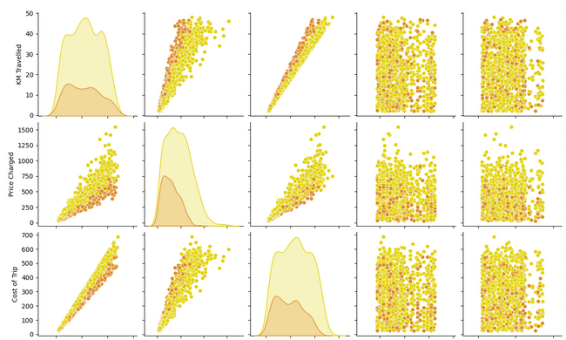
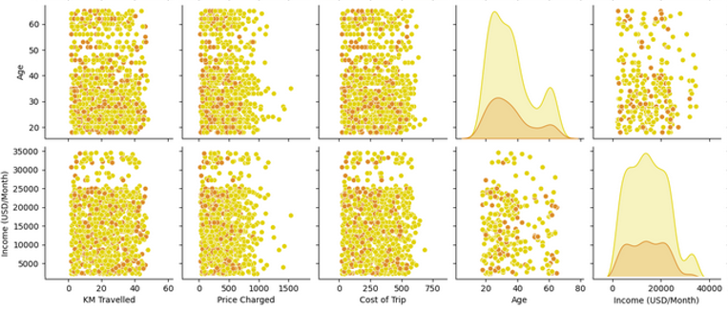
Relationships between variables

Slide 6
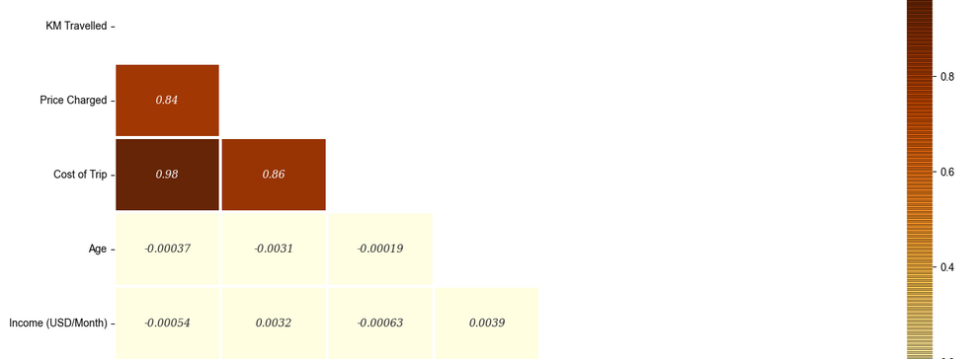
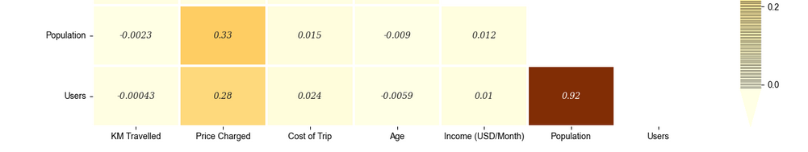
Correlation between variables

Slide 7
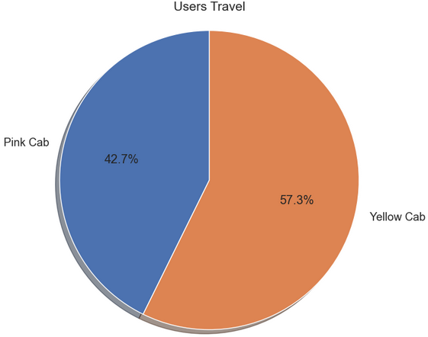
Correlation between variables

Slide 8
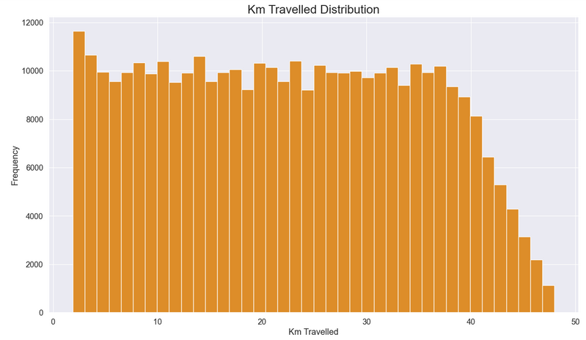
Correlation between variables

Slide 9
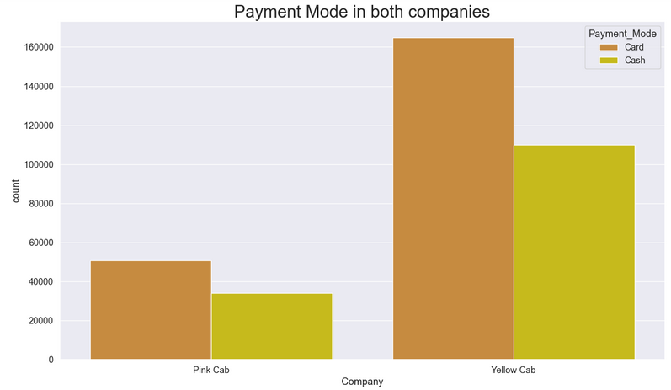
Correlation between variables

Slide 10
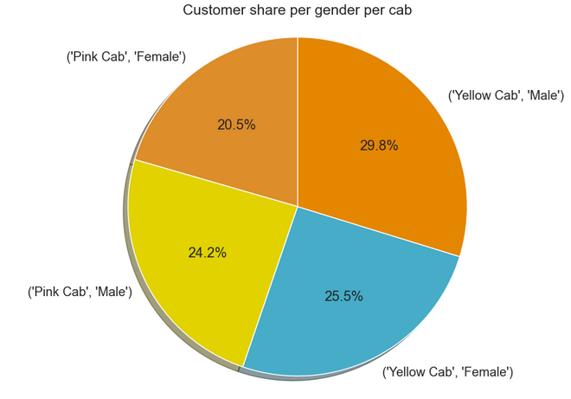
Correlation between variables

Slide 11
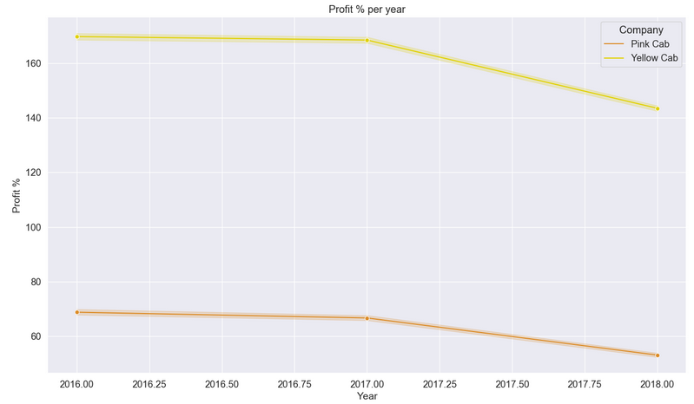
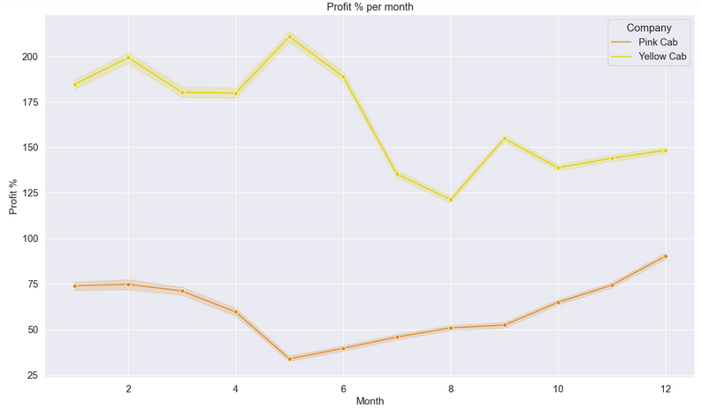
Correlation between variables

Slide 12
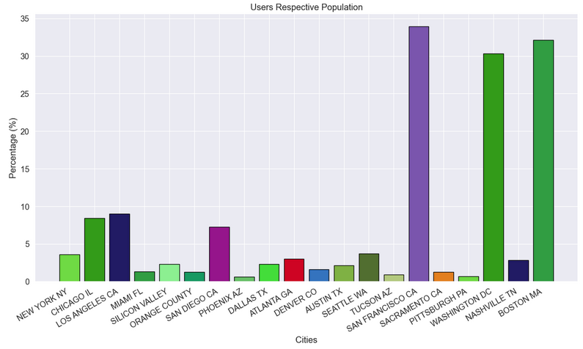
Correlation between variables

Slide 13
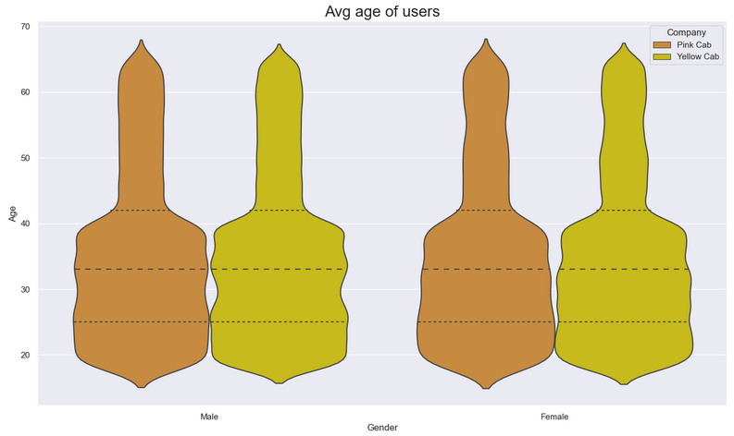
Correlation between variables

Slide 14
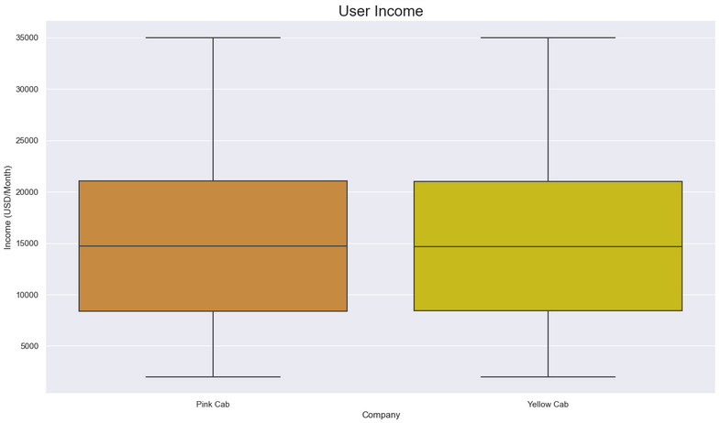
Correlation between variables

Slide 15
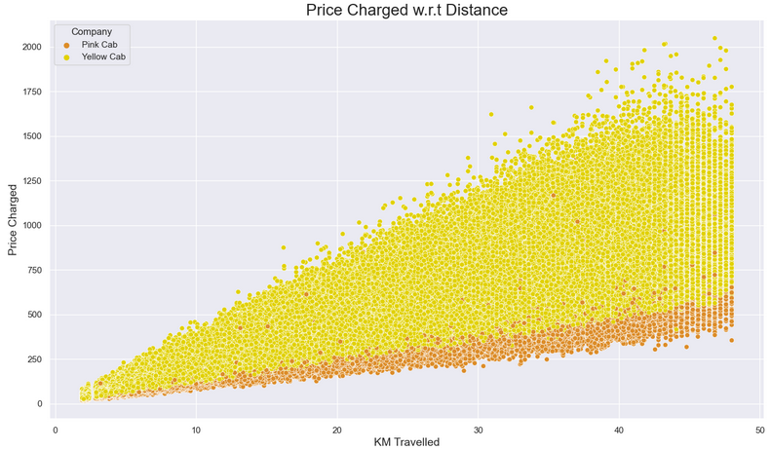
Correlation between variables

Slide 16
Hypothesis 1
Is there any difference between the distance travelled and the cab company
According to the p-value, lower than 0.05, there is a difference between the distance travelled and the cab company.
Hypothesis 2
Is there any difference between age and payment mode
According to the p-value, greater than 0.05, there is no difference regarding age ant the payment mode.
Hypothesis 3
Is there any difference between Profit and Income
According to the p-value, lower than 0.05, there is difference regarding income for Yellow Cab, but no significant difference between Pink Cab and income.
Therefore, looks like Yellow Company users have a bigger income than Pin ones.

Slide 17
Recommendations
We have evaluated both the cab companies on following points and found Yellow cab better than Pink cab:
Customer Reach : Yellow cab has higher customer reach in 25 cities while Pink cab has higher customer reach in 4 cities. We have also observed that Yellow cab is doing good in covering other cab users as compared to Pink cab.
Customer Retention: We have analyzed this in two segments : at least 5 drive and at least 10 drive with the same cab company. And we found that Yellow cab is doing far better than Pink cab in both these segments.
Age wise Reach : Yellow cab has customer in all age group and it’s been observed that it’s even popular in 60+ age group as equally as its in 18-25 age group.
Average Profit per KM: Yellow cab’s average profit per KM is almost three times the average profit per KM of the Pink cab.
Income wise Reach :Both the cabs are very popular in high and medium income class but here also Yellow cab is performing better than Pink cab in offering their services to all the three income class group (low, medium and high)
Ride count and Profit Forecasting : Both the companies are facing loss in the profit and no. of ride. Yellow cab’s forecasted profit loss is around 1.83% while Pink cab’s loss in 3.1%.Pink cab is facing more loss even when its forecasted no of ride loss is lesser than Yellow cab.
On the basis of above point , we will recommend Yellow cab for investment.

Slide 18
Thank You

