Slide 1

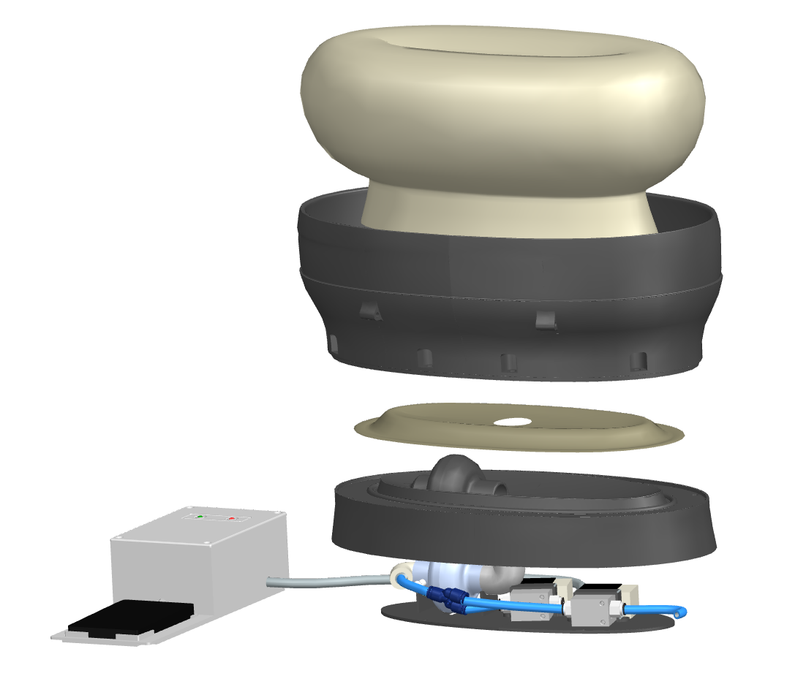
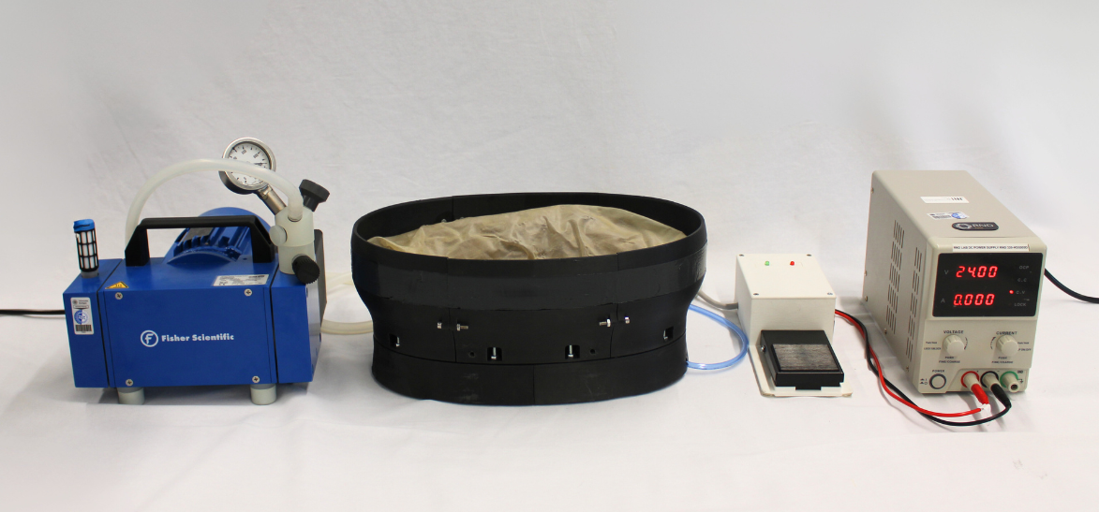
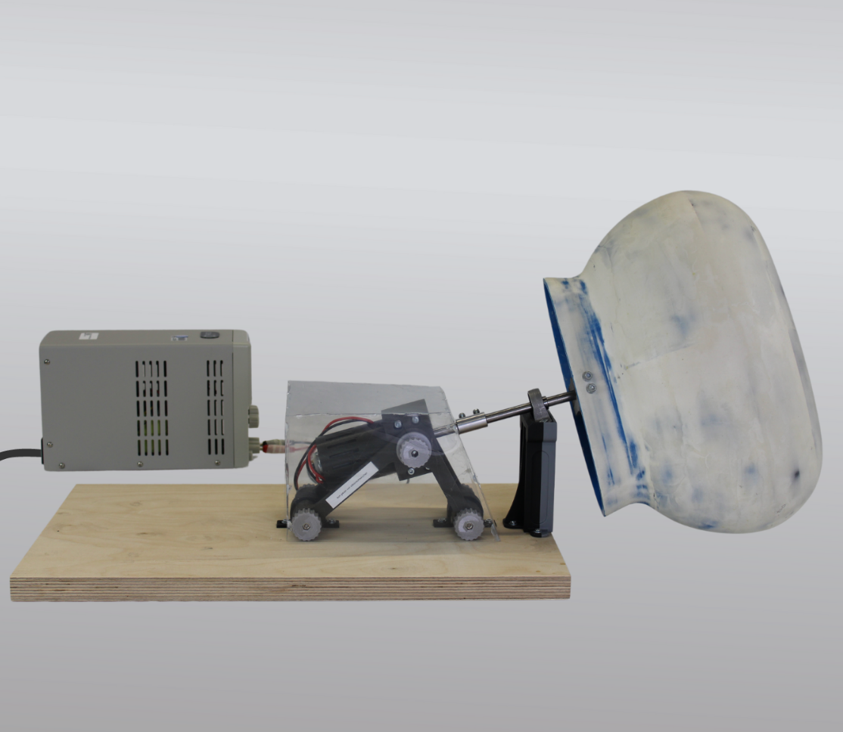
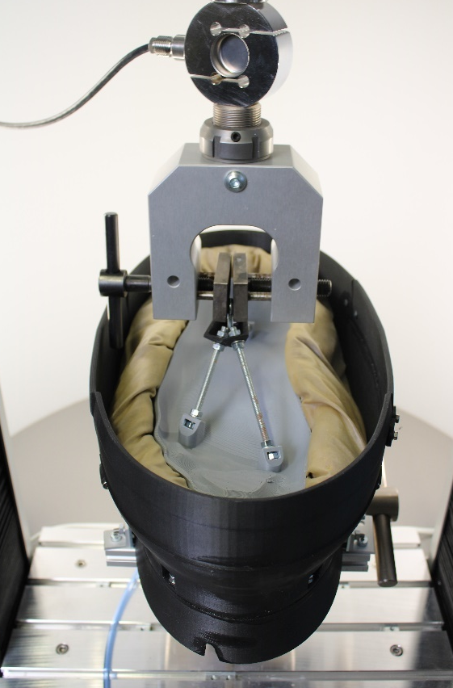
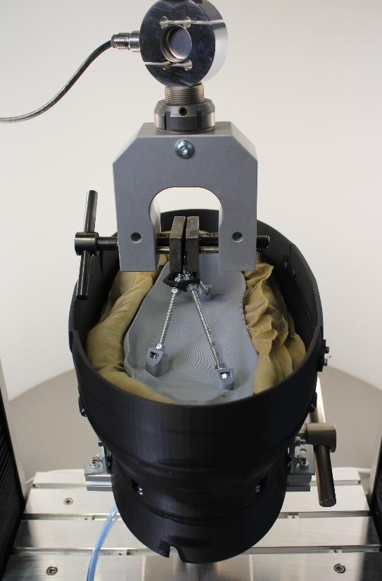
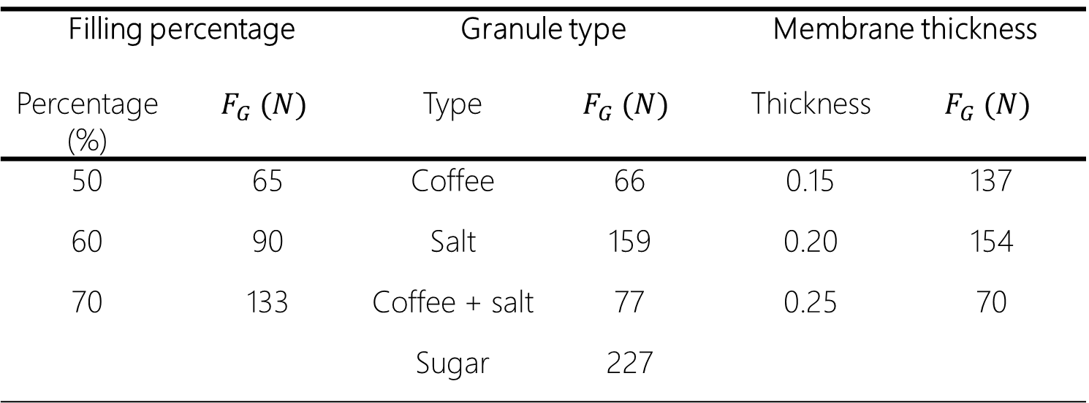
Development of a Granular Jamming Gripper for Ankle Rehabilitation
Bachelor thesis 0227
05.03.2024
N. Halouani, P. Shah Nazar¹ , P. P. Pott¹ ¹Institut für Medizingerätetechnik, Universität Stuttgart, Deutschland
Background
Objectives
Ankle injuries and disabilities require extensive rehabilitation, which is aided by ankle rehabilitation robotics, for which the limited or absent involvement of therapists necessitates securely fixing the foot or leg to the device [1]. The commonly employed mechanisms for attaching the foot to the device, inspired from industrial robotic designs, include belts, straps, and elastic bands, which can constrain the leg or foot and become uncomfortable during prolonged rehabilitation periods [1,2].
Development of a Granular Jamming Gripper (GJG) that attaches the German adult’s foot’s plantar surface through deformation of a granule-filled membrane to its geometry and its subsequent hardening upon application of vacuum in the membrane.
Controllability with a foot pedal.
Investigation of suitable filling percentage, granule type and membrane thickness
System design
Results
Granule-filled latex membrane housed in a collar-shaped base and connected through a filter to air and vacuum.
Ellipsoid-shaped membrane with a depression in the centre for the immersion of the foot and enveloping its sides with granules
Air and vacuum inputs directed by 2 alternating solenoid valves
Electronics case separate from GJG containing a foot pedal to turn on/off the gripper, green and red LEDs to indicate its state, and Arduino Uno microcontroller
GJG with 395 mm length, 194 mm width and 158 mm height able to grip a model of the 95th percentile German adult.
0.25 mm thick latex membrane of a capacity of 5.2 l filled to 60 % with sugar.
Control of the GJG with a pedal attached to a separate electronics case.
Vacuum achieved and hardening of the membrane with a 32 l/min vacuum pump and directed with solenoid valves via Arduino Uno
The biggest and roughest granules and the highest filling percentage of the selection achieve the highest gripping forces (see Figure 4).
System design
10 mm
Granule-filled membrane
Results of the tensile test
Table 1: Maximal gripping forces for selected filling percentages, granule types and membrane thicknesses
Electronics case
Latex sheet
Base
Filling percentage |  | Granule type |  | Membrane thickness
Percentage (%) | $$F_{G} (N)$$ | Type | $$F_{G} (N)$$ | Thickness | $$F_{G} (N)$$
50 | 65 | Coffee | 66 | 0.15 | 137
60 | 90 | Salt | 159 | 0.20 | 154
70 | 133 | Coffee + salt | 77 | 0.25 | 70
 |  | Sugar | 227
Foot pedal
Air filter
Solenoid valves
Pneumatic components
Figure 1: Design of the GJG
Methods
Assembled demonstrator
3D-printed base and electronics case
Membrane constructed by brushing multiple layers of liquid latex on a continuously rotating mold (see Figure 2)
Measuring the gripping force for different options of filling percentage of granules, granule types and membrane thicknesses (see Figure 3)
Determination of the gripping force for different filling percentages of granules in the membrane, granule types, and membrane thicknesses
Evaluation of the options on the criteria gripping force, ease of insertion of the foot in the membrane, durability, reproducibility and mass of the device following the VDI2225-guideline.
Vacuum Pump
Granular Jamming Gripper
Electronics
Case
Power Source
10 mm
Mold
Figure 4: Assembled GJG connected to power source and vacuum pump
Adjustable
power source
Motor in angle-
adjustable case
Conclusions
Design suitable for gripping the German adult’s foot without interfering without interfering with the ankle’s rotation
Optimal gripping ability with 60% filling, 0.25 mm membrane thickness and the choice of granulated sugar from the selection of granule types
10 mm
Bearing
Figure 2: Set-up for molding the latex membrane
Figure 3: Model of the 95th percentile German male foot immersed in the GJG for pull test. A) GJG in aerated state. B) GJG in jammed state
Literature
M. Dong et al., "State of the art in parallel ankle rehabilitation robot: a systematic review," Journal of NeuroEngineering and Rehabilitation, vol. 18, no. 1, pp. 1-15, 2021.
[Y. M. Khalid, D. Gouwanda, and S. Parasuraman, "A review on the mechanical design elements of ankle rehabilitation robot," Proceedings of the Institution of Mechanical Engineers, Part H: Journal of Engineering in Medicine, vol. 229, no. 6, pp. 452-463, 2015.
www.imt.uni-stuttgart.de

