Slide 1
DB2_MidTerm_NaheedSajjad
File created on: 10/14/2025 11:00:14 PM

Slide 2
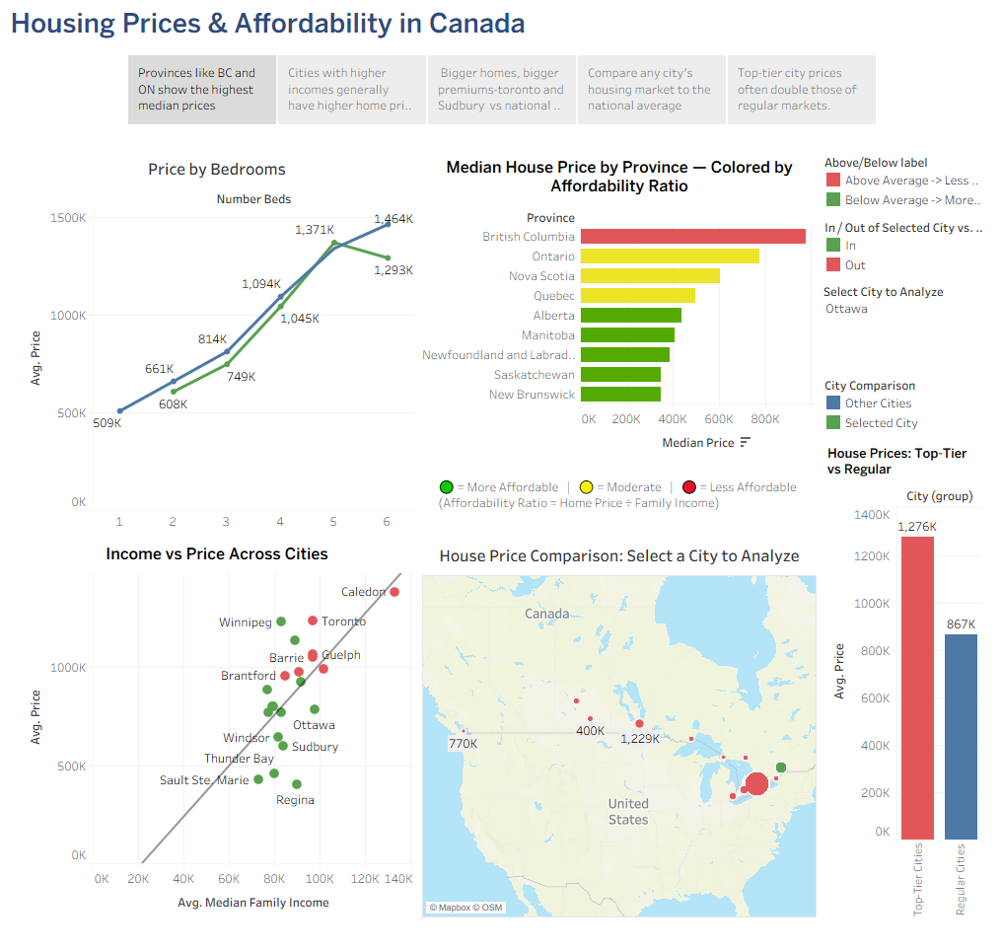

Slide 3
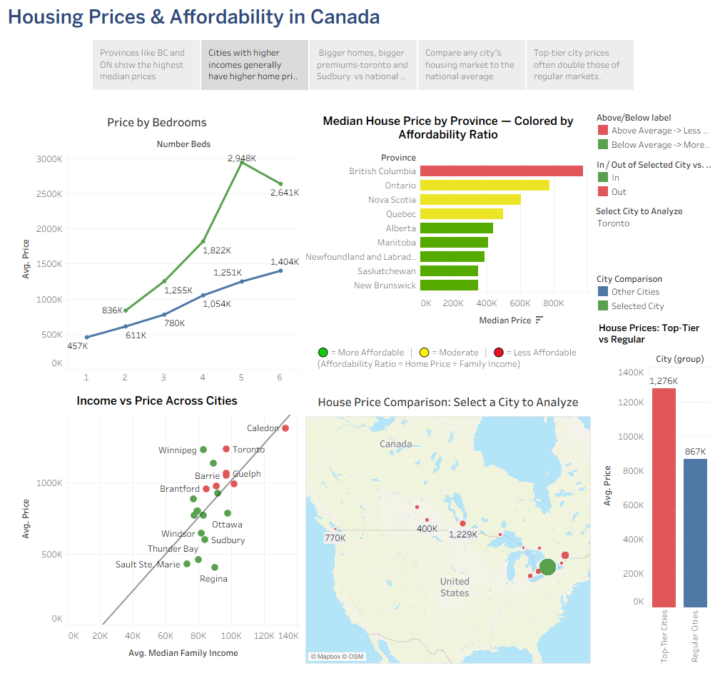

Slide 4
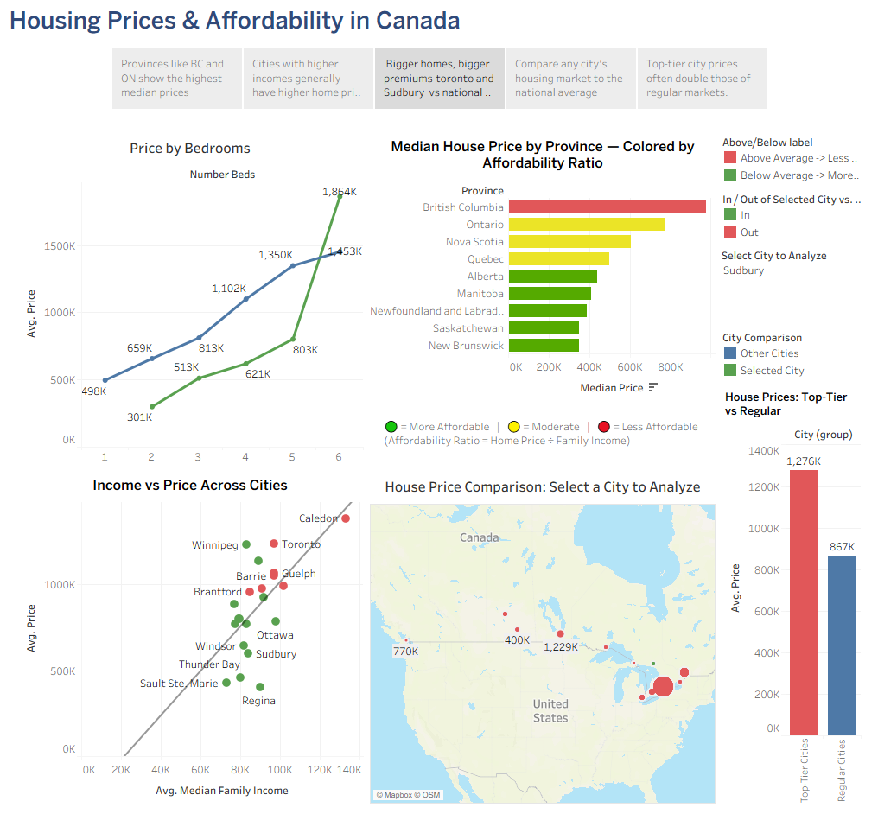

Slide 5
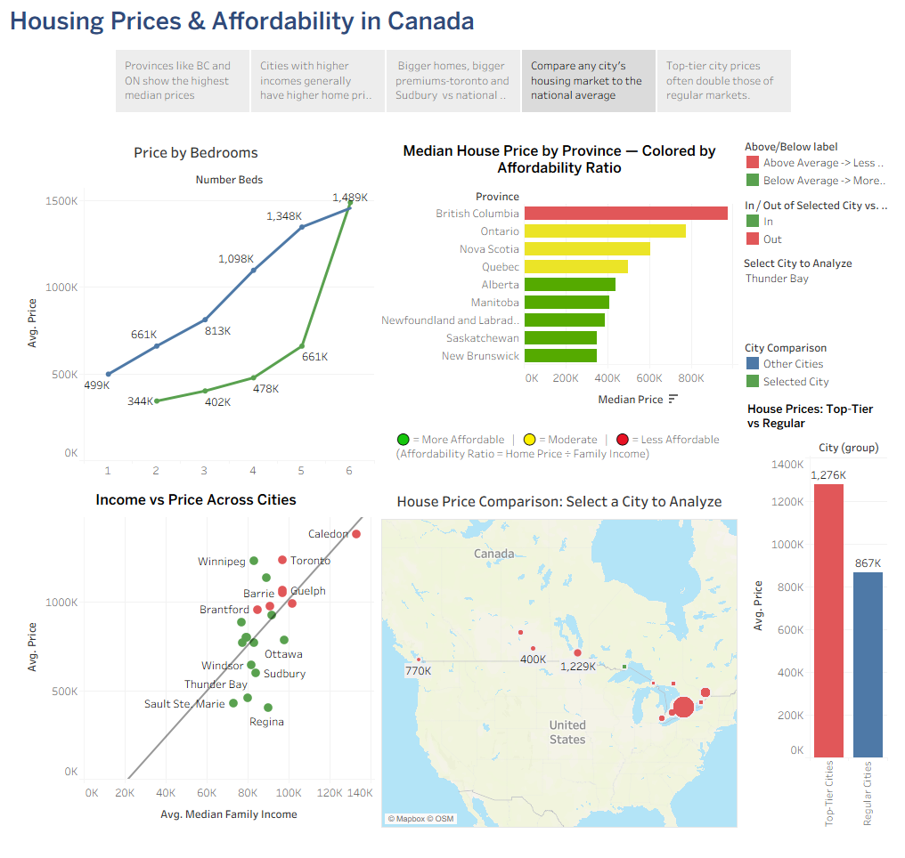

Slide 6


