Slide 1



COURSE PRESENTATION · FISH AND SHELLFISH NUTRITION
TOPIC 3 · LIPIDS
TOPIC 8 · FEED ADDITIVES
MD. NAHIAN ISLAM
Student ID 22903022 · Session 2021–22 · 4th Year
Department of Fisheries
Notes:
Good morning. My name is MD. Nahian Islam, student ID 22903022, 4th year, Department of Fisheries. Today I will present two connected syllabus sections for Fish and Shellfish Nutrition: Topic 3, Lipid Nutrition, and Topic 8, Feed Additives.
Why put these two together? Because in a modern aquafeed, lipids are the most expensive energy source and the most oxidation-prone ingredient, while feed additives are the tools we use to protect lipids, improve digestion, and keep the animal healthy. The two topics meet in one place: the feed pellet.
My plan is: first the biology of lipids, then the fatty acids that matter, then how we meet essential fatty acid requirements in practice — and then the additive technologies that make modern feeds work. Throughout, I will use species we actually farm in Bangladesh.

Slide 2
01 · OBJECTIVES & ROADMAP
What this presentation sets out to do
Two syllabus sections, one continuous argument.
01
Define
DECK MAP
TOPIC 3
Lipid Nutrition
Slides 3–11
02
Classify
3.1–3.2
Functions · Classification
03
Quantify
Essential fatty acid requirements, always stated with the species attached.
3.3–3.4
Fatty acids · EFA roles
04
Apply
3.5
Requirements by species
TOPIC 8
Feed Additives
Slides 12–20
05
Localise
Lipid Nutrition & Feed Additives in Aquaculture · MD. Nahian Islam · Fisheries, 4th Year
01
Notes:
Five objectives, and here is the route we will take through them.
On the left: define, classify, quantify, apply, and localise. Every one of those verbs maps to a question you should be able to answer by the end.
On the right is the deck map. Topic 3 runs from the section divider through slide 11. Sub-topic 3.1 and 3.2 cover functions and classification; 3.3 and 3.4 cover fatty acid structure and the roles of the essential fatty acids; 3.5 covers quantitative requirements species by species.
Topic 8 then takes the same logic into additive technology, and the last five slides are the practical, Bangladesh-specific and forward-looking section.

Slide 3

INTRODUCTION
94.4
million tonnes
of farmed aquatic animals in 2022 — 51% of all aquatic animal production
~45
per cent
of global fish oil supply is consumed by the aquafeed sector
FAO (2024). The State of World Fisheries and Aquaculture 2024. Rome: FAO.
Introduction · Lipid nutrition in aquatic animals
02
Notes:
Let me frame the problem in three moves.
First: aquatic animals are what they digest. We can write a nutritionally perfect formula on paper, but if the lipid has oxidised, or the fatty acid is esterified in the wrong position, or the pellet leaches its solubles before the fish finds it, the animal does not get the nutrient.
Second: fish cannot synthesise the omega-3 and omega-6 families. They lack the desaturases needed to introduce a double bond beyond carbon 9. That is the biological reason lipids are a dietary essential and not merely an energy source.
Third: scale. In 2022 aquaculture produced 94.4 million tonnes of aquatic animals, passing capture fisheries for the first time. Aquaculture already takes roughly 45 percent of global fish oil. So lipid nutrition is simultaneously a biology problem, a formulation problem and a supply problem.

Slide 4
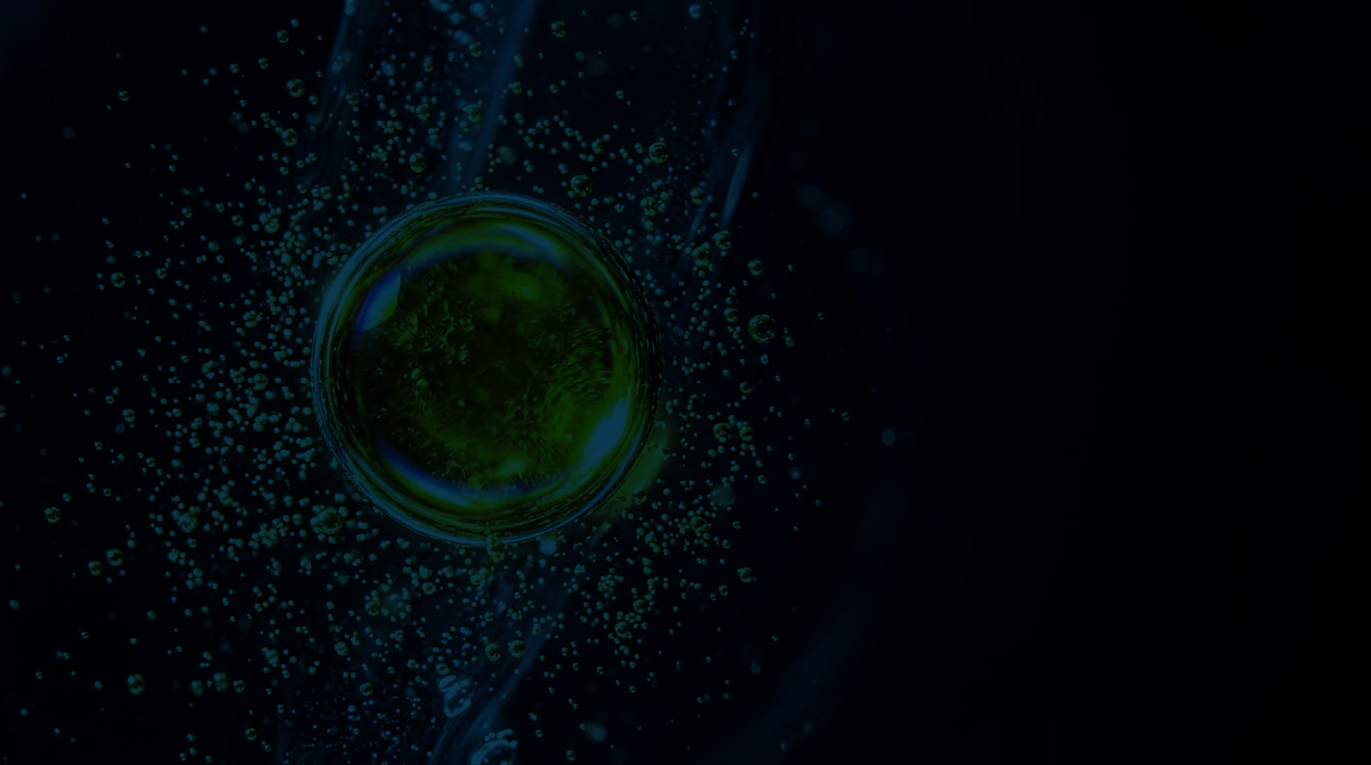

TOPIC 3
3.1 Definition & functions
3.2 Classification & composition
3.3 Fatty acid structure
3.4 Role of essential fatty acids
3.5 Fatty acid requirements
Emulsified lipid droplet in water, dark-field micrograph
Notes:
We begin Topic 3.
The image behind is a lipid droplet emulsified in water — which is, in a sense, exactly what a cell membrane is: a structured film of lipid separating two aqueous compartments.
Five sub-topics. First, definition and functions. Second, classification and composition. Third, fatty acid structure, where the important biology sits. Fourth, the specific roles of EPA, DHA and ARA. And fifth, the quantitative requirements, species by species.

Slide 5
3.1 · DEFINITION & FUNCTIONS
They share one chemical property — insolubility in water — and almost nothing else.
THE BUILDING BLOCK
DEFINITION
glycerol
C1
sn-1
16:0
C2
sn-2
18:2 n-6
C3
sn-3
18:1 n-9
01
“Lipid” is a class, not a molecule
02
Energy density
03
Aqueous transport
39.5 kJ/g gross energy, against 23.6 kJ/g for protein.
Because lipids do not dissolve, fish move them as lipoproteins.
Definitions after Tocher (2003); NRC (2011); FAO (1989) energy values.
Lipid Nutrition & Feed Additives in Aquaculture · MD. Nahian Islam · Fisheries, 4th Year
04
Notes:
Sub-topic 3.1, definition.
Lipids are a heterogeneous group: triglycerides, phospholipids, sterols, wax esters, free fatty acids. What unites them is a physical property, not a chemical one — they do not dissolve in water. That single fact drives almost everything else: it is why lipids must be emulsified in digestion, why they must be carried in lipoproteins in the blood, and why they are the structural material of every membrane.
The panel on the right is the molecule you must be able to draw: glycerol carrying three fatty acids by ester bonds — a triacylglycerol. Chain one and three are saturated, typically palmitic and stearic acid. Chain two is unsaturated, often oleic acid. That positional pattern is not random: in fish, the middle position is preferentially hydrolysed by pancreatic lipase, which is one reason dietary fatty acid composition shows up so directly in the flesh.

Slide 6
3.1 · FUNCTIONS
Five jobs that only lipids can do
Energy is the one everybody quotes. Structurally, the other four matter more.
01
02
03
04
05
Energy
39.5
PL
EPA · DHA · ARA
PG · LT · TX
PL · chol.
kJ/g
Gross energy values after Cho et al. (1982); functions synthesised from Tocher (2003) and NRC (2011).
Lipid Nutrition & Feed Additives in Aquaculture · MD. Nahian Islam · Fisheries, 4th Year
05
Notes:
Five jobs of a lipid — and I want to spend a moment on why energy is the least interesting one.
One, energy. Lipid delivers about 39.5 kilojoules per gram of gross energy, against roughly 23.6 for protein. So lipid is the densest energy source in the feed. That matters twice over: it spares protein for growth, and it keeps the pellet energy-dense enough that the fish does not have to eat impossible quantities.
Two, membrane structure. Every cell in the fish is bounded by a phospholipid bilayer, and the fatty acids in that bilayer determine how fluid it is. Change the dietary fatty acids and you literally change the physics of the cell surface.
Three, essential fatty acids. These are the ones the fish cannot make. I will cover them in detail in 3.3 and 3.4.
Four, signalling. Prostaglandins, leukotrienes and thromboxanes all come from 20-carbon fatty acids. This is why the omega-3 to omega-6 balance has immune consequences, not just growth consequences.
Five, absorption and transport. Without bile salts and phospholipids, the fish cannot emulsify fat at all; without lipoproteins it cannot move it around the body.

Slide 7
3.1 · FUNCTIONS IN PRACTICE
More lipid is not automatically better
CRUDE LIPID IN DIET (% dry matter)
0
5
10
15
20
WHEN THE RANGE IS EXCEEDED
Nile tilapia
5–8%
Fatty liver
4–7%
Hepatic steatosis reduces liver function and fillet quality.
Indian major carps
Pangasius
6–10%
Protein sparing inverts
Fish eat to an energy target, so excess lipid suppresses protein intake.
Asian seabass
8–14%
4–8%
Pellet strength falls
Macrobrachium prawn
High oil inclusion makes extruded pellets friable and prone to leaching.
Penaeus monodon
6–9%
Rancidity risk rises
More unsaturated lipid means more substrate for oxidation.
Indicative ranges compiled from NRC (2011), Lim et al. (2011), Glencross (2009) and shrimp nutrition reviews; values are formulation targets, not fixed requirements.
Lipid Nutrition & Feed Additives in Aquaculture · MD. Nahian Islam · Fisheries, 4th Year
06
Notes:
This is the practical translation of "lipid as energy".
The bars are crude lipid ranges used in commercial grow-out formulations. Nile tilapia sits around 5 to 8 percent. Indian major carps, in pond polyculture, are usually lower — 4 to 7 percent — because the pond supplies a lot of natural food. Pangasius is pushed higher, 6 to 10, in intensive systems. Asian seabass is a marine carnivore and needs both more lipid and the right fatty acids.
Two very important cautions. First, these are formulation targets, not requirements — the true requirement is for specific fatty acids, which may be a fraction of one percent. Second, the ceiling matters: exceed it and you get fatty liver, reduced fillet quality, weaker pellets and faster oxidation.
And note the honest caveat at the bottom: these ranges move with life stage and with the energy-to-protein ratio of the whole formula.

Slide 8
3.2 · CLASSIFICATION
Three families, three different jobs
LIPIDS
SIMPLE
COMPOUND
DERIVED
esters of fatty acids with alcohols
lipids conjugated to other groups
formed by hydrolysis or synthesis
Triacylglycerols
Phospholipids
Sterols
TAG — 95% of storage lipid; main energy reserve
PL — lecithin, cephalin; the membrane backbone
Cholesterol — essential in crustaceans, not fish
Waxes
Glycolipids
Fatty acid derivatives
Wax esters — mainly marine zooplankton and some fish
Sugar-bearing lipids; minor in fish, present in algae
Eicosanoids, prostaglandins, leukotrienes
Free fatty acids
Lipoproteins
Fat-soluble vitamins
FFA — the form absorbed across the gut wall
Lipid + protein carriers in blood and yolk
A, D, E, K and carotenoid pigments
Why it matters in formulation: fish digest TAG efficiently; phospholipids are required by larvae and crustaceans that cannot synthesise enough; sterols are a dietary essential for shrimp but not for fish.
After Christie (1982); Tocher (2003); D’Abramo (1998) on crustacean sterol requirement.
Lipid Nutrition & Feed Additives in Aquaculture · MD. Nahian Islam · Fisheries, 4th Year
07
Notes:
Sub-topic 3.2, classification.
The classic three-way split. Simple lipids are esters of fatty acids with alcohols — the triacylglycerols that make up roughly 95 percent of storage lipid, plus wax esters and free fatty acids. Compound lipids are conjugated: phospholipids, glycolipids, lipoproteins. Derived lipids are what you get after hydrolysis or synthesis — sterols, eicosanoids, fat-soluble vitamins.
Now, the classification is not just bookkeeping. Three practical consequences.
Fish digest triacylglycerol very efficiently. But larval fish and crustaceans cannot synthesise phospholipid fast enough for their own membranes, so phospholipid becomes a dietary essential for them — typically one to three percent of the diet in shrimp larvae.
Sterols are the striking exception. Shrimp and prawns cannot synthesise cholesterol, so it is a genuine dietary requirement, usually quoted around 0.25 to 0.4 percent of the diet. Fish can synthesise sterols and do not need dietary cholesterol.
So the same "lipid" word covers a nutrient that is optional for a tilapia and obligatory for a shrimp.

Slide 9
3.2 · COMPOSITION & STRUCTURE
WHY THE FATTY ACID MATTERS
EXTRACELLULAR / WATER
Fluidity
Protein function
CYTOPLASM
Precursor pool
Membrane ARA and EPA are released on demand to make eicosanoids.
PC
PE
PS / PI
Lecithin
phosphatidylcholine
phosphatidylethanolamine
serine / inositol
soy lecithin
the dominant class in fish membranes
DHA-rich; up to ~40% of its fatty acids
signalling and membrane trafficking
the practical PL source in aquafeed
Bilayer schematic redrawn after Singer & Nicolson (1972); DHA content of PE after Glencross (2009).
Lipid Nutrition & Feed Additives in Aquaculture · MD. Nahian Islam · Fisheries, 4th Year
08
Notes:
This is the slide I would put on the exam if I were setting it.
The figure is a phospholipid bilayer. Each molecule has a hydrophilic head containing phosphate and a nitrogenous base — choline, ethanolamine, serine or inositol — and two hydrophobic fatty acid tails. In water they spontaneously arrange tail-to-tail. That is the membrane.
Look at the highlighted section: that is a membrane protein embedded in the bilayer. It is not floating in a rigid wall — it needs the lipid around it to be fluid enough to change shape. That is why the fatty acid composition of the membrane is functionally important, not merely structural.
The second point is the DHA argument. DHA has six double bonds, which makes it extremely kinked and extremely flexible at low temperature. Cold-water fish accumulate DHA in their membranes — in phosphatidylethanolamine it can reach around 40 percent of total fatty acids. Warm-water fish need less.
Third: the membrane is also a store. When a cell is stimulated, phospholipase releases ARA and EPA from the membrane, and those become eicosanoids. So membrane composition sets the precursor pool for immune signalling.
The four classes at the bottom are what you will actually meet in a formulation: PC and PE dominate, and soy lecithin is the practical commercial phospholipid source.

Slide 10
3.2 · COMPOSITION & STRUCTURE
What goes into the oil phase of a feed
MARINE OILS
PLANT OILS
OTHER SOURCES
Fish oil (anchovy, sardine)
Soybean oil
Soy lecithin
EPA + DHA rich
linoleic (18:2 n-6)
phospholipid
18–30% n-3 LC-PUFA
LA ~50%
1–3% of diet
Krill oil
Linseed / flax oil
Microalgae (Schizochytrium)
EPA, DHA, astaxanthin
α-linolenic (18:3 n-3)
DHA, no fishy taint
high PL content
ALA ~50%
growing share
Tuna / cod liver oil
Rapeseed / mustard oil
Single-cell oils / yeast
DHA rich
oleic + LA
DHA, ARA
variable, costly
locally available in BD
research to commercial
Palm oil
saturated, energy only
no EFA value
The substitution problem: replacing fish oil with plant oil lowers cost but dilutes EPA and DHA — the very nutrients the formulation exists to deliver.
Fatty acid composition after FAO (1986) and Turchini et al. (2009); lecithin inclusion after shrimp feed reviews.
Lipid Nutrition & Feed Additives in Aquaculture · MD. Nahian Islam · Fisheries, 4th Year
09
Notes:
Now the ingredient list — what actually goes into the oil phase.
Three groups. Marine oils: fish oil from anchovy and sardine is the classic EPA and DHA source; krill oil also carries astaxanthin and phospholipid; cod liver oil is DHA-rich but expensive.
Plant oils: soybean oil is linoleic-rich; linseed is α-linolenic-rich; rapeseed and mustard oil are locally important in Bangladesh; palm oil gives energy and saturated fat but no essential fatty acid value at all.
Other sources: soy lecithin as a phospholipid; and increasingly microalgae — Schizochytrium is a commercial DHA source that does not carry a fishy taint.
The bar at the bottom is the central tension of modern aquafeed. Fish oil is finite and expensive. Plant oils are cheap and abundant. But replacing fish oil with plant oil dilutes exactly the long-chain omega-3 that the formulation exists to deliver. Our group in Bangladesh faces this daily: mustard and rapeseed oil are cheap and local, but they carry neither EPA nor DHA.
That tension is why 3.5 — requirements — and Topic 8 — additives — matter as much as the ingredient list.

Slide 11
3.3 · FATTY ACID STRUCTURE
Every fatty acid in this presentation can be described by three numbers.
ANATOMY OF A FATTY ACID
1
3
6
9
12
15
18
METHYL (n) END
the water-loving end; forms the ester bond
18:3 n-3
18
:3
n-3
carbons in the chain
double bonds
first double bond from the methyl end
α-linolenic acid (ALA) — the parent of the omega-3 family
01
CHAIN LENGTH
02
SATURATION
03
GEOMETRY
Short (<C8), medium (C8–C14), long (C16+) or very long (C20+)
No double bond = saturated; one = MUFA; two or more = PUFA
cis double bonds kink the chain; trans bonds stay straight
Nomenclature after IUPAC; chain anatomy after Tocher (2003).
Lipid Nutrition & Feed Additives in Aquaculture · MD. Nahian Islam · Fisheries, 4th Year
10
Notes:
Sub-topic 3.3. If you can hold this diagram in your head, all the rest follows.
A fatty acid is a carboxyl group at one end, attached to a hydrocarbon chain, ending in a methyl group at the other end. Everything that matters is described by three numbers.
Eighteen to three, n-3. Eighteen carbons. Three double bonds. And n-3 means the first double bond is counted from the methyl end, on carbon 3. That is α-linolenic acid — the parent of the entire omega-3 family.
Notice the double bonds drawn as short parallel strokes. In life they are nearly all cis, which puts a kink in the chain and stops the molecules packing tightly. That is why unsaturated fats are liquid at room temperature and saturated fats are solid. Trans fatty acids — rare in nature, common in industrial partial hydrogenation — keep the chain straight, and for that reason behave physically more like saturated fat.
So the three variables are chain length, saturation, and geometry. Chain length determines how the molecule behaves in digestion; saturation determines melting point and oxidation risk; geometry determines packing.

Slide 12
3.3 · CLASSIFICATION OF FATTY ACIDS
Three families, three physical behaviours — and therefore three different roles in a feed.
SATURATED
MONOUNSATURATED
POLYUNSATURATED
SFA
MUFA
PUFA
palmitic 16:0 · stearic 18:0
oleic 18:1 n-9
LA 18:2 n-6 · ALA 18:3 n-3 · EPA · DHA
Solid at room temp
Liquid, but stable
Liquid; oxidation-prone
·
Straight chain; packs tightly
·
One cis double bond = one kink
·
Two or more cis double bonds
·
Mainly used for energy
·
Good energy source, well digested
·
Includes the essential fatty acids
·
No essential fatty acid value
·
Not essential — fish can make it
·
Structural and signalling roles
OXIDATION RISK
SFA
MUFA
PUFA (2 db)
EPA / DHA (5–6 db)
Classification after NRC (2011); oxidation susceptibility follows the number of bis-allylic methylene groups.
Lipid Nutrition & Feed Additives in Aquaculture · MD. Nahian Islam · Fisheries, 4th Year
11
Notes:
Three families.
Saturated fatty acids have no double bonds. Palmitic and stearic acid are the common ones. Straight chain, packs tightly, solid at room temperature, and chemically stable — but no essential fatty acid value. They give energy and nothing else.
Monounsaturated fatty acids have one cis double bond. Oleic acid, 18:1 n-9, is the typical example. One kink in the chain, so they stay liquid but are still reasonably stable. Fish can synthesise oleic acid, so it is not essential. It is a good energy source and it is well digested.
Polyunsaturated fatty acids have two or more cis double bonds. Linoleic and α-linolenic are the parent molecules of the two families, and EPA and DHA are their long-chain derivatives. These carry the essential function, and they also carry the fragility — the more double bonds, the more susceptible to oxidation.
That trade-off is the point of the row at the bottom: the same property that makes a fatty acid biochemically valuable — unsaturation — is what makes it unstable in a feed bag. Protection is therefore not optional; that is where antioxidants in Topic 8 come from.

Slide 13
3.3 · OMEGA-3 & OMEGA-6
Two families, one shared enzyme
OMEGA-3
OMEGA-6
18:3 n-3
α-linolenic acid (ALA)
18:2 n-6
linoleic acid (LA)
plant oils: linseed, canola
soybean, sunflower, corn oils
18:4 n-3 → 20:4 n-3
desaturation + elongation
18:3 n-6 → 20:3 n-6
desaturation + elongation
Δ6- and Δ5-desaturase, elongase
same enzymes as the n-3 pathway
20:5 n-3
EPA — eicosapentaenoic acid
20:4 n-6
ARA — arachidonic acid
precursor of 3-series eicosanoids
precursor of 2-series eicosanoids
22:6 n-3
DHA — docosahexaenoic acid
22:5 n-6
DPA n-6 (docosapentaenoic)
retina, brain, membrane fluidity
rises when n-3 is limiting
Because Δ6-desaturase is shared, a large excess of dietary n-6 suppresses n-3 conversion — and vice versa. This competition is why the n-3 : n-6 ratio is formulated, not just the absolute amounts.
Pathway after Sargent et al. (2002); Tocher (2003); enzyme competition reviewed by Glencross (2009).
Lipid Nutrition & Feed Additives in Aquaculture · MD. Nahian Islam · Fisheries, 4th Year
12
Notes:
This is the diagram to remember for omega-3 versus omega-6.
Both families start with an eighteen-carbon parent: α-linolenic acid on the left, linoleic acid on the right. Both then go through the same sequence of desaturation and elongation steps, in the same order, using the same enzymes.
The omega-3 pathway produces EPA at twenty carbons and five double bonds, and DHA at twenty-two carbons and six double bonds. The omega-6 pathway produces arachidonic acid at twenty carbons and four double bonds.
Now look at the middle label: same enzymes. That is the critical point. Δ6-desaturase is a shared, rate-limiting step. If the diet is flooded with linoleic acid, the enzyme is busy with n-6 substrate and the fish converts less ALA to EPA and DHA. That is why a ratio matters, not just a total.
And this is exactly the situation in a cheap plant-oil-based feed: plenty of n-6, very little n-3. The consequence is not just less EPA and DHA — it is more ARA, and a shift in the eicosanoid profile towards a more inflammatory set.
One honest caveat: freshwater species like tilapia and carp have a reasonably active desaturase system, so they can partly compensate. Marine species largely cannot.

Slide 14
3.3 · THE THREE MOLECULES THAT MATTER MOST
Same family chemistry, very different biological destinations.
EPA
20:5 n-3
DHA
22:6 n-3
ARA
20:4 n-6
Eicosapentaenoic acid
Docosahexaenoic acid
Arachidonic acid
Membrane phospholipids; liver and muscle
Retina, brain, sperm, gill and membrane lipids
Membrane phospholipids; high in eggs and larvae
Sparing ARA, modulating inflammation
Highest EFA value in most species
Essential in marine larvae and shrimp
THE DIVISION OF LABOUR
EPA and ARA are signal molecules — short, fast, immune and vascular. DHA is a building material — long-lived, structural, concentrated where electrical signals move.
DHA content of phosphatidylethanolamine after Glencross (2009); ARA function after Bell & Sargent (2003).
Lipid Nutrition & Feed Additives in Aquaculture · MD. Nahian Islam · Fisheries, 4th Year
13
Notes:
Three molecules, three jobs.
EPA — eicosapentaenoic acid, twenty carbons, five double bonds. It is the precursor of the 3-series eicosanoids, which are broadly anti-inflammatory and vasodilatory. Think of EPA as the signal molecule: it is released from the membrane on demand and converted quickly.
DHA — docosahexaenoic acid, twenty-two carbons, six double bonds. This is the most unsaturated fatty acid in the animal. It is not primarily a signalling molecule; it is a building material. It concentrates in the retina, in the brain, and in gill membranes. In neural phosphatidylethanolamine it can be forty percent of the fatty acids. That is also why DHA consistently shows the highest essential fatty acid value across species — Glencross's 2009 review is explicit about this.
ARA — arachidonic acid, twenty carbons, four double bonds, omega-6 family. It is the precursor of the 2-series prostaglandins and leukotrienes. It is often described as pro-inflammatory, which is too simple: ARA metabolites are also required for normal osmoregulation and stress response. In marine larvae and in shrimp, ARA is a genuine essential fatty acid in its own right.
Look at the chain drawings: DHA has six double bonds, and you can see how kinked it is compared with ARA. Structure is function.

Slide 15
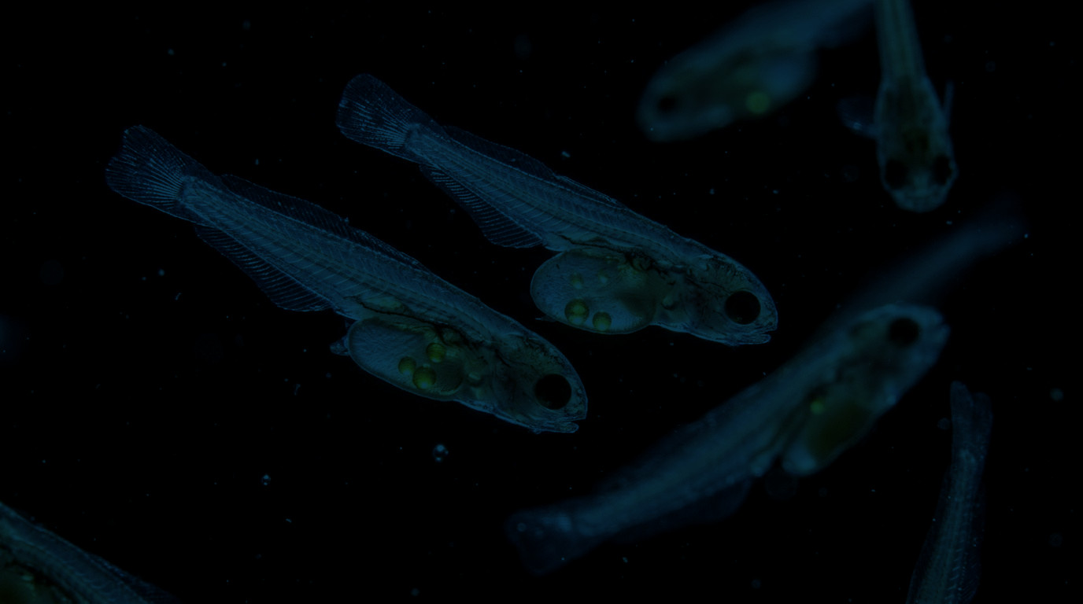

3.4 · ROLE OF ESSENTIAL FATTY ACIDS
01
02
Membrane structure
Growth & survival
DHA
EPA + DHA
03
04
Immune function
Reproduction
Newly hatched larvae
ARA / EPA
DHA + ARA
Synthesis of Tocher (2003), Glencross (2009), Izquierdo et al. (2001) on broodstock EFA.
Lipid Nutrition & Feed Additives in Aquaculture · MD. Nahian Islam · Fisheries, 4th Year
14
Notes:
Sub-topic 3.4. Where do these molecules actually do their work? Four places.
One, membrane structure. DHA and EPA are built into every phospholipid bilayer. Keep the bilayer fluid and its embedded proteins work properly.
Two, growth and survival. A deficiency shows up first as reduced growth, then reduced feed efficiency, then mortality. Larvae are hit hardest because they are building membranes faster than at any other stage in life.
Three, immune function. Essential fatty acids set the precursor pool for eicosanoids. Change the pool and you change the inflammatory response, and therefore resistance to infection and tolerance of stress.
Four, reproduction. This is the one most often neglected in practice. Broodstock diets with good LC-PUFA content improve fecundity, egg quality, hatching rate and larval viability. If you underfeed the broodstock, you cannot fix it later in the hatchery — the egg is already built.
The photograph shows newly hatched larvae. Those yolk sacs and oil globules are where the larva's lipid ration is stored. If the broodstock diet was deficient, the larva starts life with a deficit no nursery feed can fully repair.

Slide 16
3.5 · FATTY ACID REQUIREMENTS
SPECIES
% OF DIET
WHAT THE EVIDENCE SAYS
Nile tilapia
n-6 (LA) 0.5–1.0%
Requires linoleic acid; can elongate to ARA. n-3 also beneficial.
Oreochromis niloticus
Indian major carp
LA + ALA, ~1% total
Both families required; active desaturation. Ponds supply much of it naturally.
Labeo rohita, Catla catla
Pangasius
mixed plant oils suffice
Freshwater catfish; EFA requirement is met by C18 PUFA in practice.
Pangasianodon hypophthalmus
Asian seabass
n-3 LC-PUFA 1.0–1.7%
Marine carnivore: needs EPA and DHA directly; DHA is the limiting nutrient.
Lates calcarifer
Penaeus monodon
n-3 HUFA 0.5–1.0% + PL 1–3%
Cholesterol 0.25–0.4% also required; cannot synthesise sterols.
black tiger shrimp
Macrobrachium rosenbergii
LC-PUFA ~0.1%
Much lower LC-PUFA need than penaeids; both families work.
freshwater prawn
Teal = requirement can be met by C18 precursors (LA / ALA). Amber = requirement must be met by preformed long-chain PUFA (EPA / DHA / ARA).
After NRC (2011); Lim et al. (2011); Glencross (2009); D’Abramo (1998); shrimp PL and sterol requirements from FAO and Penaeid reviews.
Lipid Nutrition & Feed Additives in Aquaculture · MD. Nahian Islam · Fisheries, 4th Year
15
Notes:
Sub-topic 3.5 — and this slide is the one I want to be careful about, because it is where people generalise dangerously.
Read the table by species, never by row average.
Nile tilapia: the quantitative requirement that is well established is for linoleic acid, the n-6 parent, at around 0.5 to 1 percent of the diet. Tilapia can elongate it to ARA and can convert ALA to EPA and DHA. So a tilapia feed can legitimately use plant oil.
Indian major carps: rohu and catla respond to both families, roughly one percent total C18 PUFA. In pond polyculture a lot of that comes from natural food, not the pellet.
Pangasius: a freshwater catfish; mixed plant oils satisfy the requirement in practice.
Asian seabass: different animal. A marine carnivore that needs preformed EPA and DHA, with total n-3 LC-PUFA around 1 to 1.7 percent, and DHA is the nutrient most often limiting. Plant oil will not fix a seabass deficiency.
Penaeus monodon: n-3 HUFA at 0.5 to 1 percent, plus phospholipid at 1 to 3 percent, plus cholesterol at 0.25 to 0.4 percent, because it cannot make sterols at all.
Macrobrachium rosenbergii: the freshwater prawn, with a much lower LC-PUFA requirement — around 0.1 percent — and either family works.
The colour code at the bottom is the mental shortcut: teal species can use the precursors; amber species need the finished product.

Slide 17
3.5 · DIAGNOSIS
01
02
03
04
Silent
Metabolic
Clinical
Terminal
THE OTHER FAILURE MODE
THE BIOMARKER
Deficiency signs after Watanabe (1982); Sargent et al. (2002); triene:tetraene ratio after Holman (1960).
Lipid Nutrition & Feed Additives in Aquaculture · MD. Nahian Islam · Fisheries, 4th Year
16
Notes:
How do you recognise a deficiency in the field?
Four stages. First, silent: growth slows and feed conversion gets worse, but nothing is visible. This is the stage that gets misdiagnosed as a disease or a water-quality problem.
Second, metabolic: the tissue fatty acid profile changes before any external sign. EPA and DHA fall. DPA n-6 and mead acid rise. If you have a lab, this is where you can catch it.
Third, clinical: fin erosion, pale gills, loss of skin pigmentation, and in fry the so-called shock syndrome — reduced tolerance of handling and transfer.
Fourth, terminal: mortality, and in broodstock poor egg quality and hatch rate.
The biomarker box at the bottom is worth remembering for an exam: when essential fatty acids are short, the desaturase system makes 20:3 n-9 — mead acid — instead of ARA. So a raised 20:3 n-9 to 20:4 n-6 ratio, the triene to tetraene ratio, is the biochemical proof of deficiency.
And the caution on the right: too much n-3 relative to n-6 is also a problem, because it suppresses ARA synthesis. Balance matters in both directions.

Slide 18
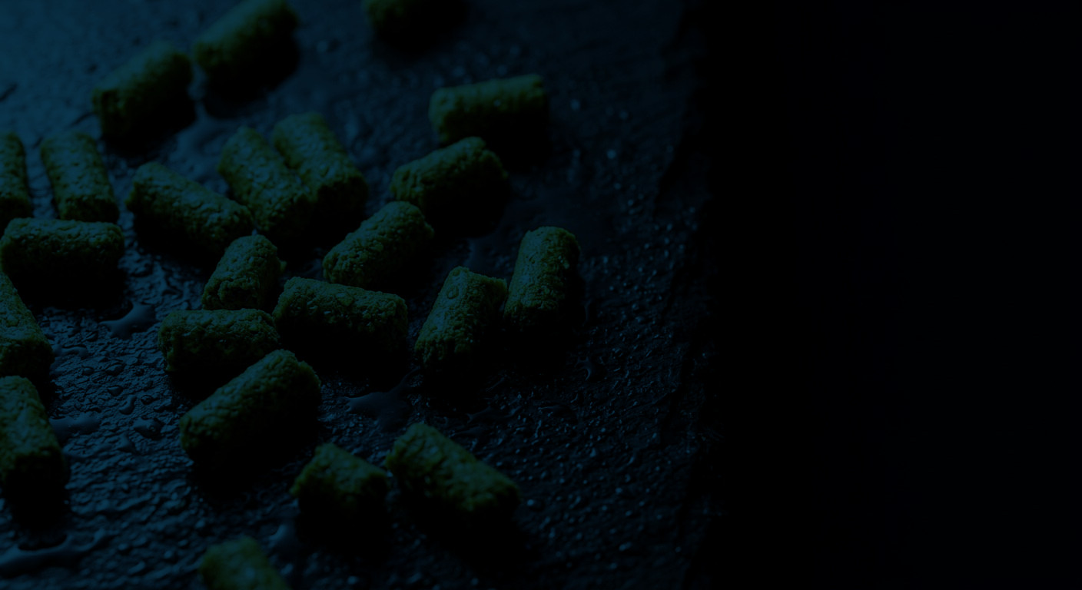

TRANSITION
THE PROBLEM
THE ADDITIVE RESPONSE
A well-formulated lipid can still fail in the bag.
·
EPA and DHA oxidise during storage and extrusion
·
Antioxidants protect the double bonds
·
Phytate locks up phosphorus in plant-heavy formulas
·
Phytase releases phytate-bound phosphorus
·
Larvae cannot digest the lipid fraction efficiently
·
Emulsifiers and enzymes improve lipid digestion
·
Pathogens colonise a nutrient-dense pellet
·
Probiotics and prebiotics manage the gut
Transition · Topic 3 → Topic 8
17
Notes:
This is the hinge of the presentation.
Everything up to here has been about what to put in the pellet: which lipids, which fatty acids, how much of each, for which species. That is the formulation problem.
Topic 8 is about the other half: making that formulation survive. A perfectly balanced lipid can still fail. EPA and DHA oxidise during storage and extrusion. Phytate in a plant-heavy formula locks up phosphorus that the fish cannot release. Larvae cannot digest the lipid fraction efficiently. And a nutrient-dense pellet is an excellent place for pathogens to grow.
Every one of those problems has a specific additive response. Antioxidants protect the double bonds. Phytase releases phytate-bound phosphorus. Emulsifiers and exogenous enzymes improve lipid digestion. Probiotics and prebiotics manage the gut microbial community.
So the second half of the talk is not a separate topic — it is the delivery mechanism for the first half.

Slide 19

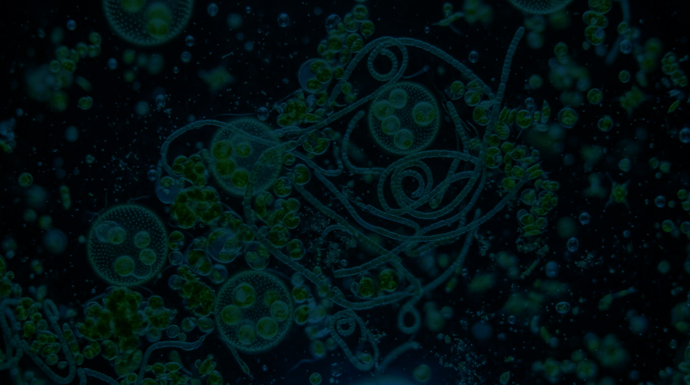
TOPIC 8
Types · Functions and mechanisms of action · Aquafeed nutraceuticals
8.1 Types of feed additives
8.2 Functions and mechanisms
8.3 Aquafeed nutraceuticals
Mixed microalgal and cyanobacterial culture
Notes:
Topic 8, Feed Additives.
The image is a mixed microalgal and cyanobacterial culture — which is itself a feed additive story. Several of the functional ingredients we will discuss come from exactly this kind of biomass.
Three sub-topics. 8.1 is the taxonomy: what categories of additive exist. 8.2 is the mechanism: how each one actually works, because "improves growth" is not an explanation. And 8.3 takes the modern, premium end of the category — nutraceuticals — and asks what is genuinely supported by evidence and what is marketing.

Slide 20
8.1 · TYPES
NUTRITIONAL
HEALTH & GUT
PROTECTIVE
QUALITY & INTAKE
supply or unlock nutrients
change the microbial community
keep the feed and the animal stable
change how the feed looks and tastes
Vitamin premix
Probiotics
Antioxidants
Pigments (carotenoids)
Mineral premix
Prebiotics
Preservatives
Attractants
Amino acids
Synbiotics
Binders
Palatability enhancers
Enzymes (phytase, xylanase)
Immunostimulants
Mycotoxin binders
Phytogenics
FUNCTIONAL INGREDIENTS
Soy lecithin, microalgae, seaweed meals, yeast derivatives and organic acids sit across these groups — they supply nutrients and act biologically at the same time.
Taxonomy after the course syllabus; grouping follows FAO (2018) and the functional-additive literature (e.g. Krogdahl et al., 2010).
Lipid Nutrition & Feed Additives in Aquaculture · MD. Nahian Islam · Fisheries, 4th Year
19
Notes:
Sub-topic 8.1 is a long list — fourteen categories in the syllabus. I have grouped them into four functional families, because a list is easy to memorise and impossible to use.
Nutritional additives supply or unlock nutrients: vitamin premixes, mineral premixes, amino acids, and enzymes. Phytase belongs here because it unlocks phosphorus that is already in the feed.
Health and gut additives change the microbial community: probiotics, prebiotics, synbiotics, immunostimulants.
Protective additives keep both the feed and the animal stable: antioxidants, preservatives, binders, and mycotoxin binders.
Quality and intake additives change how the feed behaves: pigments, attractants, palatability enhancers, and phytogenics.
The note at the bottom matters for the exam: several modern ingredients do not fit neatly into one box. Soy lecithin is a nutrient and an emulsifier and a phospholipid source. Microalgae are a nutrient and a pigment source. Organic acids are preservatives and growth promoters. The taxonomy is a convenience, not a law of nature.

Slide 21
8.1 · TYPES IN DETAIL
What each one is, at what level it is used, and what it is expected to deliver.
PROBIOTICS
PRE- & SYNBIOTICS
ENZYMES
Bacillus subtilis · Lactobacillus · Pediococcus · yeast (Saccharomyces)
MOS · FOS · GOS · inulin · β-glucan
Phytase · xylanase · cellulase · protease · lipase
10⁶–10⁹ CFU per g of feed
0.1–0.4 g/kg (MOS / β-glucan)
phytase 500–1 000 FTU/kg
IMMUNOSTIMULANTS
ANTIOXIDANTS
PIGMENTS
β-1,3/1,6-glucan · nucleotides · peptidoglycan · levamisole
α-tocopherol (vitamin E) · BHT · BHA · ethoxyquin
Astaxanthin · canthaxanthin · β-carotene
0.1–0.2% β-glucan, pulse-fed
100–250 mg/kg
30–50 mg/kg (30–100 in salmonids)
Inclusion levels are indicative ranges drawn from the cited literature and commercial practice; they are label and species dependent, not universal requirements.
Lipid Nutrition & Feed Additives in Aquaculture · MD. Nahian Islam · Fisheries, 4th Year
20
Notes:
Six groups you will actually discuss in a formulation meeting, with the typical inclusion range.
Probiotics are live microorganisms. The formal FAO definition is "live microorganisms that, when administered in adequate amounts, confer a health benefit on the host." Bacillus, Lactobacillus, Pediococcus and yeasts are the common genera. Typical counts run from a million to a billion colony-forming units per gram.
Prebiotics are the opposite logic: a non-digestible substrate that selectively feeds beneficial bacteria. MOS, FOS, GOS, inulin. β-glucan is usually classed as an immunostimulant rather than a prebiotic, though the categories overlap.
Enzymes are catalysts — phytase, xylanase, cellulase, protease. Phytase at 500 to 1000 FTU per kilogram is the single most economically important example in plant-heavy feeds.
Immunostimulants activate innate immunity — β-glucans, nucleotides, peptidoglycan.
Antioxidants are what protect the lipids from Topic 3: vitamin E, BHT, BHA. Without them, all that expensive EPA and DHA degrades in the bag.
Pigments are carotenoids: astaxanthin is the important one, at 30 to 50 milligrams per kilogram, and higher in salmonids.
And the honest caveat: these ranges are indicative, they depend on the product and the species, and they are not universal requirements the way an amino acid requirement is.

Slide 22
8.2 · FUNCTIONS — MECHANISM 01
How a probiotic actually protects a gut
GUT LUMEN
organic acids · bacteriocins · lowered pH
1
Competitive exclusion
Probiotics occupy adhesion sites and consume limiting nutrients, so pathogens cannot colonise.
2
Antimicrobial compounds
Bacteriocins, organic acids and hydrogen peroxide lower pH and inhibit pathogens directly.
3
Digestive enzyme supply
Bacillus and Lactobacillus secrete amylase, protease and lipase, improving feed utilisation.
4
Immune modulation
Cell-wall components stimulate phagocytes, lysozyme and complement in the gut mucosa.
INTESTINAL EPITHELIUM
mucus layer + microvilli
THE CAVEAT
Effects are strain-specific and depend on viability at the point of ingestion — a probiotic that does not survive extrusion or storage is an expensive inert ingredient.
Mechanisms after Verschuere et al. (2000); Balcázar et al. (2006); Ringø et al. (2010); FAO/WHO (2001) definition.
Lipid Nutrition & Feed Additives in Aquaculture · MD. Nahian Islam · Fisheries, 4th Year
21
Notes:
Now 8.2 — functions, and specifically the mechanism, because a claim without a mechanism is not science.
The diagram is a cross-section of the gut. On the bottom, the epithelium with its microvilli. Above it, the mucus layer. In the lumen, the teal rods are probiotic bacteria and the coral spheres are pathogens.
Four things happen at once.
One, competitive exclusion. The probiotic adheres to the mucus and occupies the adhesion sites. The pathogen has nothing to bind to. The probiotic also consumes the limiting nutrients the pathogen would have used. The crossed-out pathogen on the right is that idea.
Two, antimicrobial compounds. Bacteriocins, organic acids, hydrogen peroxide. The organic acids lower the luminal pH, which is unfavourable to many pathogens.
Three, digestive enzymes. Bacillus and Lactobacillus secrete amylase, protease and lipase, which improves feed utilisation directly — this is the part that shows up as a better FCR.
Four, immune modulation. Cell wall components — peptidoglycan, lipoteichoic acid — stimulate phagocytic cells and increase lysozyme and complement activity in the mucosa.
The caveat is important for your evaluation: all of this is strain-specific, and it requires live cells at the point of ingestion. That is why viability through extrusion and storage is the practical bottleneck.

Slide 23
8.2 · FUNCTIONS — THE WHOLE MAP
IN THE BAG
IN THE GUT
IN THE TISSUE
IN THE PRODUCT
Antioxidants
Enzymes
Amino acids
Pigments
scavenge free radicals; stop lipid peroxidation
hydrolyse phytate, NSP and protein
fill the limiting gap in protein synthesis
deposit colour in flesh or shell
Preservatives
Emulsifiers
Vitamins & minerals
Attractants
inhibit mould and bacterial spoilage
disperse lipid into micelles for lipase
cofactors for metabolism and bone
raise intake, reduce waste
Binders
Organic acids
Immunostimulants
Phytogenics
hold the pellet together; reduce fines and leaching
lower pH; inhibit pathogens
prime innate immune cells
antioxidant and antimicrobial in tissue
Mycotoxin binders
Probiotics / prebiotics
Essential fatty acids
Selenium, vitamin E
adsorb aflatoxin in the gut
change the microbial community
build membranes; make eicosanoids
extend shelf life of the fillet
An additive used at the wrong stage is wasted: a probiotic added after extrusion may be dead; an antioxidant added after the oil has oxidised protects nothing.
Synthesis of FAO (2018); Encarnação (2016); Ringø et al. (2010); Kiron (2012).
Lipid Nutrition & Feed Additives in Aquaculture · MD. Nahian Islam · Fisheries, 4th Year
22
Notes:
This is the map that ties 8.2 together. Read it left to right, because that is the order in which the additive meets the animal.
In the bag: antioxidants, preservatives, binders, mycotoxin binders. These protect the feed before the fish ever sees it.
In the gut: enzymes, emulsifiers, organic acids, probiotics and prebiotics. These change what is digested and who lives in the intestine.
In the tissue: amino acids, vitamins and minerals, immunostimulants, essential fatty acids. These supply metabolism, immunity and structure.
In the product: pigments, attractants, phytogenics, and antioxidant nutrients such as selenium and vitamin E. These change what the consumer buys and how long the fillet keeps.
The bar at the bottom is the practical lesson. Timing matters. A probiotic added after extrusion may already be dead. An antioxidant added after the oil has oxidised protects nothing. This is why additive strategy is a process question, not just a formulation question.

Slide 24
8.3 · AQUAFEED NUTRACEUTICALS
CONVENTIONAL
NUTRACEUTICAL
WORKING DEFINITION
Replaces a known nutrient gap
Modulates a physiological process
Requirement-based dose
Response-based dose, often narrow
Vitamins, minerals, amino acids
Polyphenols, algal oils, β-glucans
WHERE THEY COME FROM
MICROALGAE
SEAWEED
Deficiency is the failure mode
No deficiency state — effect or no effect
Schizochytrium · Arthrospira
Ulva · Sargassum · fucoidan
Cheap, well characterised
Expensive, batch-variable
HERBAL EXTRACTS
MARINE BY-PRODUCTS
garlic · neem · oregano · moringa
krill · shrimp shell · chitosan
Definition after Zeisel (1999) and the functional-feed literature; categories after Abdel-Latif et al. (2020) and Ringø et al. (2010).
Lipid Nutrition & Feed Additives in Aquaculture · MD. Nahian Islam · Fisheries, 4th Year
23
Notes:
Sub-topic 8.3, nutraceuticals. This is the part of the syllabus with the most hype around it, so I want to define it precisely.
A conventional additive supplies something the animal needs. A vitamin premix corrects a deficiency. An amino acid fills a limiting gap. You can state the requirement, measure the gap, and dose accordingly.
A nutraceutical does something different: it modulates a physiological process. β-glucans prime the immune system. Microalgal DHA supplies a fatty acid. Polyphenols from a herbal extract act as antioxidants and antimicrobials. There is no deficiency state — the animal may be perfectly healthy without it. The question is whether the effect is real and worth the cost.
That difference produces the whole right-hand column of the table. Requirements are based on dose; nutraceuticals are based on response, often with a narrow optimum. Conventional additives are cheap and well characterised; nutraceuticals are expensive and batch-variable.
The bottom row is where they come from — microalgae, seaweed, herbal extracts, and marine by-products. Every one of those is a real, research-active source in Bangladesh, and every one has a variable and poorly standardised active-ingredient content. That is the central practical problem.

Slide 25

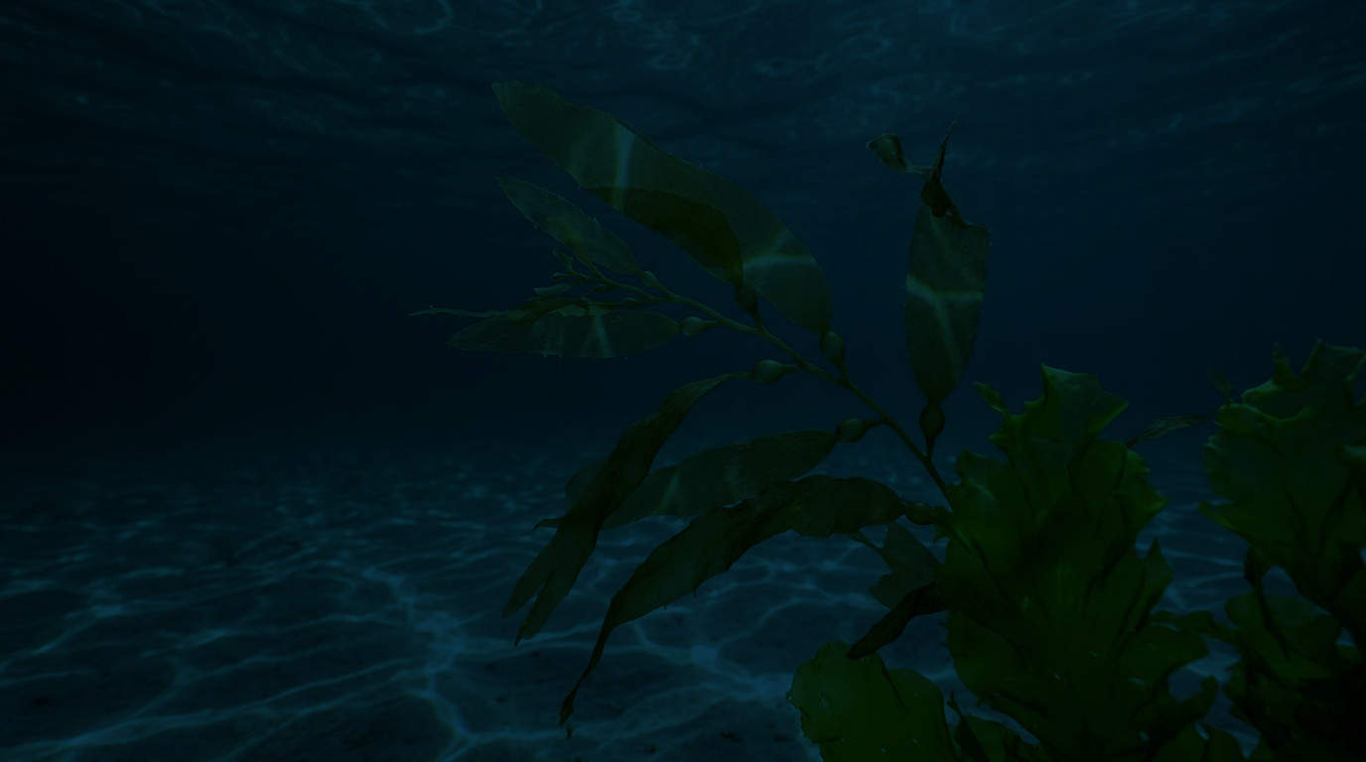
8.3 · APPLICATIONS
NUTRACEUTICAL
APPLICATION IN AQUACULTURE
EVIDENCE STATUS
Omega-3 oils (microalgae)
Replace fish oil DHA without fishy taint; enrich the fillet
Strong
β-glucans / nucleotides
Immunostimulation before a stress event; vaccine adjuvant
Strong for immune markers
Probiotics (Bacillus, LAB)
Gut health, FCR, survival against Vibrio and Aeromonas
Strong, strain-specific
Carotenoids
Astaxanthin for colour; antioxidant and immune roles
Strong for colour
Seaweed polysaccharides
Fucoidan, ulvan: antioxidant, immune, antiviral
Promising, dose unclear
Herbal extracts
Garlic, neem, moringa, oregano: antimicrobial, growth
Variable; standardisation is the problem
Chitosan / crustacean waste
Immunostimulant and binder; valorises processing waste
Promising, variable quality
READING THE COLUMN
Compiled from Dawood et al. (2019); Abdel-Latif & Alagawany (2020); Ringø et al. (2010); Glencross (2009).
Lipid Nutrition & Feed Additives in Aquaculture · MD. Nahian Islam · Fisheries, 4th Year
24
Notes:
The application table, with an honest evidence column.
Omega-3 oils from microalgae: strong. They replace fish oil DHA without the fishy taint, and they can enrich the fillet.
β-glucans and nucleotides: strong for immune markers and as vaccine adjuvants. The effect is measurable — respiratory burst, lysozyme, phagocytic index — but the translation to survival under field conditions is less consistent.
Probiotics: strong, but strictly strain-specific. Bacillus subtilis is not interchangeable with Lactobacillus plantarum.
Seaweed polysaccharides — fucoidan from brown algae, ulvan from green — are genuinely promising: antioxidant, immune, even antiviral. The problem is dose. We do not yet have a well-established dose–response for most species.
Herbal extracts: this is where the literature is weakest. Garlic, neem, moringa, oregano all show antimicrobial activity in vitro. In vivo results are variable, and the fundamental problem is standardisation — two garlic extracts are not the same product.
Carotenoids: strong for colour, which is an economic endpoint, so the effect is easy to measure.
Chitosan: promising, and attractive because it valorises shrimp shell waste — relevant to Bangladesh's processing industry.
The note at the bottom tells you how to read "strong" versus "promising", because that distinction is what separates a literature review from a marketing brochure.

Slide 26
8.4 · FIELD REALITY · BANGLADESH
MEASURED IN BANGLADESHI AQUAFEEDS · VS LEGAL LIMIT
WHAT THE FORMULATOR CAN ACTUALLY DO
Aflatoxin B₁
196.3 µg/kg
≈ 98× the limit
Bind the toxin
legal limit 2 µg/kg
Chromium (Cr)
174.6 mg/kg
> 1 700× the limit
Test the raw material
legal limit 0.10 mg/kg
Aflatoxin risk is highest in damaged maize, groundnut cake and rice bran — the cheapest ingredients.
Lead (Pb)
3.32 mg/kg
Control the oil
no limit in the 2010 Act
no aquafeed limit set
Rancid oil destroys vitamin E and carotenoids; peroxide value and an antioxidant at milling.
Cadmium (Cd)
0.40 mg/kg
Buy the process, not the label
no limit in the 2010 Act
no aquafeed limit set
Viability of probiotics and activity of enzymes are both lost in poor storage.
The Fish Feed and Animal Feed Act 2010 sets aflatoxin B₁ at 2 ppb, total aflatoxin at 4 ppb. Measured aflatoxin B₁ is roughly 100× the limit and chromium more than 1 700× — the gap is enforcement at small-mill level, not the standard itself.
Tabassum et al. (2025), Biol. Trace Elem. Res. 203:1129–1141; Bhowmik et al. (2023), Food Chem. Adv. 2:100235; Fish Feed and Animal Feed Act 2010 (Bangladesh).
Lipid Nutrition & Feed Additives in Aquaculture · MD. Nahian Islam · Fisheries, 4th Year
25
Notes:
This slide is the one I would put in front of a policy audience.
Sub-topic 8.4 — practical application, and the honest field reality in Bangladesh.
On the left, what has actually been measured in Bangladeshi aquafeeds. Aflatoxin B1 has been reported at 196 micrograms per kilogram. The legal limit under the Fish Feed and Animal Feed Act 2010 is 2 micrograms per kilogram. That is roughly a hundredfold exceedance. Chromium has been measured at 174 milligrams per kilogram against a limit of 0.1 — chromium from tanned leather waste entering the feed chain, at more than a thousandfold.
Cadmium around 0.4 and lead around 3.3 milligrams per kilogram. Both are above levels that would be acceptable in food-producing animals, and neither has an aquafeed-specific limit in the 2010 Act, which is itself an important gap.
On the right, four things a formulator can actually control.
One, bind the toxin. Hydrated sodium calcium aluminosilicate or yeast cell wall at 0.2 to 0.5 percent. Note the mechanism: it binds aflatoxin in the gut. It does not remove it from the bag, and it does not fix a bad batch.
Two, test the raw material. The highest-risk ingredients are the cheapest ones — damaged maize, groundnut cake, rice bran. Cheap is not cheap.
Three, control the oil. Rancid oil destroys vitamin E and carotenoids, so all the antioxidant chemistry from the earlier slides is wasted if the oil arrives oxidised.
Four, buy the process, not the label. Probiotic viability and enzyme activity both die in a hot store.
The bottom line is the important sentence: the standard is fine, the enforcement is the gap.

Slide 27
8 · CONCLUSION
Six things to carry out of this lecture
If you remember nothing else, remember these.
01
Lipid is not one nutrient
02
The fatty acid profile is the real specification
03
Requirements are species- and stage-specific
04
Deficiency is quiet, not dramatic
05
Additives buy stability, not growth
06
In Bangladesh, safety outranks optimisation
Formulate for the species in front of you, with the ingredients you can actually buy, and test them.
Lipid Nutrition & Feed Additives in Aquaculture · MD. Nahian Islam · Fisheries, 4th Year
26
Notes:
To close, six things to carry out of this lecture.
One. Lipid is not one nutrient. Phospholipids, sterols, free fatty acids and triglycerides are chemically different, behave differently in the animal, and cost different amounts.
Two. The fatty acid profile is the real specification. Total lipid tells you energy. The n-3 to n-6 ratio and the DHA share tell you whether the animal will grow, survive, and taste right.
Three. Requirements are species- and stage-specific. A tilapia, a rohu and a shrimp postlarva do not share a lipid requirement. If you take one number from this lecture, do not take a universal one.
Four. Deficiency is quiet. Reduced growth, poor FCR, fin erosion, fatty liver. Those appear long before mortality, and by the time you see mortality you have lost a month of production.
Five. Additives buy stability, not growth. Antioxidants, phytase and emulsifiers protect value that is already in the formula. They rarely create growth out of nothing.
Six, and the one specific to our context. In Bangladesh, safety outranks optimisation. Aflatoxin and heavy metals in cheap raw materials will cost more than a suboptimal n-3 to n-6 ratio ever will.
The line at the bottom is the whole lecture in one sentence: formulate for the species in front of you, with the ingredients you can actually buy, and test them.
Thank you — I am happy to take questions.

Slide 28
REFERENCES
References
APA 7th edition.
National Research Council. (2011). Nutrient requirements of fish and shrimp. National Academies Press. https://doi.org/10.17226/13039
Lipid Nutrition & Feed Additives in Aquaculture · MD. Nahian Islam · Fisheries, 4th Year
27
Notes:
These are the references, in APA seventh edition, and only the sources actually used in the deck. I have kept the DOI on every entry so you can verify any number I quoted.
A note on what is not here: I have deliberately not cited anything I could not confirm. Where a value is a range drawn from commercial practice rather than a published requirement, the slide says so. If you are submitting this for assessment, check your department's preferred edition and formatting, and check any citation your instructor requires that I have not included.

