Slide 1
INFORMATION SYSTEM DESIGN LABORATORY
PROJECT : EVENT MANAGEMENT SYSTEM
Prothom Ghosh
Roll:2107097
Al Nahian Zarif
Roll:2107098
Abdullah Al Mahmud
Roll:2107099

Slide 2
SUMMARY OF THE PROJECT
The Event Management System allows users to plan, organize, and manage events efficiently.It provides authentication features including secure login and signup pages .Users can browse services like photography, decoration, entertainment, and transport.The system also includes a shop section where users can purchase event-related products.The homepage offers a dynamic overview of available services and trending products.Each service category provides detailed descriptions, pricing, and booking options.The photography and entertainment sections let users explore professional options for their events.Decoration and transport services help users arrange logistics and visual aesthetics.The shop section offers products like furniture, lighting, tableware, and audio equipment.
Users can add chosen products to a cart and complete the booking later.Admins can manage services, track bookings, and update the available inventory.The interface ensures a smooth, modern, and responsive experience for users.All data (users, orders, and services) are stored in a secure database.Users receive confirmation and summary details after successful bookings or purchases.The project aims to provide a one-stop digital solution for complete event planning.

Slide 3
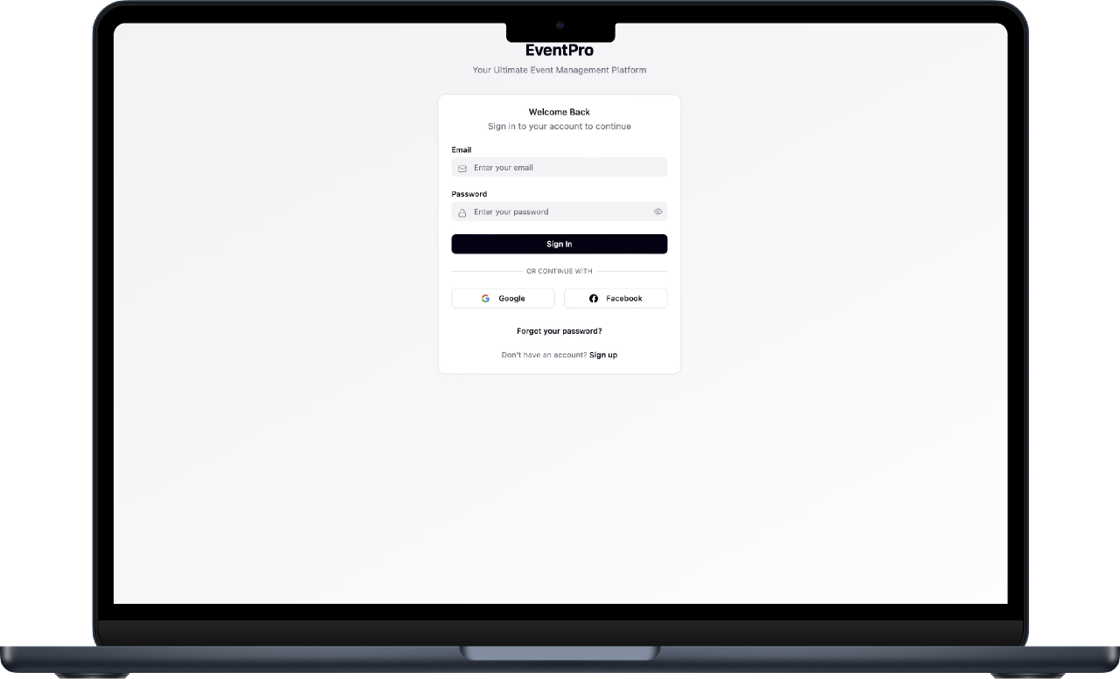
LOGIN PAGE
The Login Page serves as the secure entry point for existing users to access their accounts. It includes email and password input fields with proper validation and a “Forgot Password” option for recovery. Upon successful authentication, users are redirected to the homepage. The design ensures data security while maintaining a user-friendly interface. It provides instant feedback if incorrect credentials are entered, keeping the login process efficient and reliable.

Slide 4
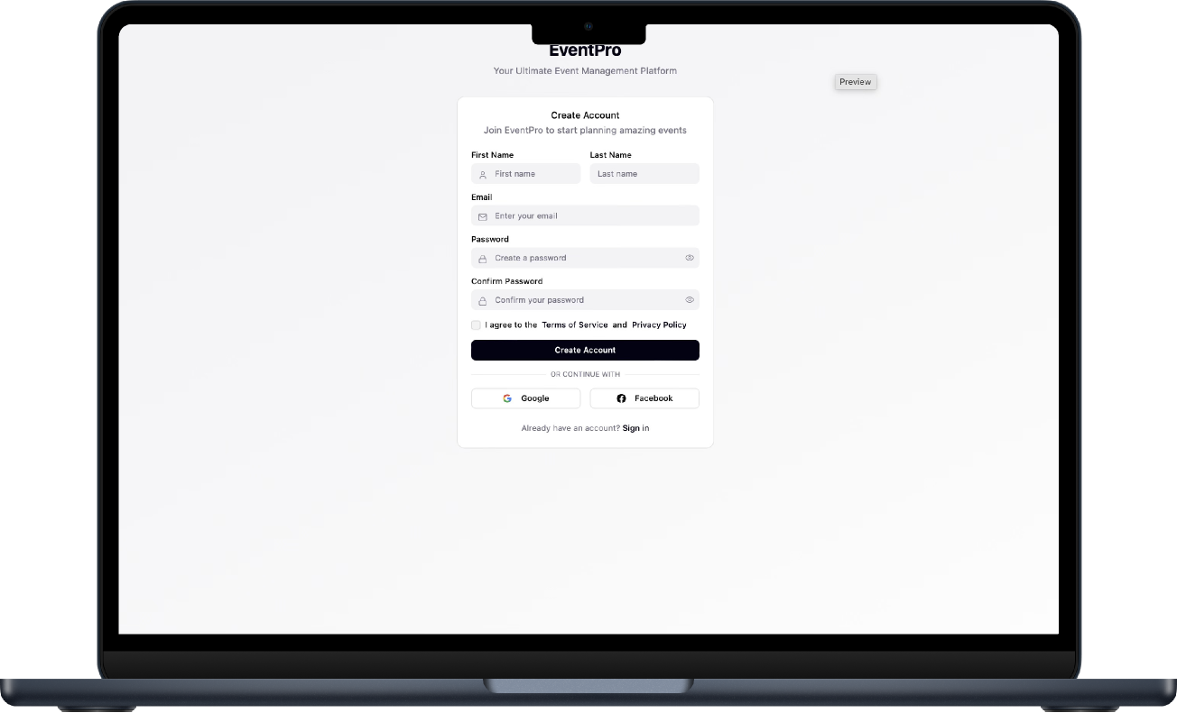
SIGNUP PAGE
Describe with this direction is all about, and how it’s distinct from other the directions. If you can, include links to relevant files or docs.
Replace the image with a Figma prototype or GIF to really sell it.

Slide 5
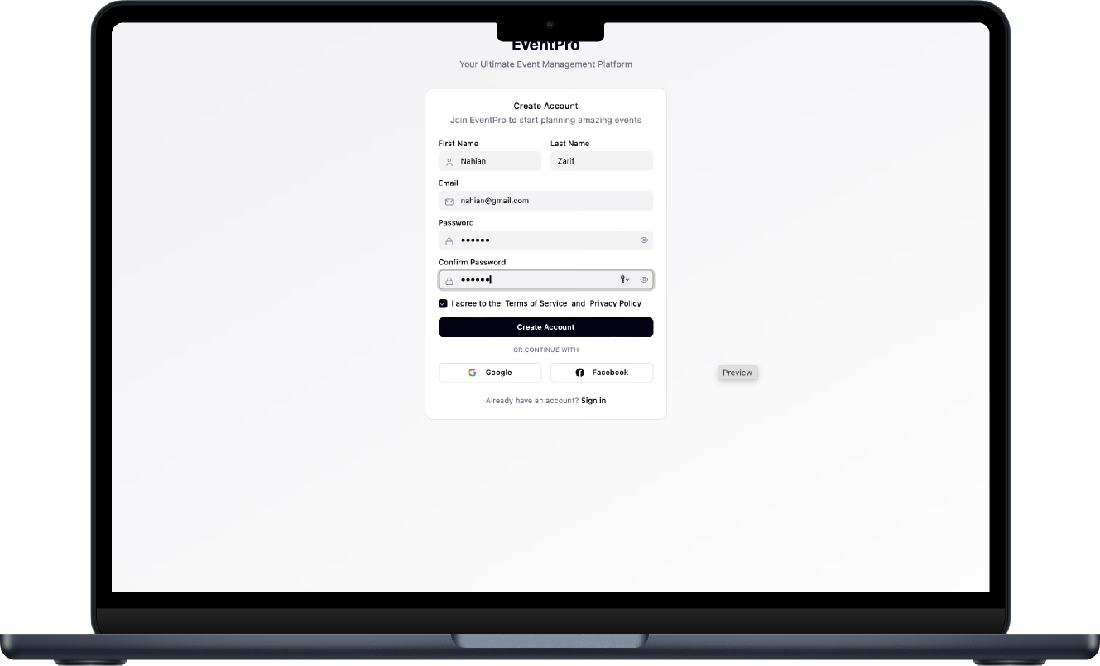
SIGNUP PAGE
The Signup Page or Fill-Up Page allows new users to register by entering essential details such as name, email, and password. The form includes validation checks for email format and password strength, ensuring accurate and secure data collection. Once submitted, the user data is stored safely in the backend database. Upon successful registration, a confirmation message is displayed, and users are guided to the login page. This page ensures a smooth onboarding process for all new users.

Slide 6
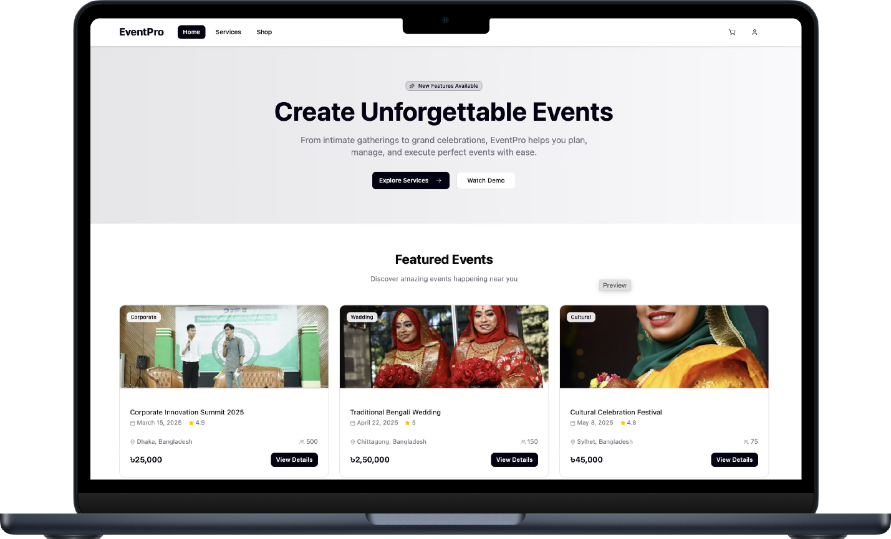
HOME PAGE
The Home Section acts as the central hub of the website, showcasing the platform’s services, featured shops, and ongoing offers. It includes engaging visuals, banners, and navigation menus that direct users to different parts of the system. The homepage highlights trending services and products, allowing users to explore and book directly. It also includes quick-access buttons like “Book Now” or “Explore More,” encouraging interaction. The layout is modern, responsive, and visually appealing.

Slide 7
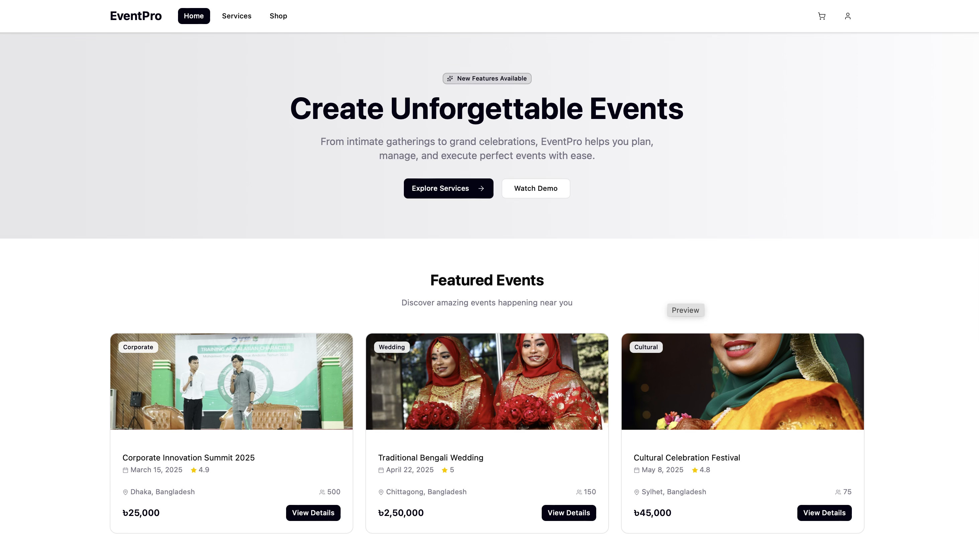

Slide 8
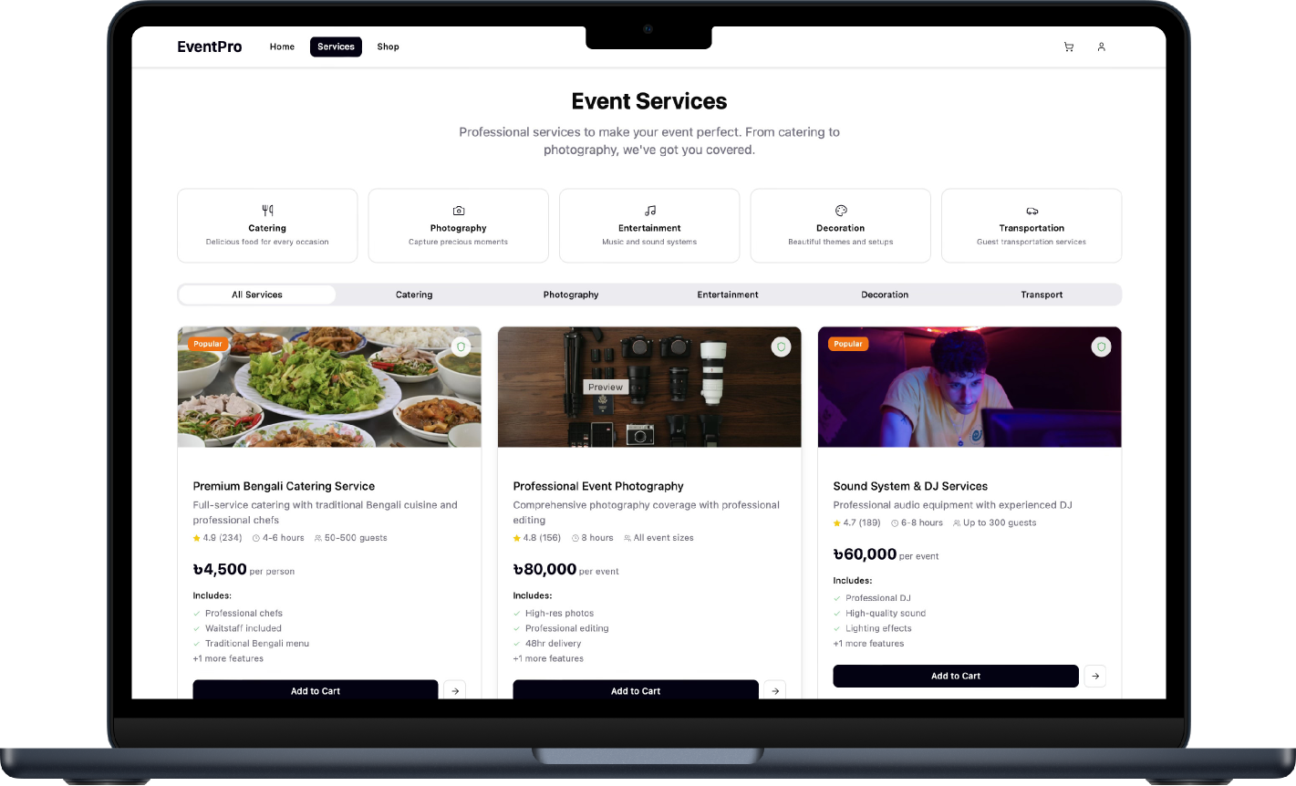
ALL SERVICES
The Service Section introduces
users to various event service categories. Within Category, users
can view all available service types like photography, entertainment, decorations, and transport.
The Photography section offers professional event photographers
with different packages, sample portfolios, and price ranges. Cost estimates are displayed instantly
to help plan budgets.Together,
these sections create a full-service event management experience.

Slide 9
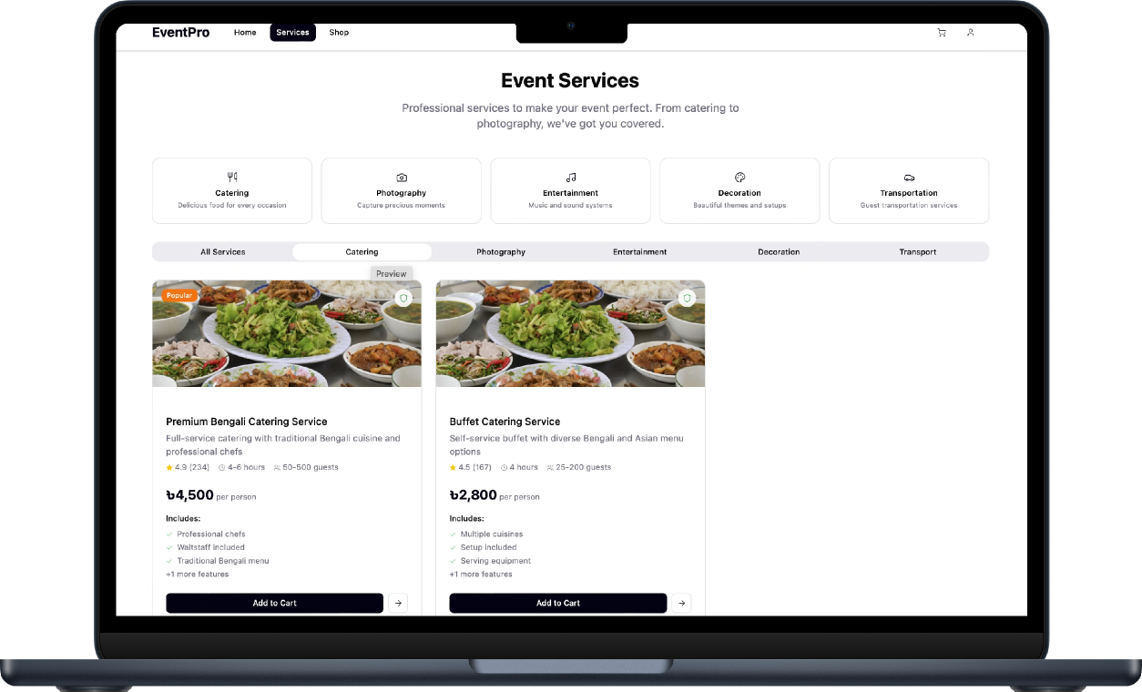
CATERING
The catering section provides users with high-quality food and beverage services for various events such as weddings, parties, and corporate functions. It offers multiple menu options, including vegetarian, non-vegetarian, and custom cuisines to match event themes and guest preferences.Users can also customize meal packages based on the number of guests and event duration. Detailed information about chefs, service quality, and delivery timing is displayed clearly. This section ensures every event offers a memorable dining experience with professional and timely catering support.

Slide 10
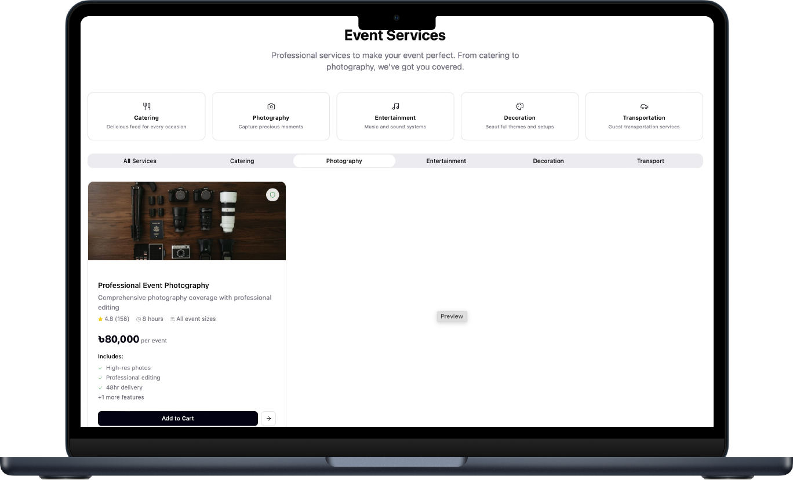
PHOTOGRAPHY
The photography section connects users with professional event photographers who specialize in weddings, corporate events, and
parties. Each profile includes portfolio
samples, package details, and
customer reviews.The section allows customization of photography
packages based on duration or event type. After completing the service, users can rate their experience for others to see. It’s designed to help
users find and book trusted photographers effortlessly.

Slide 11
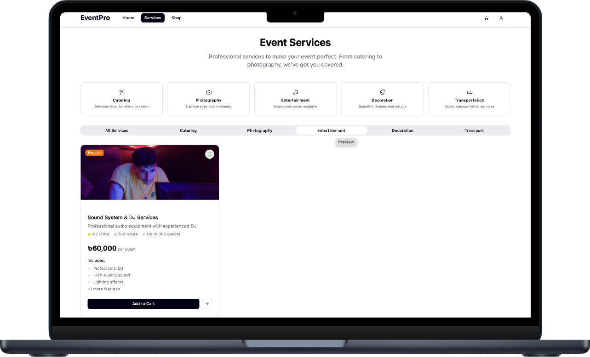
ENTERTAINMENT
The entertainment section provides users with access to a variety of performers such as DJs, live bands, and stage artists. Each entertainer’s profile includes details about experience, style, and performance clips. Users can filter options based on event type or music genre to suit their preferences. Booking is simple, with available dates and price ranges shown clearly. There’s also an option to combine entertainment bookings with other event services. This section ensures that every event is lively, engaging, and memorable.

Slide 12
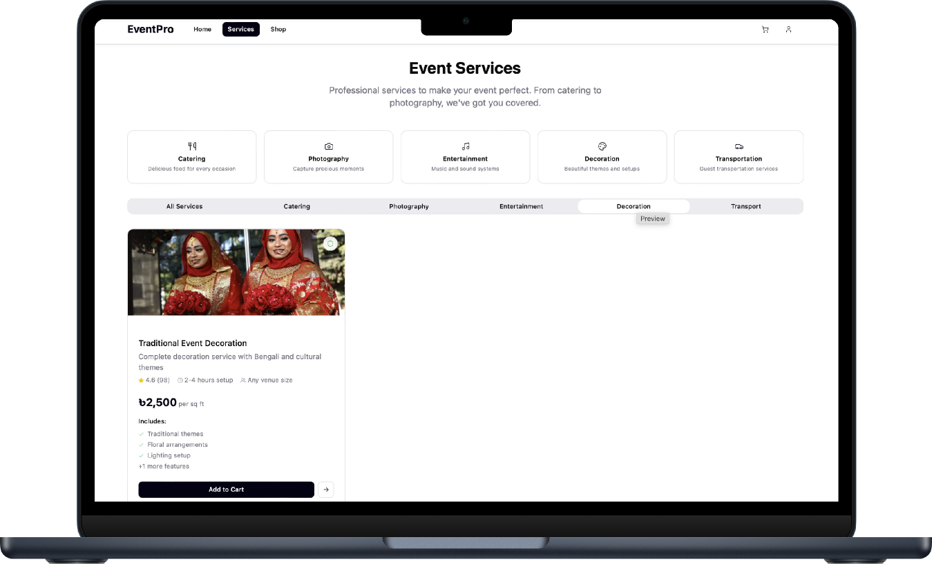
DECORATION
The decorations section focuses on beautifying events with creative and customizable themes. Users can
browse decoration setups for weddings, birthdays, and corporate events. Each package includes visuals of flower arrangements, lighting, and color schemes. Customers can modify themes to match their event style and budget. Real-time cost estimates are displayed for better planning. This section combines elegance with flexibility, allowing users to design their dream event atmosphere.

Slide 13
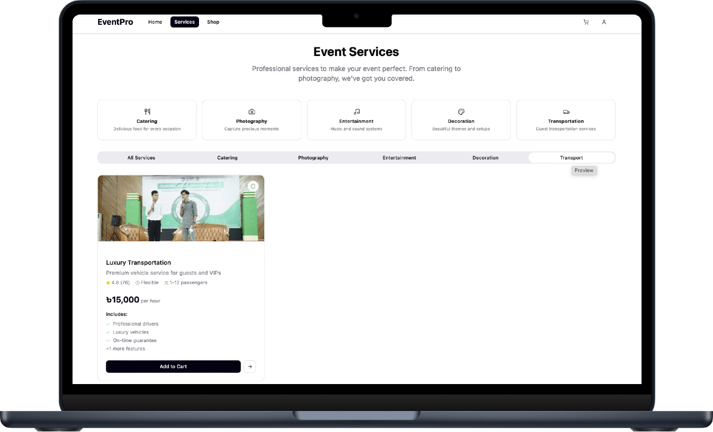
TRANSPORT
The transport section manages all travel-related services for event logistics. It provides options for luxury cars, vans, and buses suitable for guests and equipment transfers. Users can schedule vehicles according to event time and location. The interface displays real-time availability and cost estimates for better decision-making. All transport bookings are securely integrated with the main event system. This ensures smooth coordination, punctuality, and comfort for all event attendees.

Slide 14
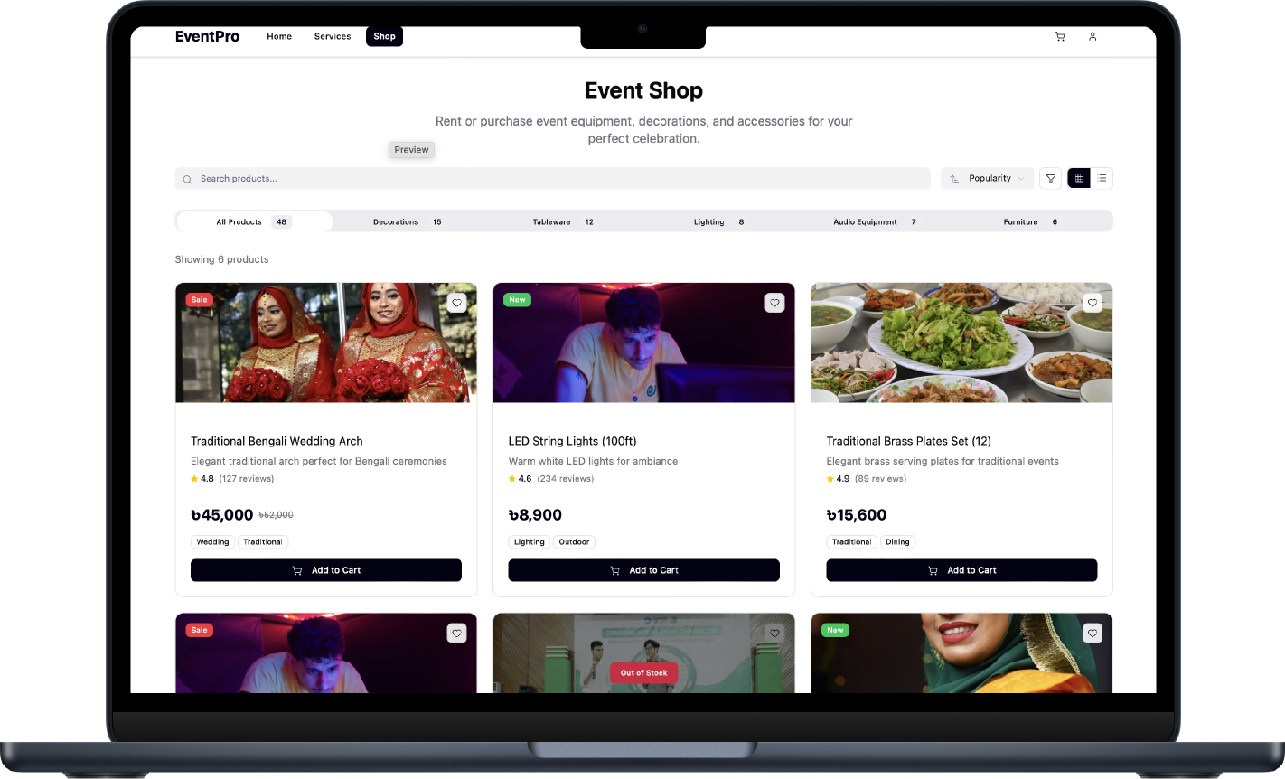
SHOP SECTION
The all-products section displays
every item available in the event
shop in one place. It allows users to browse, search, and filter by
product type, price range, and stock availability. Each product card
includes high-quality images,
detailed descriptions, and prices.
Users can add items directly to
their cart or wishlist for later. The section is designed for quick
browsing and easy purchasing. It connects smoothly with specific product categories like decorations, lighting, or furniture.

Slide 15
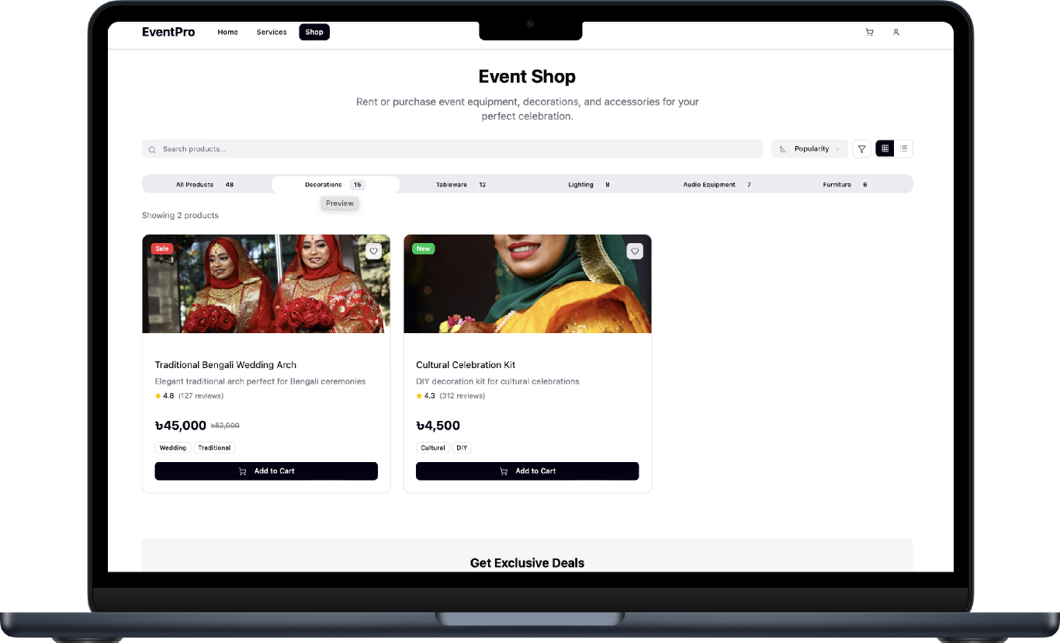
DECORATION
The decorations shop section provides a wide variety of event items such as flowers, ribbons, drapes, and stage backdrops. Users can explore both trendy and traditional styles for different occasions. Each product listing includes details about material, color options, and rental availability. The section allows users to order single items or complete decoration sets. Recommendations are shown based on the event type selected by the user. It ensures easy customization for any decorative theme.

Slide 16
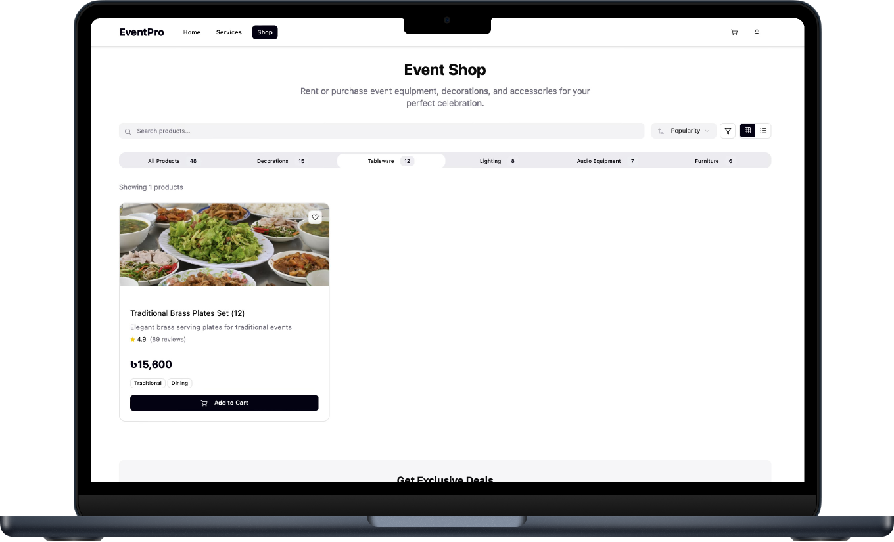
TABLEWARE
The tableware section features elegant dining essentials like plates, glasses, cutlery, and serving trays. Users can select from premium, standard, or eco-friendly options depending on their budget. Each item displays detailed specifications, prices, and rental choices. Event planners can view curated tableware sets for weddings or corporate functions. There’s also a bulk order option for large gatherings. This section ensures every dining setup looks professional and cohesive.

Slide 17
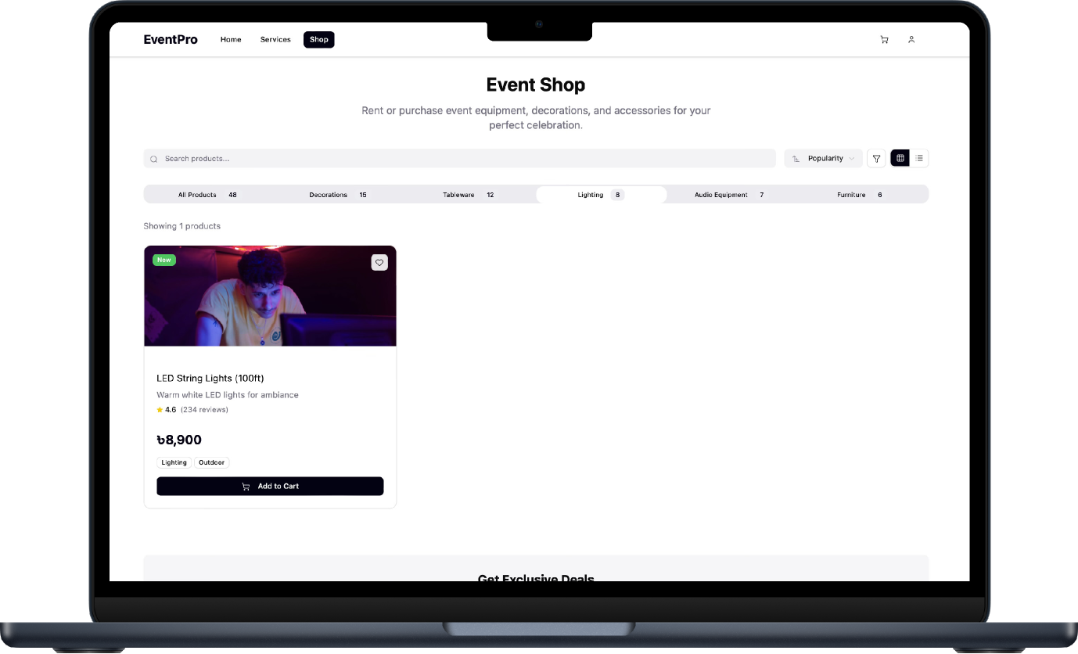
LIGHTING
The lighting section offers decorative, ambient, and stage lighting solutions for all event types. Users can explore LED, fairy, spotlight, and laser lighting options. Each listing includes brightness levels, color effects, and sample visuals. Customers can preview how the lighting will look in different environments. Availability and real-time pricing are displayed clearly for convenience. This section helps create perfect visual aesthetics and mood lighting for every event.

Slide 18
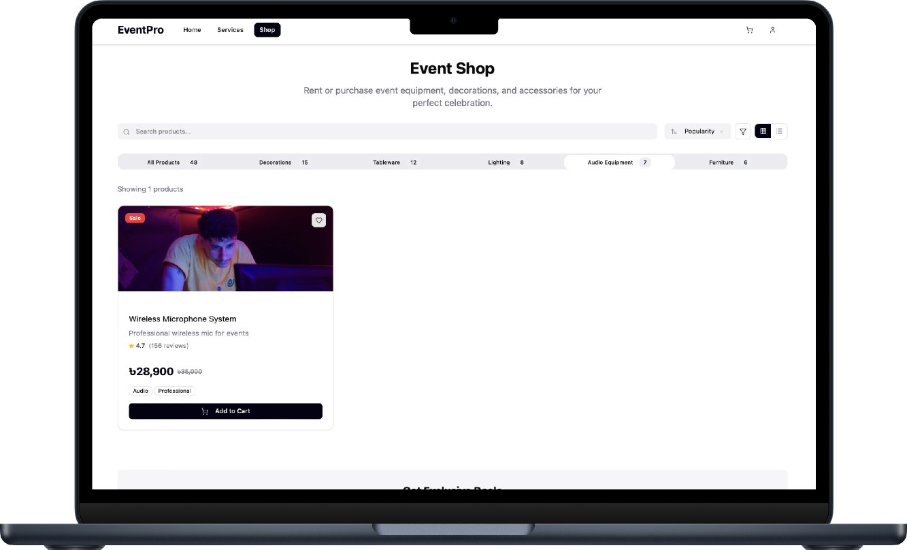
AUDIO
The audio section provides professional-grade sound systems, microphones, and speakers suitable for small to large events. Each product includes technical specifications like power output, brand, and setup compatibility. Users can preview demo audio clips to gauge quality before renting or buying. Audio packages are categorized for weddings, concerts, or conferences. Installation and on-site support services are also available. The section ensures that every event delivers crystal-clear sound.

Slide 19
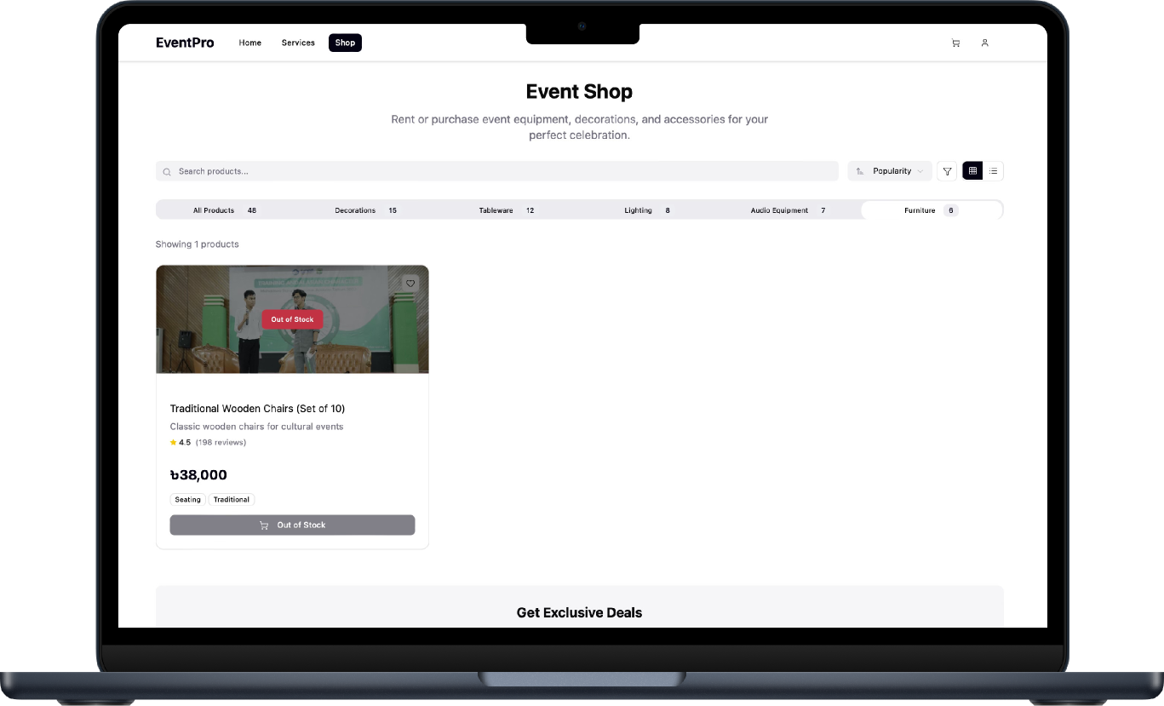
FURNITURE
The furniture section supplies event furniture such as tables, chairs, couches, and stages. Both modern and traditional designs are available to match different event themes. Each item includes material details, dimensions, and rental costs. Users can preview furniture setups through example layouts. Bulk booking options are provided for large events or corporate functions. This section ensures comfort, aesthetics, and functionality in every event arrangement.

