Slide 1

TaxCode CSE - 350
Fairuz Rahman Chowdhury
Masum Alam Nahid

Slide 2

Contents
Introduction
Why should current taxation system get involved with blockchain
How our project works to get rid of the current flawed system and our tax generation process
This Photo by Unknown Author is licensed under CC BY-SA-NC

Slide 3
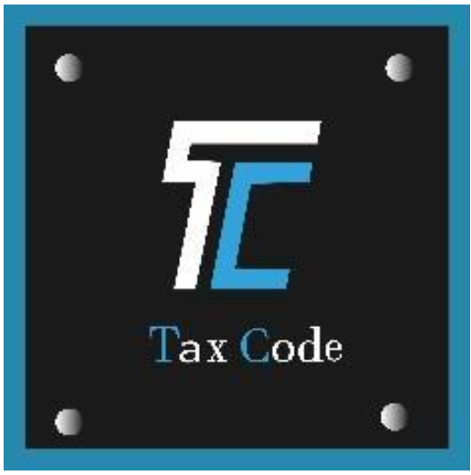
Introduction
Blockchain technology – a distributed ledger that allows anything of value to be traded securely, transparently and without the risk of tampering – could be just what the world of tax is waiting for. It can deliver real-time, reliable information to a wide group of people, and create a system where both taxpayers and tax authorities have equal confidence in the veracity of the data collected. It could make it easier for people to pay tax and for governments to narrow the tax gap.
Key characteristics of Blockchain:
Based on consensus
Sealed with cryptography
Chronological and time-stamped
Digital

Slide 4
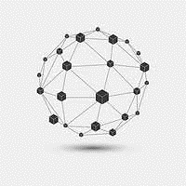
Why should current taxation system get involved with blockchain
Weakness in current taxation system
High degree of tax evasion
Limited administrative capacity
Resource constraints (Human and Logistics)
Cumbersome legal procedures
High tax incidence
Why Blockchain?
Tracking where and when VAT has been paid, and in doing so reduce VAT fraud
Giving more visibility to micro transactions such as those done by individuals as part of the sharing economy
Giving tax authorities and other regulators more confidence in the data supplied to them

Slide 5
How our project works to get rid of the current flawed system and our tax generation process
Transparency – blockchain provides provenance, traceability and transparency of transactions.
Control – access to permissioned networks is restricted to identified users.
Security – the digital ledger cannot be altered or tampered with once the data is entered. Fraud is less likely and easier to spot.
Real-time information – when information is updated, it’s updated for everyone in the network at the same time.
Therefore, Blockchain could allow us to capture information from many perspectives. The result is more detail, more visibility, more useful information and more certainty.

Slide 6
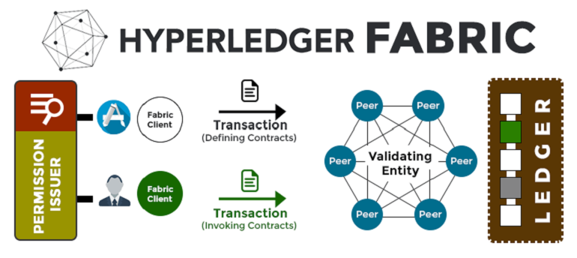
Authentication
Client
Admin
Add transaction
Query company by tax status
Update transaction
Give permission to update a transaction
Pay generated tax

Slide 7
Tax generation process
Tax based on company creation
Tax based on transaction
Tax based on company creation
Company create
-Revenue
-Share market value
Non-Publicly traded company
Share market value
Publicly traded company
Less than 10% of revenue
Greater than 10% of revenue
Tax=40% of revenue
Company corporate tax
Tax=35% of revenue

Slide 8
Tax based on transaction
Manufacturing & assembling on abroad carry 57%
Duty tax
Manufacturing on abroad & assembling at home carry 17%
Manufacturing & assembling at home carry 5%
VAT
15% for all company

