Slide 1
SEO
MyInterestedArea:
SEO | Digital marketing | Affiliate marketing | Amazon | Social media ads | Google ads & campaign | YouTube ads

Slide 2
Module : 01 Introduction to SEO
What is SEO? Definition and importance
- How search engines work.
- Difference between organic and paid search.
SEO Terminologies ○ Keywords, SERPs, backlinks, meta tags, anchor text, etc.
Understanding Search Engine Algorithms, Brief on algorithms like Google’s PageRank, Panda, Penguin, and others. ○ Emphasis on E-A-T (Expertise, Authoritativeness, Trustworthiness)

Slide 3
SEO def’
SEO stands for ”search engine optimization”, and it's the process of improving a website's visibility in search results. [1]
SEO is the process of improving a website so that it ranks higher in search engine results, like Google. [2]
By optimizing various element s of a website such as its content , structure and links
SEO helps increase the visibility of the site, making it easier for people to find when they search for relevant topics or keywords.
Deciding to hire an SEO is a big decision that can potentially improve your site and save time, but you can also risk damage to your site and reputation. Make sure to research the potential advantages as well as the damage that an irresponsible SEO can do to your site.[3]

Slide 4
Continue SEO def’
It’s a process that helps your website rank higher in search engine results. The goal is to get your site to appear at the top when someone searches for products or services you offer.
For example, if you sell coffee, SEO can help your website show up on the first page of Google when people search for “buy coffee”. Higher rankings lead to more clicks to your website, and that means more potential customers for your business.[4]
SEO is sometimes called SEO marketing, SEO optimization, or organic search marketing. [5]

Slide 5
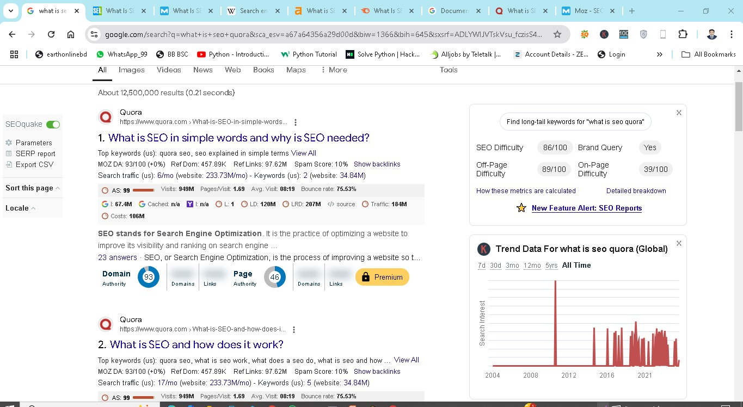
Importance of SEO
Page Ranking
Visitor
Backlink
Cost
SEO difficulty
On-page “
Off page “
Domain Authority
Page age
Keyword research

Slide 6
Continue the importance
Search Engine Optimization (SEO) is a powerful digital marketing strategy that can help businesses improve their visibility, drive traffic, and build trust with customers.[1]
1. Increased web traffic
2. SEO Can Be Highly Cost Effective
3. It Helps You Protect Your Brand
4. Your Competitors Are (Probably) Doing It
5. Better user experience
6. SEO Results Are Quantifiable
7. Long-term growth
8. Higher ROI
9. Building backlinks
10. Support affordable marketing.
[6] ,[ 7]

Slide 7
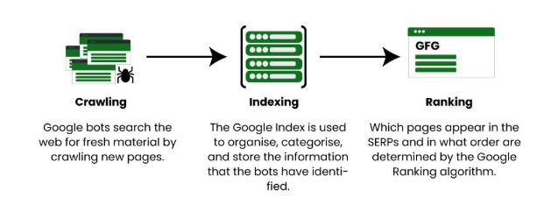
How search engine work!
Search engines are an integral part of our daily lives.
A search engine is a software system or online service that allows users to find information on the internet by entering keywords or phrases.
[8]

Slide 8
Working keynotes of SEO
Crawling: Search engines use web crawlers, also known as bots or spiders, to systematically explore the web. These crawlers begin their journey from a set of seed URLs, which are usually established, trusted websites. They follow links from these pages to other sites, creating a web of interconnected pages. | Indexing: Once a web crawler visits a web page, it scans and processes the page’s content, including text, images, and metadata. The information collected is then added to the search engine’s index, a vast database that stores details about each web page. | Ranking: The real magic happens in this step. Search engine algorithms analyze the indexed web pages to determine their relevance and value for specific search queries. Factors like keyword usage, content quality, backlinks, and user engagement play a crucial role in determining a page’s rank in search results. | Regular Updates: Search engines revisit web pages they’ve previously crawled to update their index. This ensures that search results are always up-to-date. If your webpage changes, the search engine reflects those changes in its index.

Slide 9
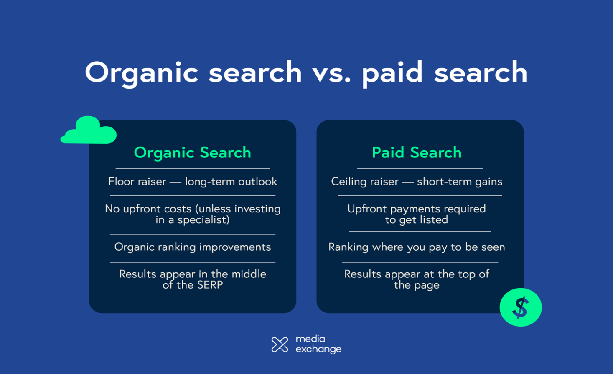
difference between organic search and paid search
> Organic Search is a long process to get rank in one of the top positions.
> Organic Search gets less clicks.
> By paying big amount, site can be ranked on top quickly.
> Paid search gets more clicks.

Slide 10
SEO Technologies
Keyword search:
In search engine optimization (SEO), keywords are words or phrases that are added to online content to improve search engine rankings. They are also known as key phrases or focus keywords
Long tail keyword | Short-tail keywords | Transactional keywords
Branded keywords

Slide 11
Seo Tech continue
Backlinks:
A backlink is a link created when one website links to another. Backlinks are also called “links”, or "inbound links", or "incoming links." Backlinks are important to people moving around the internet and to Search Engine Optimization (SEO).

Slide 12
SEO Technologies
BackLinks
2. Manage your backlinks profile:
Quality over Quantity: Focus on getting links from reputable and relevant websites rather than pursuing a large quantity of links.
Regular Audit: Periodically audit your backlinks to ensure they are from reputable sources.
Disavow Harmful Links: If necessary, use the disavow tool to remove harmful or spammy backlinks.[9]
1. Build high quality backlinks:
Content Quality: Produce high-quality content that others would naturally want to link to.
Outreach: Actively engage in outreach to relevant websites, asking for backlinks.
Guest Posting: Contribute guest posts to authoritative websites in your niche. [9]

Slide 13
SEO Technologies
What Are SERPs
Search Engine Results Pages (also known as “SERPs” or “SERP”) are Google’s response to a user’s search query. SERPs tend to include organic search results, paid Google Ads results, Featured Snippets, Knowledge Graphs and video results. [10]
The SERPs determine how your site appears on Google’s first page. [10]

Slide 14
SEO tech
Most important meta tags for SEO:
meta title,
meta description, meta robots,
Meta refresh tag,
abandoned meta tag,
Charset meta tag,
Viewport meta tag,
Language meta tag
Adult meta tag
Meta Tags in SEO:
Meta tags are elements within your HTML code that aren’t visible to the user and yet play a crucial role in your SEO performance and the user experience you provide.
By using meta tags, you can make sure browsers and search engines behave as you want them to, and display your content in SERPs according to your preferences.

Slide 15
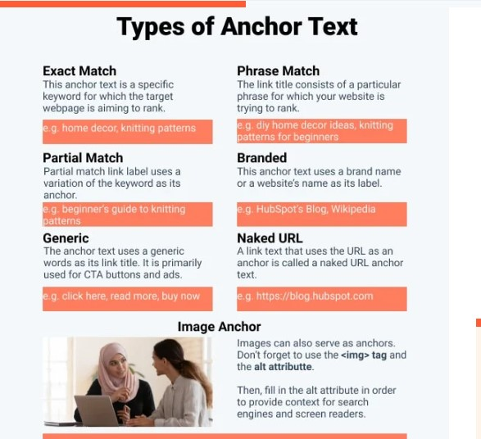
SEO tech
Anchor text,
also known as link text or link title, is the clickable text in a hyperlink that takes users to another page or website
[11]

Slide 16
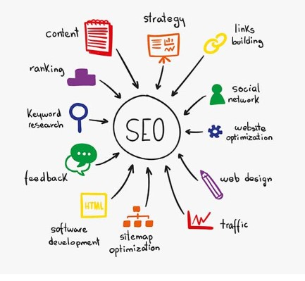
An overview of SEO tech
[12]

Slide 17
SEO Algorithms
Google page rank :
Google PageRank is an algorithm that ranks web pages in search results based on the quality and quantity of links pointing to them.
How it works
PageRank estimates a page's importance by counting the number and quality of links to it. The algorithm assumes that more important websites receive more links from other websites.

Slide 18
SEO Algorithms
Panda
Identifying high-quality content: Panda rated content based on factors like originality, depth, and analysis
Lowering the ranking of low-quality content: Panda penalized sites with thin, duplicated, or spam content
Improving user experience: Panda helped users find more useful content on search engine results pages (SERPs)
.

Slide 19
SEO Algorithms
Penguin
It penalizes websites that use low-quality links
How it works
The Penguin algorithm targets specific pages on a website, rather than penalizing the entire site. It focuses on links, but other factors can also affect a site's ranking.
What it targets
Buying links
Link farming
Automated links
PBNs

Slide 20

SEO Algorithms
RankBrain:
RankBrain is a major part of the Google algorithm that uses artificial intelligence and machine learning to learn about users and how they respond to the search results, particularly on previously unseen queries.
Hummingbird:
It is a search algorithm used by Google. It was first introduced in August 2013, to replace the previous Caffeine algorithm, and focused on making search more predictive and topically relevant

Slide 21
SEO Algorithms E-E-A-T
Experience: This new element emphasizes the importance of first-hand experience in content creation. Google now favors content written by individuals who have direct knowledge or practical experience related to the topic.
Expertise: Content should be produced by individuals who are knowledgeable in their fields. For instance, health-related content must ideally be authored or reviewed by medical professionals.
Authoritativeness: This refers to the overall credibility of the website and its authors. A site that is recognized as a leader
in its niche will rank better than one that lacks authority.
Trustworthiness: Trust is paramount; websites must demonstrate reliability through accurate information, transparent practices, and positive user experiences. [13]
E-E-A-T,
Experience,
Expertise,
Authoritativeness,
Trustworthiness
>The expertise of the creator of the content.
>The authoritativeness of the creator of the content, the content itself, and the website.
>The trustworthiness of the creator of the content, the content itself, and the website.[14]

Slide 22
References
[1] www.google.com
[2] https://www.quora.com/What-is-SEO-in-simple-words-and-why-is-SEO-needed
[3] https://developers.google.com/search/docs/fundamentals/do-i-need-seo
[4] https://ahrefs.com/blog/what-is-seo/
[5] https://www.semrush.com/blog/what-is-seo/
[6] https://www.semrush.com/blog/importance-of-seo/
[7] https://startupnation.com/grow-your-business/maximize-your-marketing/importance-seo-digital-marketing-shibli/
[8] https://www.geeksforgeeks.org/search-engines-work/
[9] https://www.geeksforgeeks.org/seo-techniques-introduction-tips-and-how-it-helps-to-increase-traffic-and-ranking/
[10] https://backlinko.com/hub/seo/serps
[11] https://blog.hubspot.com/marketing/anchor-text
[12] https://www.hurix.com/tips-technical-seo/
[13] https://www.quora.com/Why-is-E-E-A-T-important-for-your-SEO-strategy
[14] https://www.searchenginejournal.com/google-eat/what-is-it/

