Slide 1
Speech Signal Analysis: Noise Removal & Processing
Digital Signal Processing Project
Group Members:
AHAD HOSSAIN HIMEL
ISLAM MD TANVIRUL
JOY NAHID HASSAN
AKHI JAYADA JAHAN

Slide 2
Introduction & Objectives
Project Overview:
• Analyze a recorded speech signal with added noise.
• Apply DSP techniques: band-pass filtering, compression, normalization, amplification, and final low-pass filtering.
• Evaluate results in time and frequency domains, and through spectrograms.

Slide 3
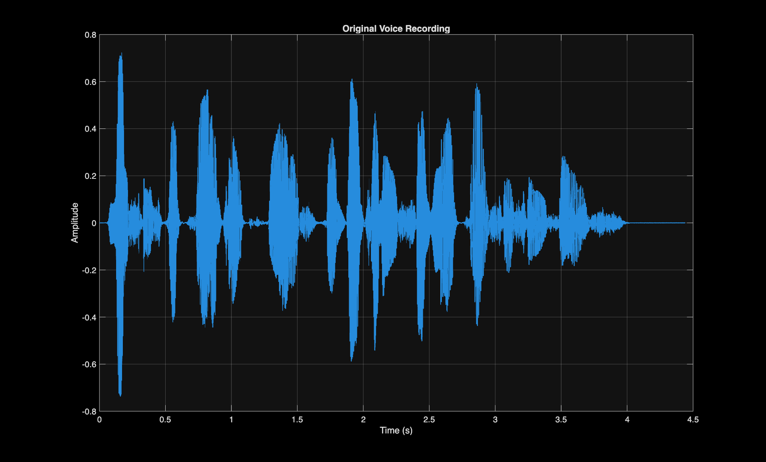

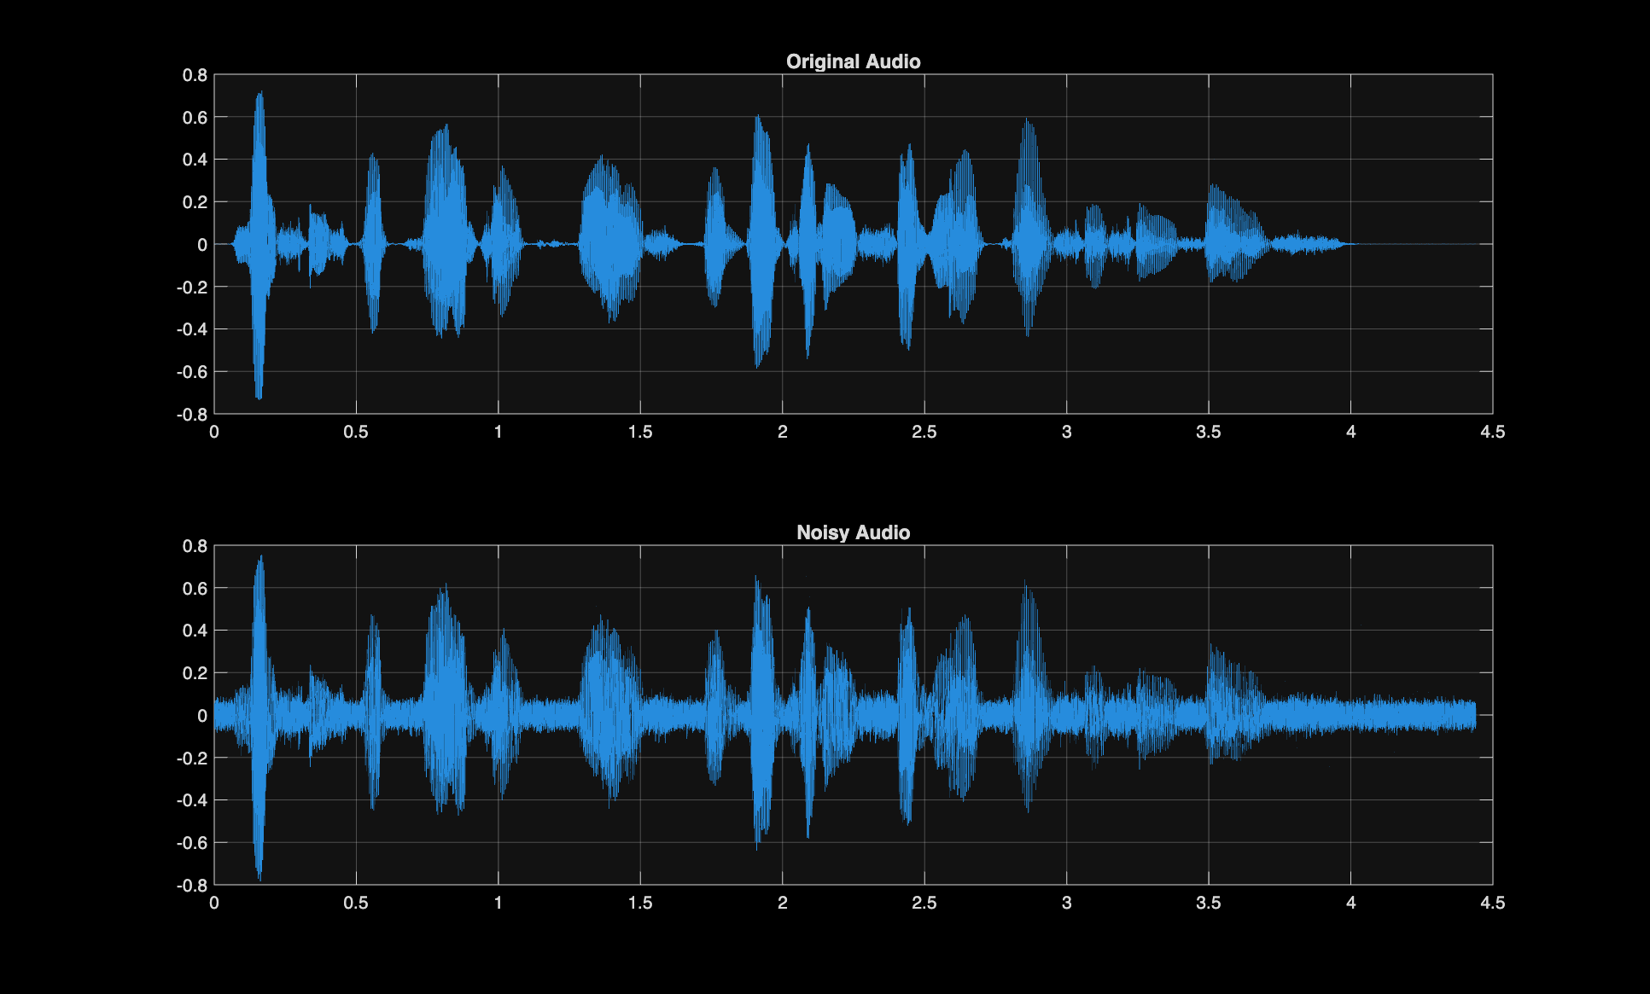
Original vs. Noisy Signal
• AWGN added with SNR = 15 dB
• Added a 5 kHz sinusoidal interference to simulate hum
• Clear difference between clean and noisy signals

Slide 4
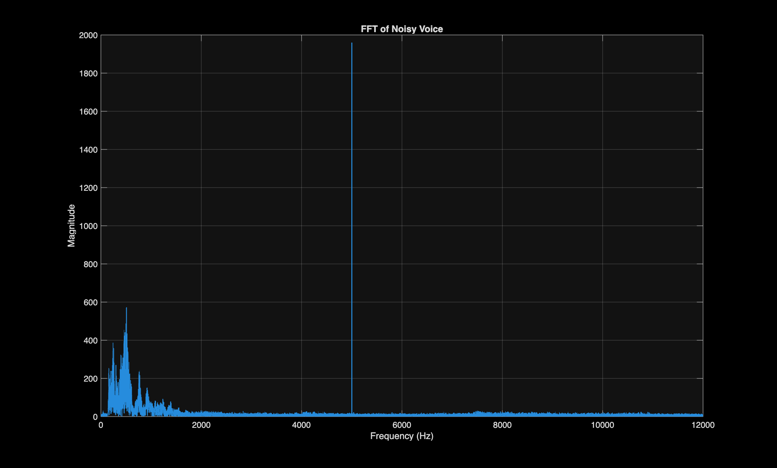
Frequency-Domain Analysis (FFT)
• FFT reveals high-frequency components introduced by noise and interference.
• The 5 kHz tone appears as a strong spike in the spectrum.

Slide 5
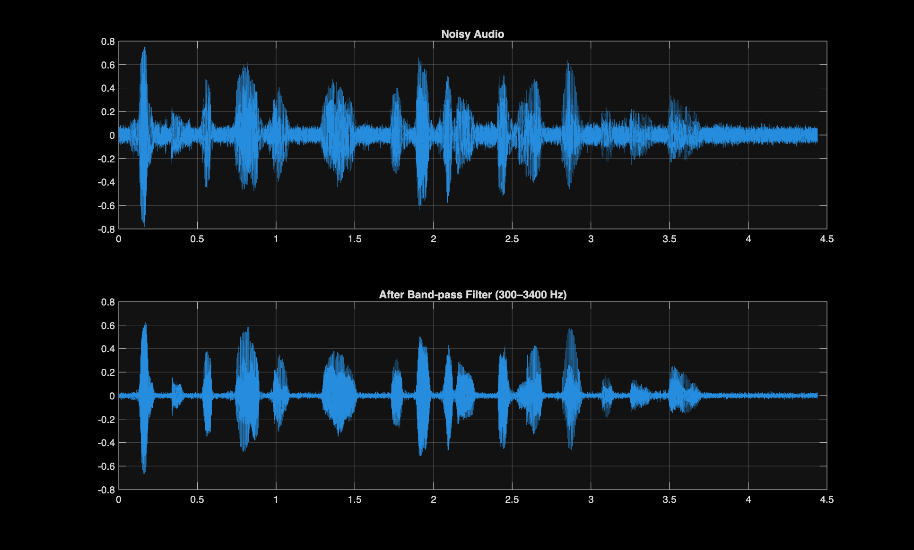
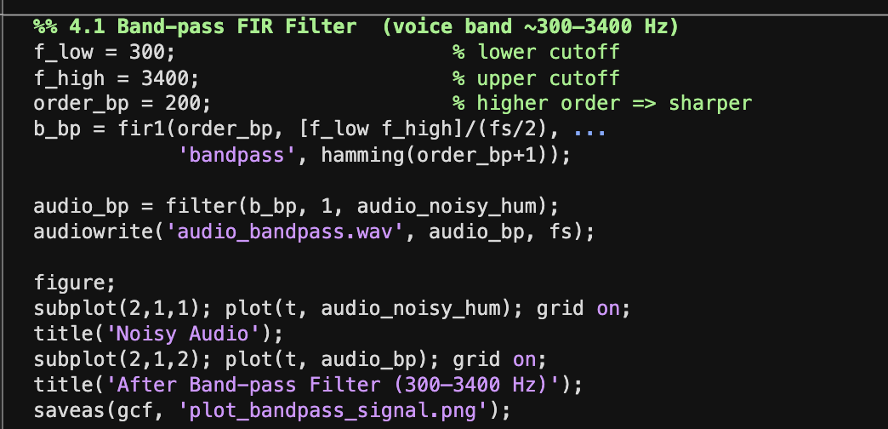
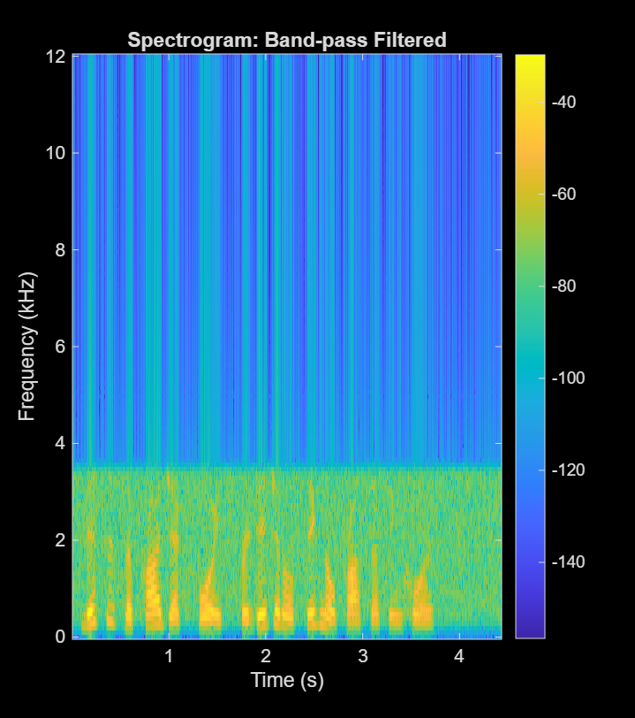
Band-Pass Filtering
• Applied a Hamming-windowed FIR band-pass filter (Order 200).
• Passed frequencies between 300 Hz and 3400 Hz (voice band).
• Removed low-frequency hum and high-frequency noise.

Slide 6
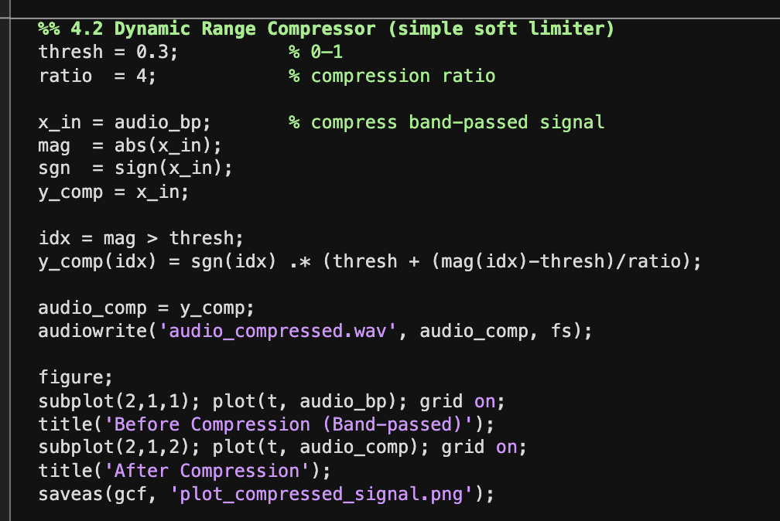
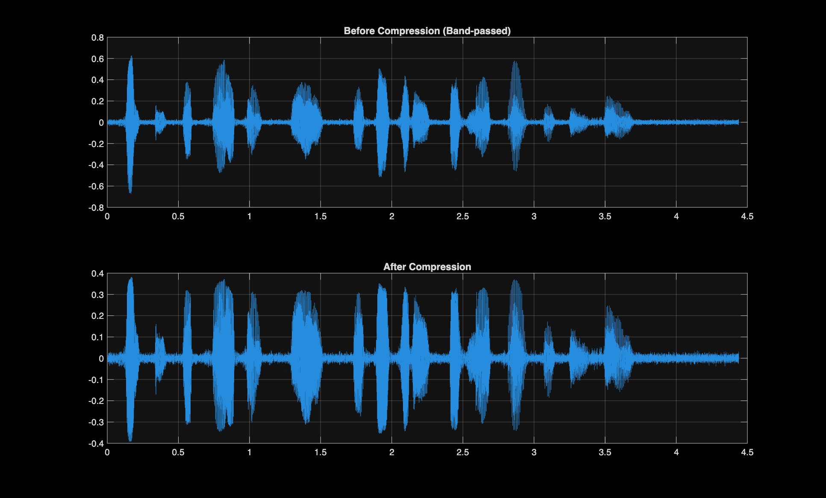
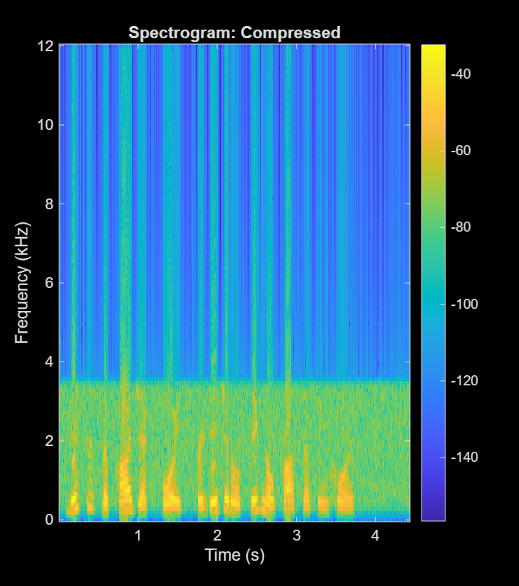
Dynamic Range Compression
• Compression: Signals above threshold (0.3) compressed with ratio 4:1.
• Results: Reduced dynamic range

Slide 7
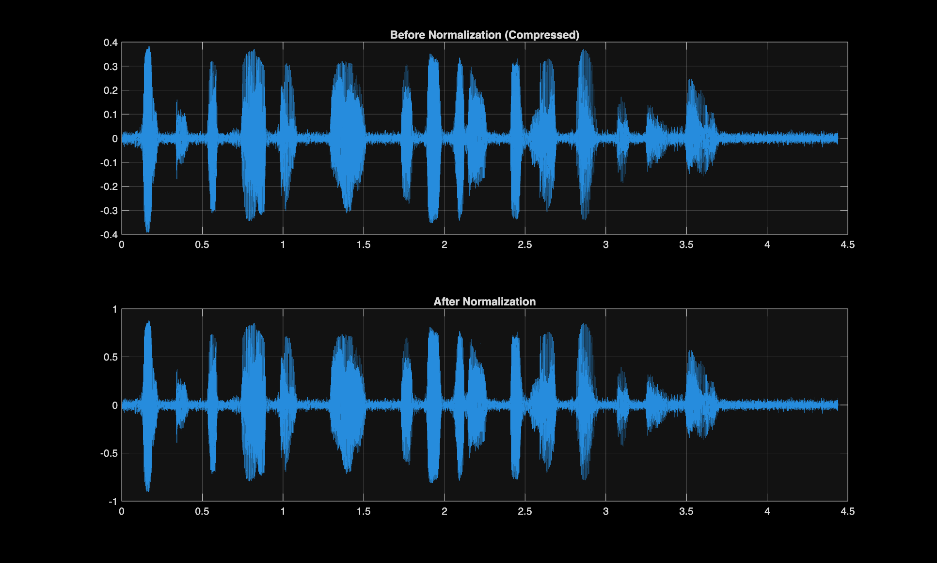
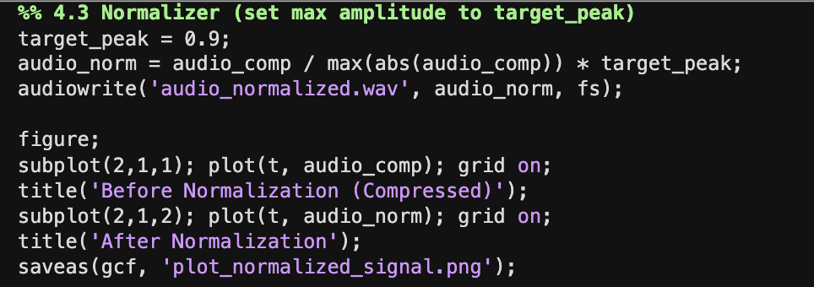
Dynamic Range Normalization
• Normalization: Scaling signal to target peak of 0.9.
• Result: controlled peaks, balanced overall amplitude.

Slide 8
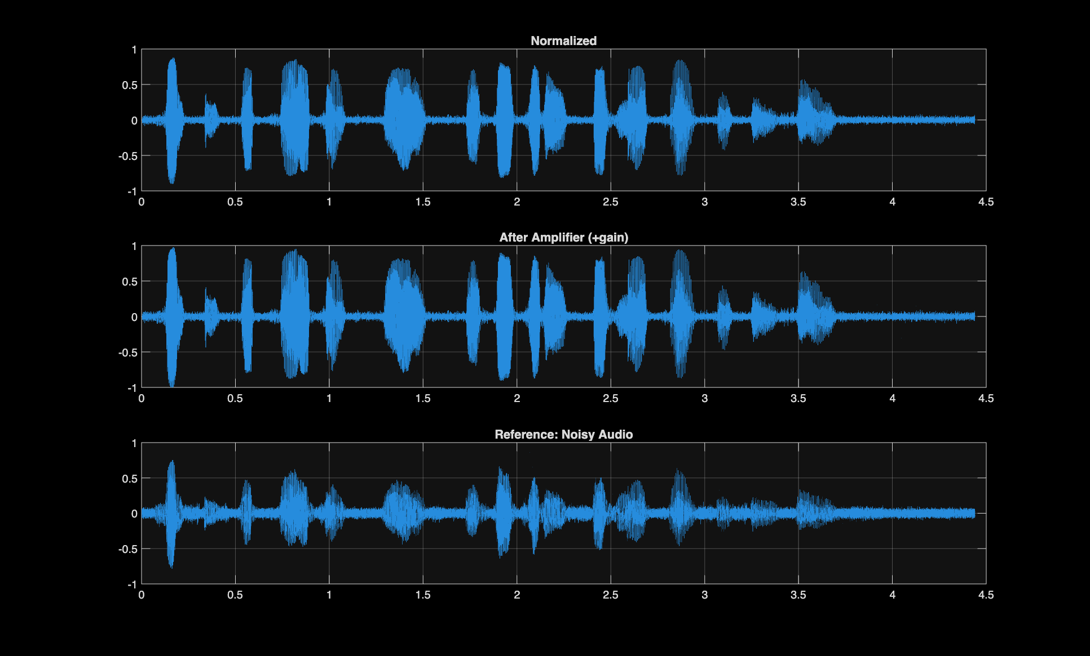
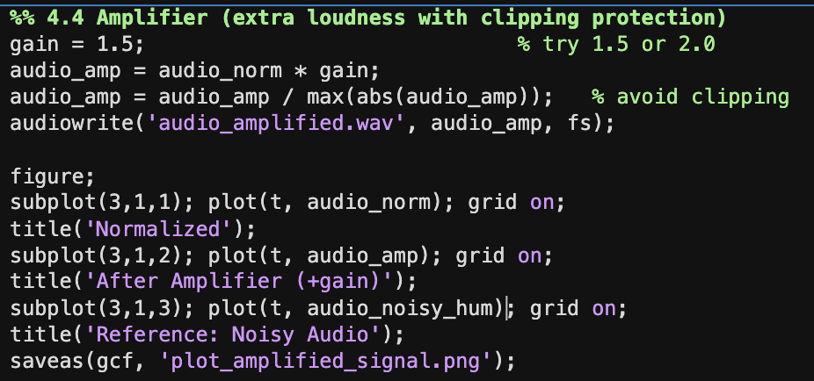
Amplification
• Amplification: Increased loudness with gain 1.5 and avoided clipping.

Slide 9
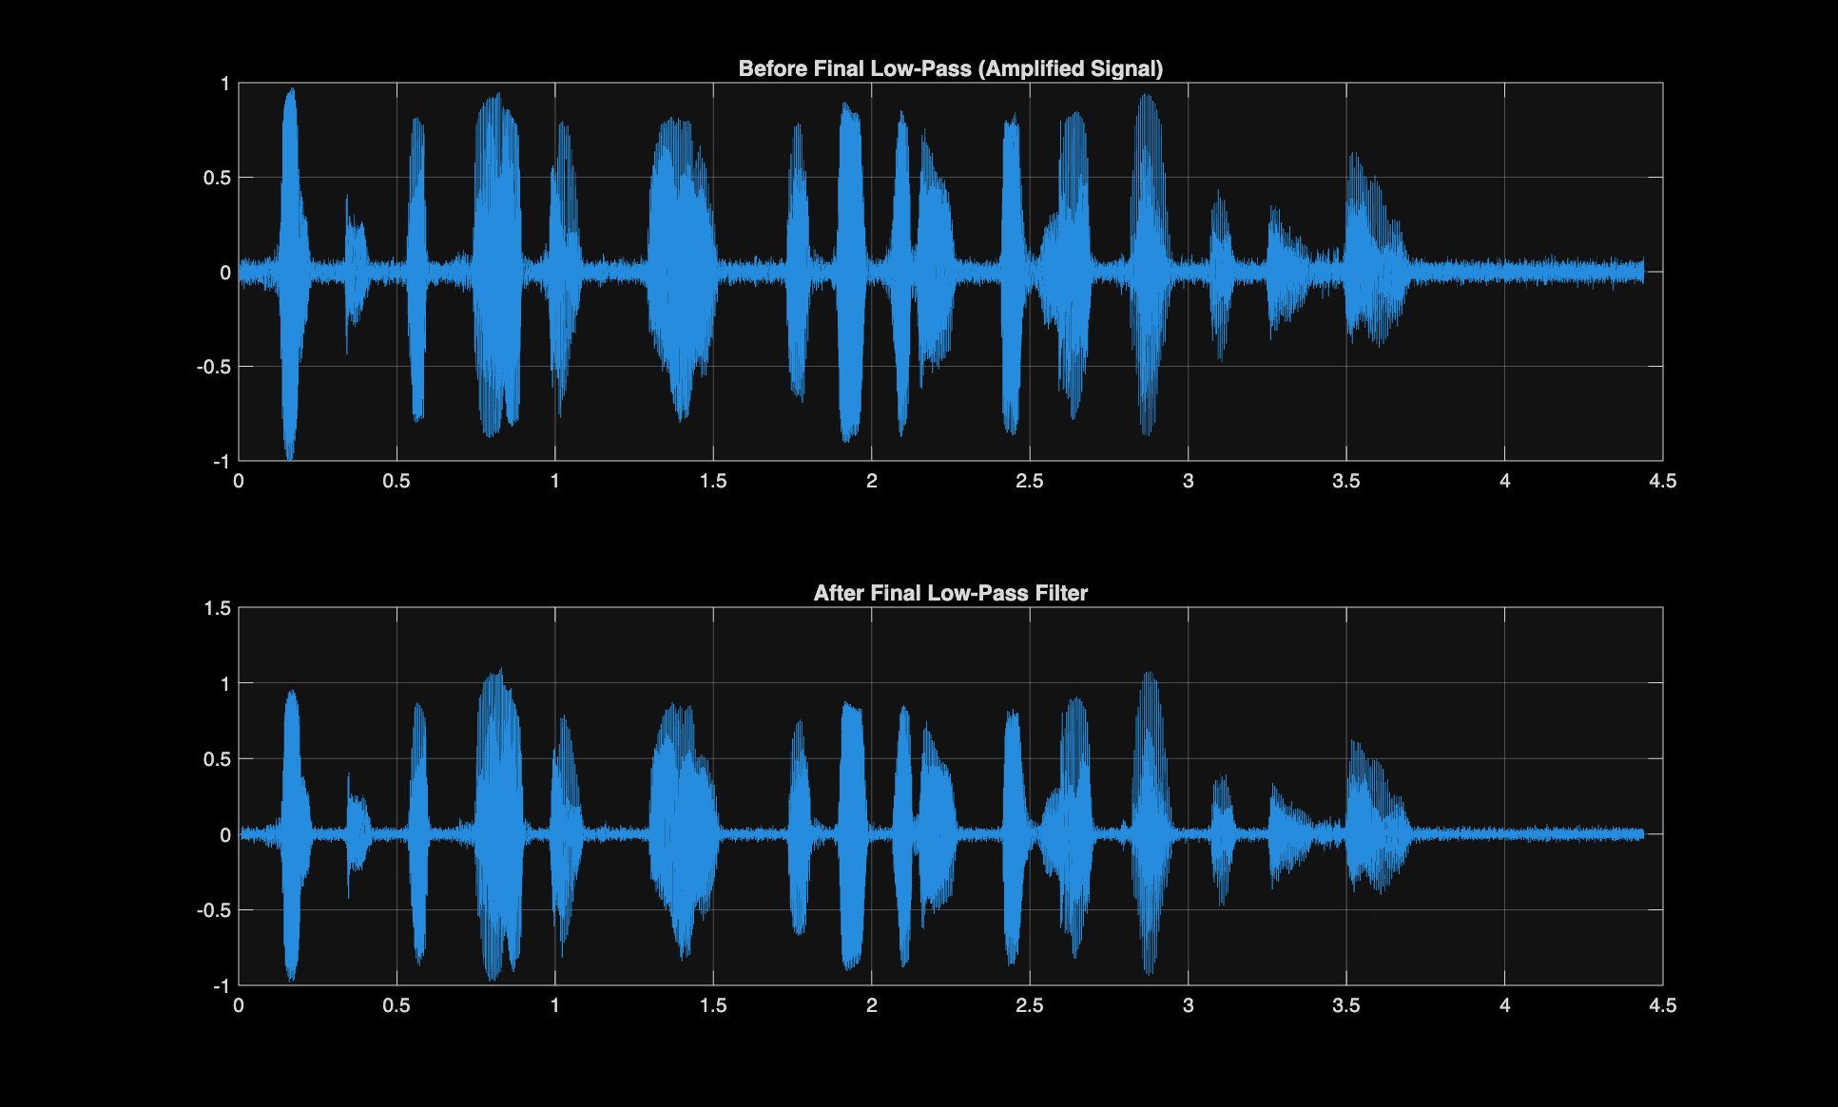
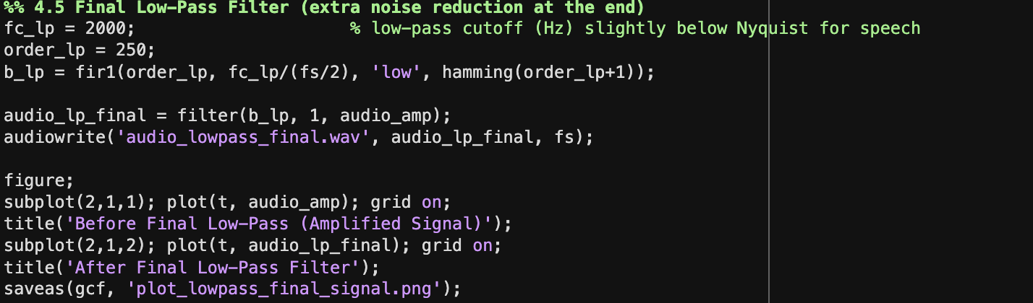
Final Low-Pass Filtering
• Final Low-Pass Filter: FIR low-pass (Order 250) with 2 kHz cutoff to further reduce
high-frequency noise.
• Enhanced clarity with minimal residual noise.

Slide 10
Downsampling & Spectrogram Analysis
Downsampling and Spectrogram Findings:
• Downsampled signal by factor of 4 to illustrate aliasing; observed expected spectral overlaps.
• Spectrograms reveal the time-frequency content at each processing stage.
• After band-pass and low-pass filtering, speech components are well-isolated and noise is suppressed.

Slide 11
Conclusion & Observations
Key Outcomes:
• Noise removal techniques significantly improved signal clarity.
• Band-pass filtering focused on voice frequencies while eliminating outside noise bands.
• Dynamic range compression and normalization balanced the signal’s amplitude.
• Final low-pass filtering further reduced high-frequency noise, enhancing speech intelligibility.
• These DSP techniques provide a comprehensive pipeline for processing and enhancing speech signals.

Slide 12
Thank you

