Slide 1
INTENSIVE COURSE ON ITEE FOR CANDIDATES OF APRIL 2019 EXAM
PROJECT FOR SKILL’S DEVELOPMENT OF ICT ENGINEERS TARGETING JAPANESE MARKET
Solution of FE Exam Questions:
Q1, Q2, Q3, Q4, Q5, Q6, Q7, Q8, Q9, Q10, Q11, Q12, Q13, Q14, Q15
Solutions Provided By:
Dr. Md. Nawab Yousuf Ali
Associate Professor, Dept. of CSE,
East West University

Slide 2
Question 1

Slide 3
Question no 1 Which of the numbers expressed in fractions of decimal number equals to hexadecimal number 0.248?
Options:
a. 31/32
b. 31/125
c. 31/512
d. 73/512

Slide 4
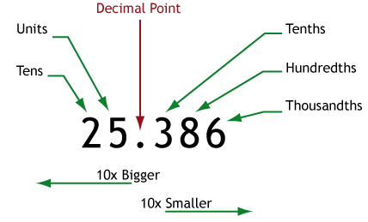
Question no 1
Decimal Number:
Decimal number is represented using 10 different numerals, the digits 0, 1, 2, 3, 4, 5, 6, 7, 8, 9. It also requires a dot (decimal point) to represent decimal fractions. Base of the decimal number is: 10

Slide 5
Question no 1
Hexadecimal Number:
Hexadecimal is a positional numeral system with a radix, or base, of 16.
It uses sixteen distinct symbols, most often the symbols "0"–"9" to represent values zero to nine, and “A"–"F“ to represent values ten to fifteen.
For example: 3A4.9F1 is a hexadecimal number

Slide 6
Question no 1
Conversion Decimal number to Hexadecimal Number:
For integer part of the number we follow the rules:
Divide the integer number by 16
Write the remainder on right side
Continue divide the integer by 16 until the quotient is 0
Read the number up (down to up)
For fraction part of the number we follow the rules:
Multiply the fraction decimal by 16
Write the integer part aside
Continue multiply the fraction part until fraction part is zero (0)
Read the number down (top to down)

Slide 7
Question no 1
Conversion Decimal fraction number to Hexadecimal Number:
Option a. 31/32=0.96875
Integer Part | Fraction Part
 | 0.96875 X16
(F)15 | 0.5X16
8 | .0
So, 31/32=0.96875 (decimal)=0.F8(Hexadecimal )
Thus, option a is incorrect answer

Slide 8
Question no 1
Conversion Decimal fraction number to Hexadecimal Number:
Option b. 31/125=0.248
Integer Part | Fraction Part
 | 0.248 X16
(F)15 | .488X16
(C)12 | .928
(E)14 | .848
So, 31/125=0.248 (decimal)=0.FCE (Hexadecimal )
Thus option b is incorrect answer

Slide 9
Question no 1
Conversion Decimal fraction number to Hexadecimal Number:
Option c. 31/512=0.06054
Integer Part | Fraction Part
 | 0.06054X16
0 | .96875X16
(F)15 | .5X16
8 | .0
So, 31/512=0.06054(decimal)=0.0F8(Hexadecimal)
Thus option c is incorrect answer

Slide 10
Question no 1
Conversion Decimal fraction number to Hexadecimal Number:
Option d. 73/512=0.142578125
Integer Part | Fraction Part
 | 0.142578125X16
2 | .28125X16
4 | .5X16
8 | .0
So, 31/512=0.142578125(decimal)=0.248(Hexadecimal)
Therefore, Option d is correct answer.

Slide 11
Question 2

Slide 12
Question no 2 The following procedure is an algorithm that leaves 1 on the rightmost side and sets all other bits to 0 when a bit string in which at least one of the digits is 1 is given. For example, when 00101000 is given, 00001000 is obtained. Which logical operation will be filled into blank ?
X
Step1: Consider the given bit string A as an unsigned binary number, subtract 1 from A, and let B be the result
Step2: Calculate the exclusive OR (XOR) of A an B, and let C be the result
Step3: Calculate _____ of A and C and let A be the result
Options:
a. XOR b. NAND c. AND d. OR
X

Slide 13
Question 2
Unsigned binary numbers are positive numbers and thus do not require an arithmetic sign.
An m-bit unsigned number represents all numbers in the range 0 to 2^{m} − 1.
Similarly, the range of 16-bit unsigned binary numbers is from
From 0 to 65,535₁₀ in decimal and
From 0000 to FFFF₁₆ in hexadecimal.

Slide 14
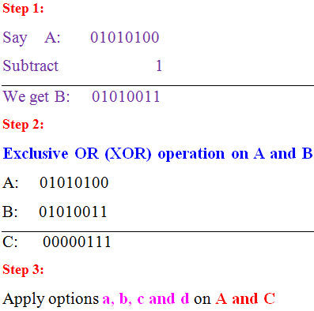
Question 2
We consider a number and follow the steps given in the question:

Slide 15
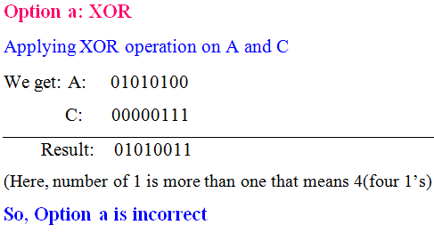
Question 2

Slide 16
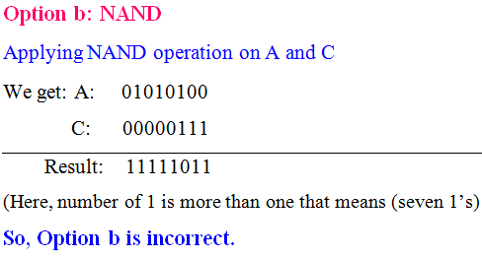
Question 2

Slide 17
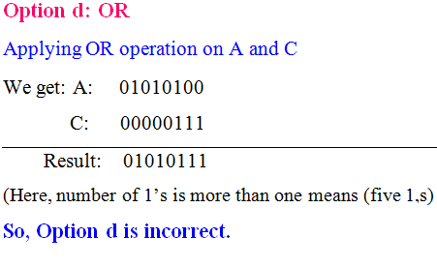
Question 2

Slide 18
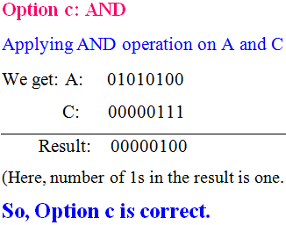
Question 2

Slide 19
Question 3

Slide 20
Question no. 3 Which is the most appropriate explanation for machine learning in AI?
Options:
Technology for making computers has the learning ability naturally performed by human beings, such as finding a specific patterns from the stored data
Technology for reproducing life phenomena and evolution processes using computers, machines etc.
Technology for inputting expertise in a specific field into a computer and inferring by the computer using the input knowledge
Technology for bringing teaching materials and learning management ability to computers by using information technology such as Web system for people to perform interactive learning

Slide 21
Question no. 3
Commentary on correct answer:
Machine learning is an application of artificial intelligence (AI) that provides systems the ability to automatically learn and improve from experience without being explicitly programmed.
Machine learning focuses on the development of computer programs that can access data and use it learn for themselves.
Therefore, the correct answer is: a

Slide 22
Question no. 3
Life phenomena and evolution process of human beings can not be defined using machine learning and AI.
So, option (b) is incorrect.
Machine learning is compatible with learning from data. Expertise of a field can not be inputted into a computer.
So, option (c) is incorrect.
It’s not possible to incorporate teaching materials with learning management to perform interactive learning using machine learning.
So, option (d) is incorrect.

Slide 23
Question 4

Slide 24
Question no. 4 A code table was created in order to compress communication data composed of five letters A, B, C, D, E with different appearance using Huffman coding. Which of the following is appropriate as a sign to fill blank
Options:
a. 001 b. 010 c. 101 d. 110
Letters | Appropriate frequencies (%) | code
A | 26 | 00
B | 25 | 01
C | 24 | 10
D | 13
E | 12 | 111
X

Slide 25
Question no. 4
In computer science and information theory, a Huffman code is a particular type of optimal prefix code that is commonly used for lossless data compression
Huffman coding assigns variable length codewords to fixed length input characters based on their frequencies
To decode the encoded string, follow the zeros and ones to a leaf and return the character there

Slide 26
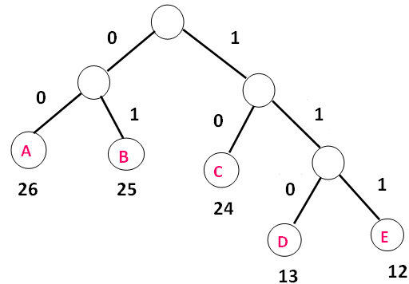
Question no. 4 Based on the frequency of the characters we have drawn a tree for Huffman coding as follows

Slide 27
Question no. 4
Letters | Appropriate frequencies (%) | code
A | 26 | 00
B | 25 | 01
C | 24 | 10
D | 13 | 110
E | 12 | 111
So, option d is correct answer

Slide 28
Question 5

Slide 29
Question no. 5 The operation for the queue is defined as follows. ENQ n: Insert data n into the queue. DEQ: Retrieve data from the queue The following operations, ENQ 1, ENQ 2, ENQ 3, DEQ, ENQ 4, ENQ 5, DEQ, ENQ 6, DEQ, DEQ were operated for an empty queue. Which data is retrieved when the next DEQ operation is done?
Options:
a. 1 b. 2 c. 5 d. 6

Slide 30
Question no. 5
A Queue is a linear structure that follows a particular order in which the operations are performed.
The order is: First In First Out (FIFO).
A good example of a queue is any queue of consumers for a resource where the consumer that came first is served first.
Queues provide services in computer science, transport, and operations research where various entities such as data, objects, persons, or events are stored and held to be processed later.

Slide 31
Question No.5
Correct option is c
Commentary on correct option:
Queue Operations
Next DEQ operation will retrieve data 5.
So, the correct answer for this question is option (c)
1 2 3
ENQ1 ENQ2 ENQ3
2 3
DEQ
2 3 4 5
ENQ4 ENQ5
3 4 5
DEQ
3 4 5 6
ENQ6
5 6
DEQ DEQ

Slide 32
Question 6

Slide 33
Question no. 6 Which is the appropriate explanation of quick sorting?
Options:
It is a method of repeating the operation of adding data to the correct position of already aligned data string
Find the minimum value in the data, then find the minimum value from the parts excluding it. This is a method of repeating this operation.
Choose an appropriate reference value and divide the data into smaller value groups and larger value groups. In the same way, select the reference value in the group and divide each group. This is a method of repeating this operation.
It is a method of gradually transferring small value data to the end by repeating comparison and replacement of adjacent data

Slide 34
Question No.6
Commentary on correct option:
Quick sort is a highly efficient sorting algorithm based on partitioning of array of data into smaller arrays.
A large array is partitioned into two arrays one of which holds values smaller than the specified value.
Quick sort usually partitions an array and then calls itself recursively twice to sort the two resulting subarrays.
Quick Sort is also based on the concept of Divide and Conquer.
Therefore, option (c) is correct which illustrates the motive theme of quick Sort algorithm.

Slide 35
Question No.6
Commentary on incorrect options:
Quick Sort never negotiates with already aligned data and thus option (a) is incorrect.
In quick sort initial array is divided into two parts depending on a reference value not the minimum value itself. Therefore, option (b) is incorrect.
Quick sort is a method of gradually sorting data by transferring smaller value to the starting point where those values should be. Therefore, option (d) is also incorrect.

Slide 36
Question 7

Slide 37
Question no. 7 Which of the items stipulated in the coding standards of the program is appropriate?
Options:
For local variables, if the data types are the same even if they are used differently, use the same variables as much as possible.
In order to improve the processing performance, we use a floating-point variable for the control variable of the loop.
To repeat the same calculation over and over, use the function’s recursive call.
When using the memory area allocation function, describe the processing when allocation is impossible.

Slide 38
Question No.7
Commentary on correct answer:
Standard coding reveals that is any special case exists for a program then that case should be mentioned while coding as a comment section of that specific line and option (d) reveals the same.
So option (d) is correct.

Slide 39
Question No.7
Commentary on incorrect Options
Same variables should not be used repeatedly in a program even they are being used in different situation.
Therefore, option (A) is incorrect.
Floating point variable is not used for control variable of a loop
So, Option (b) is incorrect
Same calculation should be conducted using function not recursive one.
Therefore, option (c) is incorrect.

Slide 40
Question 8

Slide 41
Question no. 8 Which is appropriate as an explanation of Java’s characteristics?
Options:
It is an object-oriented language, and multiple inheritance that specifies multiple superclasses is possible.
Integer and character are always treated as class.
Because there is a pointer type, you can refer directly to the address on the memory.
There is garbage collection function for memory management.

Slide 42
Question no.8
Commentary on correct option:
JAVA (also PHP and C#) has an special function for management of garbage which is referred as garbage collection function for memory management.
Thus, option (d) is correct answer

Slide 43
Question no. 8
Commentary on incorrect options:
Java never supports multiple inheritance and so only one superclass is possible but multiple subclass of a superclass is possible.
Therefore, option (a) is incorrect.
Integer and character are referred as variables in java and they are not treated as class.
So, option (b) is incorrect.
Java doesn't have pointers; Java has references. Therefore, option (C) is also incorrect.

Slide 44
Question 9

Slide 45
Question no. 9 When the number of clocks required for the execution of the instruction and the occurrence rate of the instruction are the values shown in the table for the CPU with the operation clock frequency of 700 MHz, how many MIPS is the performance of the CPU ?
Options:
a. 10 b. 50 c. 70 d. 100
Type of instruction | Clocks required for executing | Occurrence rate (%)
Operation for inter-register | 4 | 30
Operation between memory and register | 8 | 60
Non-conditional jump | 10 | 10

Slide 46
Question no. 9 MIPS. Stands for "Million Instructions Per Second." It is a method of measuring the raw speed of a computer's processor.
=
Clock Per Instruction = 4*.30+8*.60+10*.10
= 7
MIPS = 700/7
=100
Therefore, the correct option is (d)

Slide 47
Question 10

Slide 48
Question no. 10 Which register preserves at the time of the interruption so as to resume from the interrupted location after the end of the interrupt processing?
Options:
Index register b. Data register
c. Program counter c. Instruction register

Slide 49
Question no.10
Commentary on correct answer:
A program counter is a register in a computer processor that contains the address (location) of the instruction being executed at the current time. As each instruction gets fetched, the program counter increases its stored value by 1.
PC register also preserves at the time of the interruption
Thus, correct answer is (c).

Slide 50
Question no.10
Commentary on incorrect options:
An index register is a circuit that receives, stores, and outputs instruction-changing codes in a computer.
So, option (a) is incorrect
A data register (DR) is the register in CPU that stores the data being transferred to and from the immediate access storage
So, option (b) is incorrect
The instruction register (IR) or current instruction register (CIR) is the part of a CPU's control unit that holds the instruction currently being executed or decoded.
Therefore, options (d) is incorrect.

Slide 51
Question 11

Slide 52
Question no. 11 ECC is used for memory error detection and correction. When n+2 bits are required for redundant bits for data bus width 2n bits, how many bits of redundant bits are necessary for the 128-bit data bus width?
Options:
7 b. 8 c. 9 d. 10

Slide 53
Question no. 11
An error-correcting code (ECC) or forward error correction (FEC) code is a process of adding
redundant data, or
parity data, to a message, such that it can be recovered by a receiver even when a number of errors were introduced

Slide 54
Question no. 11
Commentary on correct answer:
According to the given scenario it can be concluded that,
Since, n+2 bits are required therefore 7+2 = 9 bits is required
So, the correct answer is (c)

Slide 55
Question 12

Slide 56
Question no. 12 Which one is appropriate as an explanation of USB 3.0?
Options:
It is an interface that uses 4 pairs of signal lines that transmit 2 bits of information with one clock and has a throughput of 1 Gbit /s maximum at the maximum.
It is serialized ATA specification that connects a PC and peripheral devices
It adopts isochronous transfer suitable for audio, video, etc., and it is a serial interface with broadcast transfer mode.
It is a serial interface with a data transfer mode of 5 Gbit/s called super speed.

Slide 57
Question no. 12
Commentary on correct answer:
USB 3.0 adds the new transfer rate referred to as SuperSpeed USB that can transfer data at up to 5 Gbit/s, which is about 10 times faster than the USB 2.0 standard.
Therefore, the correct option is (D)

Slide 58
Question 13

Slide 59
Question no. 13 In the Web system, which is appropriate as an advantage when placing the Web server and the application (AP) server on different physical servers?
Options:
Since the execution environment of the client is implemented in the Web server, it is not necessary to exchange screen data between the client and the AP server every time the request is made, and the amount of data communication can be small.
Since the Web server absorbs the difference between the character code system of the Web browser and the character code system of the AP server, garbled characters do not occur.
Since the business logic accompanying the access to the data is arranged in the program of the Web server, it is unnecessary to change the program of the AP server as the business logic is changed.
Processing can be divided according to the type of request from the client so that the request to the static contents with light load is processed by the Web server and the request to the dynamic contents with heavy load is processed by the AP server

Slide 60
Question 14

Slide 61
Question no. 14 There are systems where the operation status is continuously monitored. Which of the following is appropriate for the order of capacity planning work items to be implemented when new business is applied to the system in a few years after its operation? [Work item of capacity planning] (1) Evaluate whether the system configuration is appropriate, and if necessary review it. (2) Consider the necessary system configuration such as the number of servers and whether parallel distributed processing is implemented according to the system characteristics. (3) Understand the hardware performance information and the system-specific environment from the operating status of the system (4) Hears new business to users and others and grasps the requirements required of the system such as the number of expected processing and the time required for processing.
Options:
a. (3), (2), (4), (1) b. (3), (4), (2), (1) c. (4), (2), (1), (3) d. (4), (3), (1), (2)

Slide 62
Question 15

Slide 63
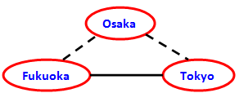
Question no. 15 There is a line represented as a solid line connecting Tokyo and Fukuoka. In order to improve the reliability between Tokyo and Fukuoka, we added a dashed detour line via Osaka. What is the availability rate between Tokyo and Fukuoka after detour line addition? Here, the availability rate of the line is 0.9 for all of Tokyo and Fukuoka, Tokyo and Osaka, Osaka and Fukuoka?
Options:
a. 0.729 b. 0.810 c. 0.981 d. 0.999

