Slide 1
INTENSIVE COURSE FOR STUDENTS
PROJECT FOR SKILL’S DEVELOPMENT OF ICT ENGINEERS TARGETING JAPANESE MARKET
Solution of FE February 2018 MOC Exam
Q1, Q2, Q5, Q51
Dr. Md. Nawab Yousuf Ali
Associate Professor, Dept. of CSE,
East West University

Slide 2
Question 1. Which expression should be placed in A in the definition of a function F(n) that calculates the factorial of n in a recursive manner? Here, n is a non-negative integer.
A
F(n)= when n>0
Given F(n)=1 when n=0
Options:
n + F(n-1) b. n-1 + F(n)
c. n x F(n-1) d. (n-1) x F(n)
4
B1, 15

Slide 3
Question 1
By definition the rule of factorial is:
n! = n × (n−1)!
Factorial Means: the factorial of any number is that number times the factorial of that number minus 1.
Recursive means: involving doing or saying the same thing several times in order to produce a particular result or effect
For example:
i) 10! = 10 × 9 × 8! ... and
ii) 125! = 125 × 124 × 123!... etc.
What About "0!" Zero Factorial?
It is generally agreed that 0! = 1.
B1, 15

Slide 4
Question 1
Given in the question: F(n)=1 when n=0, So, F(0)=1
F(1)=1
F(2)=1*2
F(3)=1*2*3
…..
F(n-1)= 1*2*3*………..*(n-1)
F(n) =1*2*3*………..*(n-1) *n
F(n) =n*F(n-1)
Finally, F(n)=n*F(n-1) that matches with option c
So, the option c is correct.
By definition of factorial we know: n!=n*(n-1)!
2
B1, 15

Slide 5
Question 1
Incorrect Options:
F(n) = n + F(n-1) is incorrect
Because in factorial there should not be any ‘+’, ‘-‘ or ‘/’ sign between the components of an expression
b. F(n) = n-1 + F(n) is incorrect like as a and also the F(n) is in the answer
d. F(n) = (n-1) x F(n) is incorrect because F(n) is in the answer
B1, 15

Slide 6
Question 2 Which of the following is the appropriate effect of cache memory?
Options:
To perform data transfer at high speed by simultaneously reading instructions from main memory to cache memory and reading data from main memory to cache memory
To retain data read from main memory in cache memory and transfer data at high speed when the CPU reads the same data later
To retain data read from main memory in cache memory and perform operations at high speed by processing instruction in parallel
To retain data read from main memory in cache memory and perform operations at high speed by decoding and running data in cache memory
B1, 15
8

Slide 7
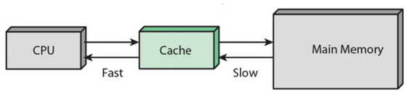
Question 2
Cache memory is a very high speed memory area so that the CPU can access data quickly.
When the CPU wants to process a data, the CPU first searches the data in Cache Memory.
If the data is not available in Cache Memory:
the CPU retrieves the data from main memory and
leaves a copy of the data in cache memory
B1, 15

Slide 8
Question 2
If the CPU needs the same data in the next time, it just retrieves the data from the cache memory leaving the main memory out of loop.
This indicates that the effect of cache memory is only to
i) retain data read from main memory and
ii) to transmit data at high speed when the CPU reads the same data later
The function matches with option b
So, the option b is correct answer.
6
B1, 15

Slide 9
Question 2
Option a:
Option a is incorrect:
In option a, there are three parts:
To perform data transfer at high speed by simultaneously reading instructions from main memory to cache memory and reading data from main memory to cache memory
i) To perform data transfer at high speed by simultaneously
ii) reading instructions from main memory to cache memory
iii) reading data from main memory to cache memory
So, option a is incorrect.
6
B1, 15

Slide 10
Question 2
Option c:
Option c is incorrect:
In option c, there are three parts:
Explanation of option c
c) To retain data read from main memory in cache memory and perform operations at high speed by processing instruction in parallel
i) To retain data read from main memory to cache memory
ii) Performs operations at high speed by
iii) Processing instructions in parallel
The function does not match with correct option
So, option c is incorrect.
B1, 15

Slide 11
Question 2
Option d:
Option d is incorrect:
In option d, there are three parts:
Explanation of option c (incorrect answer)
c) To retain data read from main memory in cache memory and perform operations at high speed by decoding and running data in cache memory
i) To retain data read from main memory to cache memory (this point is correct for cache memory)
ii) Performs operations at high speed by
iii) decoding and running data in cache memory
The function does not match with correct option
So, option c is incorrect.
B1, 15

Slide 12
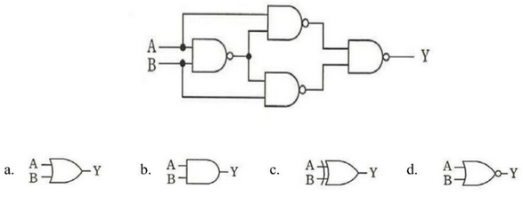
Question 5. Which of the following circuits is equivalent to the logic circuit in the figure below?
2
1
4
3
13
14
15
16
B1, 15

Slide 13

Question 5
In the figure, there are 4(four) NAND gates.
The first NAND gate has two inputs:
and
So, the output of the first NAND gate is:
12
B1, 15

Slide 14

Question 5
The second and third NAND gates are placed in the figure parallely.
We consider
the upper one as second NAND gate and
the lower one as third NAND gate
The second NAND gate has two inputs: and
The output of this NAND gate will be:
12
B1, 15

Slide 15


Question 5
The third NAND gate has two inputs: and
The output of this NAND gate will be:
The fourth NAND gate has two inputs, the outputs of the second and third NAND gates:
and
So, the output of the fourth NAND gate would be: Y=
12
B1, 15

Slide 16


Question 5
So, according to the De Morgan’s Laws we can write:
Y =
Y
This result matches with the logic circuit c
So, the option c is correct
12
B1, 15

Slide 17
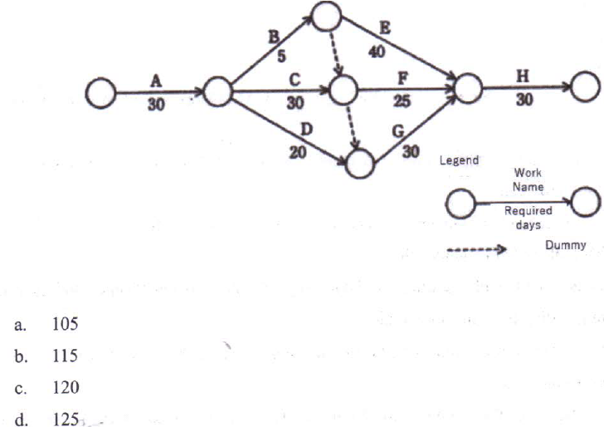
Question 51. How many days is required for the project represented by the diagram in the shortest time to complete?
24
25
26
B1, 15

Slide 18
Question 51
Critical path analysis is a technique that identifies the activities necessary to complete a task
It includes identifying the time necessary to complete each activity and
the relationships between the activities.
In the figure, we have to calculate:
Earliest node time calculation
B1, 15

Slide 19
Question 51
In the figure:
there are 8(eight) tasks namely A, B, C, D, E, F, G and H
All the tasks have to be completed to finish the project
B1, 15

Slide 20
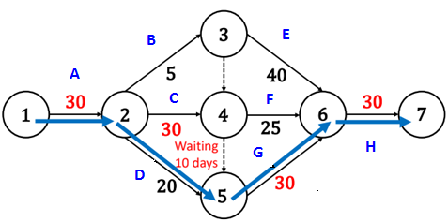
Question 51
21
22
23
24

Slide 21
Question 51
Task A needs 30 days to complete
Tasks B, C and D depend on task A to complete
Task B needs 5 days, C needs 30 days and D needs 20 days to finish
20
B1, 15

Slide 22
Question 51
In this situation, we consider task C to complete
Because task C takes 30 days to complete
By this time task B (takes 5 days) and task C (takes 20 days) will be completed
Total required time for tasks ( A and C ) will be: A + C = 30 + 30 = 60 days
20
B1, 15

Slide 23
Question 51
There is a dummy path from task C to go through task G
We consider this path from task C to task G
So, the total time to complete tasks
A + C + G = 30 + 30 + 30 =90 days
By this time tasks E (takes 40 days) and F (takes 25 days) will also be completed
20
B1, 15

Slide 24
Question 51
Finally, we go through task H (takes 30 days) to complete
So, total time required to complete the project is: 30 (A) + 30 (C) + 30 (G) + 30 (H) = 120 days
This time matches with the option c
So, the option c is the correct answer.
17
B1, 15

Slide 25
Question 51
Option a.
Option a is incorrect
Because if we complete tasks: A, B, E, and H the system takes 105 days
However, to complete all the tasks system needs 120 days
17
B1, 15

Slide 26
Question 51
Option b.
Option b is incorrect
Because if we complete tasks: A, C, F and g the system takes 115 days
However, to complete all the tasks system needs 120 days
17
B1, 15

