Slide 1
The Project for Skill’s Development of ICT Engineers Targeting Japanese Market
FE PM Question 1

Slide 2
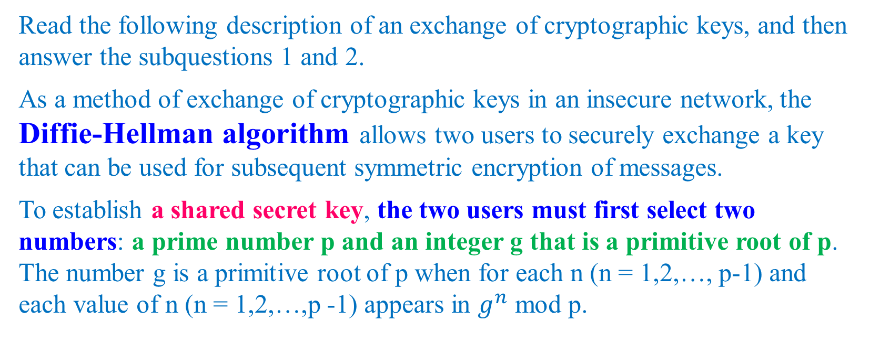
Question 1
Read the following description of an exchange of cryptographic keys, and then answer the subquestions 1 and 2.
As a method of exchange of cryptographic keys in an insecure network, the Diffie-Hellman algorithm allows two users to securely exchange a key that can be used for subsequent symmetric encryption of messages.
To establish a shared secret key, the two users must first select two numbers: a prime number p and an integer g that is a primitive root of p. The number g is a primitive root of p when for each n (n = 1,2,…, p-1) and each value of n (n = 1,2,…,p -1) appears in $g^{n}$ mod p.

Slide 3
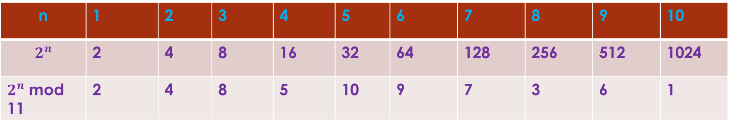
Question 1
Table 1 shows an example of primitive root when p = 11 and g = 2. The bottom row shows the numbers 1,2,…,10.
n | 1 | 2 | 3 | 4 | 5 | 6 | 7 | 8 | 9 | 10
$$2^{n}$$ | 2 | 4 | 8 | 16 | 32 | 64 | 128 | 256 | 512 | 1024
$2^{n}$ mod 11 | 2 | 4 | 8 | 5 | 10 | 9 | 7 | 3 | 6 | 1

Slide 4
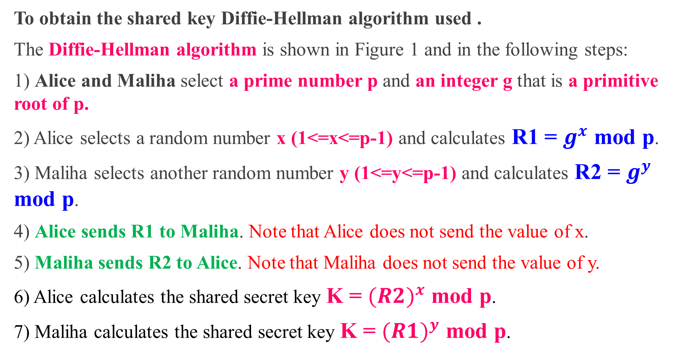
Question 1
To obtain the shared key Diffie-Hellman algorithm used .
The Diffie-Hellman algorithm is shown in Figure 1 and in the following steps:
1) Alice and Malihaselect a prime number p and an integer g that is a primitive root of p.
2) Alice selects a random number x (1<=x<=p-1) and calculates R1 = $g^{x}$ mod p.
3) Maliha selects another random number y (1<=y<=p-1) and calculates R2 = $g^{y}$ mod p.
4) Alice sends R1 to Maliha. Note that Alice does not send the value of x.
5) Maliha sends R2 to Alice. Note that Maliha does not send the value of y.
6) Alice calculates the shared secret key K = ${(R2)}^{x}$ mod p.
7) Maliha calculates the shared secret key K = ${(R1)}^{y}$ mod p.

Slide 5
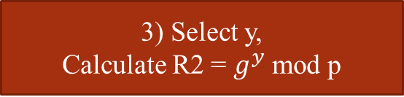
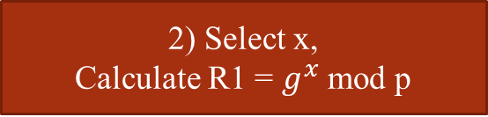


Question 1
Alice Maliha
1) Select p and g
2) Select x,
Calculate R1 = $g^{x}$ mod p
3) Select y,
Calculate R2 = $g^{y}$ mod p
4) Send R1 to Maliha
5) Send R2 to Alice
6) Calculate K = ${(R2)}^{x}$ mod p
7) Calculate K = ${(R1)}^{y}$ mod p
Figure 1. Diffie-Hellman key exchange algorithm

Slide 6
Question 1 (Sub question 1-> A)
Subquestion A :
A shared secret key is being exchanged between Alice and Maliha using this algorithm. Assume that they agreed upon the prime number p = 11 and the integer g = 2.
If Maliha has received the public key R1 = 3 from Alice, the random number x Alice has selected is
Answer :
Given that,
p = 11, g = 2, R1 = 3, x = ?
Here, x = n [because n is a random number]
A

Slide 7
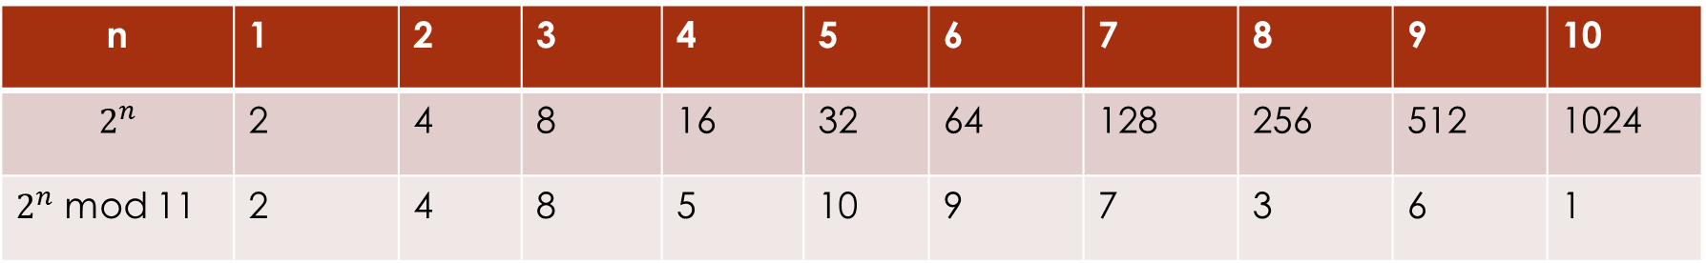
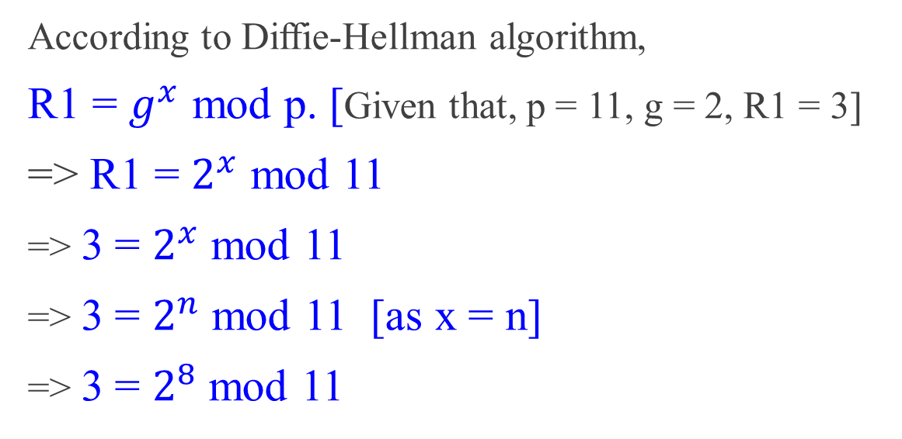
Question 1 (Sub question 1-> A)
When p = 11 and g = 2
n | 1 | 2 | 3 | 4 | 5 | 6 | 7 | 8 | 9 | 10
$$2^{n}$$ | 2 | 4 | 8 | 16 | 32 | 64 | 128 | 256 | 512 | 1024
$2^{n}$ mod 11 | 2 | 4 | 8 | 5 | 10 | 9 | 7 | 3 | 6 | 1
According to Diffie-Hellman algorithm,
R1 = $g^{x}$ mod p. [Given that, p = 11, g = 2, R1 = 3]
=>R1 = $2^{x}$ mod 11
=>3 = $2^{x}$ mod 11
=>3 = $2^{n}$ mod 11 [as x = n]
=>3 = $2^{8}$ mod 11

Slide 8
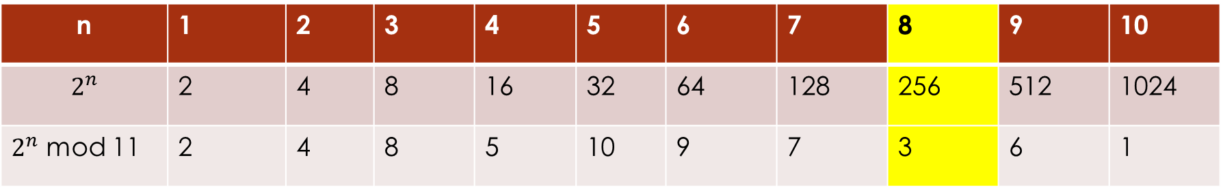
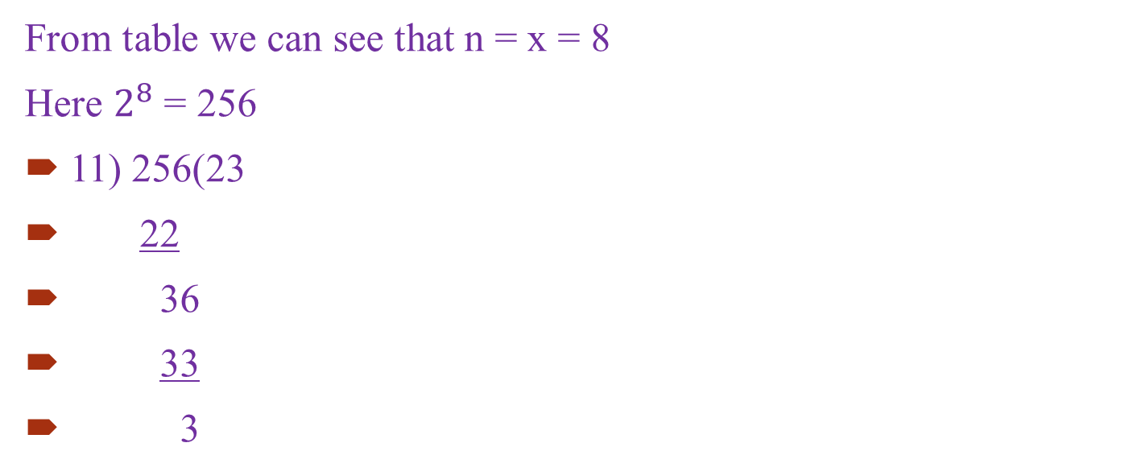
Question 1 (Sub question 1-> A)
When p = 11 and g = 2
n | 1 | 2 | 3 | 4 | 5 | 6 | 7 | 8 | 9 | 10
$$2^{n}$$ | 2 | 4 | 8 | 16 | 32 | 64 | 128 | 256 | 512 | 1024
$2^{n}$ mod 11 | 2 | 4 | 8 | 5 | 10 | 9 | 7 | 3 | 6 | 1
From table we can see that n = x = 8
Here $2^{8}$ = 256
11) 256(23
22
36
33
3
Ans. A : g) 8

Slide 9
Question 1 (Sub question 1->B)
Subquestion B :
A shared secret key is being exchanged between Alice and Maliha using this algorithm. Assume that they agreed upon the prime number p = 11 and the integer g = 2.
Also If Alice has received the public key R2 = 9 from Maliha, the random number y Maliha has selected is
Answer :
Given that,
p = 11, g = 2, R2 = 9, y = ?
Here, y = n [because n is a random number]
B

Slide 10
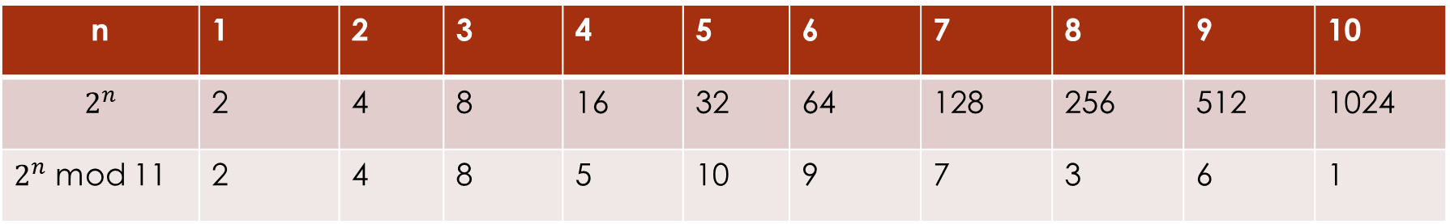
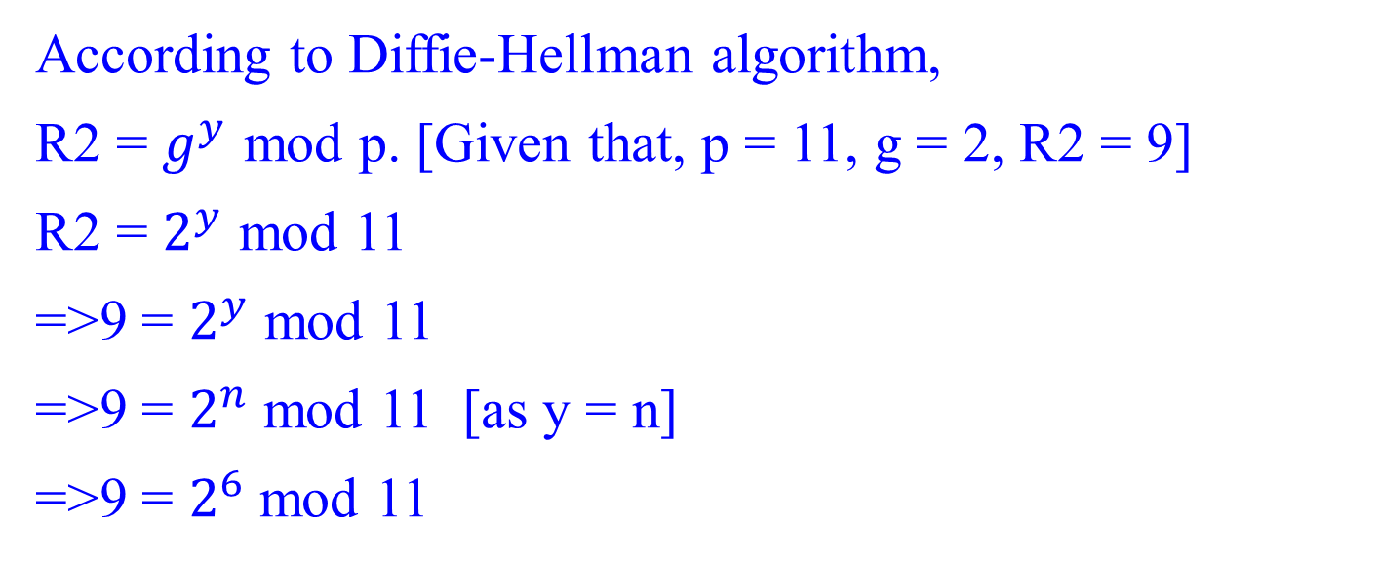
Question 1 (Sub question 1-> B)
When p = 11 and g = 2
n | 1 | 2 | 3 | 4 | 5 | 6 | 7 | 8 | 9 | 10
$$2^{n}$$ | 2 | 4 | 8 | 16 | 32 | 64 | 128 | 256 | 512 | 1024
$2^{n}$ mod 11 | 2 | 4 | 8 | 5 | 10 | 9 | 7 | 3 | 6 | 1
According to Diffie-Hellman algorithm,
R2 = $g^{y}$ mod p. [Given that, p = 11, g = 2, R2 = 9]
R2 = $2^{y}$ mod 11
=>9 = $2^{y}$ mod 11
=>9 = $2^{n}$ mod 11 [as y = n]
=>9 = $2^{6}$ mod 11

Slide 11
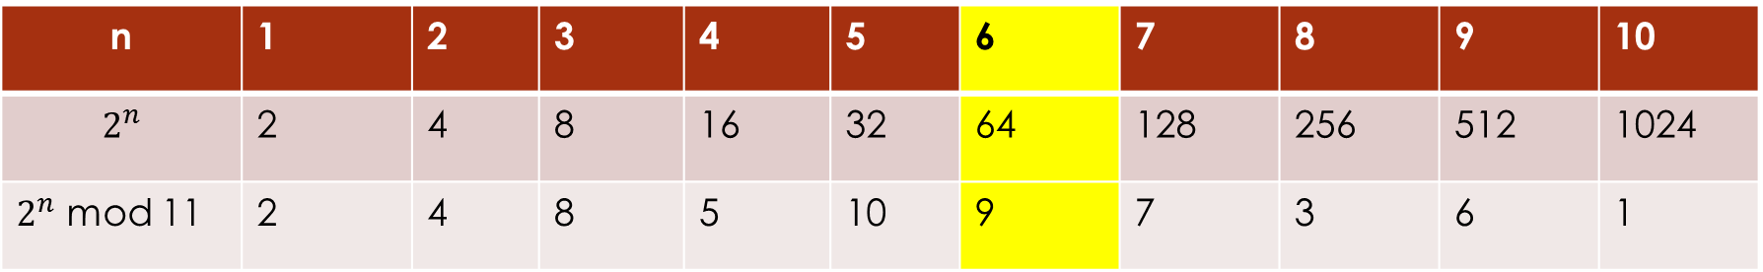
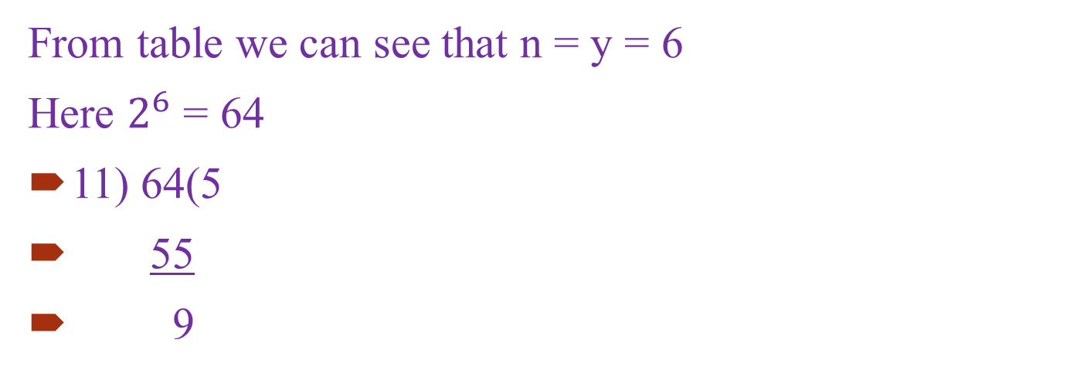
Question 1 (Sub question 1-> B)
When p = 11 and g = 2
n | 1 | 2 | 3 | 4 | 5 | 6 | 7 | 8 | 9 | 10
$$2^{n}$$ | 2 | 4 | 8 | 16 | 32 | 64 | 128 | 256 | 512 | 1024
$2^{n}$ mod 11 | 2 | 4 | 8 | 5 | 10 | 9 | 7 | 3 | 6 | 1
From table we can see that n = y = 6
Here $2^{6}$ = 64
11) 64(5
55
9
Ans. B : e) 6

Slide 12
Question 1 (Sub question 1-> C)
Subquestion C :
A shared secret key is being exchanged between Alice and Maliha using this algorithm. Assume that they agreed upon the prime number p = 11 and the integer g = 2.
In this case, R1 = 3 and R2 = 9, the shared secret key obtained by both Alice and Maliha is
Which they can use for subsequent symmetric encryption of messages.
Answer :
Given that,
p = 11, g = 2, R1 = 3, R2 = 9, x = 8, y = 6, K = ?
C

Slide 13

Question 1 (Sub question 1-> C)
According to Diffie-Hellman algorithm,
K = ${(R1)}^{y}$ mod 11
=> K = ${(3)}^{6}$ mod 11
=> k = 3
11)729(66
66
69
66
3

Slide 14

Question 1 (Sub question 1-> C)
According to Diffie-Hellman algorithm,
Similarly,
K = ${(R2)}^{x}$ mod 11
=>k = ${(9)}^{8}$ mod 11
k = 3
11) 43046721(3913338
43046718
3
Ans. C: b) 3

Slide 15
Question 1
Answer group for A, B, C, D, E, F:
2 b) 3 c) 4 d) 5
e) 6 f) 7 g) 8 h)9

Slide 16
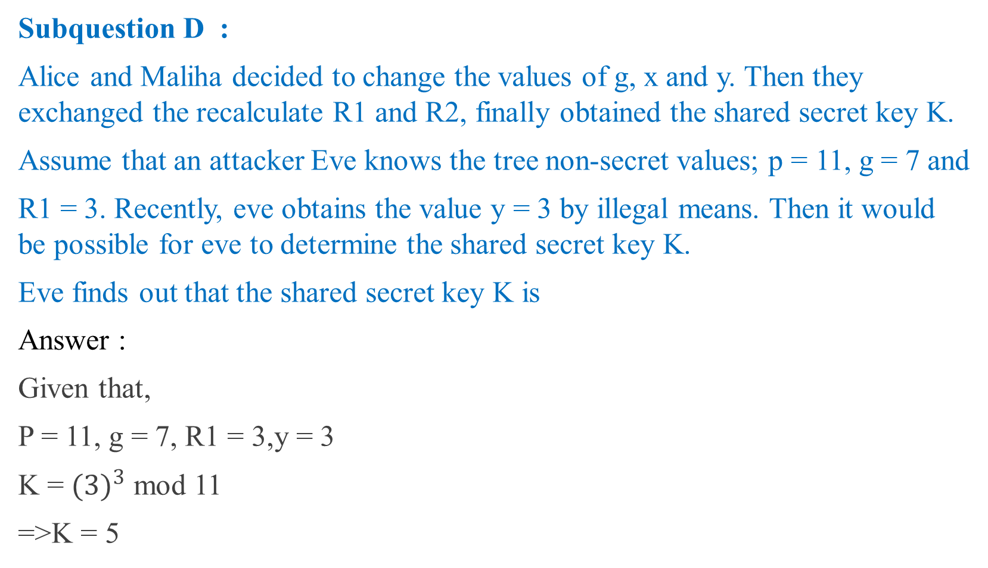
Question 1 (Sub question 2-> D)
Subquestion D :
Alice and Maliha decided to change the values of g, x and y. Then they exchanged the recalculate R1 and R2, finally obtained the shared secret key K.
Assume that an attacker Eve knows the tree non-secret values; p = 11, g = 7 and
R1 = 3. Recently, eve obtains the value y = 3 by illegal means. Then it would be possible for eve to determine the shared secret key K.
Eve finds out that the shared secret key K is
Answer :
Given that,
P = 11, g = 7, R1 = 3,y = 3
K = ${(3)}^{3}$ mod 11
=>K = 5
D
Ans D: d) 5

Slide 17
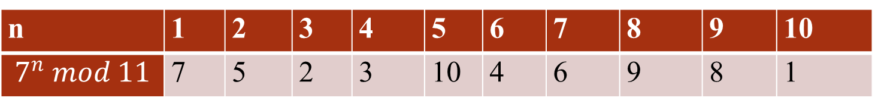
Question 1 (Sub question 2-> E, F)
Subquestion E, F :
Alice and Maliha decided to change the values of g, x and y. Then they exchanged the recalculate R1 and R2, finally obtained the shared secret key K.
Assume that an attacker Eve knows the tree non-secret values; p = 11, g = 7 and
R1 = 3. Recently, eve obtains the value y = 3 by illegal means. Then it would be possible for eve to determine the shared secret key K.
Furthermore, by referring to Table 2, Eve finds out that the value of x is
And the value of R2 is
E
F
n | 1 | 2 | 3 | 4 | 5 | 6 | 7 | 8 | 9 | 10
$$7^{n} mod 11$$ | 7 | 5 | 2 | 3 | 10 | 4 | 6 | 9 | 8 | 1

Slide 18
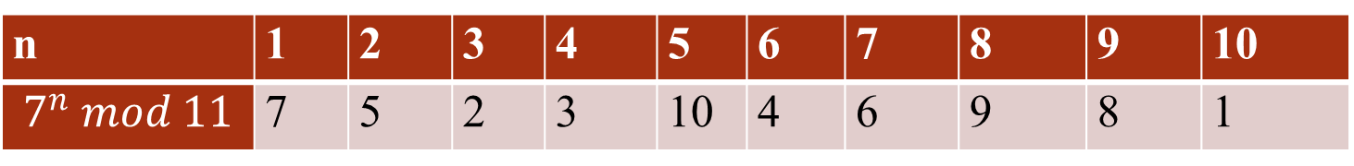

Question 1 (Sub question 2-> E, F)
n | 1 | 2 | 3 | 4 | 5 | 6 | 7 | 8 | 9 | 10
$$7^{n} mod 11$$ | 7 | 5 | 2 | 3 | 10 | 4 | 6 | 9 | 8 | 1
Given that,
P = 11, g = 7, R1 = 3, y = 3, k = 5 [value of k got from ans D]
X = ?, R2 = ?
R2 = $7^{3}$ mod 11
=>R2 = 343 mod 11
=>R2 = 2
Again for Ans E,
K = ${(R2)}^{x}$ mod 11
=> 5 = ${(2)}^{x}$ mod 11
=> 5 = ${(2)}^{n}$ mod 11
=> 5 = ${(2)}^{4}$ mod 11 [from table 1]
Here, n=x = 4
ANS E : c) 4
Ans F: a) 2

