Slide 1
Training Course on ITEE for the Candidates of October 2022 Exam
PROJECT FOR SKILL’S DEVELOPMENT OF ICT ENGINEERS TARGETING JAPANESE MARKET
Solutions
FE PM Question of April 2019
Question 1
Dr. Md. Nawab Yousuf Ali
Professor, Dept. of CSE
East West University

Slide 2
Question Read the following description of the hybrid encryption schema, and then answer the blank box A through E.
In a public-key cryptosystem, hybrid encryption uses both public-key and symmetric-key encryption.
In hybrid encryption schema, public-key encryption is used for key encapsulation and symmetric-key encryption for data encapsulation.
The key used for data encapsulation and encapsulated by public-key encryption is called the session key.
A hybrid encryption schema is shown below.

Slide 3
Question Read the following description of the hybrid encryption schema, and then answer the blank box A through E.
[Sender’s processes]
Generate session key sk for encryption. Session key sk can be generated randomly.
Encrypt plain message m using session key sk and symmetric-key encryption function SENC.
Encrypt session key sk using public-key encryption function PENC.
Transmit encrypted message c1 and encrypted session key c2 to the receiver.

Slide 4
Question Read the following description of the hybrid encryption schema, and then answer the blank box A through E.
[Receiver’s processes]
Receive encrypted message c1 and encrypted session key c2.
Decrypt the received encrypted session key c2.
Decrypt the received encrypted message c1. The resulting decrypted message is plain message m.
Figure 1 shows the hybrid encryption schema, where a rectangle indicates a function and a parallelogram indicates a variable.

Slide 5
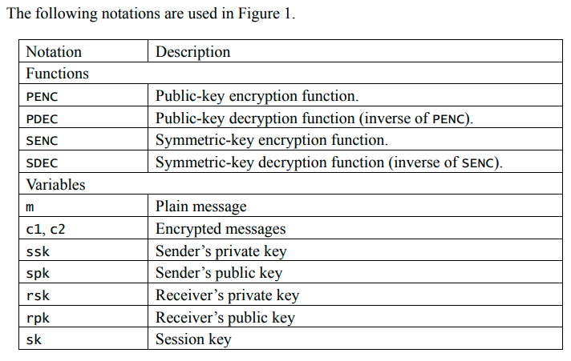
Question Read the following description of the hybrid encryption schema, and then answer the blank box A through E.

Slide 6
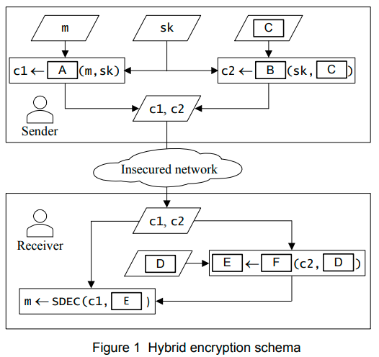
Blank Box A
Remember the Process no (2) of sender’s processes
[(2) Encrypt plain message m using session key sk and symmetric-key encryption function SENC.]
So, correct answer for blank box A is SENC (option d)

Slide 7
Blank Box B
Remember the Process no (3) of sender’s processes
[(3) Encrypt session key sk using public-key encryption function PENC.]
So, correct answer for blank box B is PENC (option b)

Slide 8
Blank Box C
correct answer for blank box B is rpk (option a)
rpk means receiver’s public key.
Because the session key is encrypted using public key encryption function PENC where it use receiver’s public key. When receiver got the message it use it’s private key to decrypt.

Slide 9
Blank Box D
Here, c2 is the encrypted session key.
Now decrypt encrypted session key c2.
Since, rpk (receiver’s public key) used for encrypt session key sk.
Therefore, receiver’s private key (rsk) will be used for decrypt the session key sk.
So, the correct answer for blank box D is rsk (option b)

Slide 10
Blank Box E, F
Since, rpk (receiver’s public key) used for encrypt the session key sk by using PENC (public key encryption function) and resultant c2.
Just reverse the logic.
Here, encrypted session key c2 and receiver’s private key rsk use PDEC (public-key decryption function) and resultant sk.
So, the correct answer for blank box E is sk (option c) and blank box F is PDEC (option a)

