Slide 1
INTENSIVE COURSE ON ITEE FOR CANDIDATES OF OCTOBER 2020 EXAM
PROJECT FOR SKILL’S DEVELOPMENT OF ICT ENGINEERS TARGETING JAPANESE MARKET
Solutions
FE AM Questions of October 2013
Question 1
Dr. Md. Nawab Yousuf Ali
Professor, Dept. of CSE
East West University

Slide 2
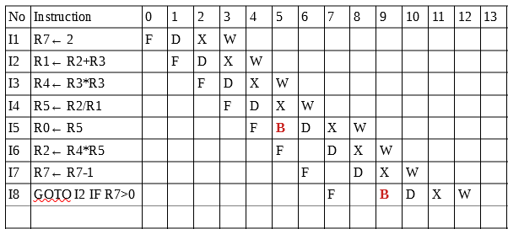
Solution of blank box A When the first 8 instructions, I1 through I8, are executed, there will be ___A___
bubbles inserted in the stages of the instructions.
Let’s analyze the given instructions

Slide 3
Solution of blank box A
Here, we can see the number of bubble ‘B’ is 2 (I5 and I8).
Thus, the correct option for blank box A is ‘c’.

Slide 4
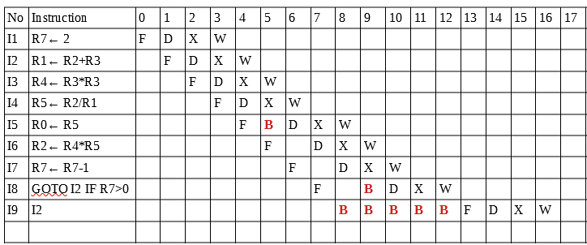
Solution of blank box B The 9th instruction is I2, because the 8th instruction I8 causes the branch. At this point, the fetch stage of the 9th instruction I2 will be at clock cycle ___B___.
After the instruction I8, the value of R7 is 1 (R7>0), so next instruction will be I2.

Slide 5
Solution of blank box B
We can see that after instruction I8, the fetch stage ‘F’ of instruction I2 will start from clock cycle 13.
So option ‘e’ is correct for blank box B.

Slide 6
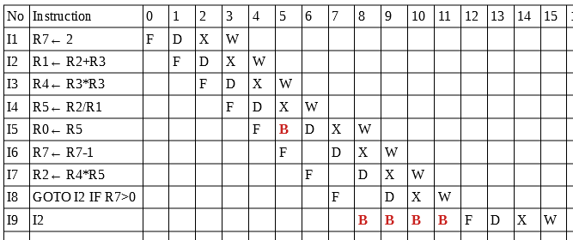
Solution of blank box C When the sequence of instructions I6 and I7 are exchanged, the number of bubbles will decrease by ___C___ for each iteration.
After exchanging instructions I6 and I7, the execution table is as follows-

Slide 7
Solution of blank box C
If we compare this instructions analyze table with previous one, we can see that bubble ‘B’ decreases by 1.
So, option ‘b’ is correct for blank box C.

Slide 8
Solution of blank box D
When on the average, the instructions have a 25% data hazard, with 20% of the instructions are executed as conditional branches, and BTB gets a 75% hit-ratio, the effective CPI is ___D___. Assuming that each stage of each instruction takes 1 clock cycle.
Here, an instruction has 4 stages (F, D, X, and W). Each stage takes 1 clock cycle. Thus, an instruction takes 4 clock cycle to complete.
Given, the instruction have a 25% data hazard. One instruction takes 4 clock cycle.
Therefore, 0.25*4 = 1
Since, BTB gets a 75% hit-ratio which is 0.75*4 = 3,
Where 20% of the instructions are executed as conditional branches. So, 0.2*3 = 0.6
Thus, effective CPI= 3 – (1 + 0.6) = 1.4

Slide 9
Solution of blank box D
So, option ‘b’ is correct for blank box D.

