Slide 1
The Project for Skill’s Development of ICT Engineers Targeting Japanese Market
FE Afternoon Questions (1 & 2)

Slide 2
Question 2
Read the following description of a door controller circuit, and then answer the subquestions 1 and 2.
A sensor-based automatic door controller has 3 states of operation: “closed”, “opened” and “closing”. When the sensor detects a person coming towards the door or going through the door, the door enters the “opened” state. When the person has passed through the door, the sensor detects nothing and the door enters the “closing” state. Within the “closing” state, another person may approach towards the door, causing the change in the state of the door from “closing” to “opened”. The idle state “closed” implies that the door is completely closed.
The sensor generates the signal S = 1 when the sensor detects a person either approaching to or passing through the door; otherwise, it generates the signal s = 0.

Slide 3
Question 2
Figure 1 shows the operational state transition diagram of the door controller.
S = 0
Closed
A
S = 0
S = 1
Closing
Opened
S = 0
S = 1

Slide 4
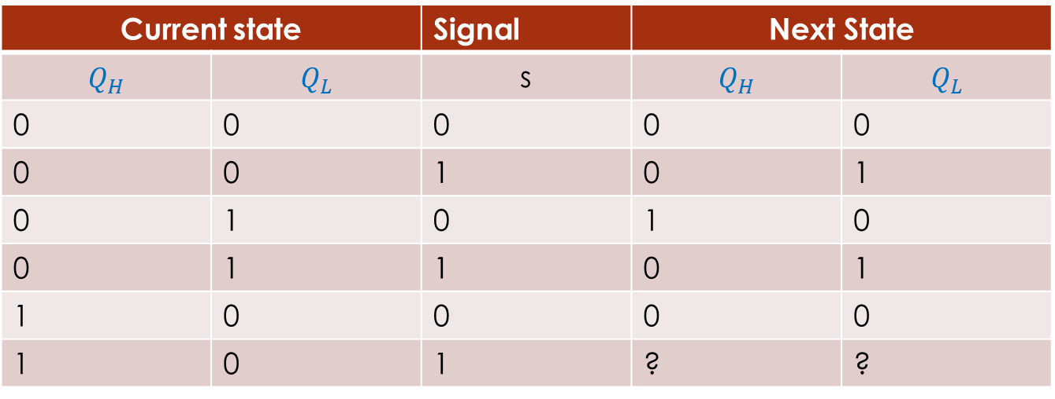
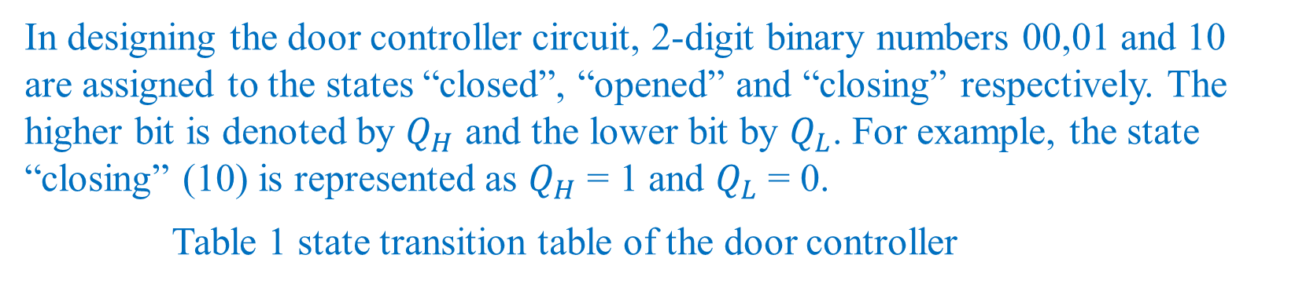
Question 2
In designing the door controller circuit, 2-digit binary numbers 00,01 and 10 are assigned to the states “closed”, “opened” and “closing” respectively. The higher bit is denoted by $Q_{H}$ and the lower bit by $Q_{L}$. For example, the state “closing” (10) is represented as $Q_{H}$ = 1 and $Q_{L}$ = 0.
Table 1 state transition table of the door controller
Current state |  | Signal | Next State
$$Q_{H}$$ | $$Q_{L}$$ | s | $$Q_{H}$$ | $$Q_{L}$$
0 | 0 | 0 | 0 | 0
0 | 0 | 1 | 0 | 1
0 | 1 | 0 | 1 | 0
0 | 1 | 1 | 0 | 1
1 | 0 | 0 | 0 | 0
1 | 0 | 1 | ? | ?
B

Slide 5
Question 2
A hardware engineer creates the program setnextstate that determines the next state.
Global: Bit type: QH, QL,s
Program: setnextstate
QH
QL s
return
C

Slide 6
Question 2 (Subquestion 1)
Answer group for A
S = 0 b) s = 1
Answer group for B
00 b) 01 c) 10 d) 11
Answer group for C
((not QH) or QL) and (not s) b) (QH and s) or (QL and (not s)
c) (not QL) and s d) QL and (not s)

Slide 7
Question 2 (Subquestion 1)
Answer A:
The sensor generates the signal S = 1 when the sensor detects a person either approaching to or passing through the door otherwise s = 0
Ans A : b) s = 1
Answer B:
00 -> “closed”
01 -> “opened”
10 -> “closing”

Slide 8

Question 2 (Subquestion 1)
S = 0
Closed
S = 1
S = 0
S = 1
Closing
Opened
S = 0
S = 1
Current state |  | Signal | Next State
$$Q_{H}$$ | $$Q_{L}$$ | s | $$Q_{H}$$ | $$Q_{L}$$
0 | 0 | 0 | 0 | 0
0 | 0 | 1 | 0 | 1
0 | 1 | 0 | 1 | 0
0 | 1 | 1 | 0 | 1
1 | 0 | 0 | 0 | 0
1 | 0 | 1 | ? | ?

Slide 9

Question 2 (Subquestion 1)
S = 0
Closed
S = 1
Ans B : b) 0 1
S = 0
S = 1
Closing
Opened
S = 0
S = 1
Current state |  | Signal | Next State
$$Q_{H}$$ | $$Q_{L}$$ | s | $$Q_{H}$$ | $$Q_{L}$$
0 | 0 | 0 | 0 | 0
0 | 0 | 1 | 0 | 1
0 | 1 | 0 | 1 | 0
0 | 1 | 1 | 0 | 1
1 | 0 | 0 | 0 | 0
1 | 0 | 1 | 0 | 1

Slide 10
Question 2 (Subquestion 1)
A hardware engineer creates the program setnextstate that determines the next state.
Global: Bit type: QH, QL,s
Program: setnextstate
QH
QL s
return
C

Slide 11
Question 2 (Subquestion 1)
Ans C: d) QL and (not S)
Answer C:
QL = S
And QH = QL and (not S)
QL | S | Not S | QL ^ not (S) = QH
0 | 0 | 1 | 0
0 | 1 | 0 | 0
1 | 0 | 1 | 1
1 | 1 | 0 | 0
0 | 0 | 1 | 0
0 | 1 | 0 | 0

Slide 12
Question 2 (Subquestion 2)
A Door controller system
Shared Storage
S, QH,QL
Update S
fetch S
update QH,QL
fetch QH, QL
Sensor
device
SetNextState
program
Motor driving device

Slide 13
Question 2 (Subquestion 2)
The door controller system operates normally on condition that the execution of the 3 components is well controlled. The description below explains a problem that may occur when the program SetNextState and the motor driving device operate independently. The program SetNextState first updates QH and then QL. Therefore, there is a very short time lag between the updates of QH and QL. During this time lag, if the motor driving system fetches the values of QH and QL, it may result to a problem. As an example, the motor driving system receives an undefined state 11 (QH=1 and QL=1) when the program updates the state of the door
By , for example the time lag problem mentioned above can be resolved.
D
E

Slide 14
Question 2 (Subquestion 2)
Answer group for D:
From “closed” to “opened” b) From “closing” to “closed”
c) From “closing” to “opened” d) from “opened” to “closing
Answer group for E:
Changing the data format of QH and QL so that they can be fetched or updated by one hardware instruction.
Changing the execution logic of the motor driving device so that it will ignore the undefined state 11
Changing the execution sequence of the program so that the program
First updates QL and then QH
d) Replacing the shared storage device with a new one so that QH and QL can be fetched faster than the current device.

Slide 15
Question 2 (Subquestion 2)
Answer D:
Here we have only 3 states :
00 -> “closed”
01 -> “opened”
10 -> “closing”
But as per the code when updating the QH and QL,
Say, QH = 0 and QL = 1
Now updating QH = 1 ….. and in the mean time before updating the QL if some one read QH and QL he will find QH = 1 and QL = 1 which is an undefined state 11
This can be happened from “opened” 01 state to closing state 10
Ans D : d) from “opened” to “closing”.

Slide 16
Question 2 (Subquestion 2)
Answer E:
As there is 2 instructions for updating the 2 values. So, there exist a very short time lag. Code needs to be changed in a format so that 2 values can be fetched by a single instruction.
Ans E: a

