Slide 1
INTENSIVE COURSE ON ITEE FOR CANDIDATES OF OCTOBER 2020 EXAM
PROJECT FOR SKILL’S DEVELOPMENT OF ICT ENGINEERS TARGETING JAPANESE MARKET
Solutions
FE AM Questions of October 2016
Question 2
Dr. Md. Nawab Yousuf Ali
Professor, Dept. of CSE
East West University

Slide 2
Solution of blank box A The following steps describe how the multiplication operation proceeds, with (-3) × (+9) =
(-27), whose internal representation is 10011 × 01001 = _____A_____, as an example.
+27₁₀ = 00011011₂ (8-bit representation)
Now add a (-ve) signed bit before the left most bit for representing -27
-27₁₀ = 100011011₂ [ because, product is 9 bits in length (including the sign bit)]
Therefore option ‘c’ is correct for blank box ‘A’

Slide 3
Solution of blank box B [7] Set the result of the logical operation ____B____ to PS.
In mathematics, (-Ve) * (-Ve) = (+Ve);
(-Ve) * (+Ve) = (-Ve);
(+Ve) * (-Ve) = (-Ve);
(+Ve) * (+Ve) = (+Ve)
In signed bit calculation 1 means negative and 0 means positive. Just implement following logic using gate.

Slide 4
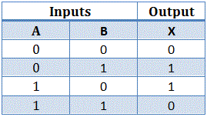
Solution of blank box B [7] Set the result of the logical operation ____B____ to PS.
The truth table of 2 input X-OR gate is-

Slide 5
Solution of blank box B [7] Set the result of the logical operation ____B____ to PS.
So, the correct option for blank box B is ‘c’.
Where symbol ‘^’ (called as caret symbol) denotes bit wise X-OR.

Slide 6
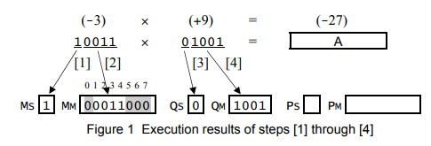
Solution of blank box C
In the calculation -3 is multiplicand and +9 is multiplier.
Now follow the steps mentioned in the question.

Slide 7
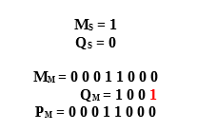
Solution of blank box C
After step 5:

Slide 8

Solution of blank box C
After first iteration of Step 6:

Slide 9

Solution of blank box C
After Second iteration of Step 6:
So, option ‘b’ is correct for blank box C.

Slide 10

Solution of blank box C
After third iteration of Step 6:

Slide 11
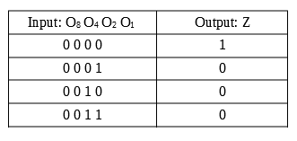
Solution for Blank box D and E
If we simplify the description we can find that-

Slide 12
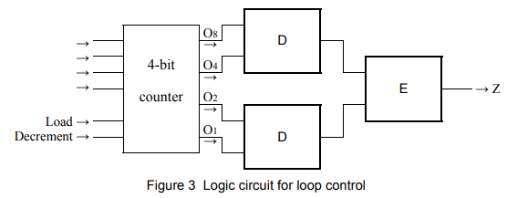
Solution for Blank box D and E
We have to put correct gate in the figure 3 thus the truth table of previous slide is satisfied.

Slide 13
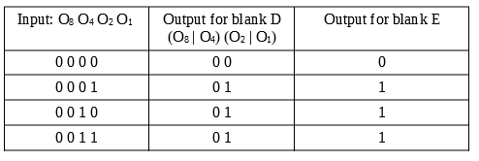
Solution for Blank box D and E
If we follow the following truth table we can able to find the answer of blank box D and E.
Here, we can see that an ‘OR’ gate use on blank D and if we put ‘NOR’ gate on blank E the truth table will satisfied.

Slide 14
Solution for Blank box D and E
Therefore option ‘b’ is correct for blank box E and option ‘e’ is correct for blank box F

Slide 15
Solution for Blank box D and E
If we follow the following truth table we can able to find the answer of blank box D and E.
Here, we can see that an ‘OR’ gate use on blank D and if we put ‘NOR’ gate on blank E the truth table will satisfied.

