Slide 1
Training Course on ITEE for the Candidates of November 2020 Exam
PROJECT FOR SKILL’S DEVELOPMENT OF ICT ENGINEERS TARGETING JAPANESE MARKET
Solutions
FE PM Question of October 2018
Question 2
Dr. Md. Nawab Yousuf Ali
Professor, Dept. of CSE
East West University

Slide 2
Question 2. Read the following description of paging, and then answer Subquestions 1 and 2.
Paging is a memory-management scheme that maps logical addresses onto physical addresses.
In a system that manages its memory by paging, logical address space is broken into blocks called pages.
Physical address space is also broken into blocks called frames.
Pages are usually placed on an auxiliary storage and loaded into available frames on demand.

Slide 3
Question 2.
A logical address consists of two parts: a page number ‘p’ and displacement ‘d’.
Similarly, a physical address consists of a frame number ‘f’ and displacement ‘d’.
The size of d is called the page size, which is fixed and common to both address spaces.
The page number is used as an index into a page table.

Slide 4
Question 2.
The page table maintains the correspondence between the page number and the frame number.
By using the page table, a logical address can be translated into physical address by replacing the page number with its corresponding frame number.

Slide 5
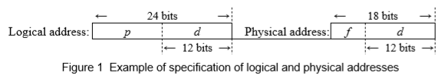
SubQuestion 1.
From the answer groups below, select the correct answer to be inserted in each blank _______ in the following description.
Notes:
5

Slide 6
SubQuestion 1.
Figure 1 shows an example of specification of logical and physical addresses.
The logical address is 24-bit long, which covers 16M (2²⁴) addresses, and the physical address is 18-bit long, covering 256k (2¹⁸) addresses.
The page size is 12-bit long, covering 4,096 (= 2¹²) addresses.

Slide 7

SubQuestion 1.
In Figure 1, the number of pages is 4,096, and the number of frames is ___A___.

Slide 8
SubQuestion 1.
In Figure 1, the number of pages is 4,096, and the number of frames is ___A___.
Solution:
From the description we know that, physical address contains page and logical address contains frames.
Since, the physical address 18 bit long and 12 bits are used for displacement ‘d’, the number of frame is 2⁽¹⁸⁻¹²⁾ = 2⁶ = 64.
So, the correct option for blank box A is : ‘b’

Slide 9

SubQuestion 1.
Generally, when the logical address is n-bit long, and the page size is m-bit long, the number of pages is expressed as ___B___.

Slide 10
SubQuestion 1.
Generally, when the logical address is n-bit long, and the page size is m-bit long, the number of pages is expressed as ___B___.
Solution:
We came to know from the description that, “The size of ‘d’ is called the page size”
Therefore, comparing with figure-1, we can find that-
Number of pages is 2(length of logical address – length of displacement)
Which is 2^{n-m}. So, the correct option for blank box B is : ‘b’

Slide 11
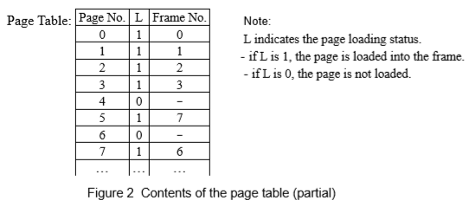
SubQuestion 2.
From the answer groups below, select the correct answer to be inserted in each blank _______ in the following description.

Slide 12
SubQuestion 2.
There is a system that features a paging mechanism.
The specification of logical and physical addresses is as shown in Figure 1.
Figure 2 illustrates a situation in which the pages in the logical address space are mapped onto the frames in the physical address space according to the page table at the moment.

Slide 13
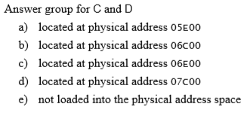
SubQuestion 2.
At this moment, the page table shows that the data at logical address 006C00 is ___C___, and the data at logical address 007E00 is ___D___.
The addresses are shown in hexadecimal.

Slide 14
SubQuestion 2.
At this moment, the page table shows that the data at logical address 006C00 is ___C___, and the data at logical address 007E00 is ___D___.
Solution for C:
Since, 006C00 is in hexadecimal format, each of number contains 4-bit.
006 C00
The left most 12 bit denotes page number. Using the figure-2 we can see that, the value of ‘L’ is 0 for page number 6. Which means page is not loaded.
So, the correct option for blank box C is ‘e’
12 bit
12 bit

Slide 15
SubQuestion 2.
At this moment, the page table shows that the data at logical address 006C00 is ___C___, and the data at logical address 007E00 is ___D___.
Solution for D:
Similarly, 007E00 is in hexadecimal format, each of number contains 4-bit.
007 E00
The left most 12 bit denotes page number and right most 12 bit is displacement ‘d’. Using the figure-2 we can see that, the value of ‘L’ is 1 for page number 7 and the corresponding frame number is 6.
12 bit
12 bit

Slide 16
SubQuestion 2.
At this moment, the page table shows that the data at logical address 006C00 is ___C___, and the data at logical address 007E00 is ___D___.
Solution for D:
Thus, from the figure 1, we can see that displacement ‘d’ is 12-bit for both logical and physical address.
Another point is that, the size of physical address is 18 bit. So, right most 12 bit will be used for displacement ‘d’ and left most 8 bit will be for frame.
Since, for the page number 7 the corresponding frame number is 6, the physical address will be 06 E00.
So, the correct option for blank box D is ‘c’

Slide 17
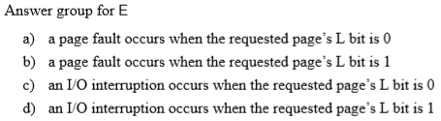
SubQuestion 2.
In this virtual storage system that uses the page table shown in Figure 2, ___E___ and then the system starts I/O operations to load the required page into the physical address space.

Slide 18
SubQuestion 2.
In this virtual storage system that uses the page table shown in Figure 2, ___E___ and then the system starts I/O operations to load the required page into the physical address space.
Solution for E:
In figure 2, ‘L’ indicates the page loading status.
If L is 1, the page is loaded into the frame and if L is 0, the page is not loaded.
A page fault occurs when the page is not loaded.
So, the correct option for blank box E is ‘a’

