Slide 1
INTENSIVE COURSE ON ITEE FOR CANDIDATES OF OCTOBER 2020 EXAM
PROJECT FOR SKILL’S DEVELOPMENT OF ICT ENGINEERS TARGETING JAPANESE MARKET
Solutions
FE AM Questions of October 2013
Question 3
Dr. Md. Nawab Yousuf Ali
Professor, Dept. of CSE
East West University

Slide 2
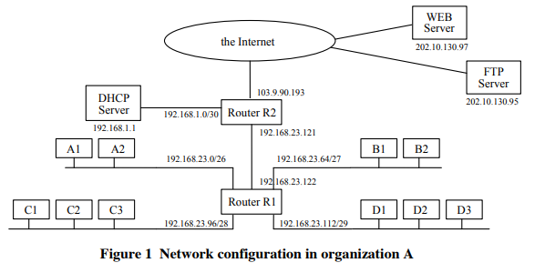
Solution of blank box A Host A2 sends the DHCPDISCOVER message to the DHCP server for requesting the addresses. The router R1 received this request message via interface m0. Then, the router R1 forwards it via interface ___A___.
Let’s compare this question with figure 1.

Slide 3
Solution of blank box A
In the question it is mentioned that ‘The router R1 received this request message via interface m0 from host A2’.
In the figure we can see that, received request of router R1 will transfer to router R2 and IP address for R2 is 192.168.23.121.

Slide 4
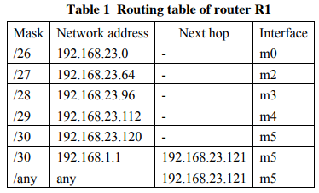
Solution of blank box A
In the table 1, we can see that interface is m5 for the IP address 192.168.23.121.
Therefore, option ‘e’ is correct for blank A.

Slide 5
Solution of blank box B and C The organization A is planning to create a new subnet with 30 customers. In order to build this subnet, organization A’s network administrator assigns network address ___B___ with the subnet mask ___C___ for this subnet.
Since number of customer (host) is 30, the range of address will be assign like below-
host address range 1 to 31
host address range 33 to 63
host address range 65 to 95
host address range 97 to 127
host address range 129 to 159 and so on.

Slide 6
Solution of blank box B
Now if we analyze the options for blank box B, only option ‘d’ will satisfy. If the network address is 192.168.23.128 then the host address starts from 192.168.23.129.
So option ‘d’ is correct for blank box B.

Slide 7
Solution of blank box C
We know that number of bits left for the host is: n = T_{b} - m (Where T_{b} is total number of bits and m is the number of bits used)
In a classful network total bits T_{b}= 8; in the question mention that 30 customers will use the network. 5 bits are required to represent decimal number 30. So, m=5

Slide 8
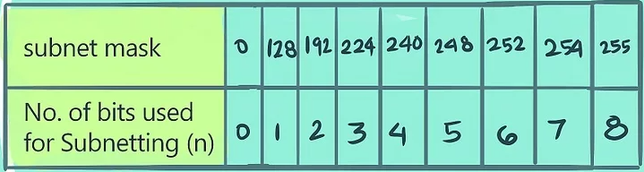
Solution of blank box C
Therefore n = T_{b} - m = 8 – 5 = 3
Subnet masks can be 0, 128, 192, 224, 240, 248, 252, 254 and 255.
The number of bits used for subnetting (n) to their corresponding subnet mask is as follows: 0=0, 128=1, 192=2, 224=3, 240=4, 248=5, 252=6, 254=7, and 255=8.

Slide 9
Solution of blank box C
Therefore the subnet mask is 255.255.255.224 for the network 192.168.23.128
So option ‘c’ is correct for blank box C.

Slide 10
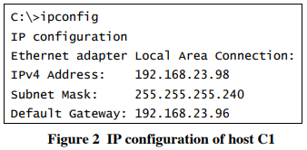
Solution of blank box D
It was found that the host C1 could not access to other network.
The host C1 successfully sent a ping message to the local network. However, the host C1
unsuccessfully sent a ping message to the 192.168.23.112/29 network.
IP configuration of the host C1 is shown in Figure 2.
From these pieces of information, it was concluded that _____D_____.

Slide 11
Solution of blank box D
From the figure 1 we can see that, default gateway 192.168.23.96 is correct for local network but not correct for 192.168.23.112/29 network.
Therefore option ‘a’ is correct for blank box D.

Slide 12
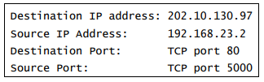
Solution of blank box E and F
A user of the host A2 uses a Web browser to connect to the WEB server. When the user sends a request to the WEB server, the host A2 creates the following IP packet

Slide 13

Solution of blank box E and F
When the packet arrives at the router R2, the NAT (network address translation) function of the router R2 translates the packet to the following, and sends it to the WEB server.
Destination IP address: 192.168.23.121
Source IP address: 192.168.23.2

Slide 14
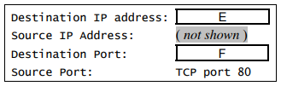
Solution of blank box E and F
When the NAT function receives its response from the WEB server, the received IP packet
will contain the following.
Destination IP address: 103.9.90.193
Source IP address: 202.10.130.97
Destination port: TCP port 1025

Slide 15
Solution of blank box E and F
So option ‘a’ is correct for blank box E and option ‘c’ is correct for blank box F.

